Slide 1

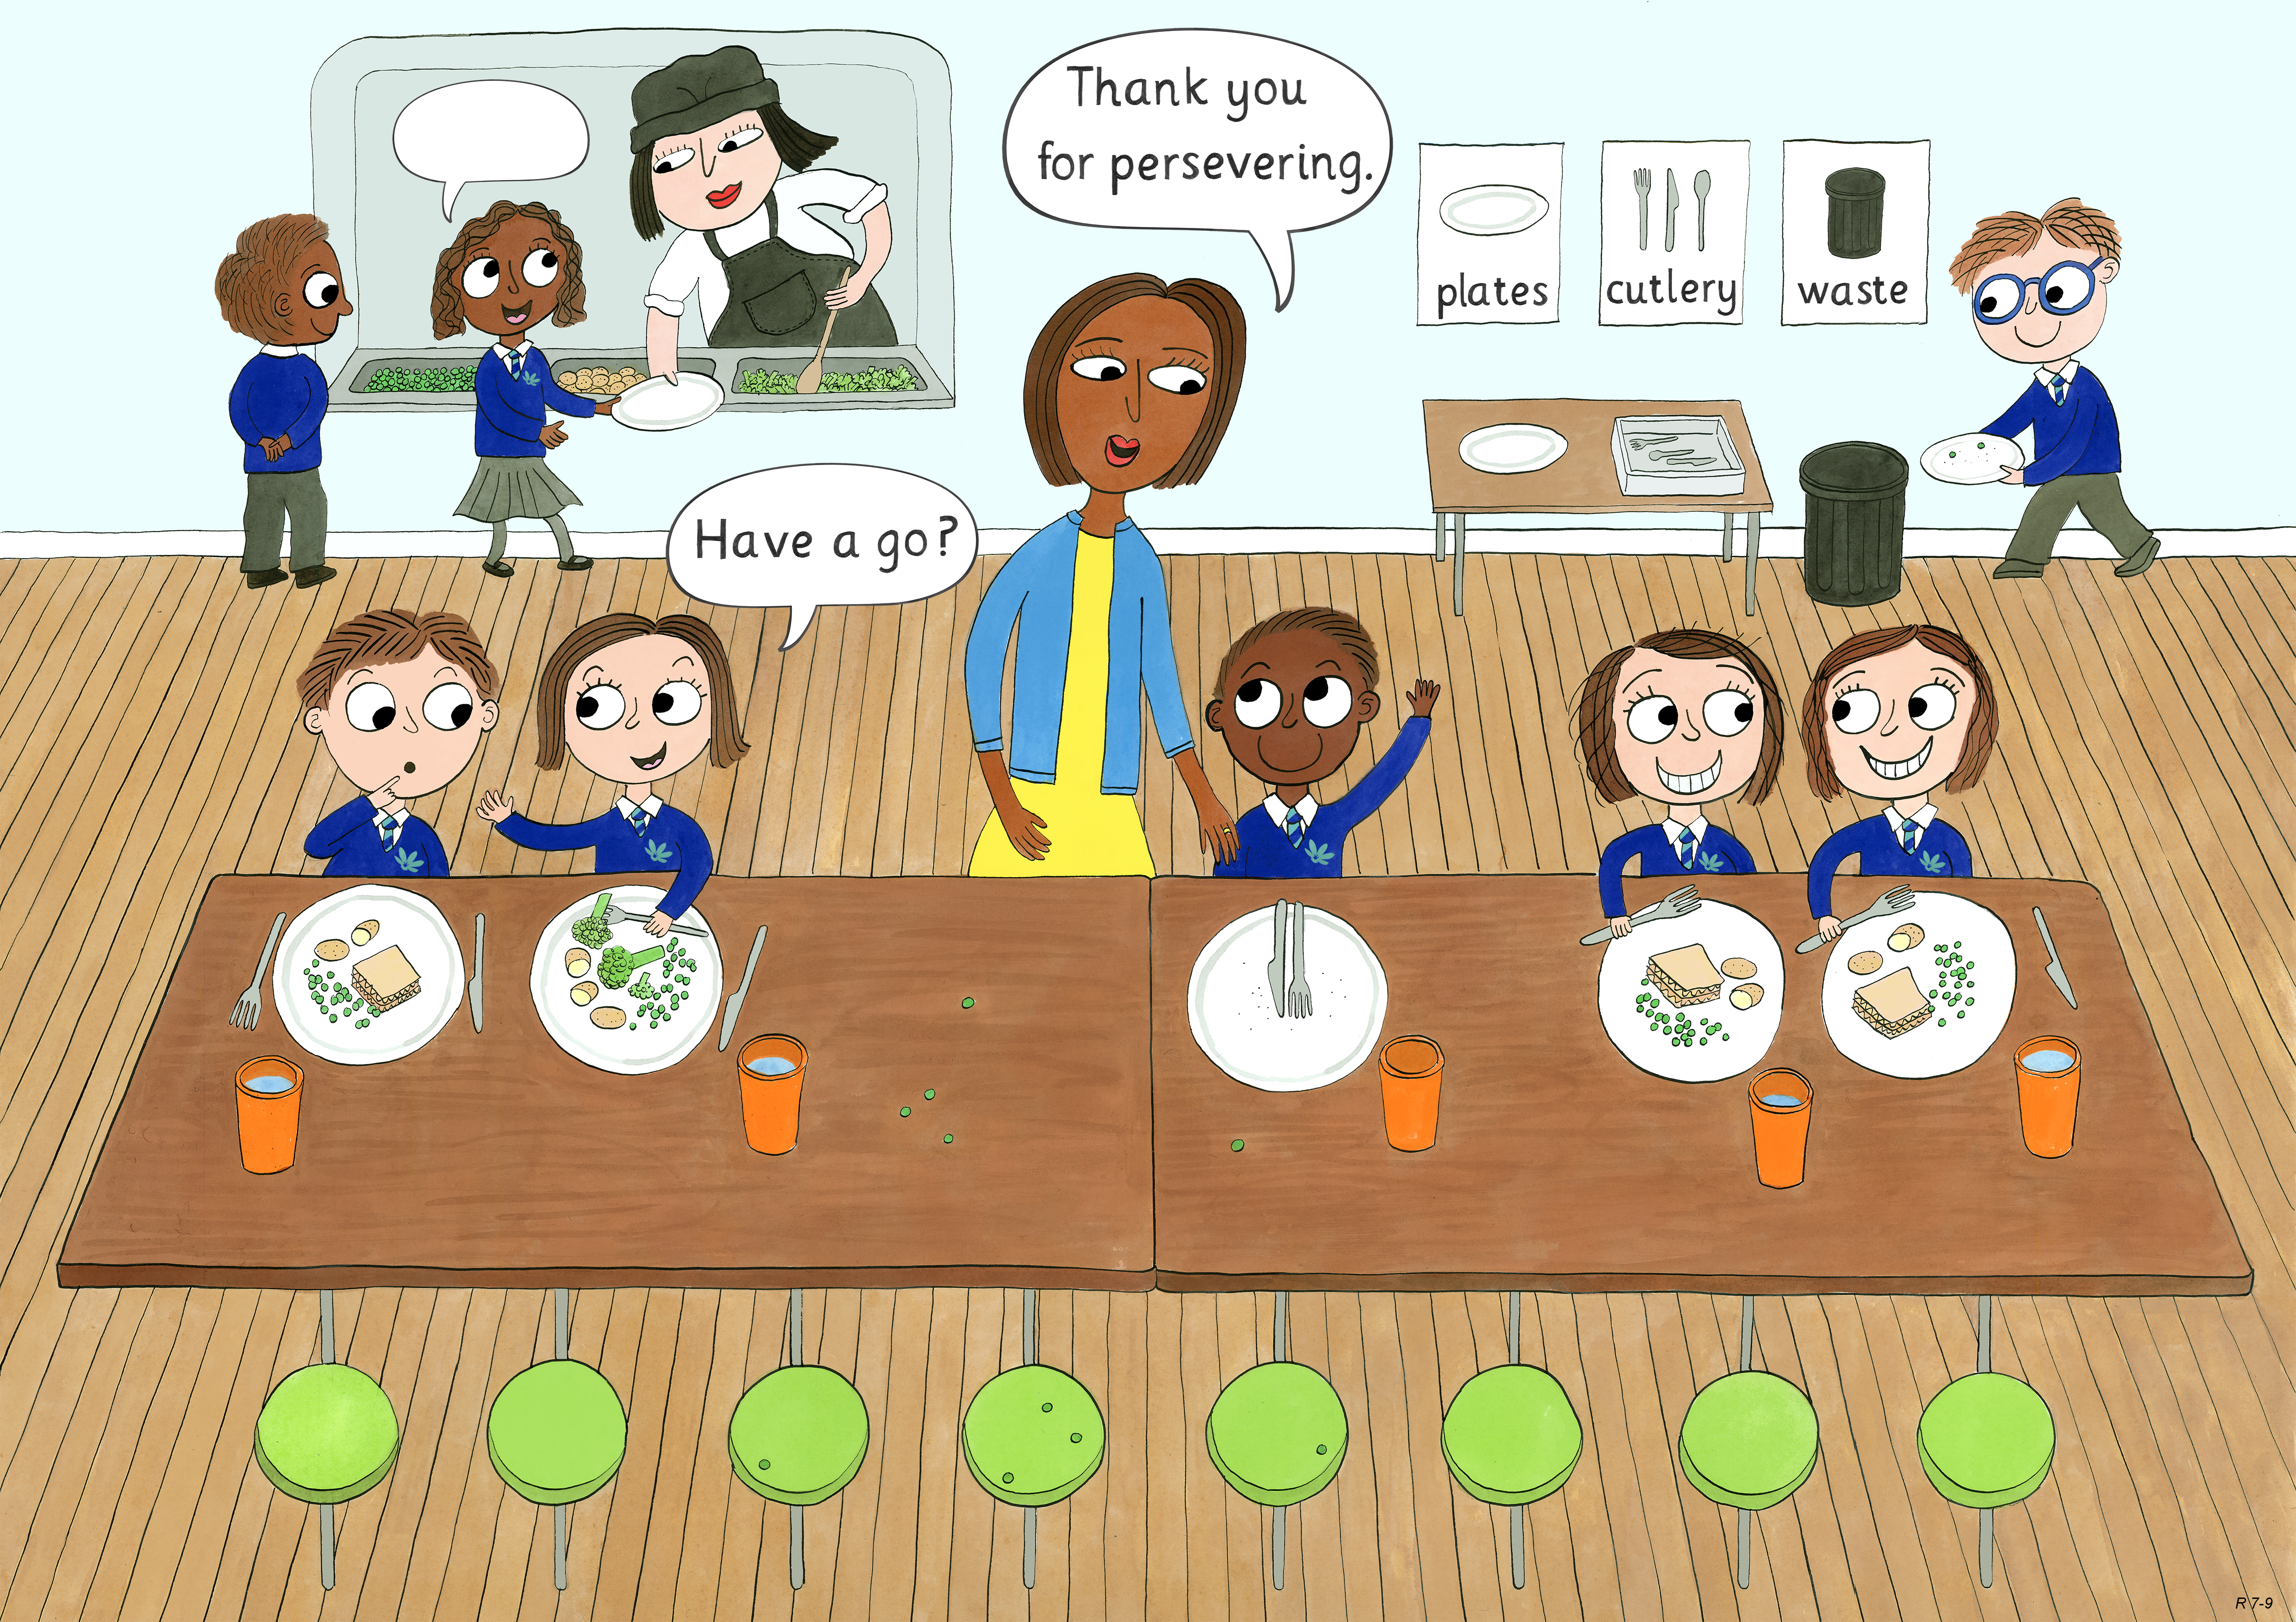
Reception: Spring 1
Perseverance, Optimism and Joy, Curiosity

Slide 2
Pencils start out looking like this!

Slide 3
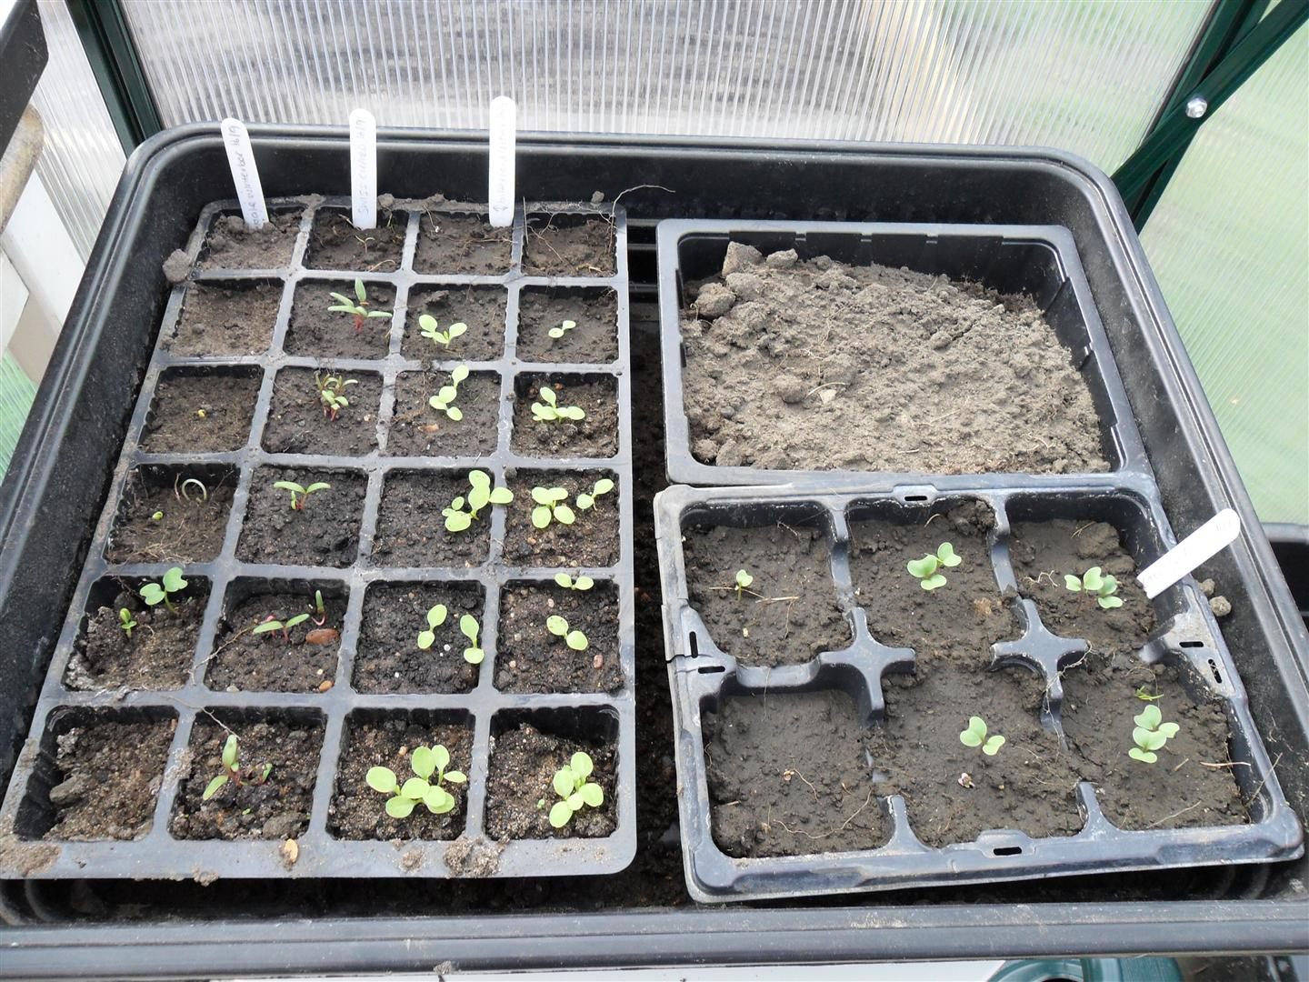
The seed is planted in a tray inside.

Slide 4
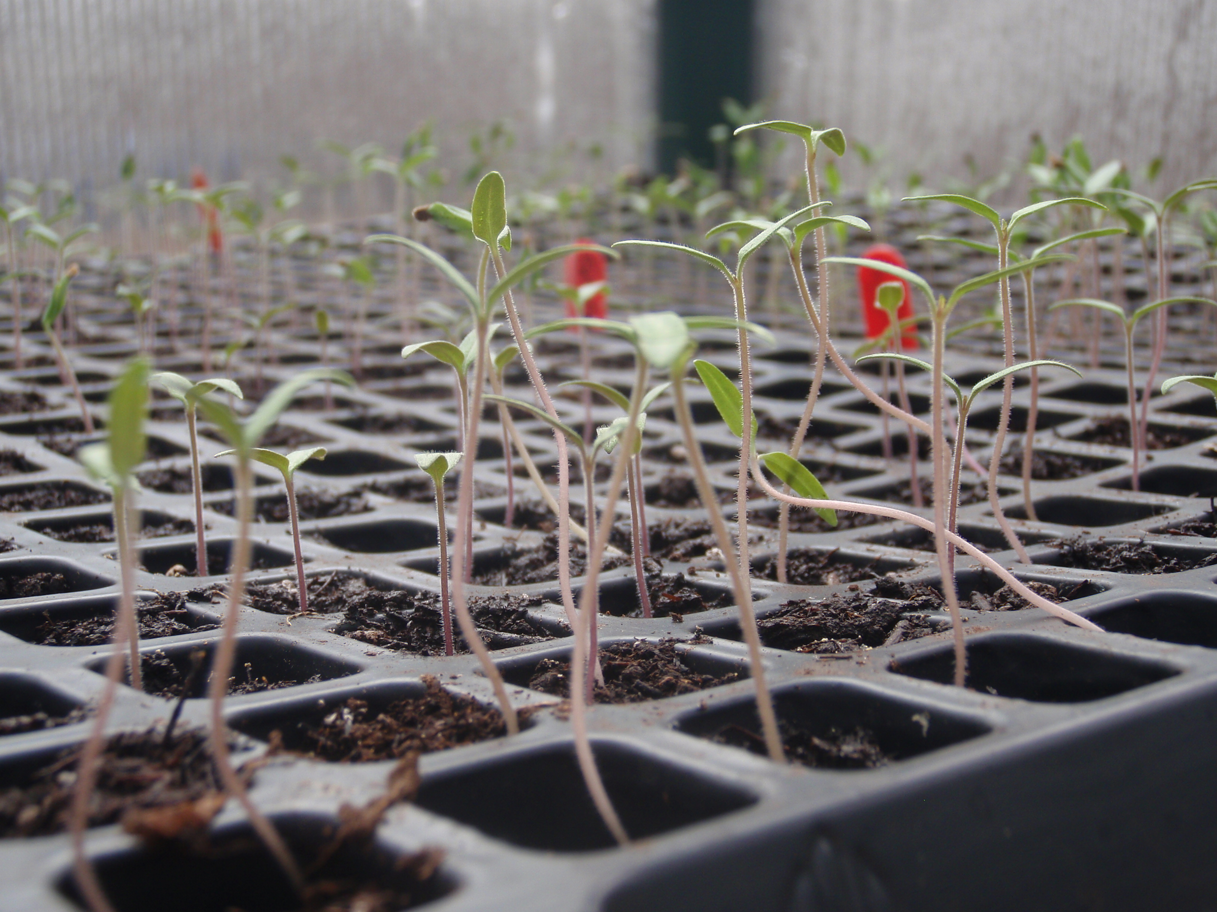
4 months later when the seed has grown into a seedling it is planted in the ground outside.

Slide 5
The seedling grows into a tree.

Slide 6
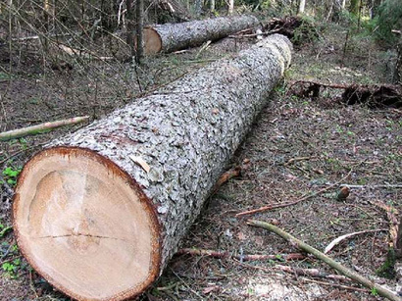
When the tree is 14 years old is it cut down.

Slide 7
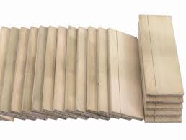
Logs from the tree are cut into small thin pieces of wood called slats.

Slide 8
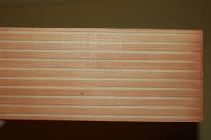
Small ridges are cut in stripes across the slats.

Slide 9
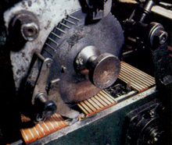
Next a special glue is put in the ridges. A dark mixture called graphite is stuck in the gaps .

Slide 10
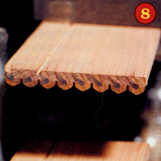
A new slat is put on top of the other one, making a sandwich. They are pressed down so they join together.

Slide 11
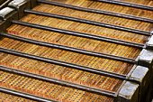
The sandwich is cut into long thin strips

Slide 12
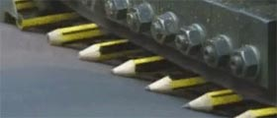
The strips are painted and sharpened.

Slide 13
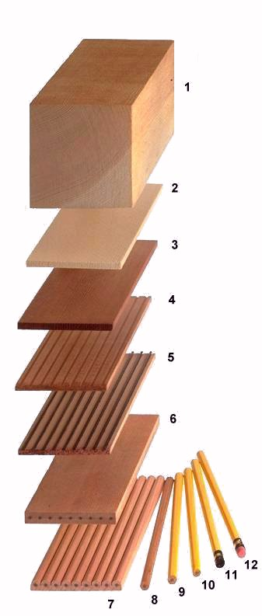

Ready for you to use!

Slide 15

Where do jumpers come from?

Slide 16
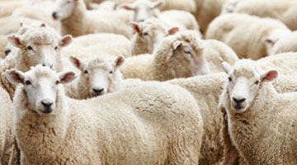

Slide 17
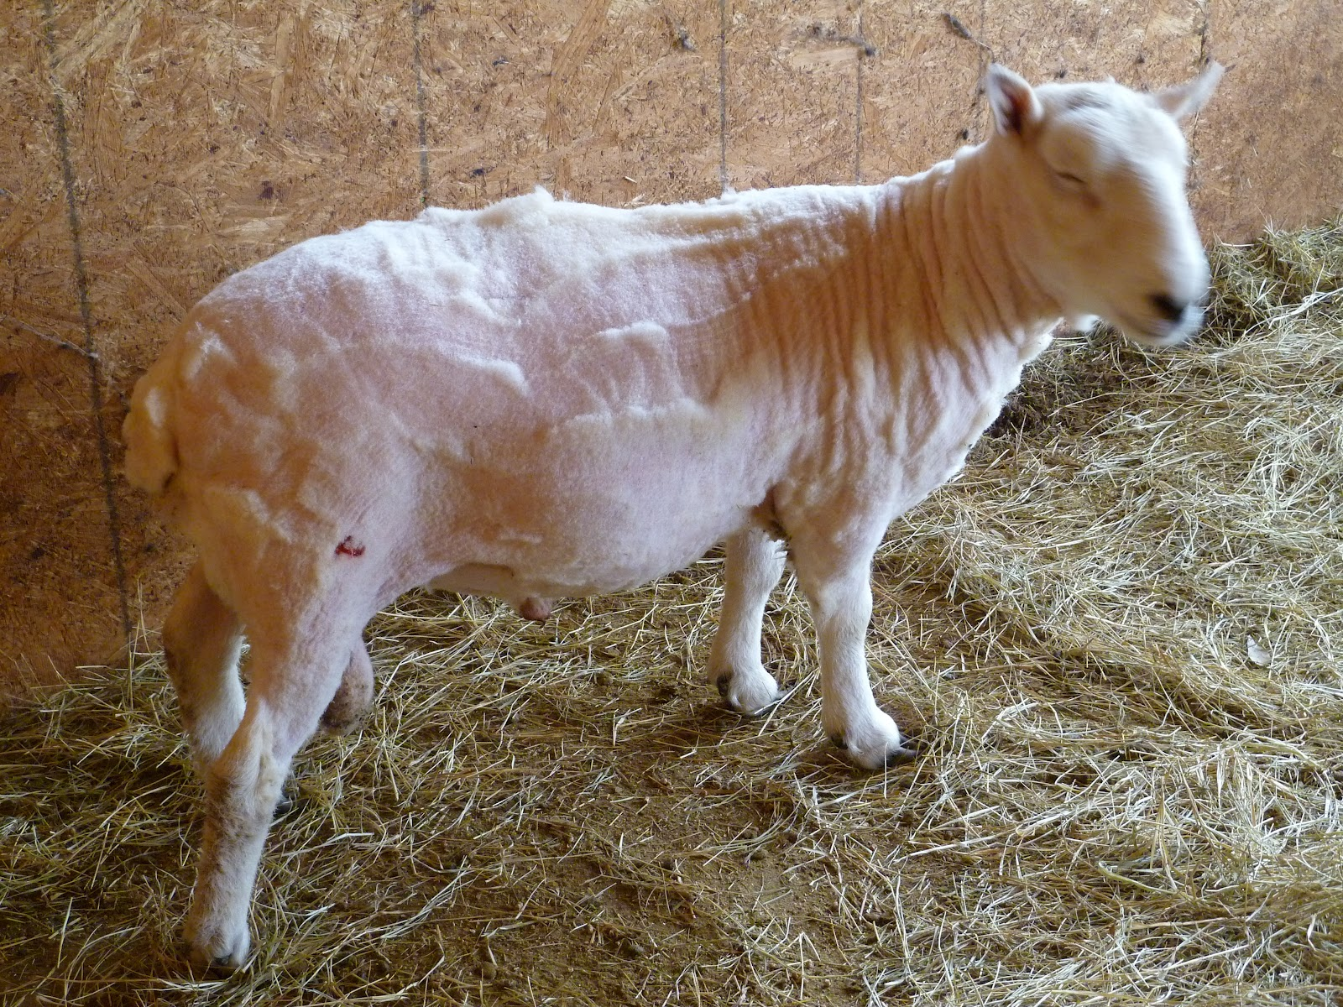

Slide 18
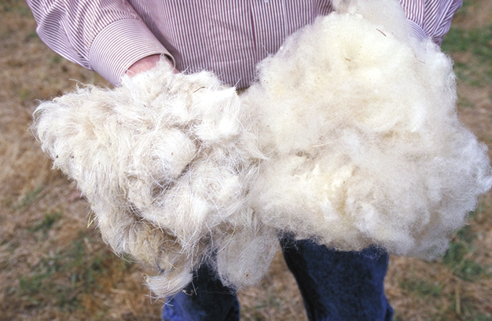

Slide 19
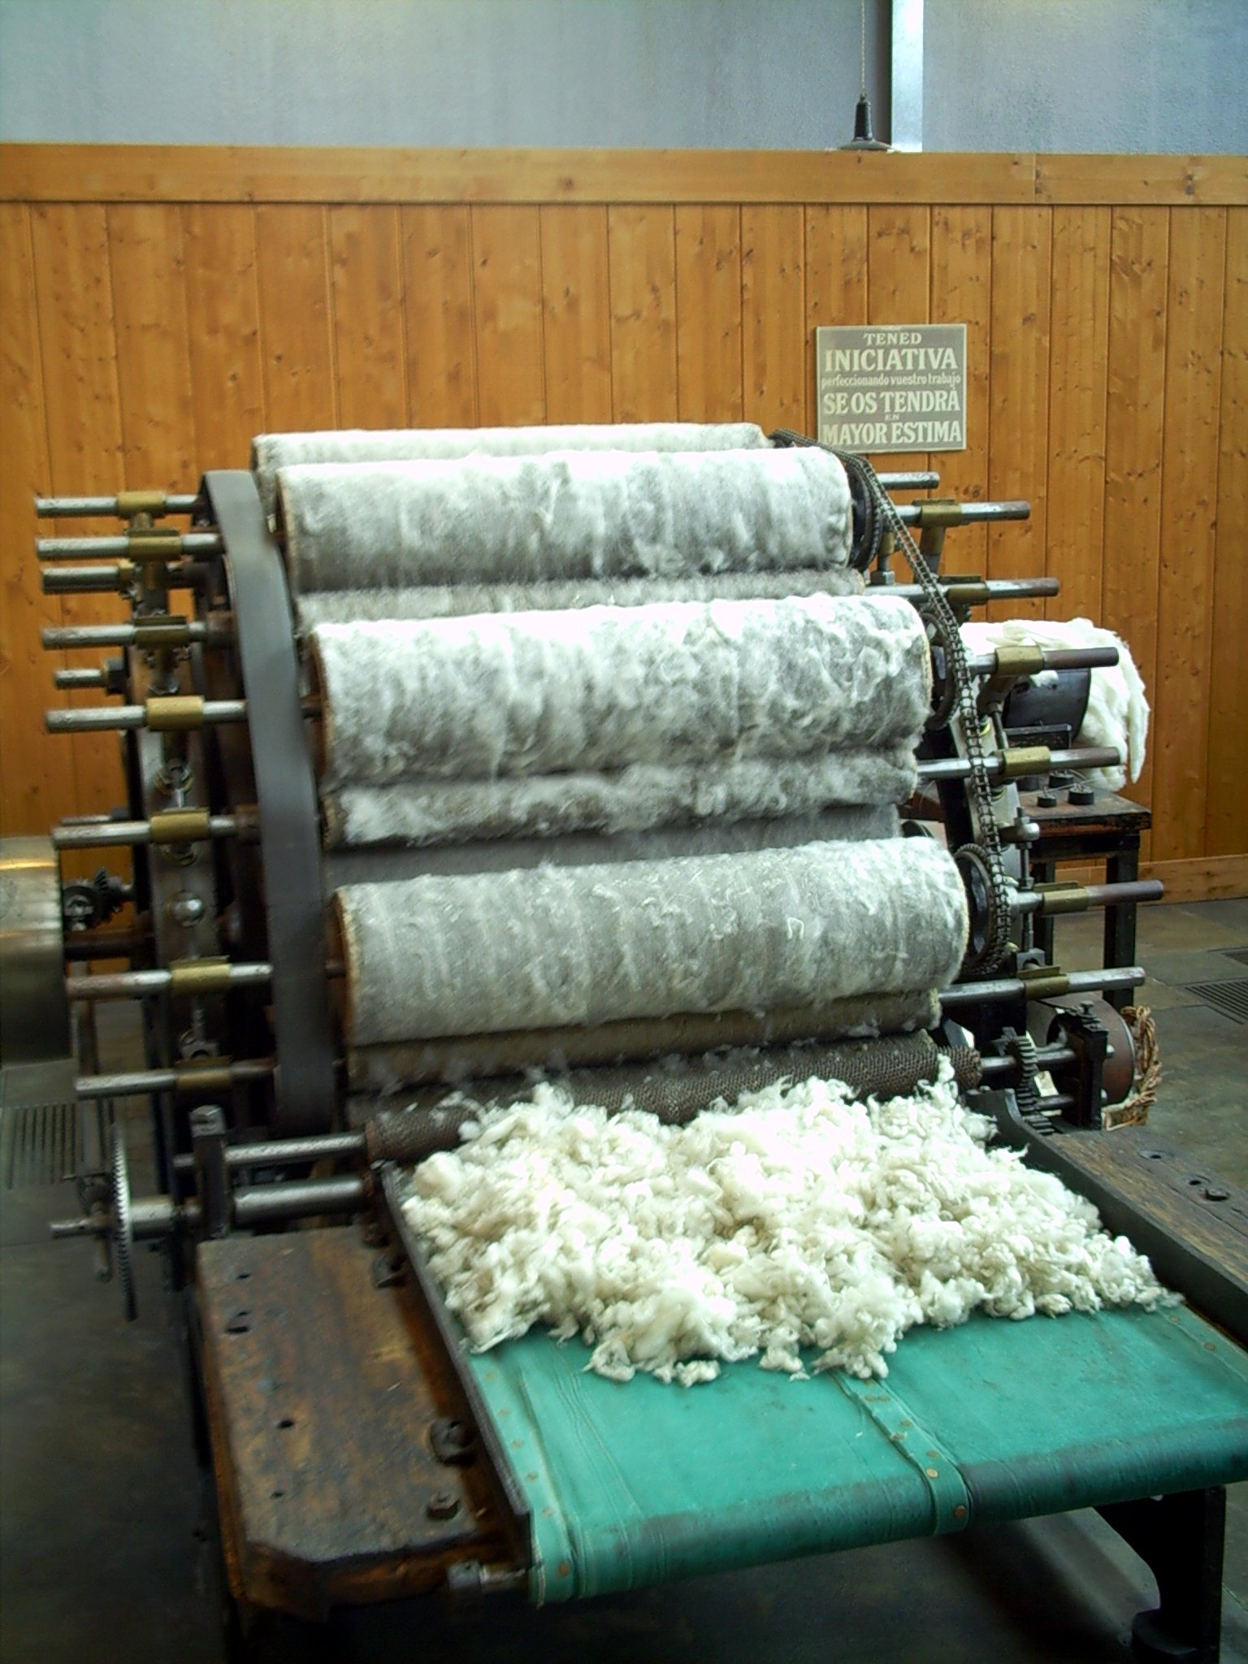

Slide 20


