Slide 1

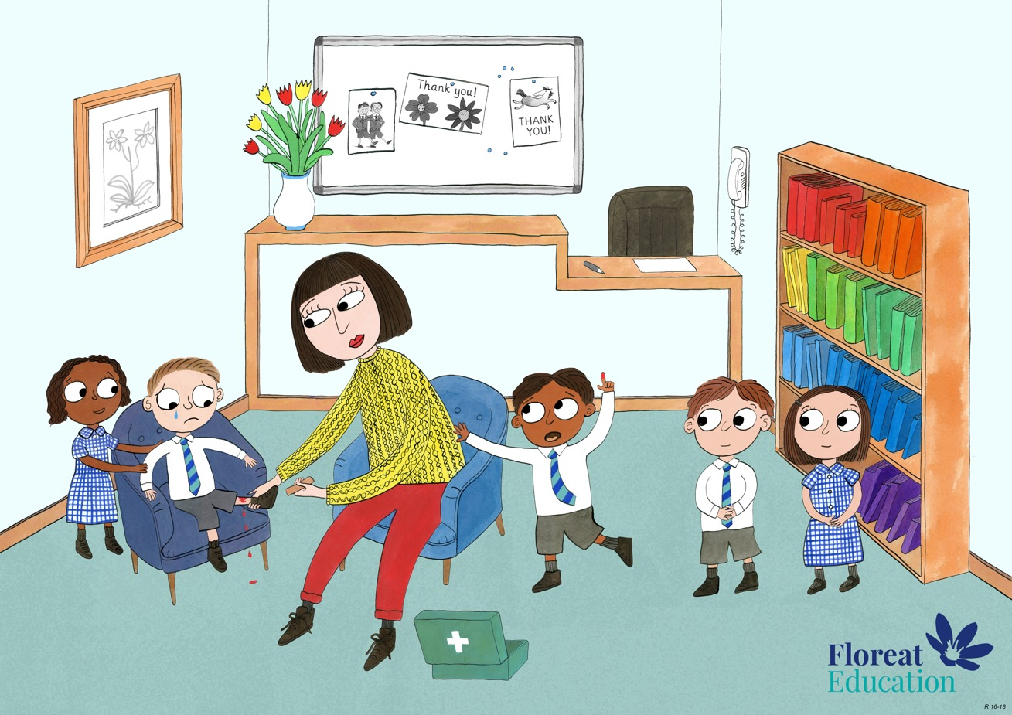
Reception: Summer 2
Humility, Empathy and Perspective, Gratitude.

Slide 2

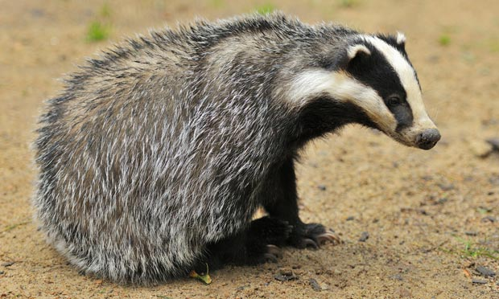
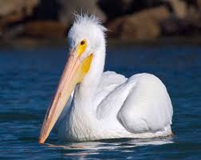
Pelican has a long sharp beak which he uses to catch fish. He can’t imagine what it is like for Badger having claws instead of a beak.
Badger has a very powerful sense of smell and can smell food from a long way away. He can’t imagine what it is like for Pelican who cannot smell anything at all!

Slide 3
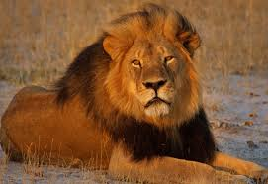
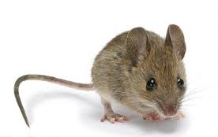
The lion is used to being strong and powerful and can’t imagine being so small and weak.
The lion can roar and scare people away whereas the mouse has to learn to be quick to
find a hiding place.

Slide 4
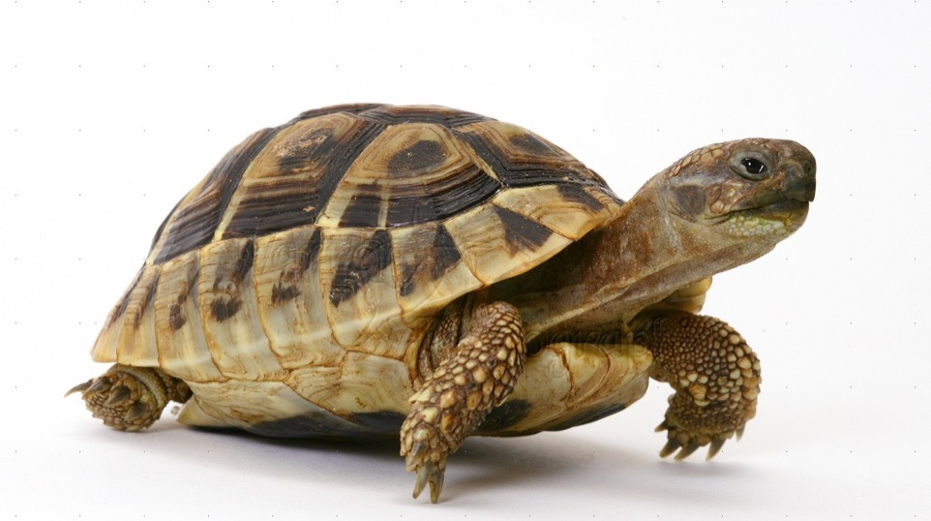
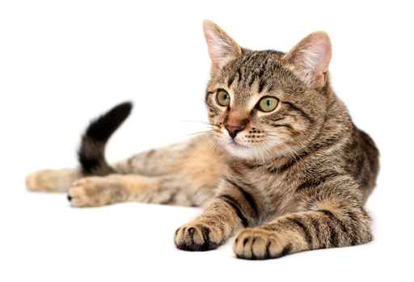
The cat can move quickly if she wants to , and she can jump onto fences or run away if she is frightened.
She cannot imagine what it is like for the tortoise who moves so slowly he could never run away from danger. He has to carry a shell on his back for protection instead!

Slide 5
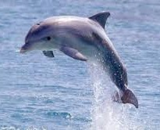
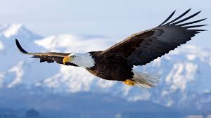
Dolphin glides easily though the water with his smooth, streamlined body and flippers. He can dive to great depths and can even hear underwater. He cannot imagine not being able to swim. But Dolphins’ body is heavy and he doesn’t have any wings so he will never be able to fly like the eagle.
The eagle’s light feathers and magnificent wings help him to glide easily through the air . Flying is easy for him! But eagles are not meant to go underwater, he will never be able to swim like dolphin.

Slide 6
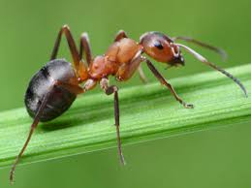
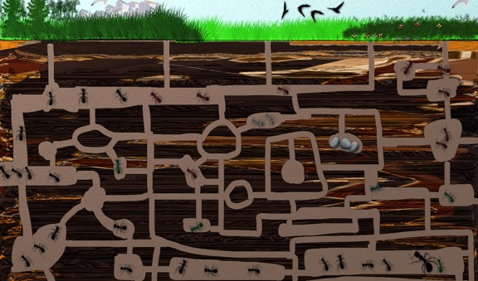
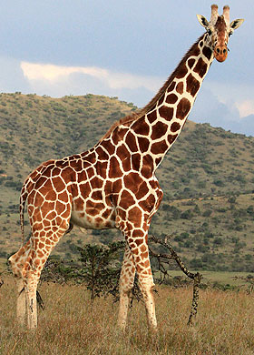
The giraffe loves her home. She is so tall she can see the fields and the streams all around her. She can’t imagine not being able to see the beautiful land around her! She thought to herself “The ant will never see this! He does not even know this is here!”
The ant is very proud of his home, which all the ants worked together to build! The whole colony is completely underground, and has passageways so tiny only ants can crawl through. He cannot imagine living anywhere else!
The ant thinks to himself “The giraffe will never see this! He does not even know this is here!”

