Slide 1

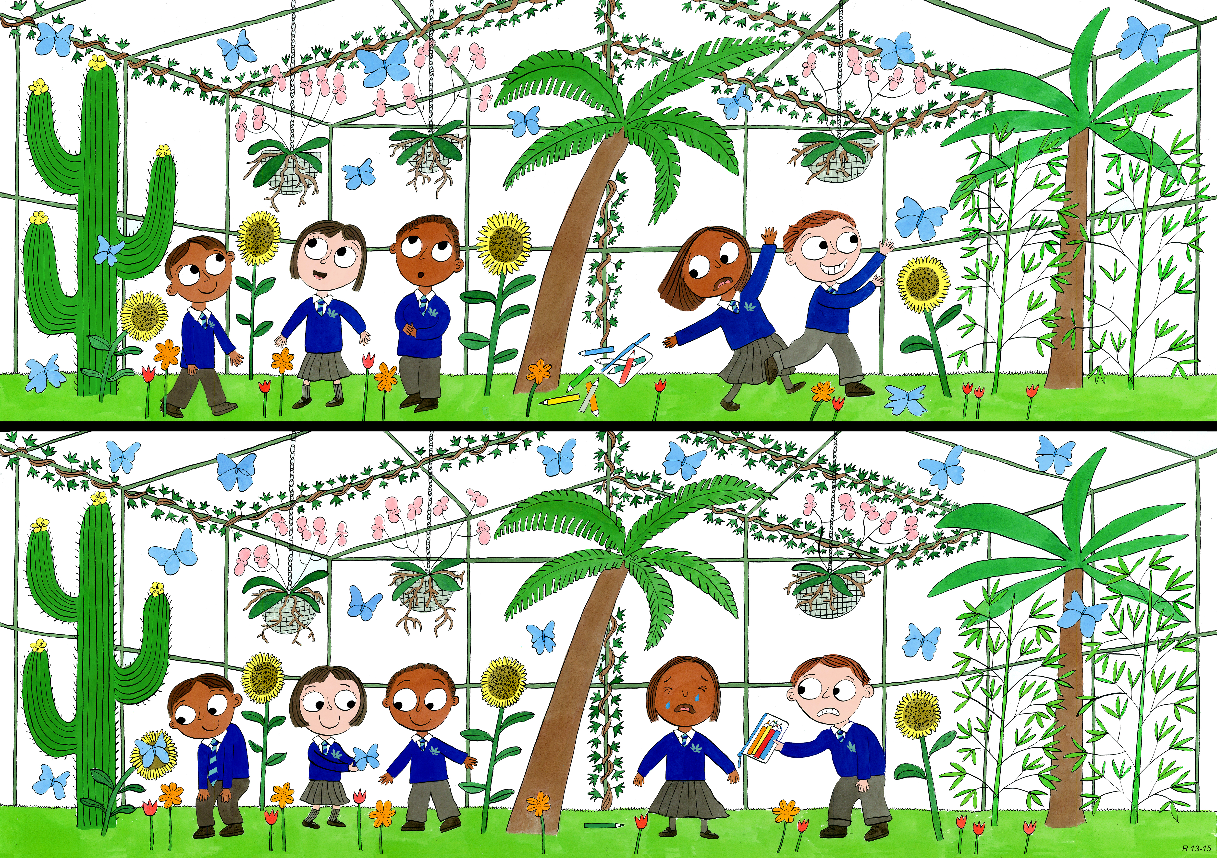
Reception: Summer 1
Judgement and Prudence, Forgiveness, Appreciation and Awe

Slide 2
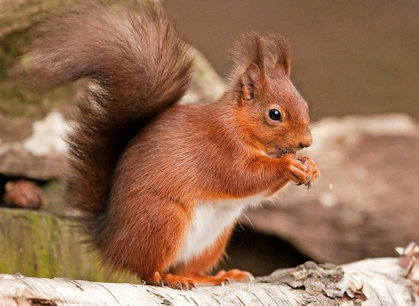
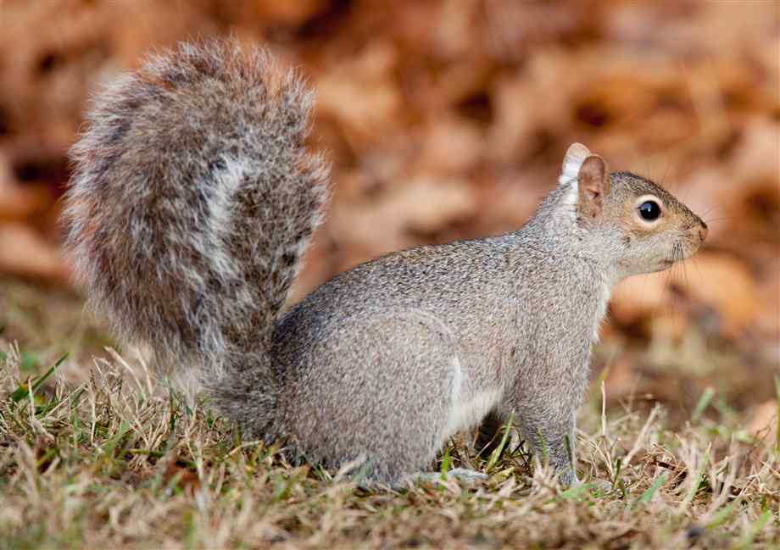
Squirrel Grey and Squirrel Red set out on a journey to a far away place.

Slide 3
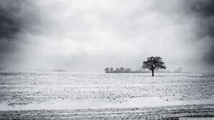
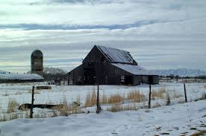
They walked through villages and towns, through farms and fields, and by the time they came to the woods they were tired and hungry.
But it was winter and they could find no food.

Slide 4
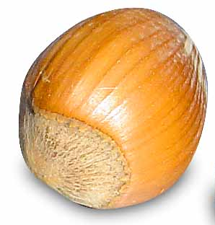
They walked out of the woods along a stony path towards a big, wide beach.
And there on the path was one large nut.

Slide 5
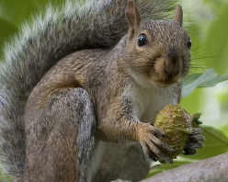
Squirrel Grey, who was hungry and strong, pushed Squirrel Red so hard that he fell onto the stony path.
Squirrel Grey grabbed the nut, and ate it in big noisy munches.

Slide 6
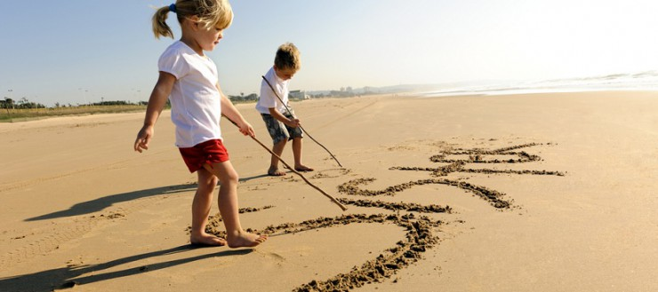
Squirrel Red rubbed his head, which was bleeding by his left ear.
They walked onto the sand.
Squirrel Red wrote, with a twig, down beside the sea, ‘Today Squirrel Grey hurt my feelings and hurt my head.’
And they walked on.
Notes:
Pause and ask the children, what will happen to the message Squirrel Red wrote in the sand?

Slide 7
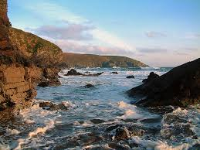
Squirrel Red liked the sound of the wild sea and the feel of the spray on his sore head.
So, in a rocky bay, just around the corner, he jumped into the water.

Slide 8
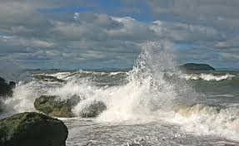
But it was too wild and too windy, and Squirrel Red was whipped by the waves, and he tossed and he turned, and he spun and he flailed.
‘Help me, Squirrel Grey!’ he called.

Slide 9
And Squirrel Grey, who was bigger and stronger than Squirrel Red, jumped into the sea.
And he saved his friend.
Squirrel Grey climbed out of the sea, holding Squirrel Red, who was dripping and shaking and cold and scared.

Slide 10
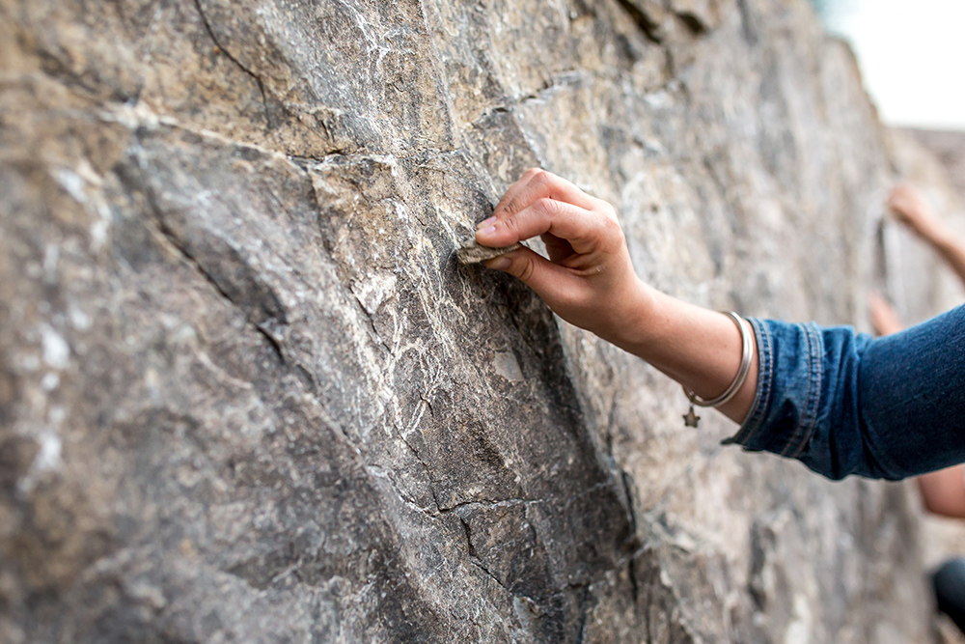
And there, Squirrel Red found a huge rock, and on it he wrote with a sharp shell, ‘Today, Squirrel Grey saved my life.’
Notes:
Pause and ask the children, what will happen to the message Squirrel Red wrote on the big rock?

Slide 11
Squirrel Grey said, ‘When I hurt you, you wrote in the sand, but now that I have helped you, you wrote on stone.
Notes:
Squirrel red wrote the bad thing in the sand because he knew it would be washed away.

