Slide 1

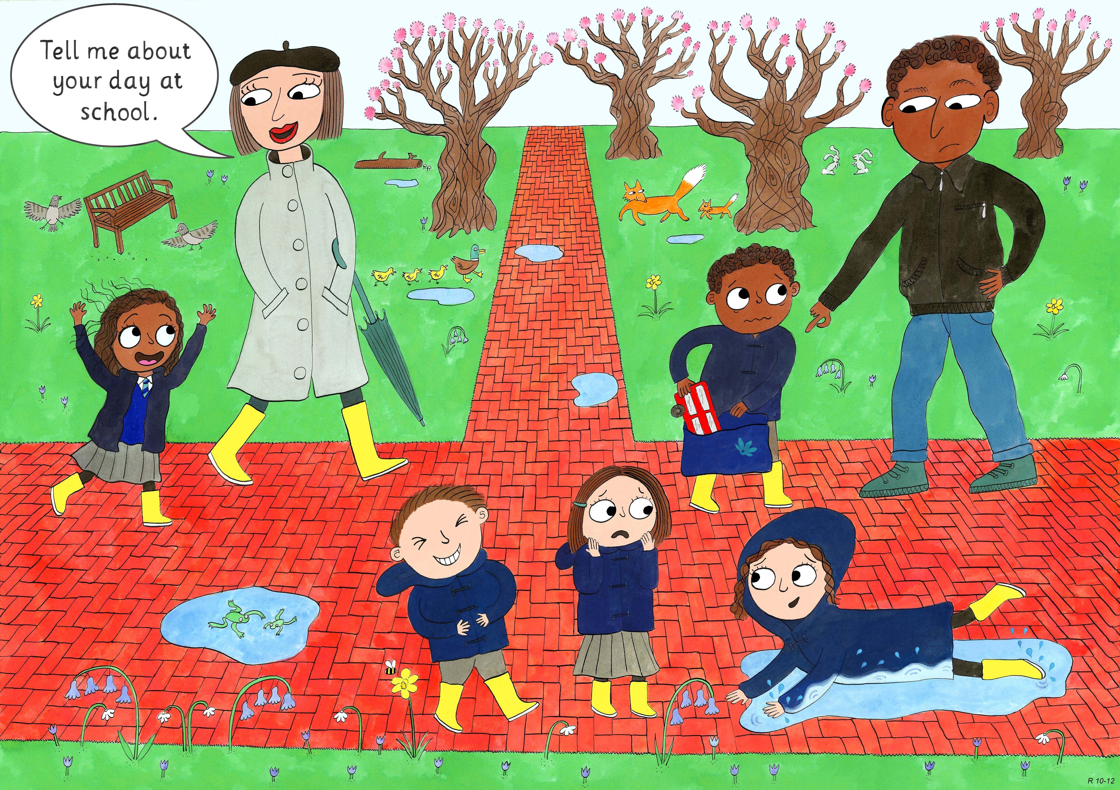
Reception: Spring 2
Creativity, Honesty, Humour

Slide 2
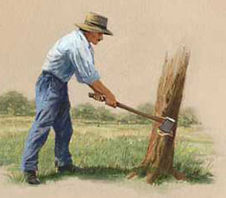
The Honest Woodcutter

Slide 3
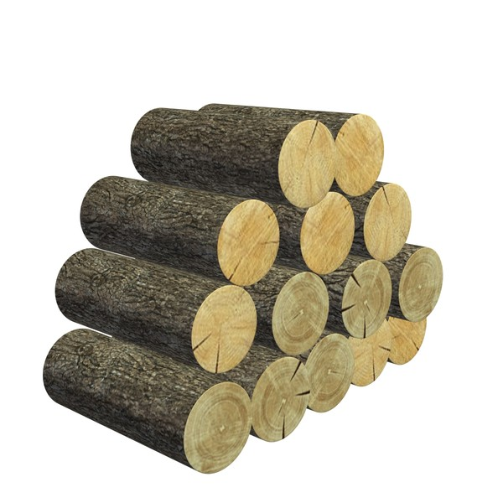
Once there was a man who was so poor he owned nothing except the wooden axe he used to earn his living chopping wood.

Slide 4
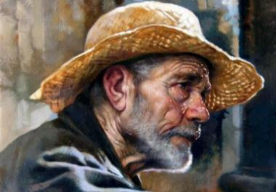
One day while he was working on the bank of a river he dropped his axe into the water. ‘Oh no!’ he said out loud . He sighed, now how would be be able to cut the wood which earned him money to buy food?

Slide 5

Nearby a strange old man had overheard the Woodcutter’s sighs.
As soon as the Woodcutter explained what had happened, the Old Man dived into the river!

Slide 6
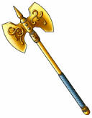
A couple of moments later the man emerged holding a golden axe.
‘Is this the one you lost?’ asked the Old Man…

Slide 7


Slide 8
‘No’ said the Woodcutter shaking his head.
So the Old Man dived back into the water.

Slide 9
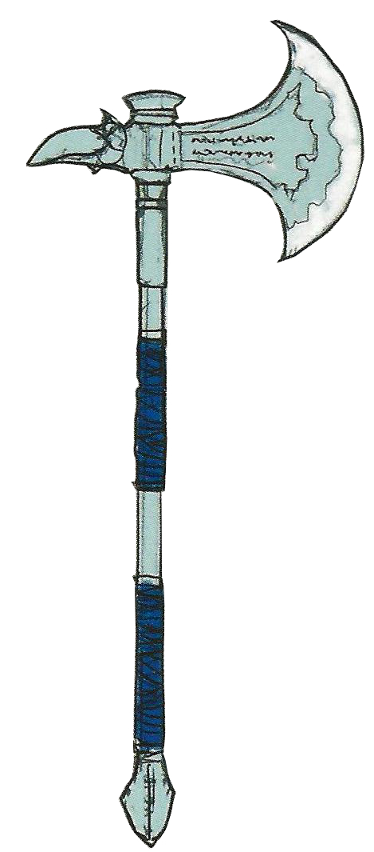
The Old Man dived into the water again and re-emerged holding a silver axe.

Slide 11
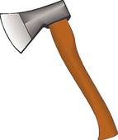
‘No, that’s not mine either’ the Woodcutter said.
The third time the Old Man came out holding the Woodcutter’s wooden axe.
‘Yes, that’s mine!’ laughed the happy Woodcutter.
‘You’ve been so honest’ said the Old Man.
‘Take the gold and silver axes too’.

Slide 12
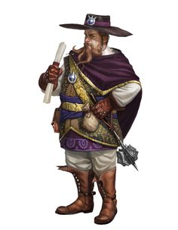

Slide 13

‘Oh no!’ he cried.
The Old Man appeared with a silver axe.
That one is mine!’ The merchant said quickly.
‘You know it is not’ said the Old Man and disappeared into thin air.
Eventually the Merchant went home, with no axe at all.

Slide 14
Why didn’t the rich merchant get a golden axe like the Woodcutter?

