Slide 1

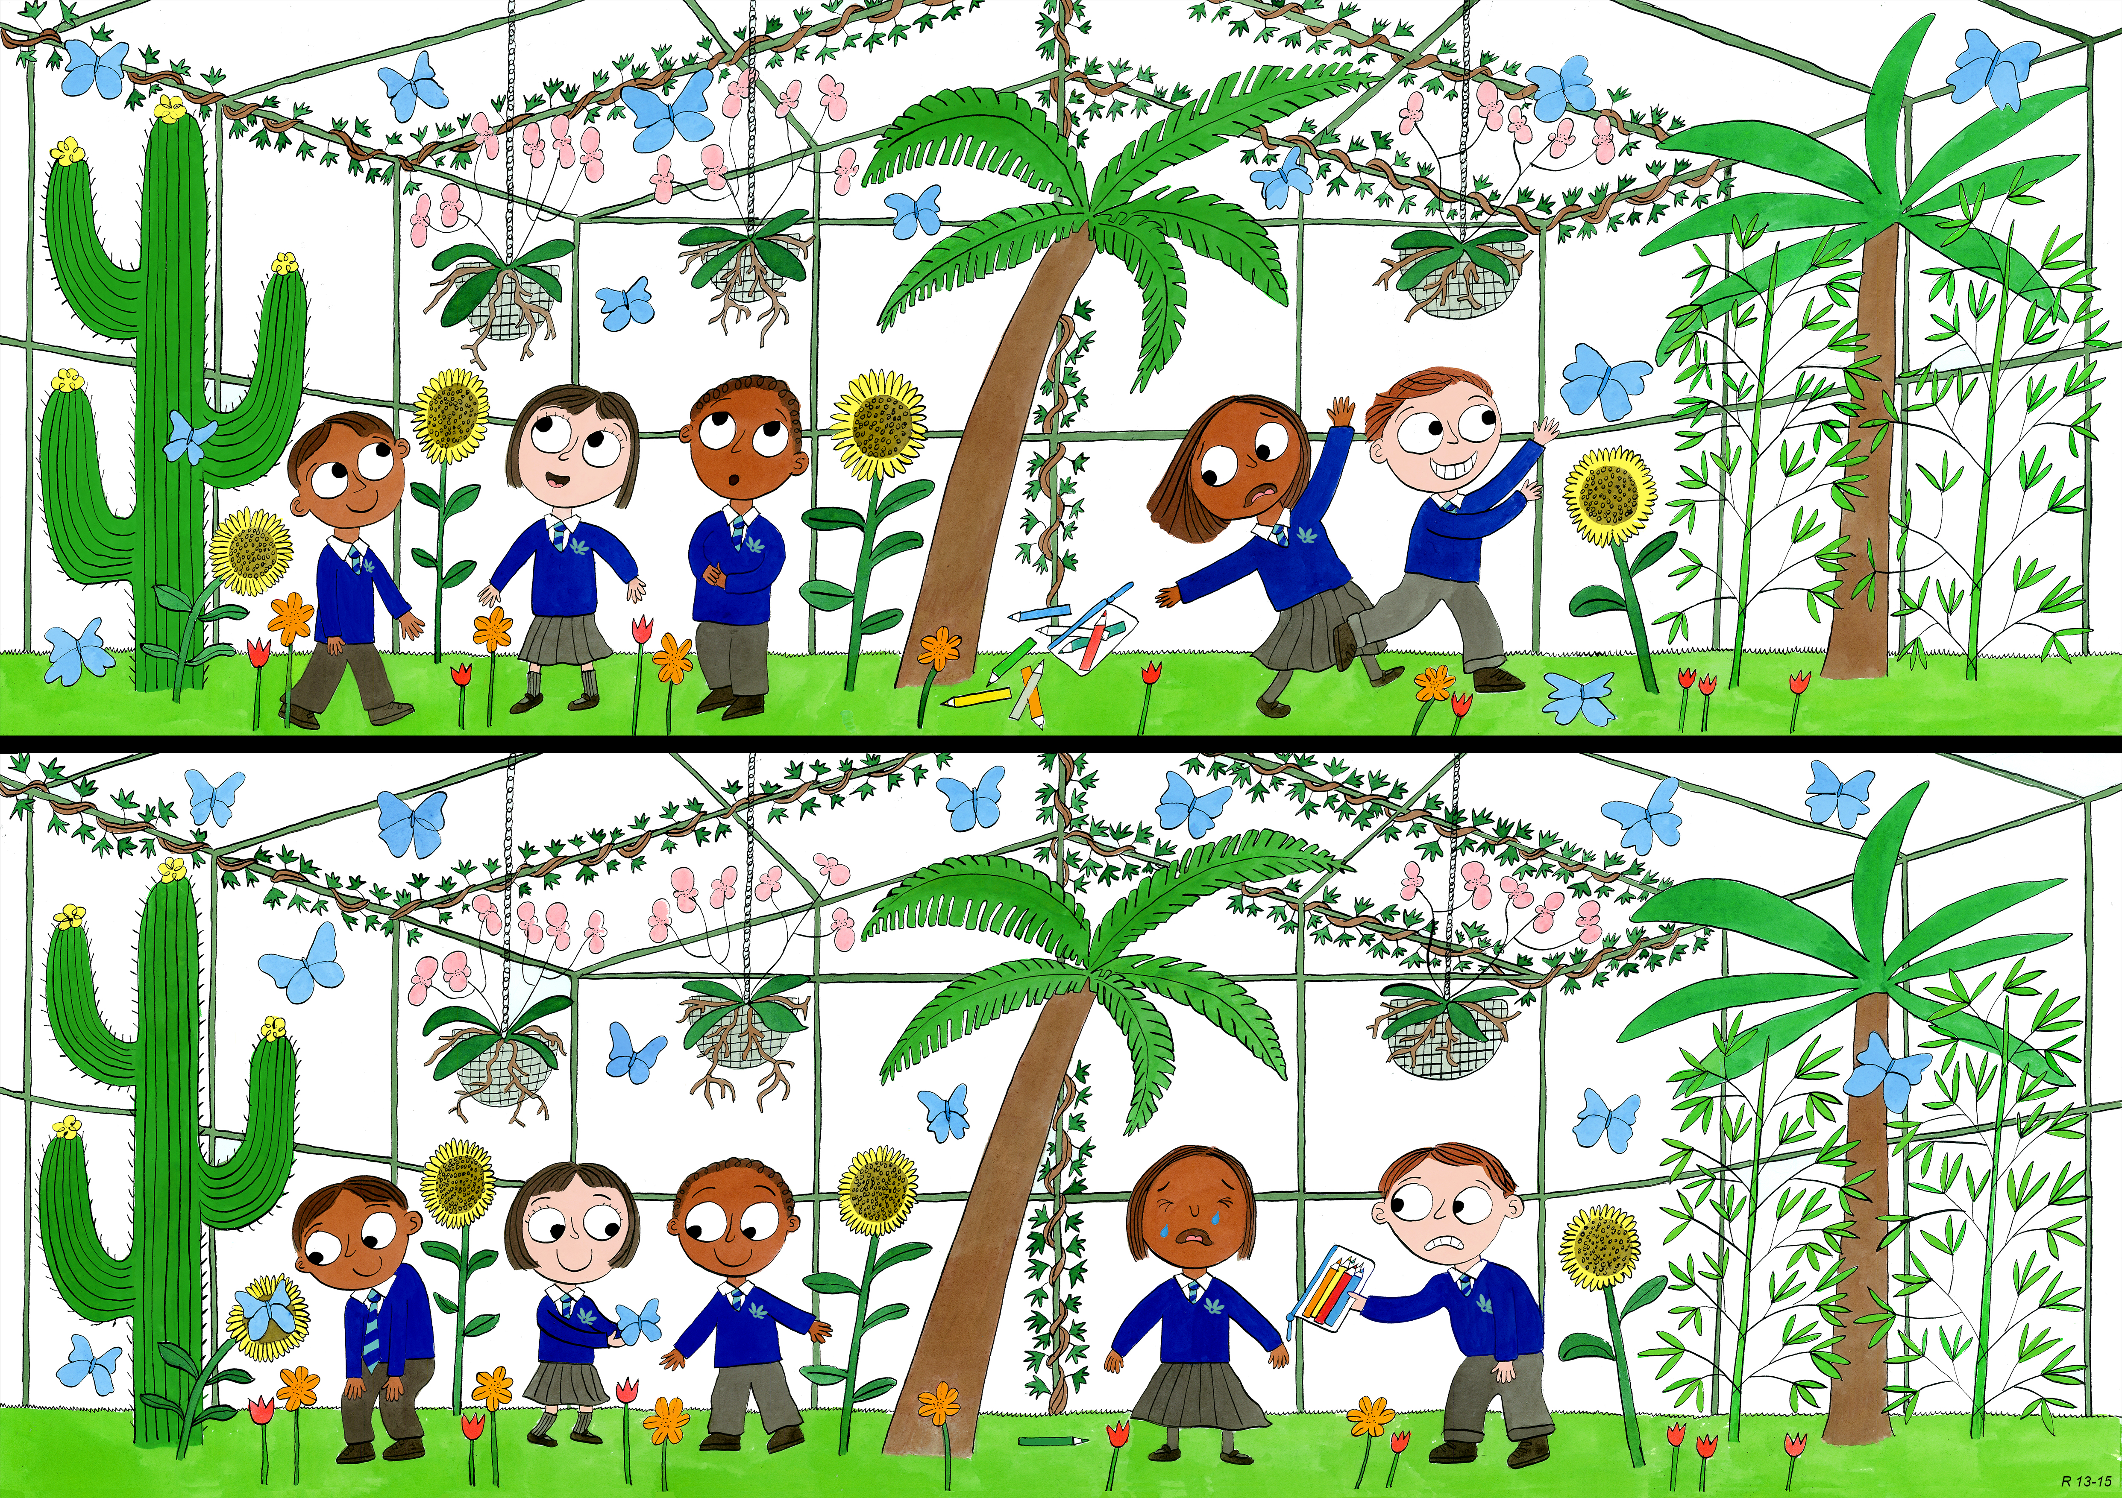
Reception: Summer 1
Judgement and Prudence, Forgiveness, Appreciation and Awe

Slide 2
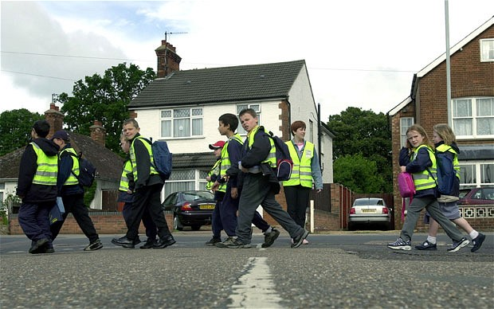
How are these children showing good judgement?
Notes:
Stop, look, listem think. Wait for an adult etc.

Slide 3
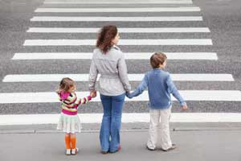
How are these children showing good judgement?
Notes:
Look both ways before crossing and make sure you’re with an adult

Slide 4
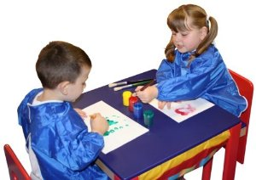
How have these children shown good judgement?

Slide 5
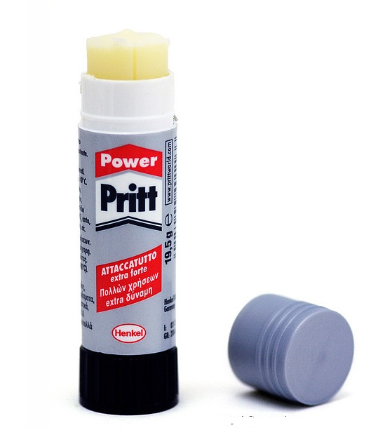




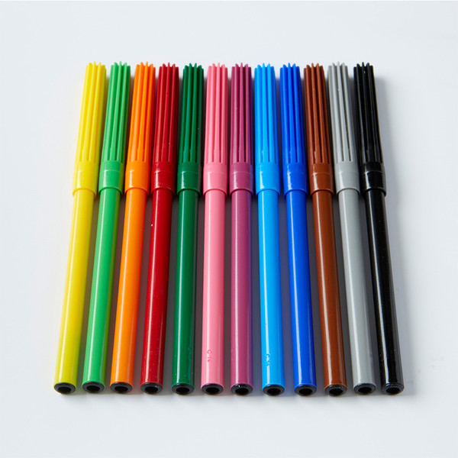
How have these children shown good judgement?

Slide 6
How are these girls showing good judgement?
Notes:
Sharing the seat, using the library to read and not play, sitting still and not fidgeting etc.

Slide 7
When might I need to show judgement?

Slide 8
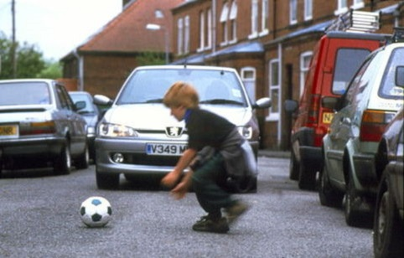
Has he shown good judgement?

Slide 9
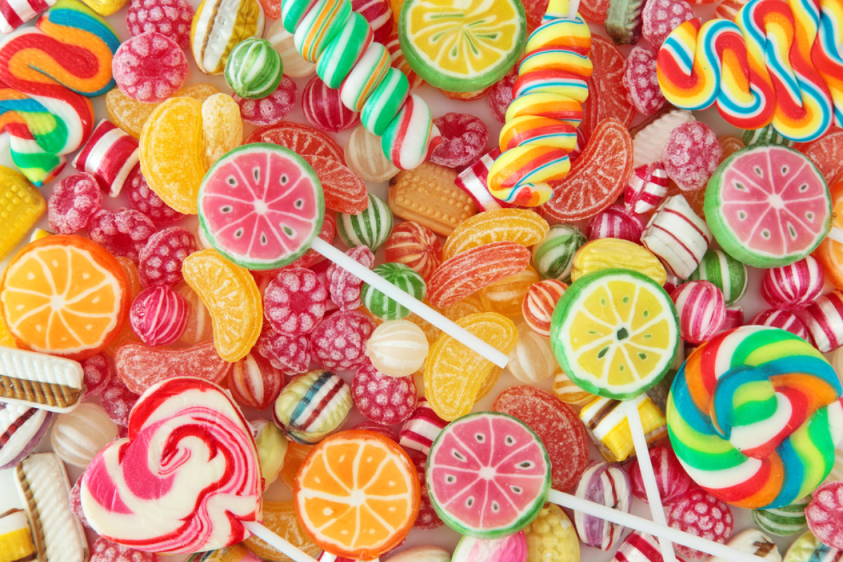
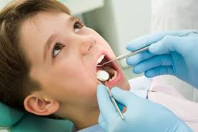
How could he show better judgement?

Slide 10
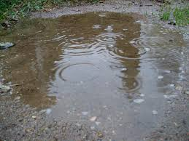
Using your good judgement, what shoes would you choose to wear when it’s raining?

Slide 11
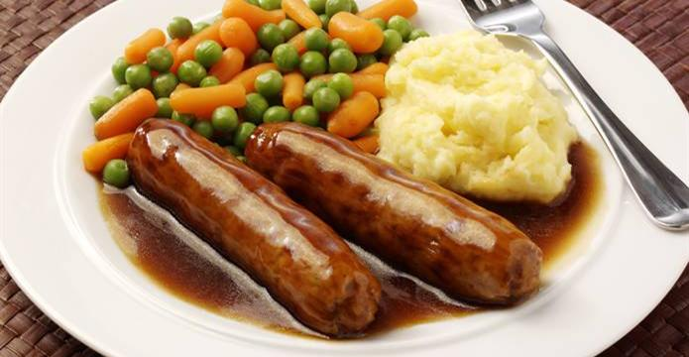
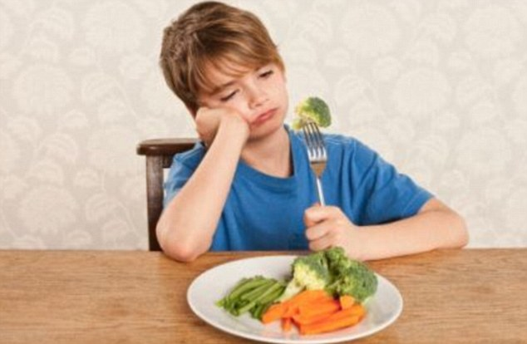
How can he show good judgement?

Slide 12
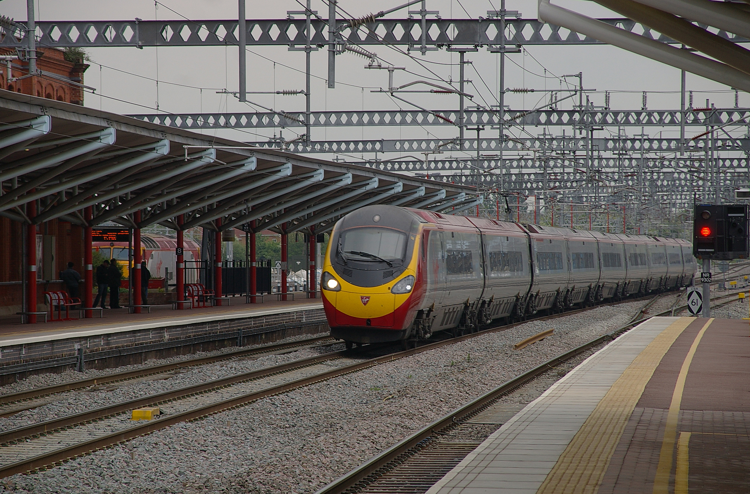
How can you show good judgement on a station platform?

Slide 13
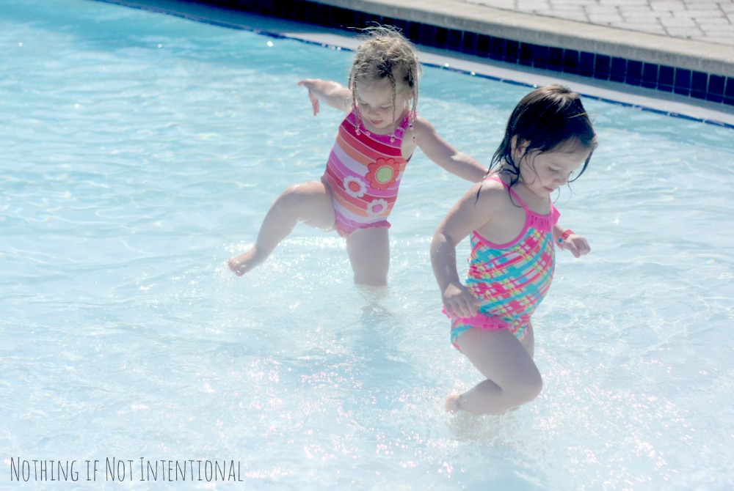
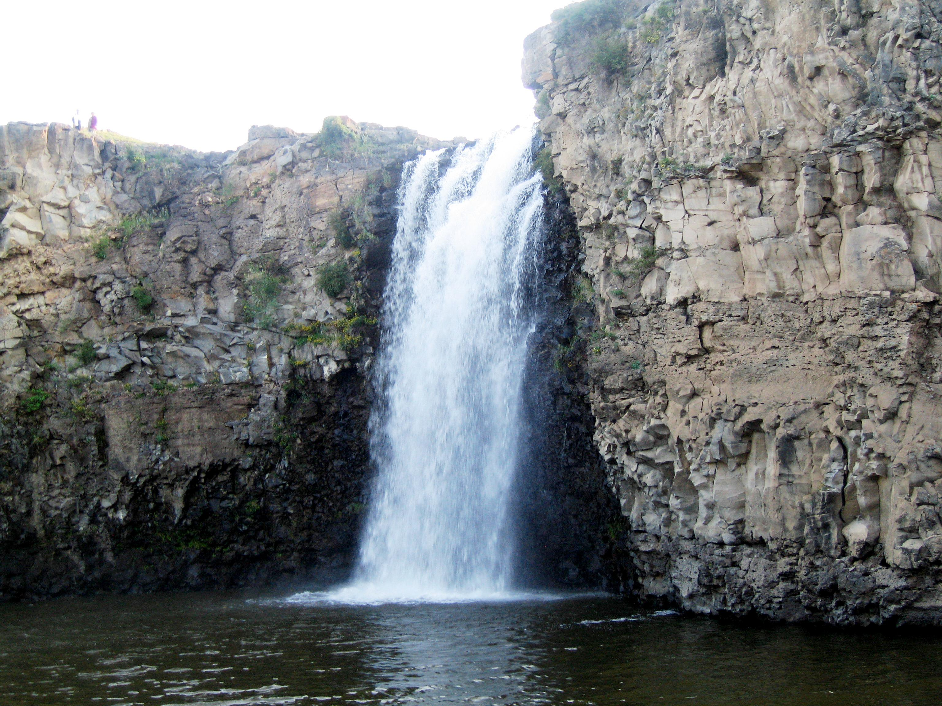
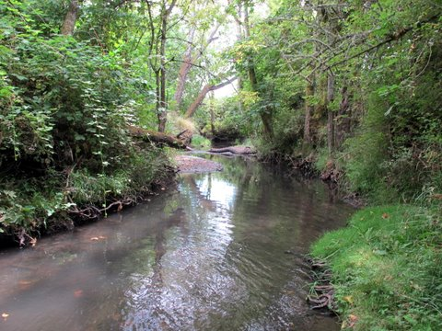
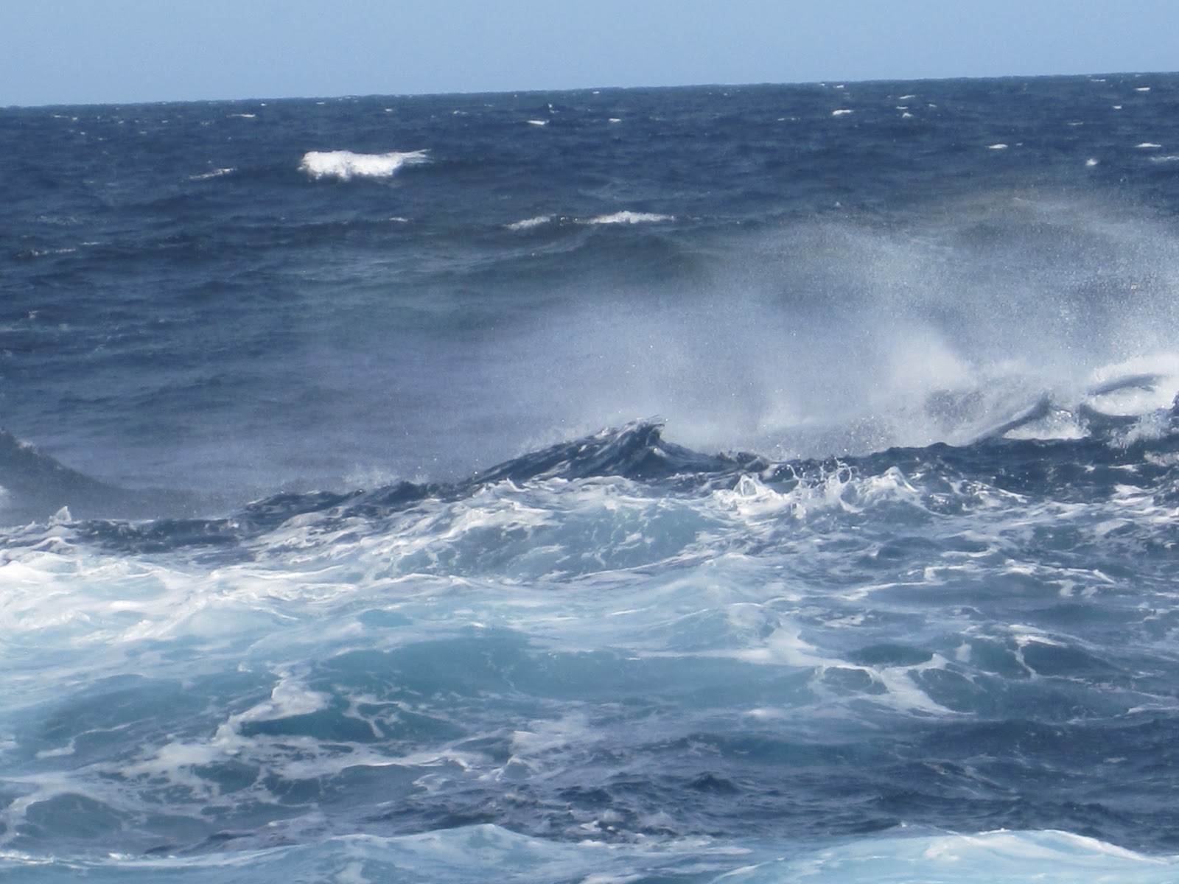
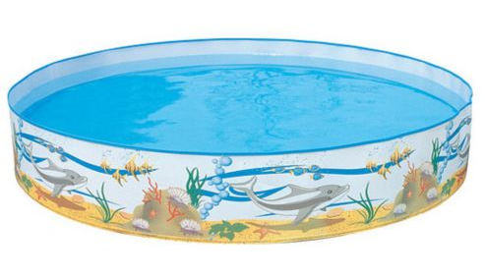
Use your good judgement to decide where is safe to swim?

Slide 14
Dilemmas

Slide 15
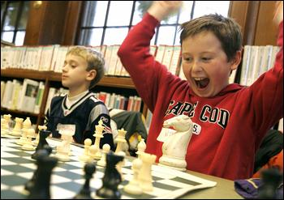
Your friend has won the game even though you are a better player than him.
How can you show your judgement?

Slide 16
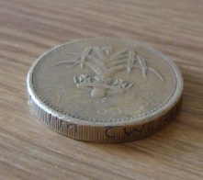
You have found a pound coin on the floor.
How can you show your good judgement?

