Slide 1

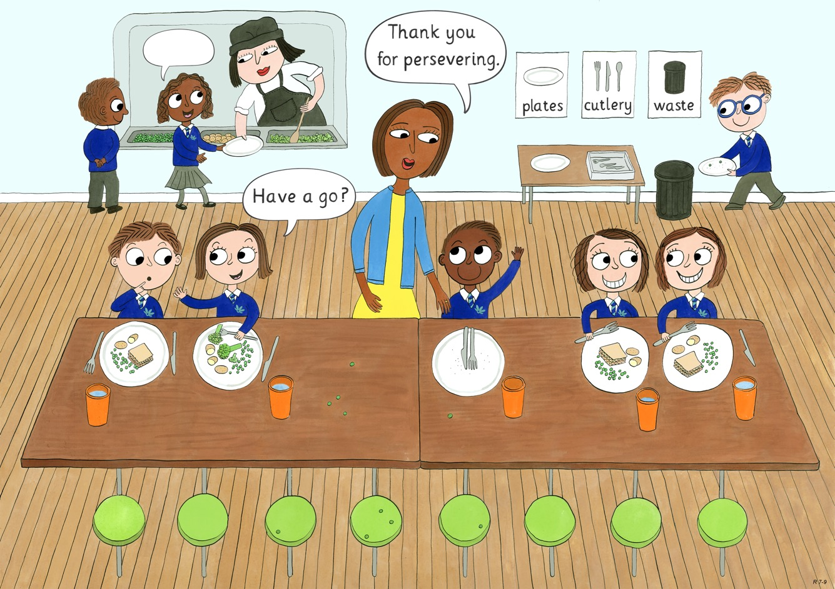
Year 1: Spring 1
Perseverance, Optimism and Joy, Curiosity

Slide 2
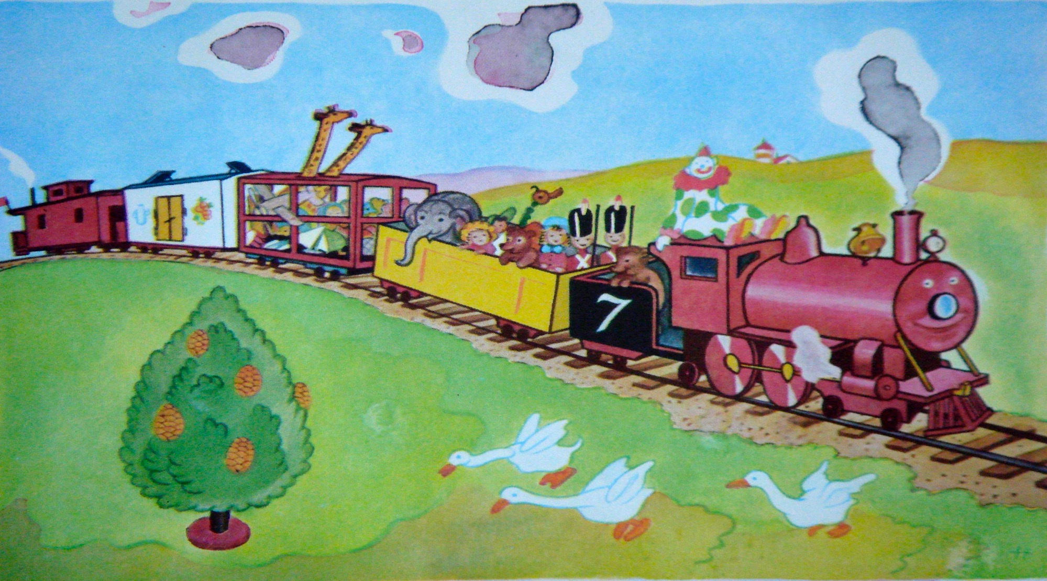

Slide 3
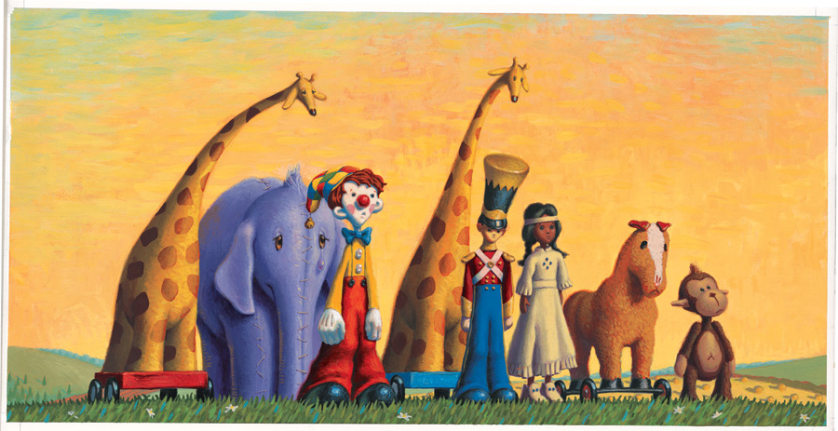

Slide 4
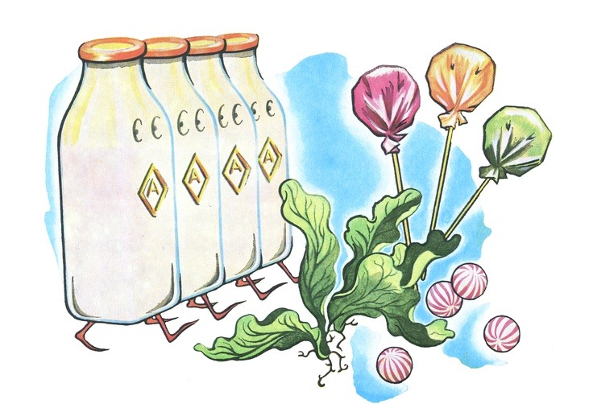

Slide 5
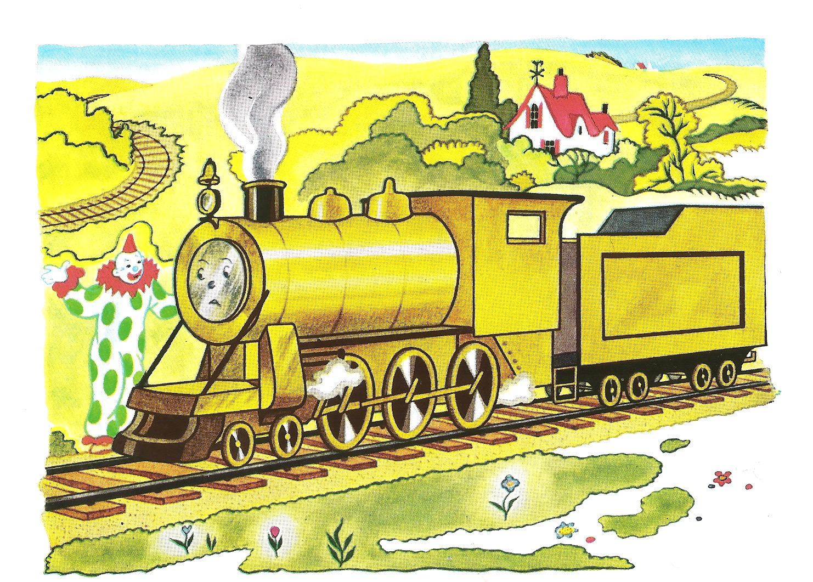

Slide 6
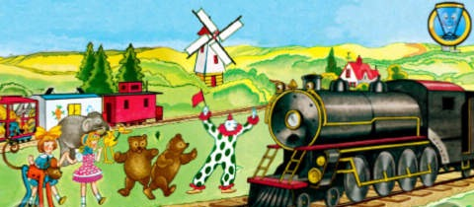

Slide 7
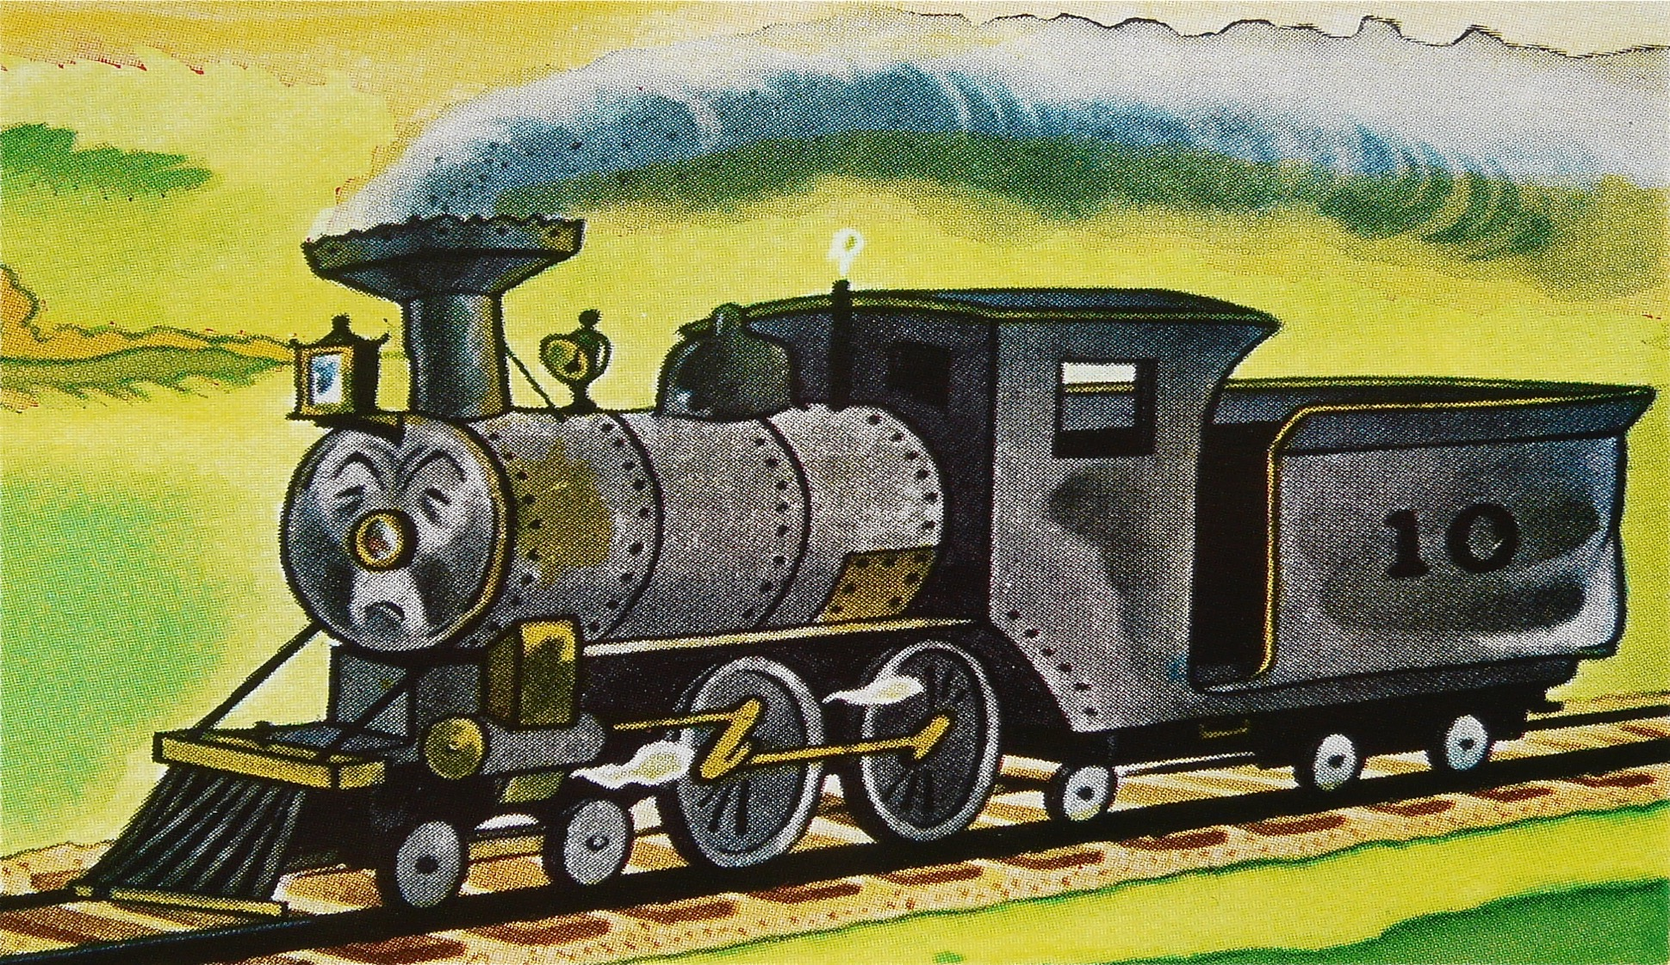

Slide 8
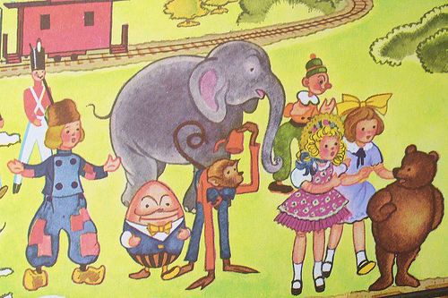

Slide 9
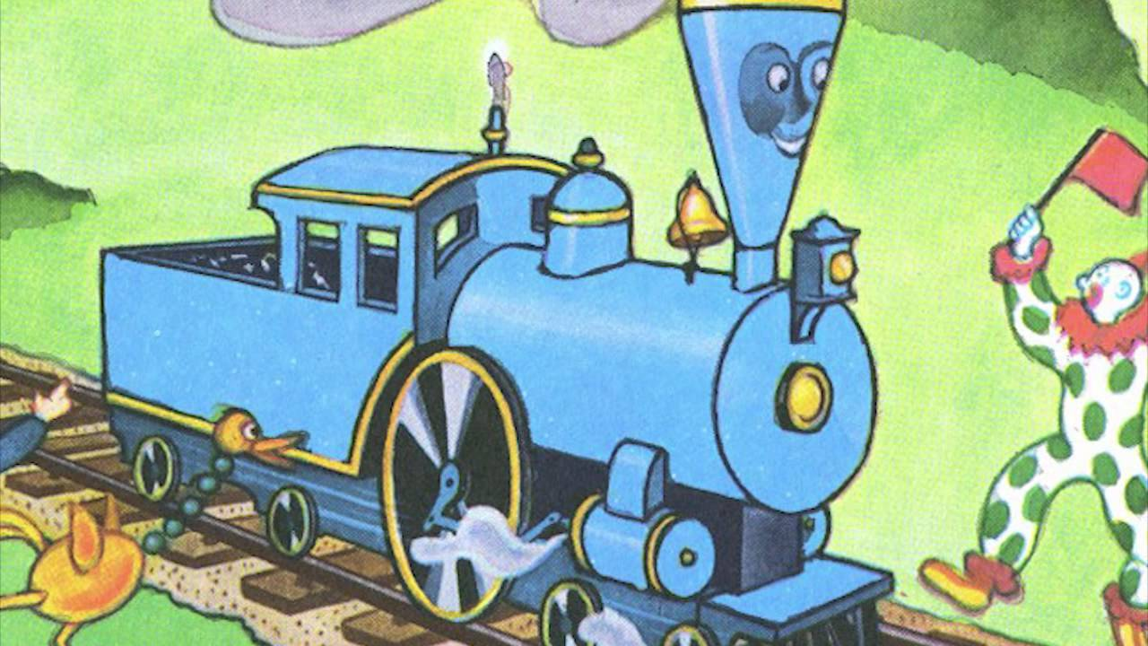

Slide 10
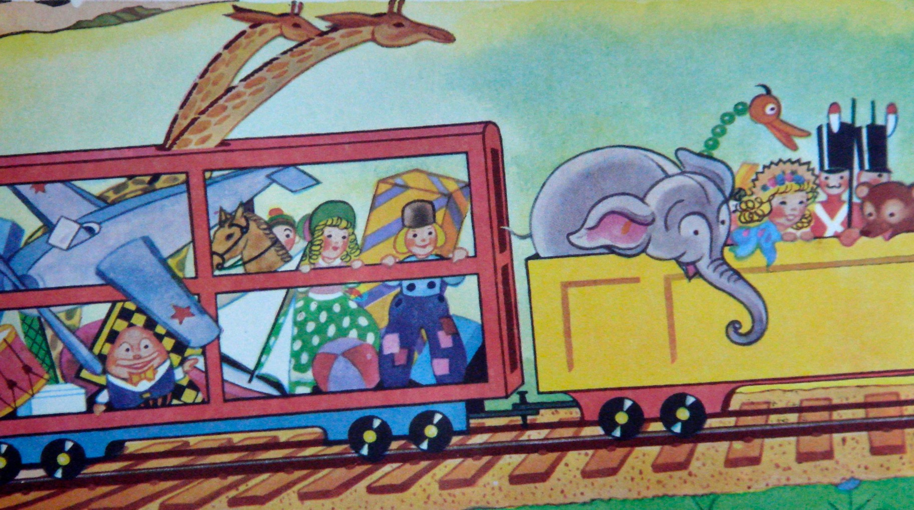

Slide 11


Slide 12
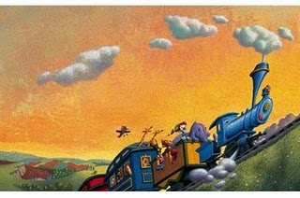

Slide 13
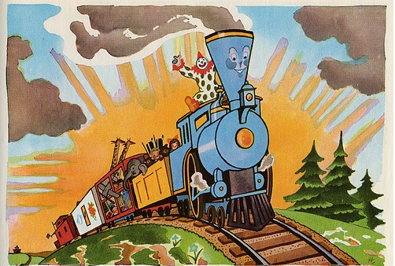

Slide 14
Perseverance
Notes:
Once you’ve shown each slide, ask a pupil to tell the class, in a full sentence, what it show eg “The boy is persevering to read the map” or “The boy should persevere with learning to ride a bike”

Slide 15
The boy can persevere to read the map.

Slide 16
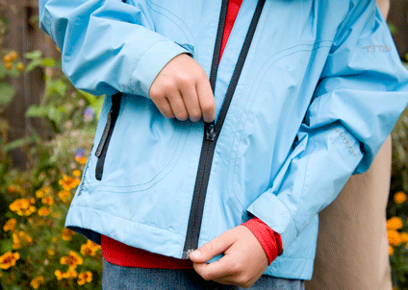
The child can persevere to …

Slide 17
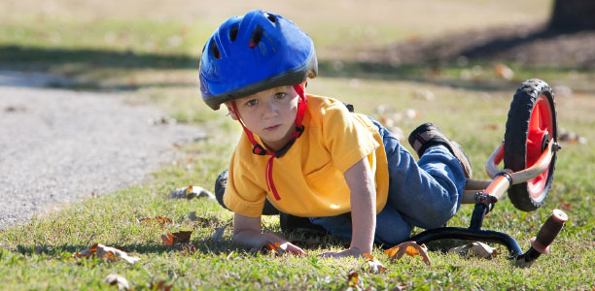
The boy can persevere to …

Slide 18
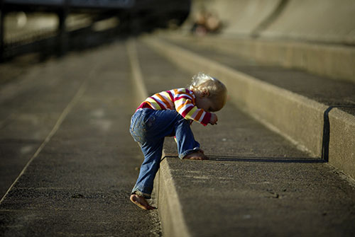
The child can persevere to …
https://www.youtube.com/watch?v=OkfEChXa2V0
Is a 1 minute video of a bear cub learning to walk

Slide 19
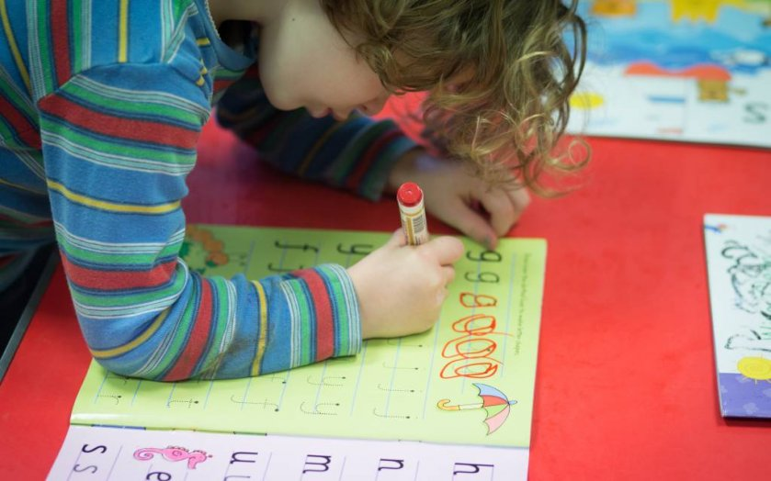
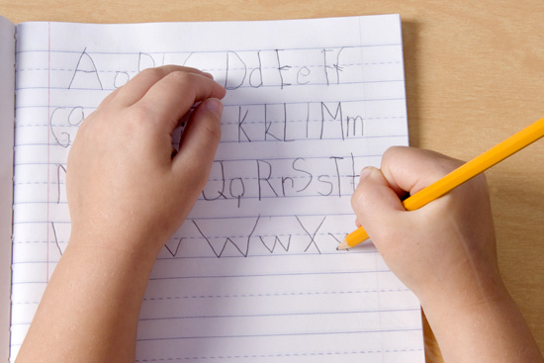
The children can persevere to …

Slide 20
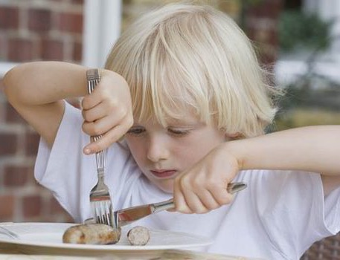
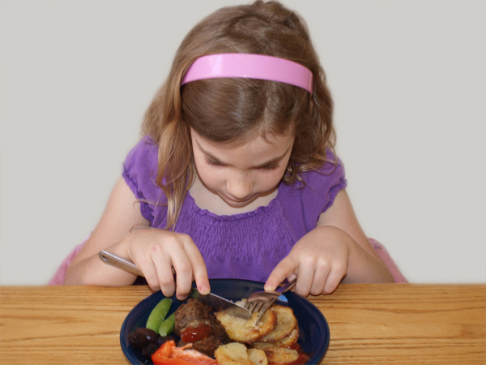
The girl can persevere to …

Slide 21
The children can persevere to …

Slide 22
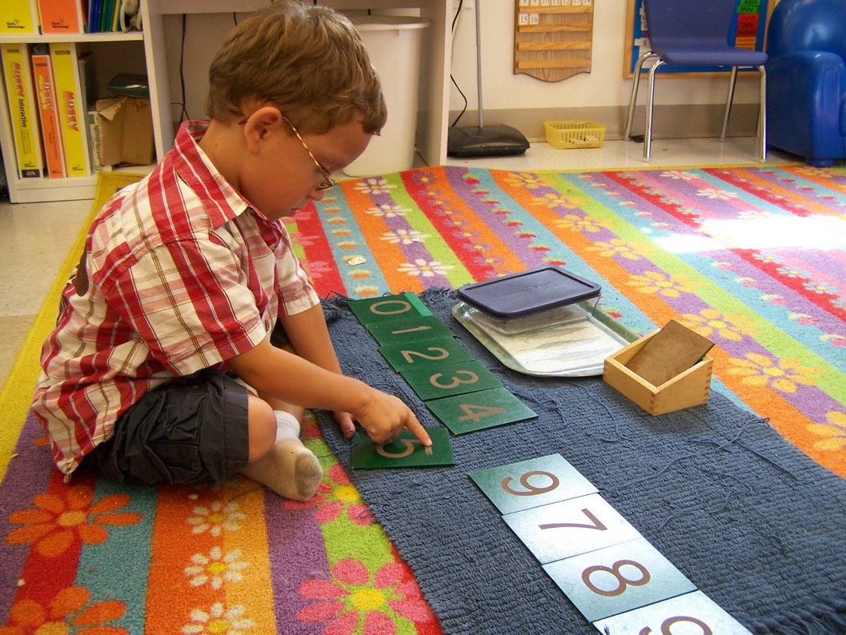
The children can persevere to …

Slide 23
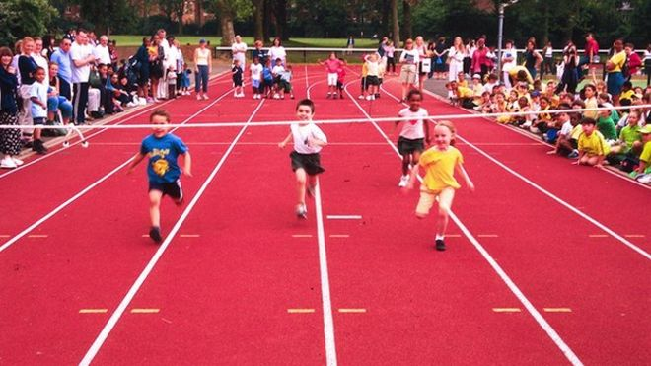
The children can persevere to …

Slide 24
The boy can persevere to …

Slide 25
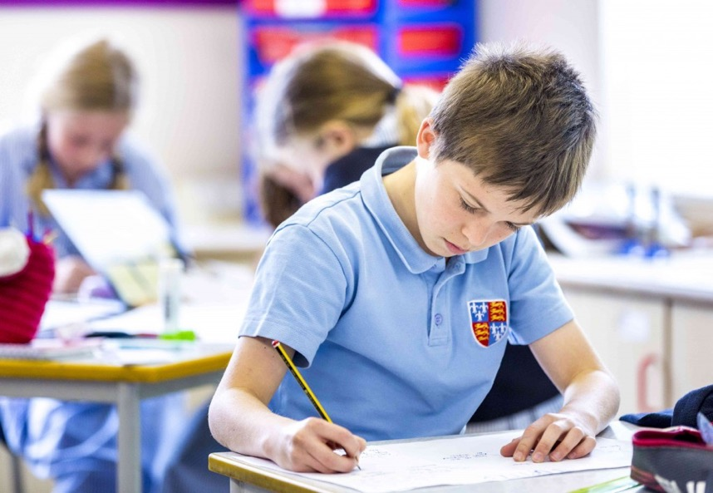
The children can persevere to …

Slide 26
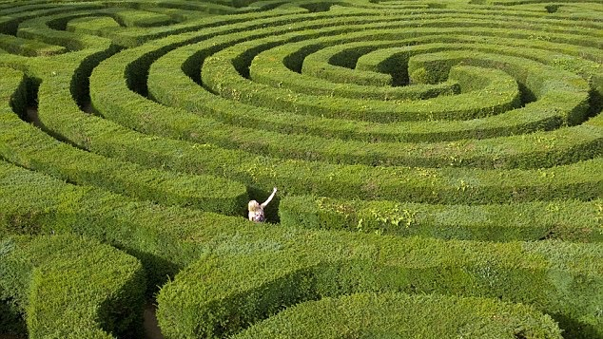
The child can persevere to …

Slide 27
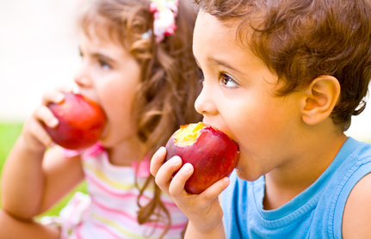
The children can persevere to …

