Slide 1

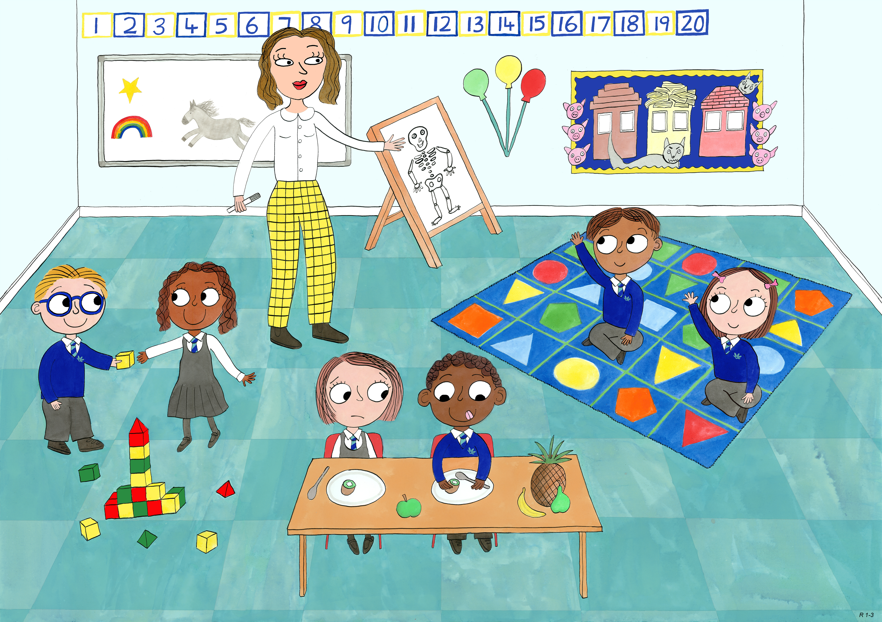
Reception: Autumn 1
Self Control, Bravery, Love and Kindness.

Slide 2
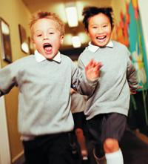
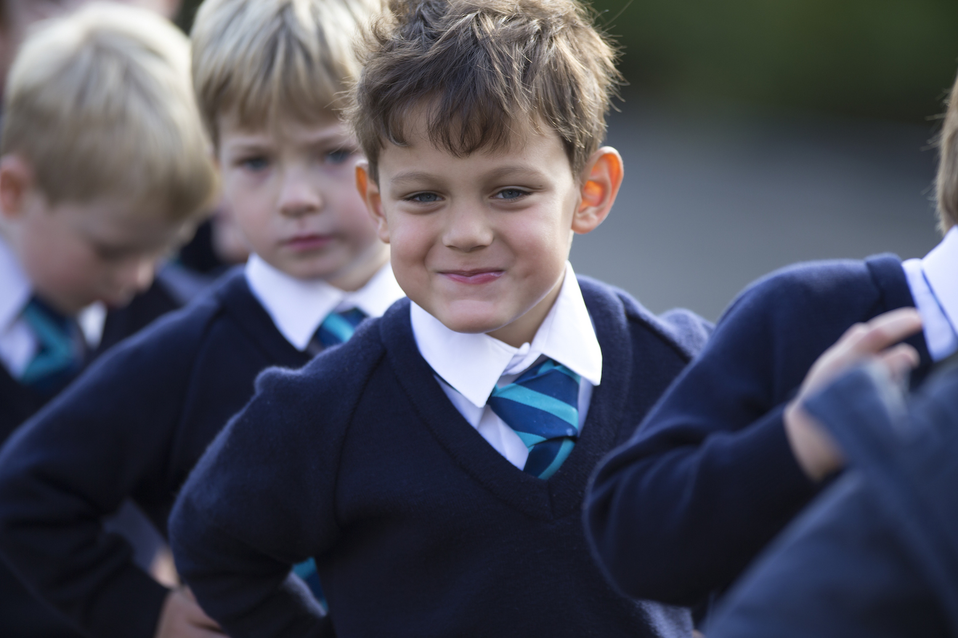
Which children have chosen to act with self control and dignity?

Slide 3
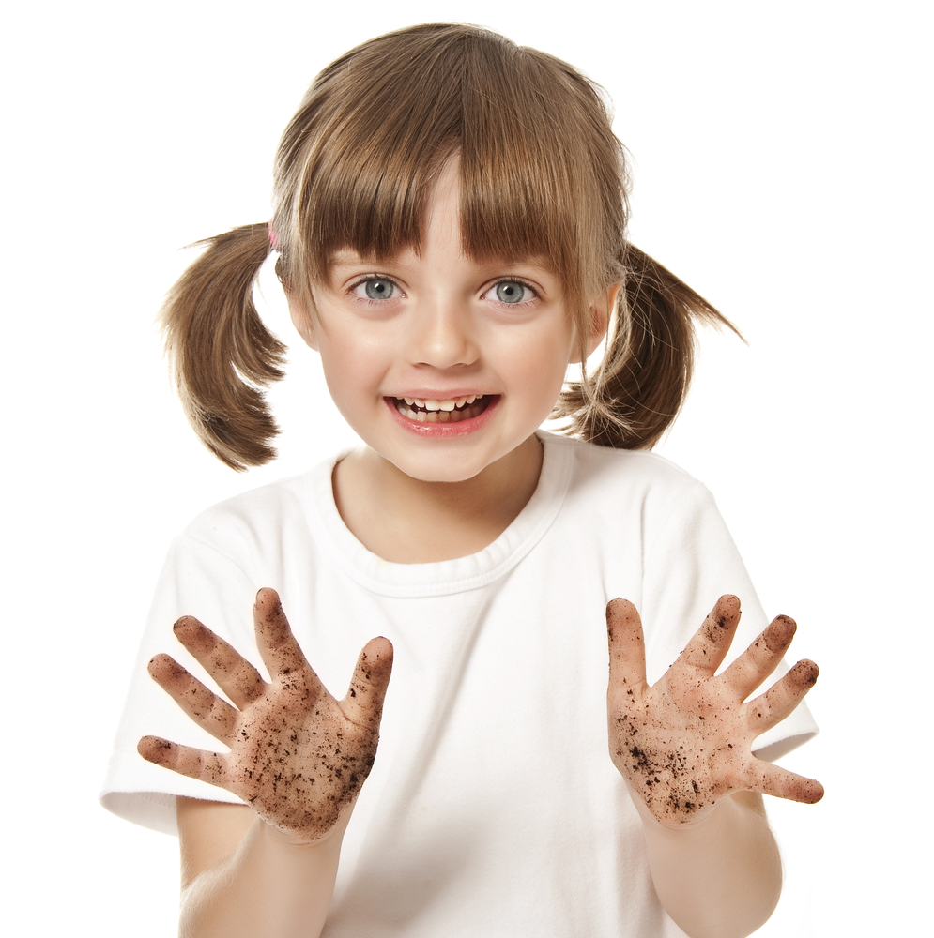
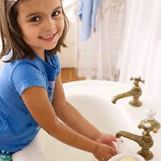
Which child will be able to eat lunch with dignity?

Slide 4
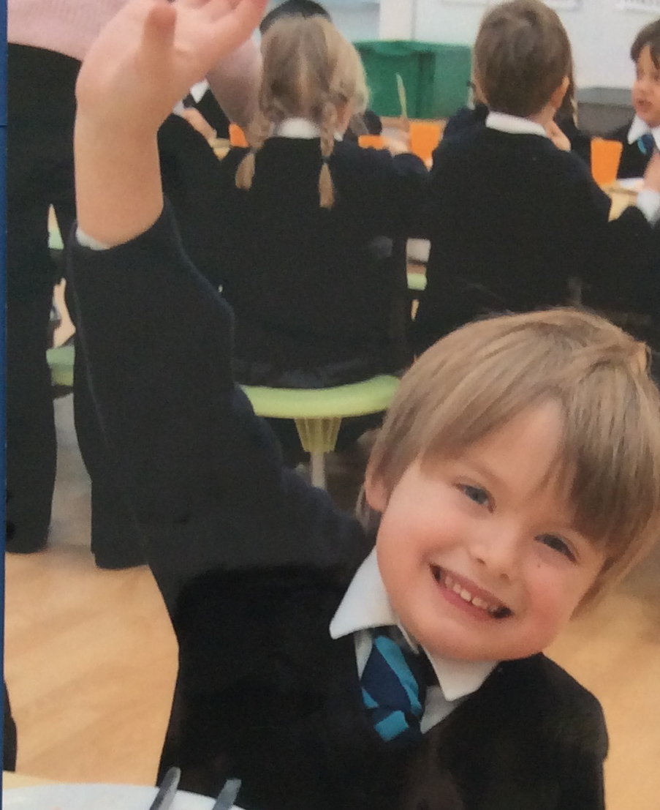
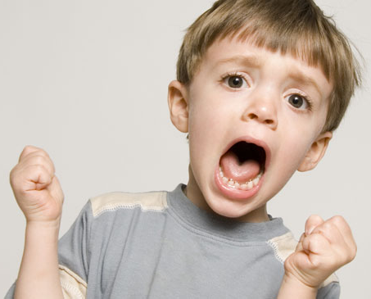
Which child is choosing to act with self control and dignity?

Slide 5
Which child is choosing to act with self control and dignity?

Slide 6
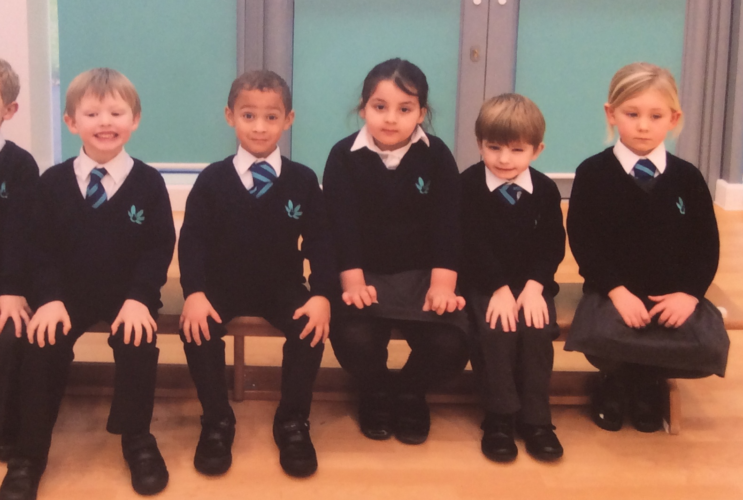
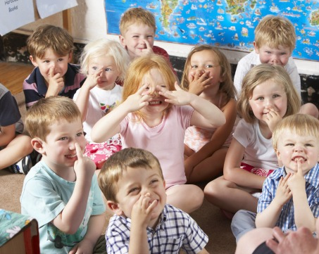
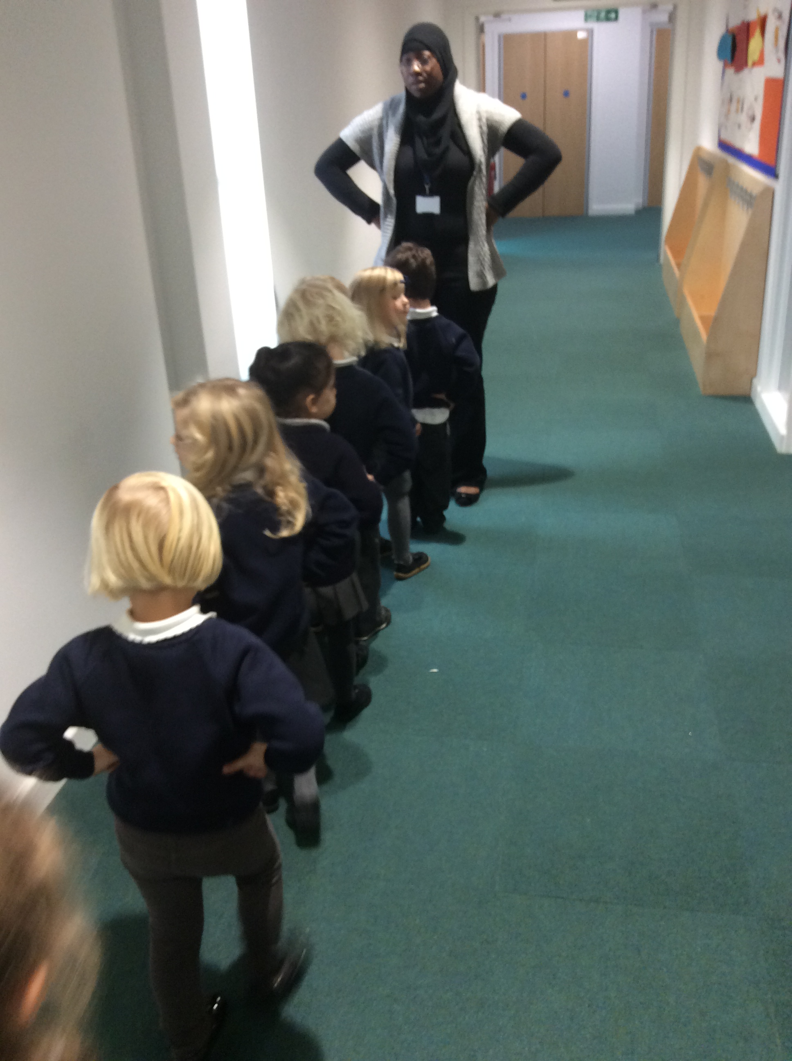
Which children are choosing to acting with self control and dignity?

Slide 7
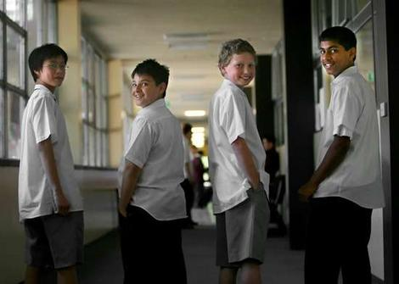
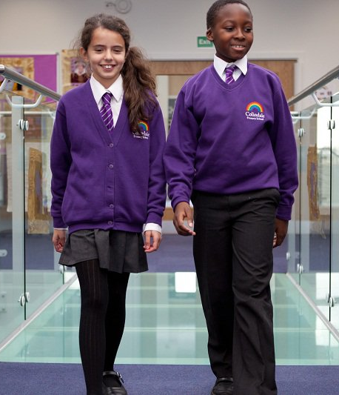
Which children are showing dignity through their uniform?

Slide 8
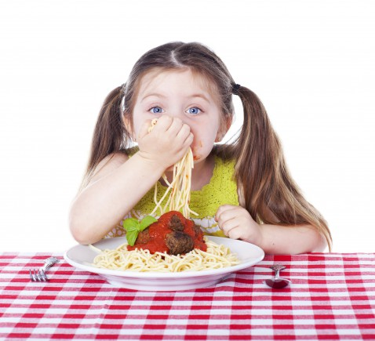
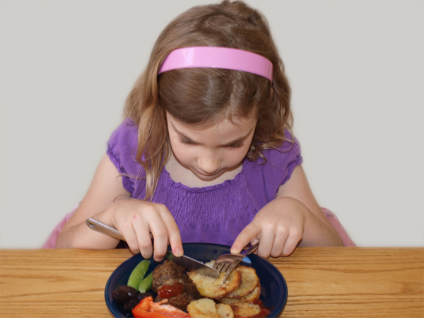
Which child has chosen to act with dignity?

Slide 9
Alfie’s Very Busy Day
Self Control and Dignity

Slide 10
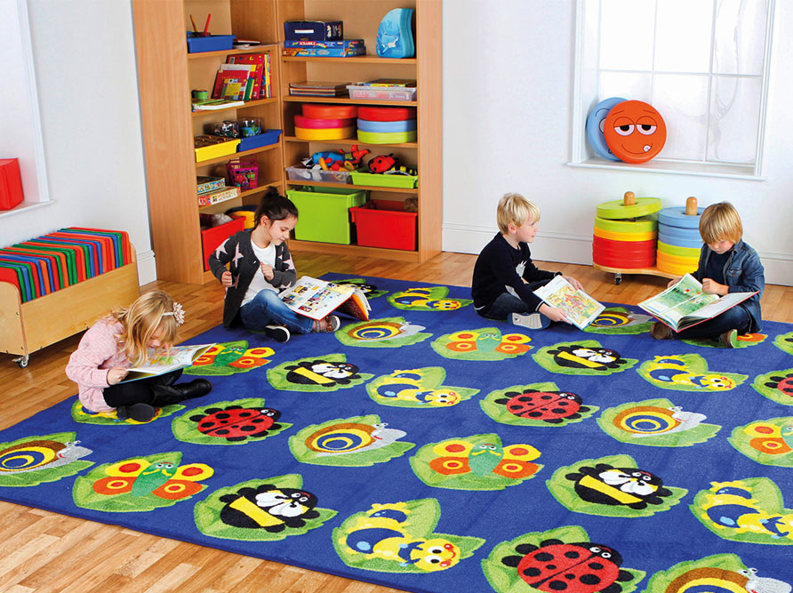

When all the children were sitting on the carpet reading, Alfie started to fidget in his carpet space and poke his friend in front of him.
How could Alfie choose to be dignified instead?

Slide 11
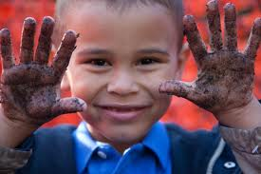
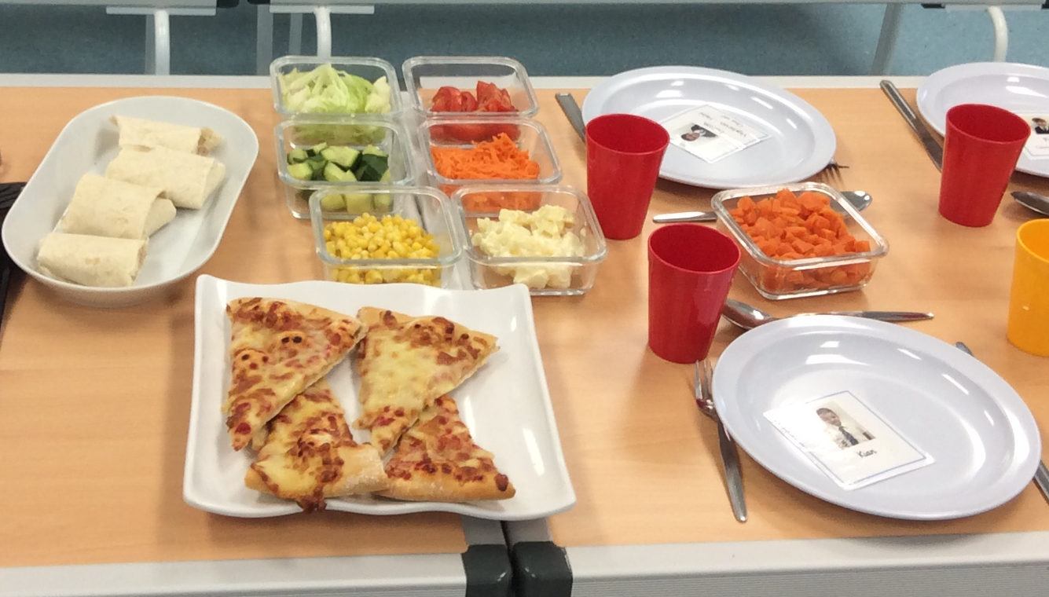
Alfie had been playing outside. He was very hungry.
In family dining today there would be pizza and sweetcorn and broccoli.
Alfie’s favourites!

Slide 12
Alfie wanted to get to the hall straight away!
How could Alfie choose to be dignified now?
Notes:
Wash hands!

Slide 13
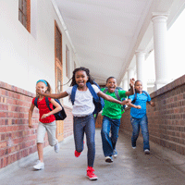
After washing his hands, Alfie and his friends ran as fast as they could to be first in the lunch line.
All they could think of was the pizza!
How could Alfie choose to be dignified instead?

Slide 14
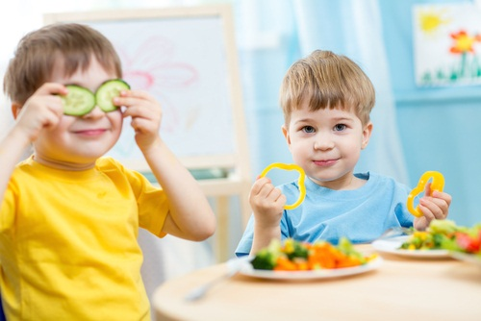
Alfie was enjoying his lunch when he saw his friends playing with their food.
How could Alfie choose to show his dignity at lunchtime?

Slide 15
Alfie and his friend had been running around during playtime.
They got hot so they took off their jumpers and loosened their shirts.
What do Alfie and his friend need to remember to do before assembly to restore their dignity?

Slide 16
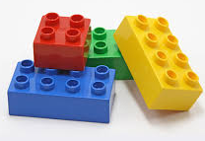
After lunch, Alfie and Freddy were just about to start playing with lego. They were going to build a boat.
Suddenly Alfie felt a tickle in his nose.
A….A….A…Chooo!
Alfie sneezed.

Slide 17
“Hurry up Alfie, I want to build a boat!”
called Freddy.
So Alfie wiped his nose on his sleeve and went over to help Freddy with the lego.
How could Alfie have chosen to show his self control and dignity here?

Slide 18
Alfie and Freddy made an amazing boat with the lego.
His teacher Miss Virtue was in the middle of
reading with some other pupils, but Alfie
thought she should see the boat immediately…..

Slide 19
“Miss Virtue, look what we made!”
.
How could Alfie have chosen to show his self control and dignity here?

Slide 20
How we show Self Control and Dignity

Slide 21
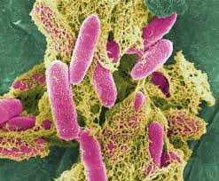
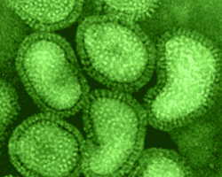
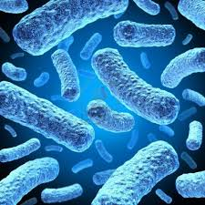
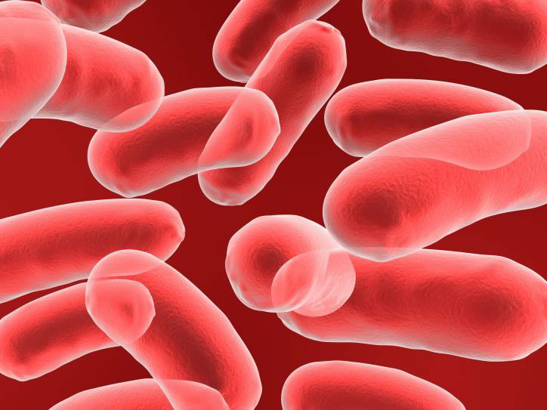
These are bacteria. They are so small you can only see them through a microscope. If they get inside your body they might make you unwell.
Notes:
Explain that these are bacteria and they are so small you can only see them through a microscope. If they get inside your body they might make you unwell.

Slide 22
Have you touched or done any of these things today?

Slide 23
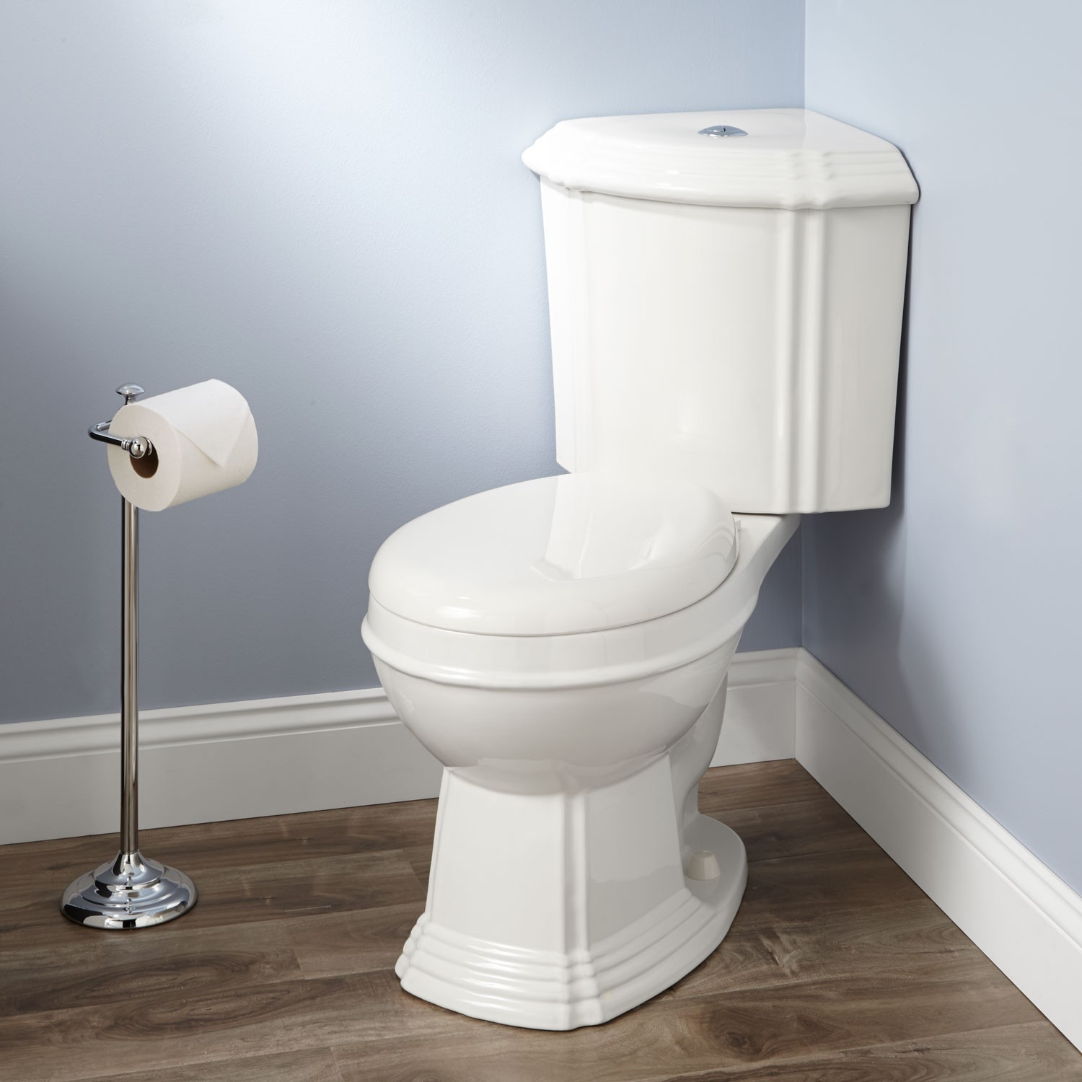

Slide 24
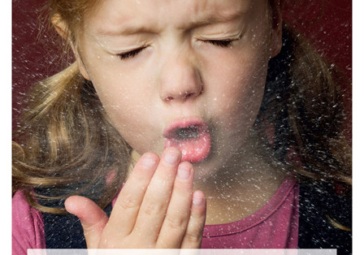


Slide 25
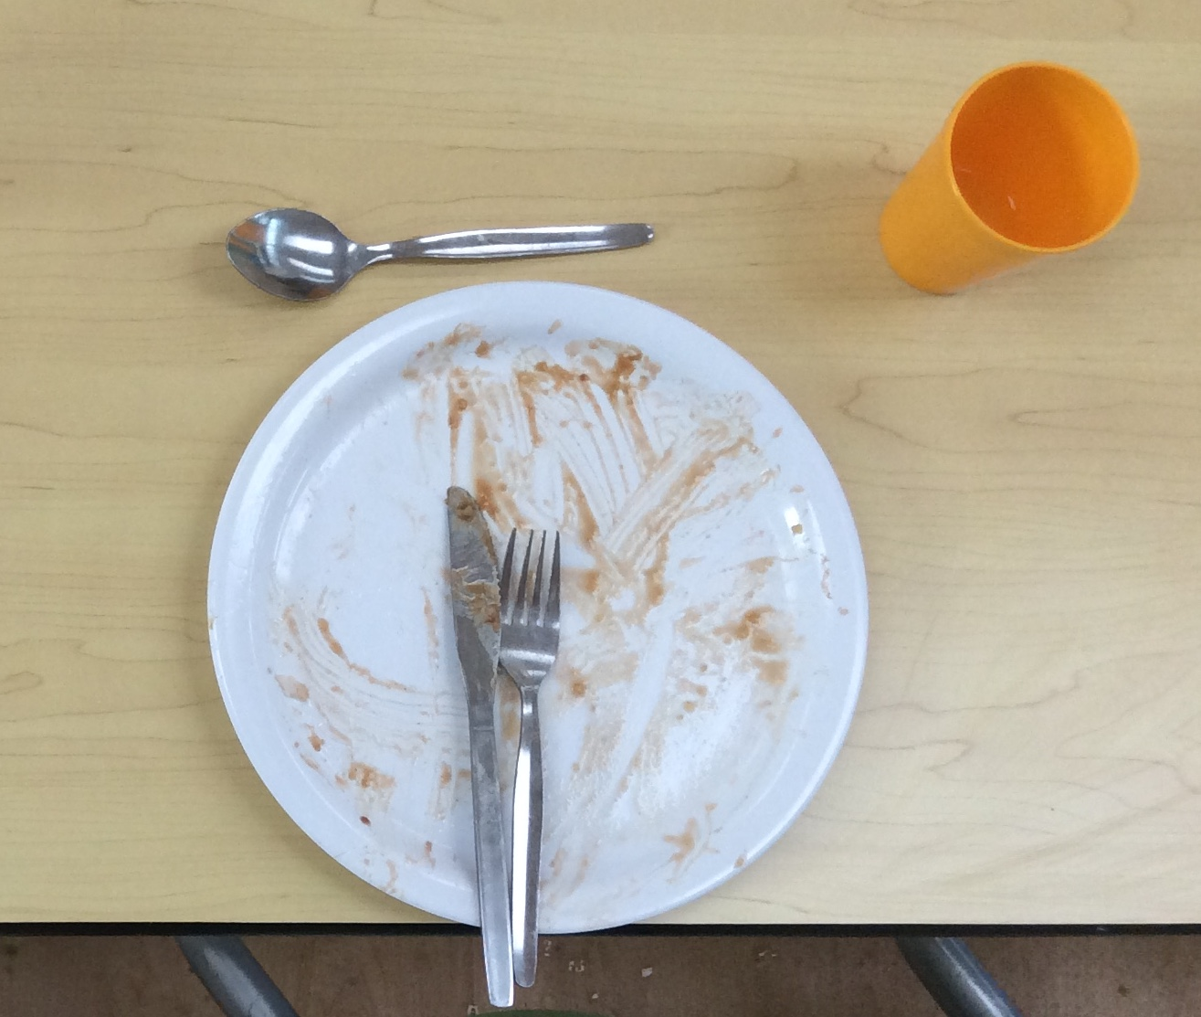

Slide 26
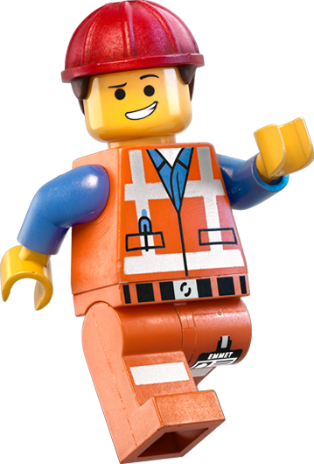
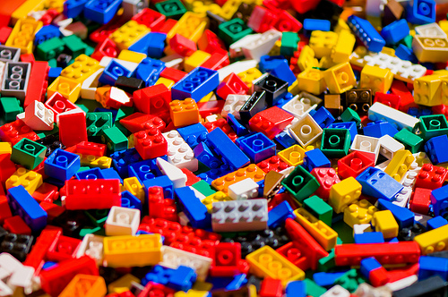

Slide 27
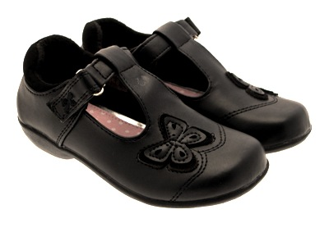

Slide 28
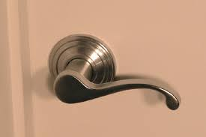

Slide 29
These are all places where bacteria live. If you touch or do any of these things you might have bacteria on your hands. If they get on your hands and then you touch your eyes or hands or mouth they can make you ill.

