Slide 1

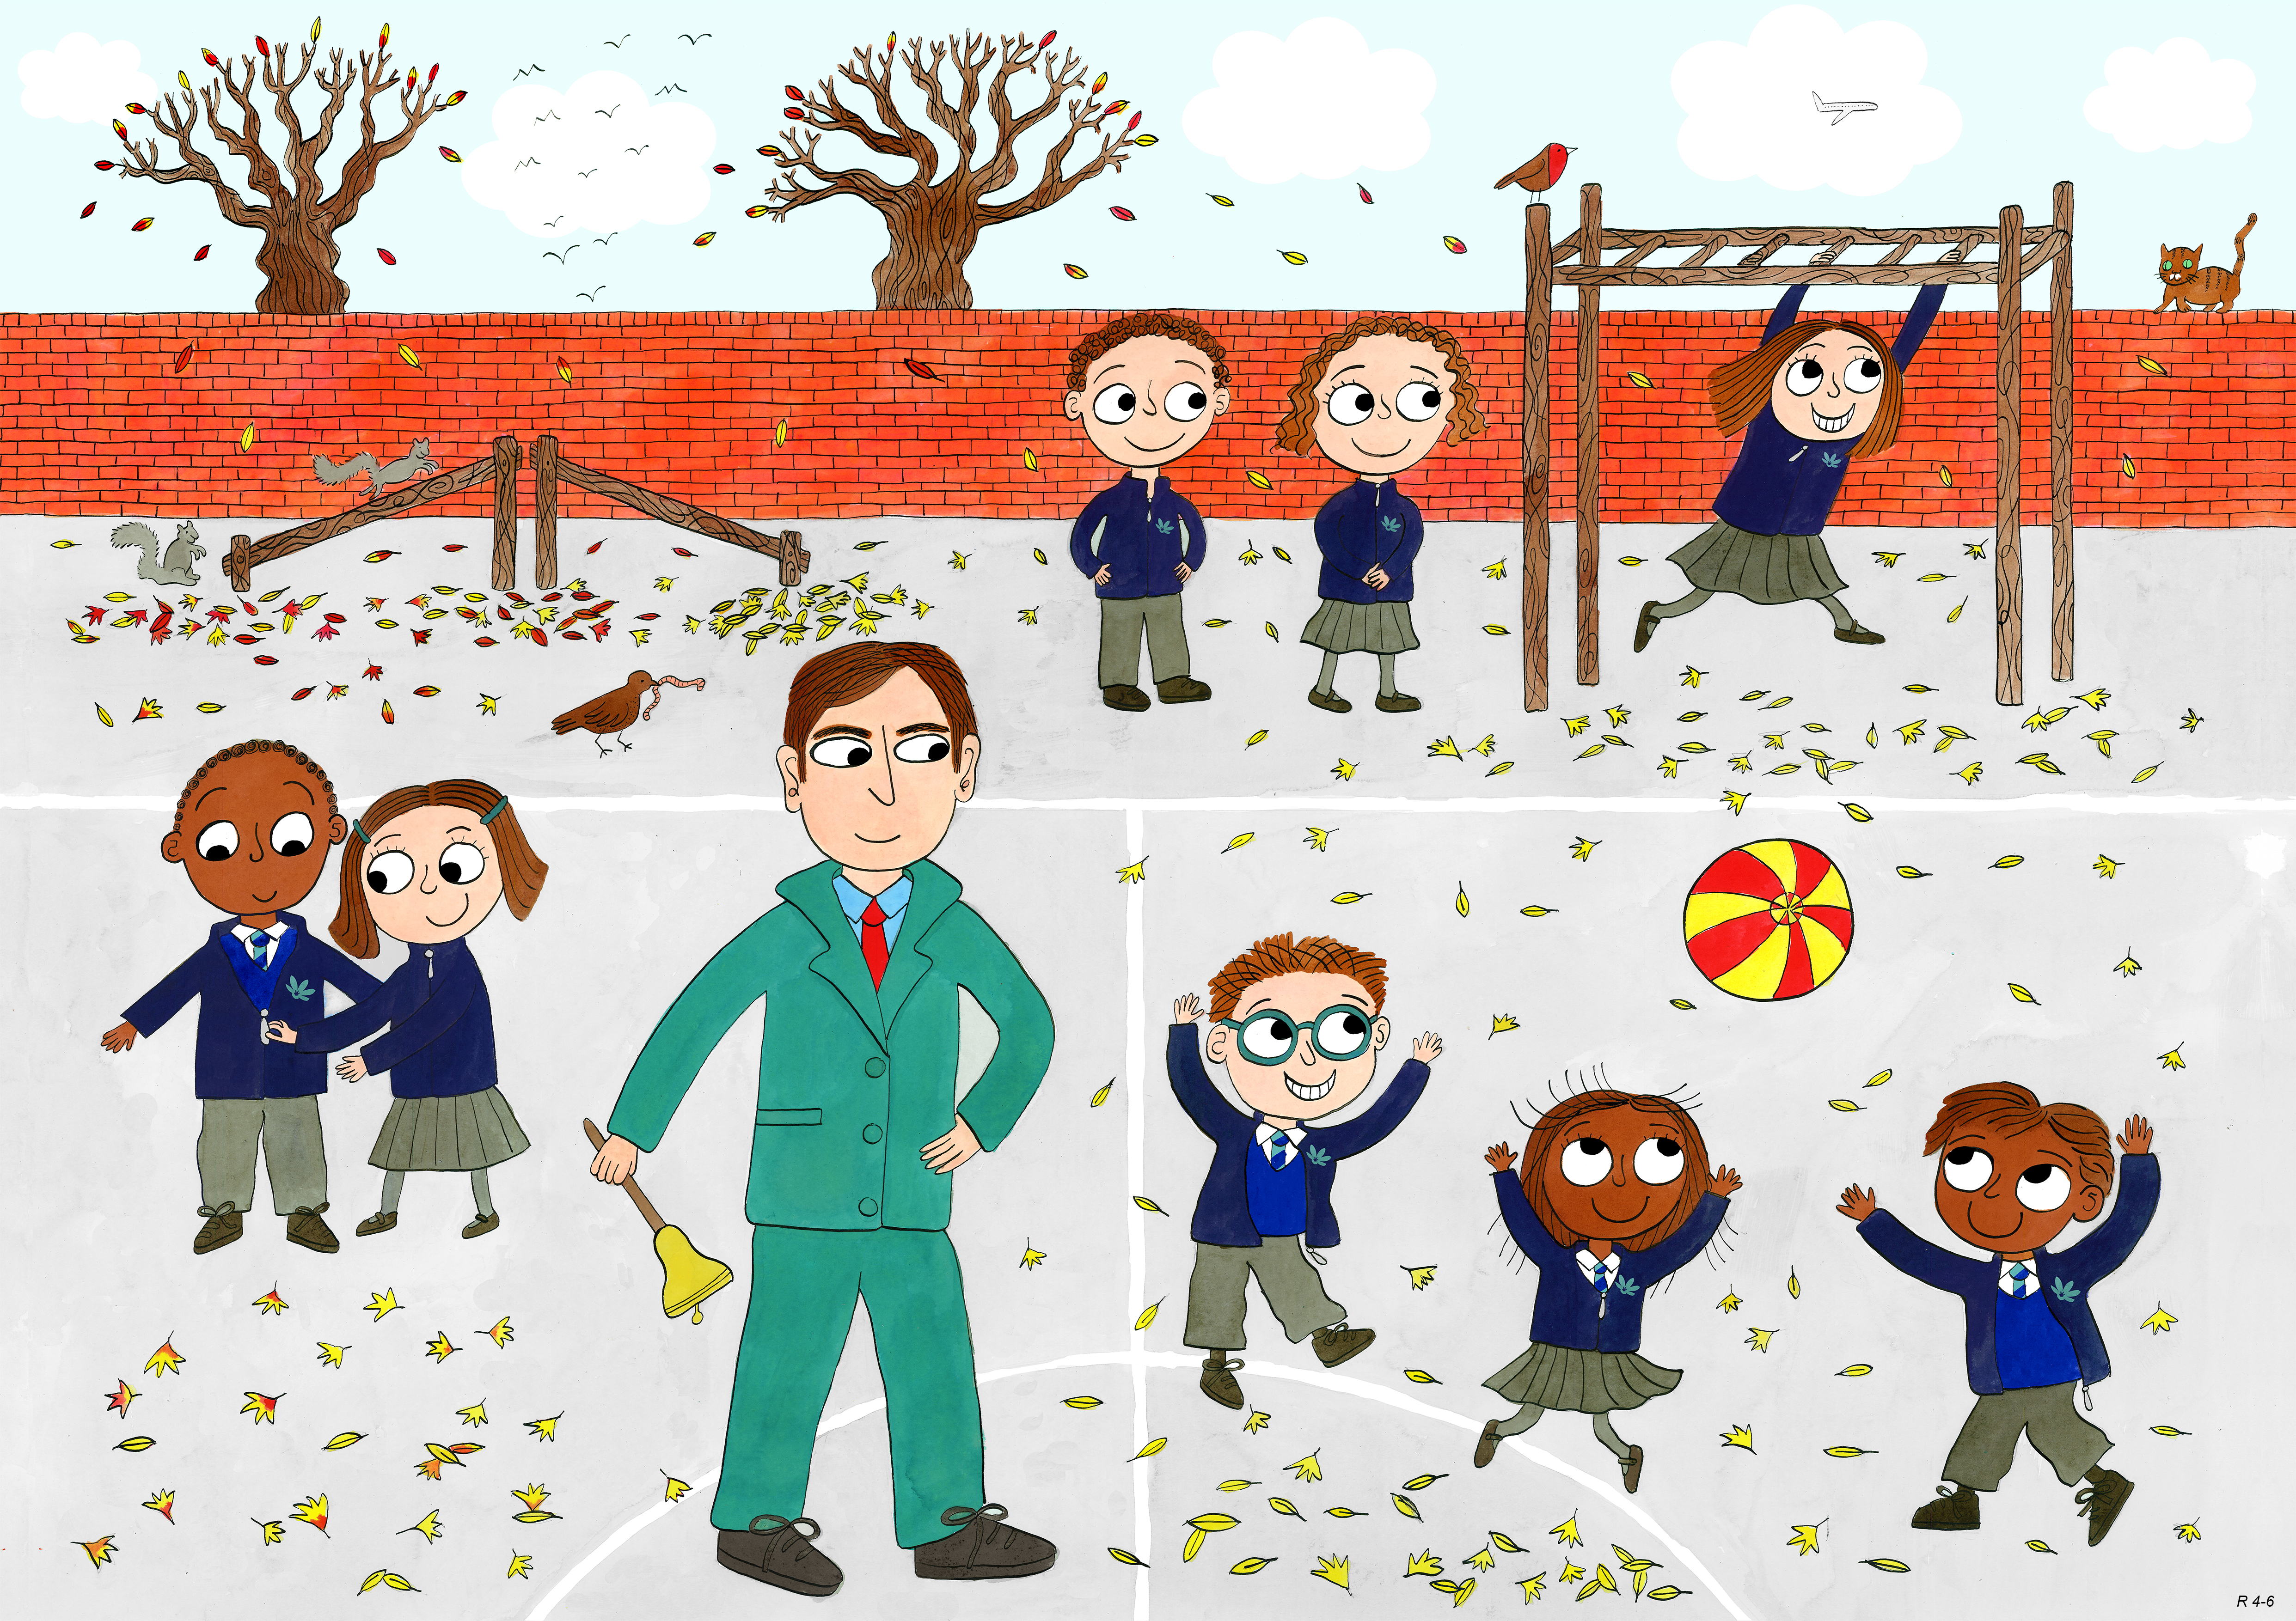
Reception: Autumn 2
Leadership and Teamwork, Fairness, Service

Slide 2
How can we serve others every day?

Slide 3

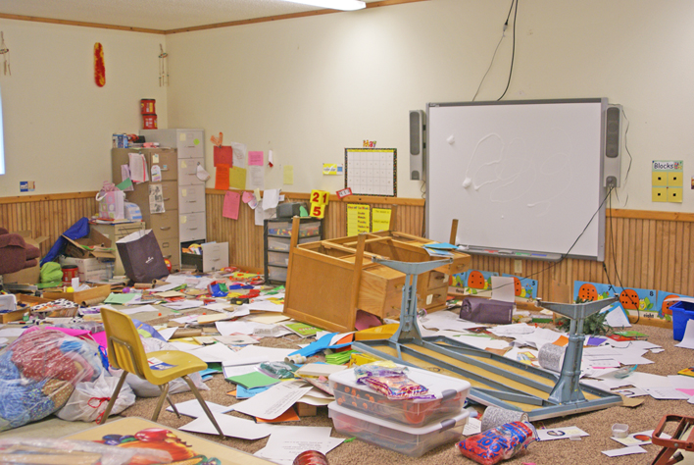
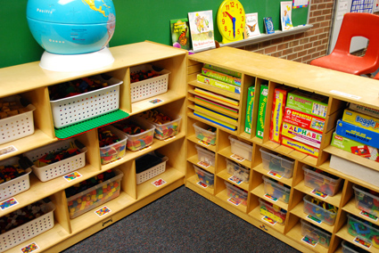
Which do you prefer, and why?

Slide 4
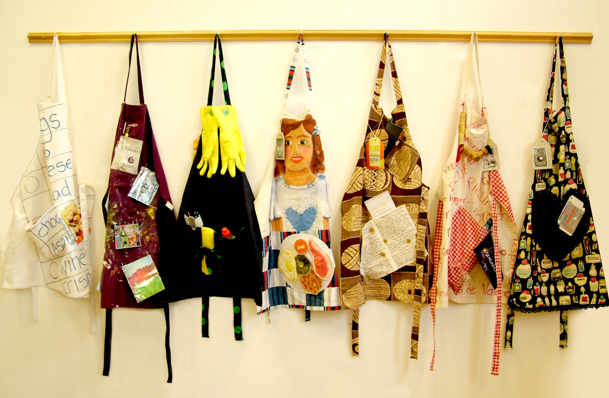
How have the children in this class served each other?

Slide 5
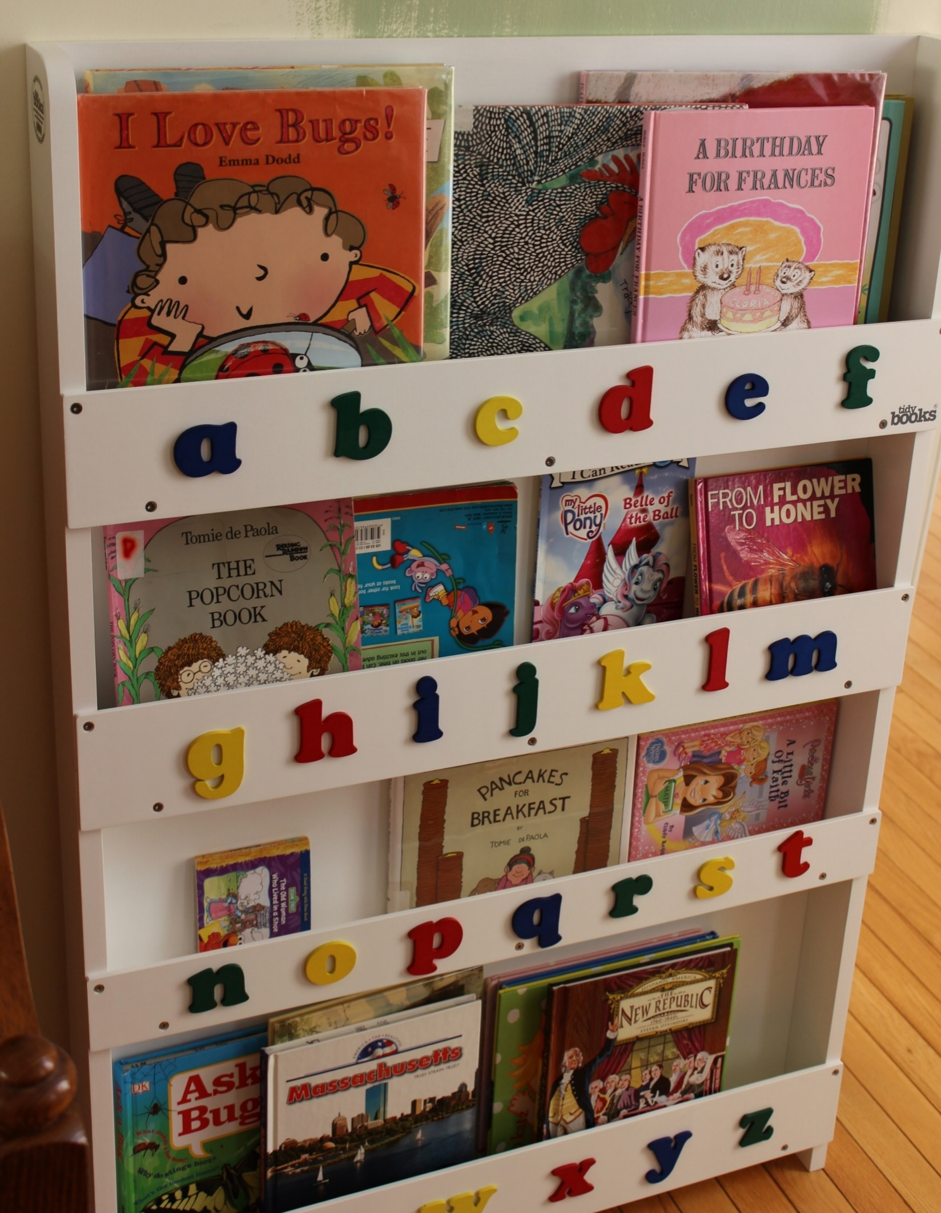
How have the children in this class served each other?

Slide 6
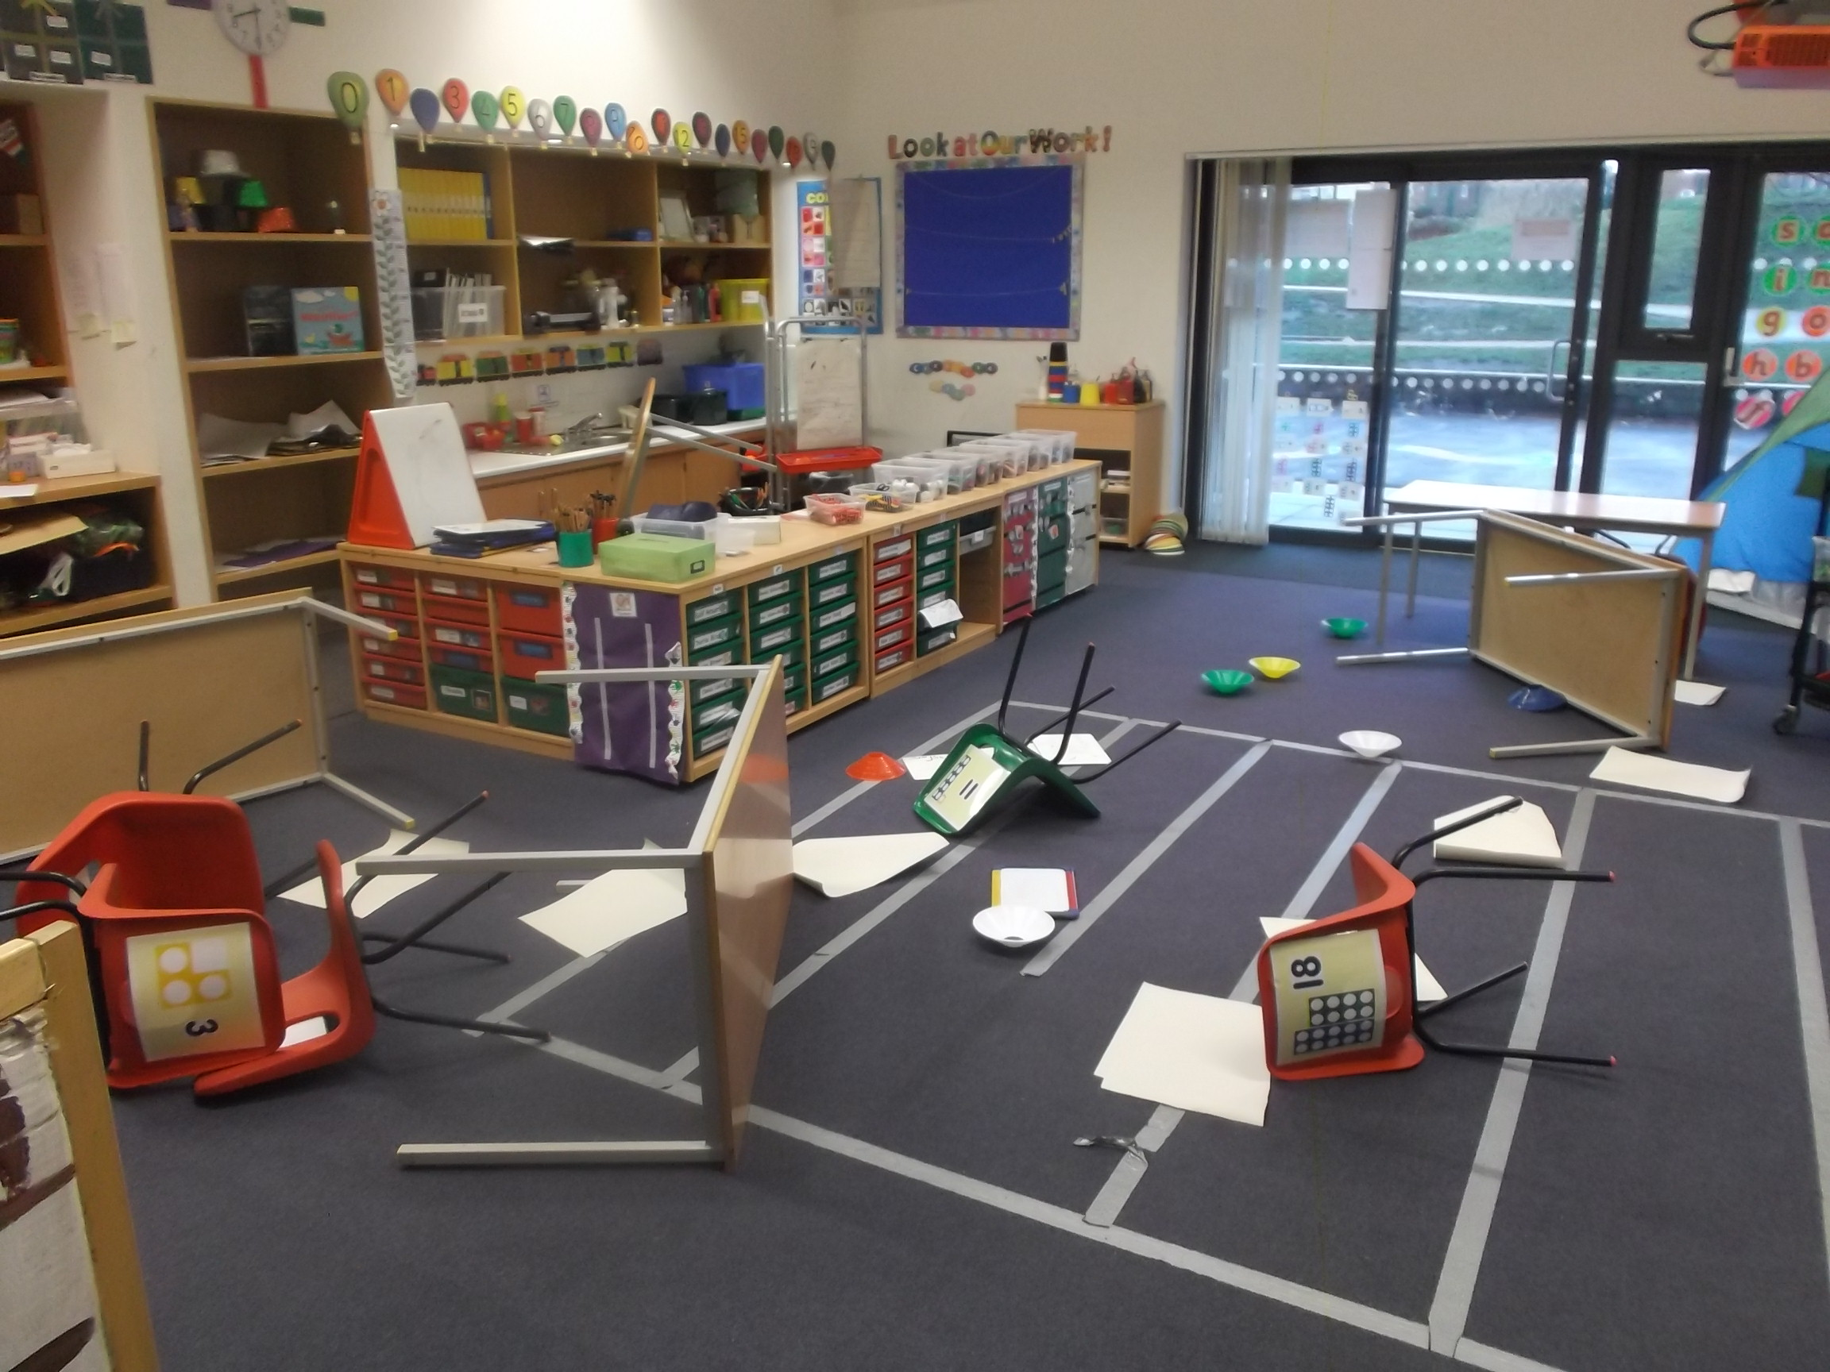
Have this class shown service to others? How does it make you feel?

Slide 7
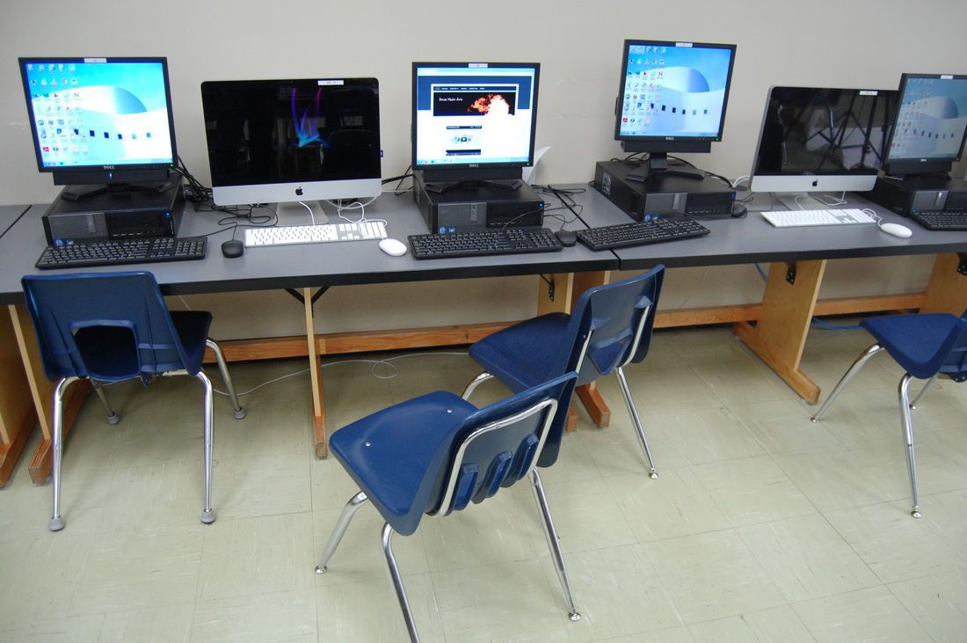
How could this class serve one another better?

Slide 8
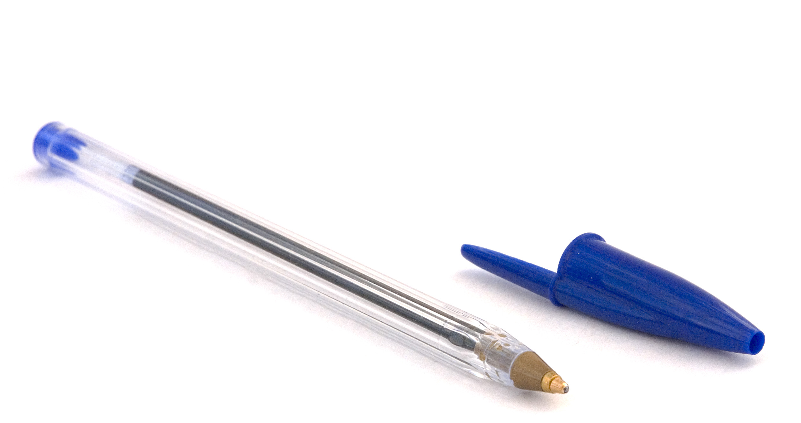
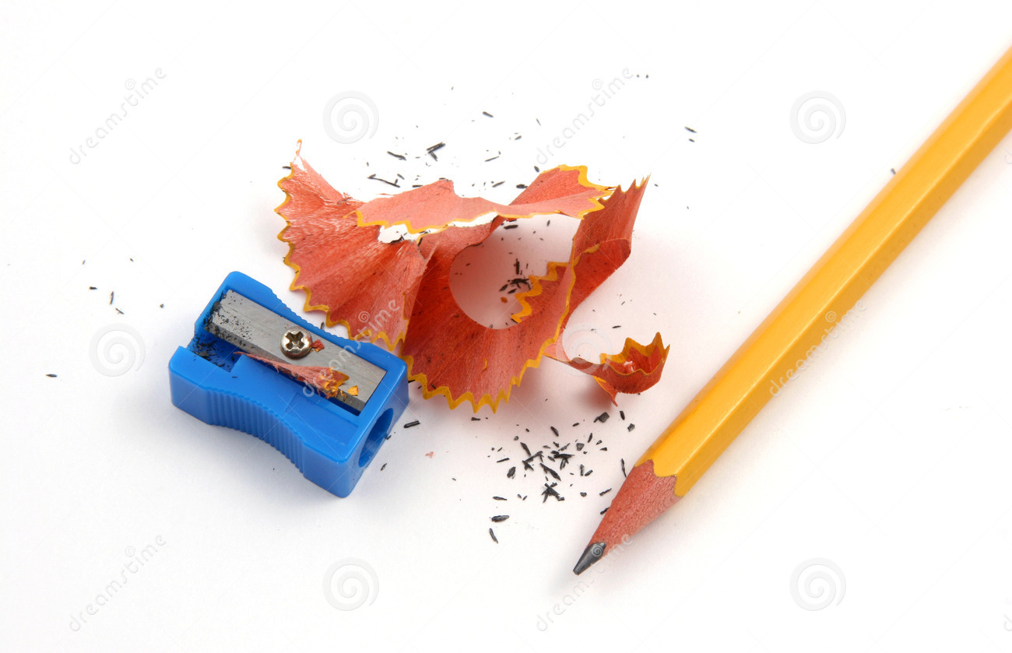
How could you serve your class after sharpening your pencil?

Slide 9
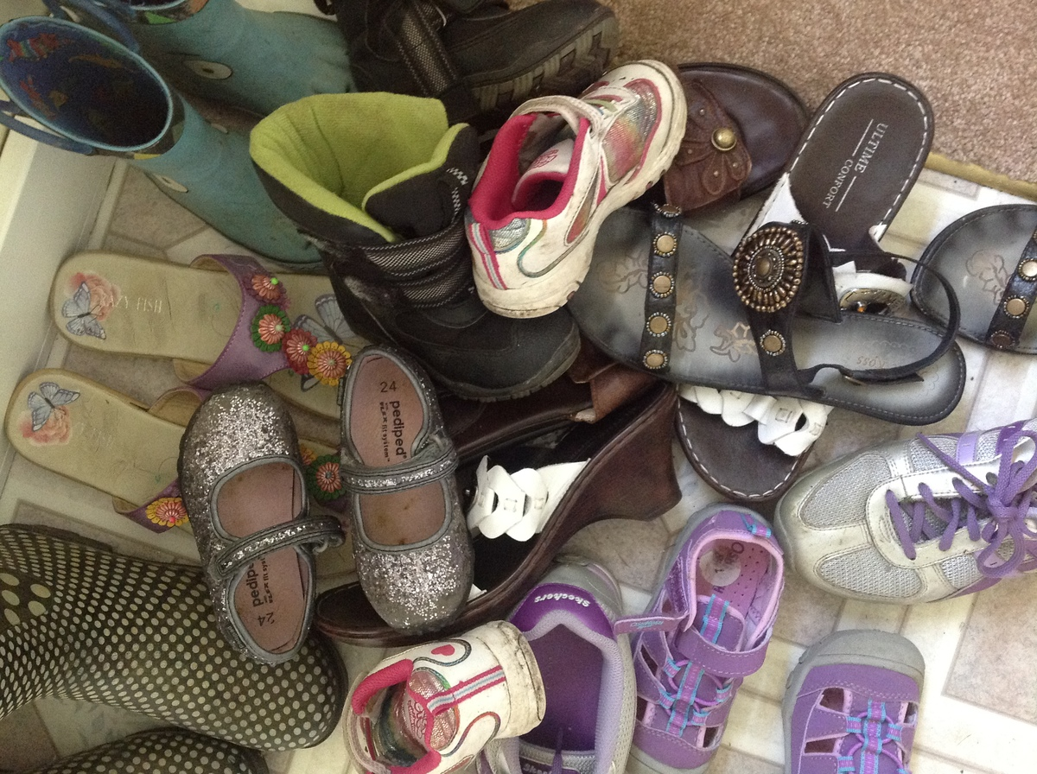
How could you serve your class if this was on the floor?

Slide 10
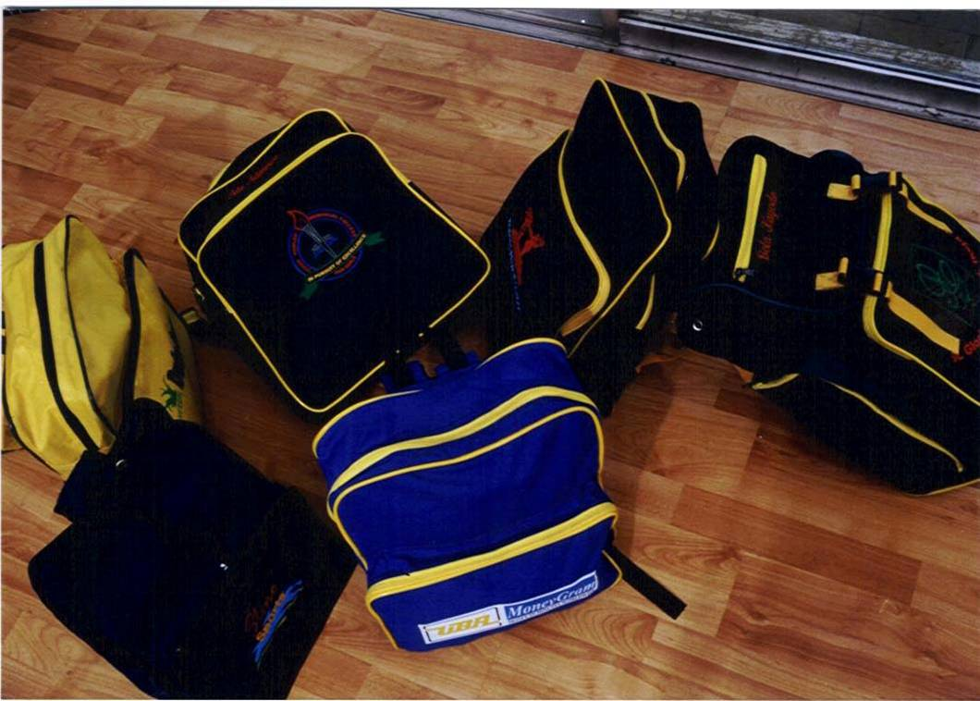
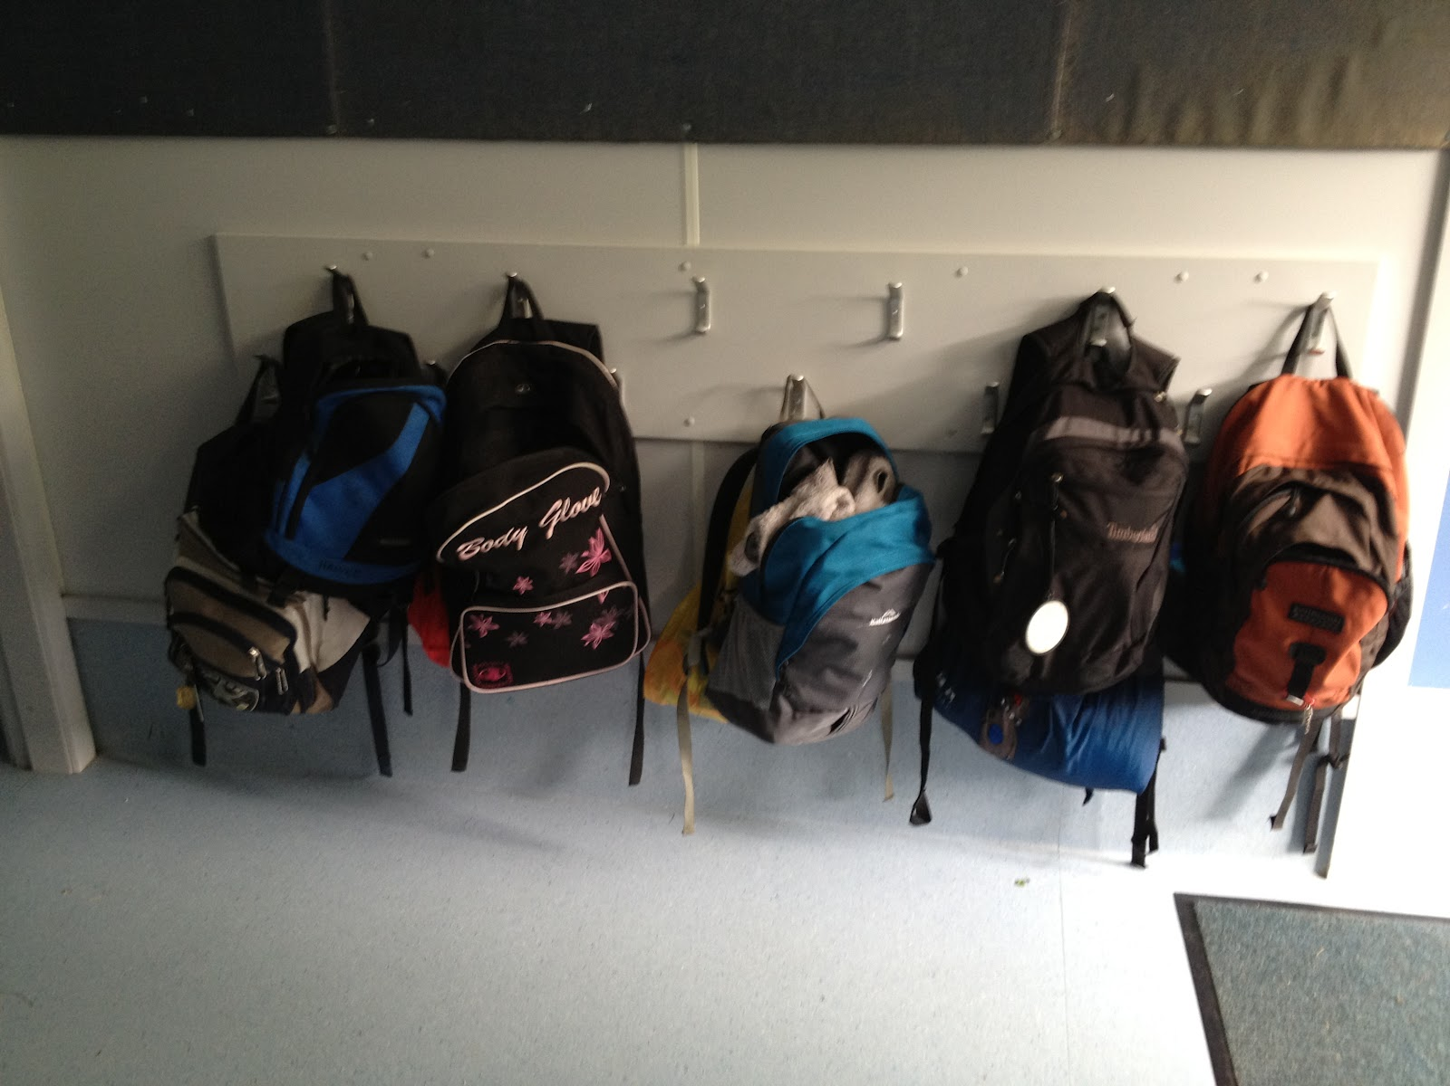
Which of these classes has been considerate of others?

Slide 11
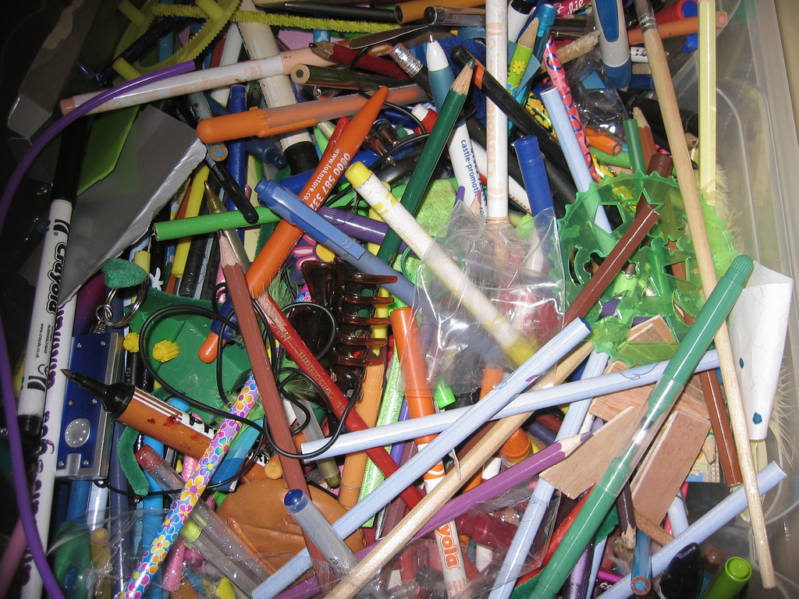

Which class has shown service to others?
Which is do you like best?

Slide 12
Which do you prefer, and why?

Slide 13
Should he need to do this?

