Slide 1

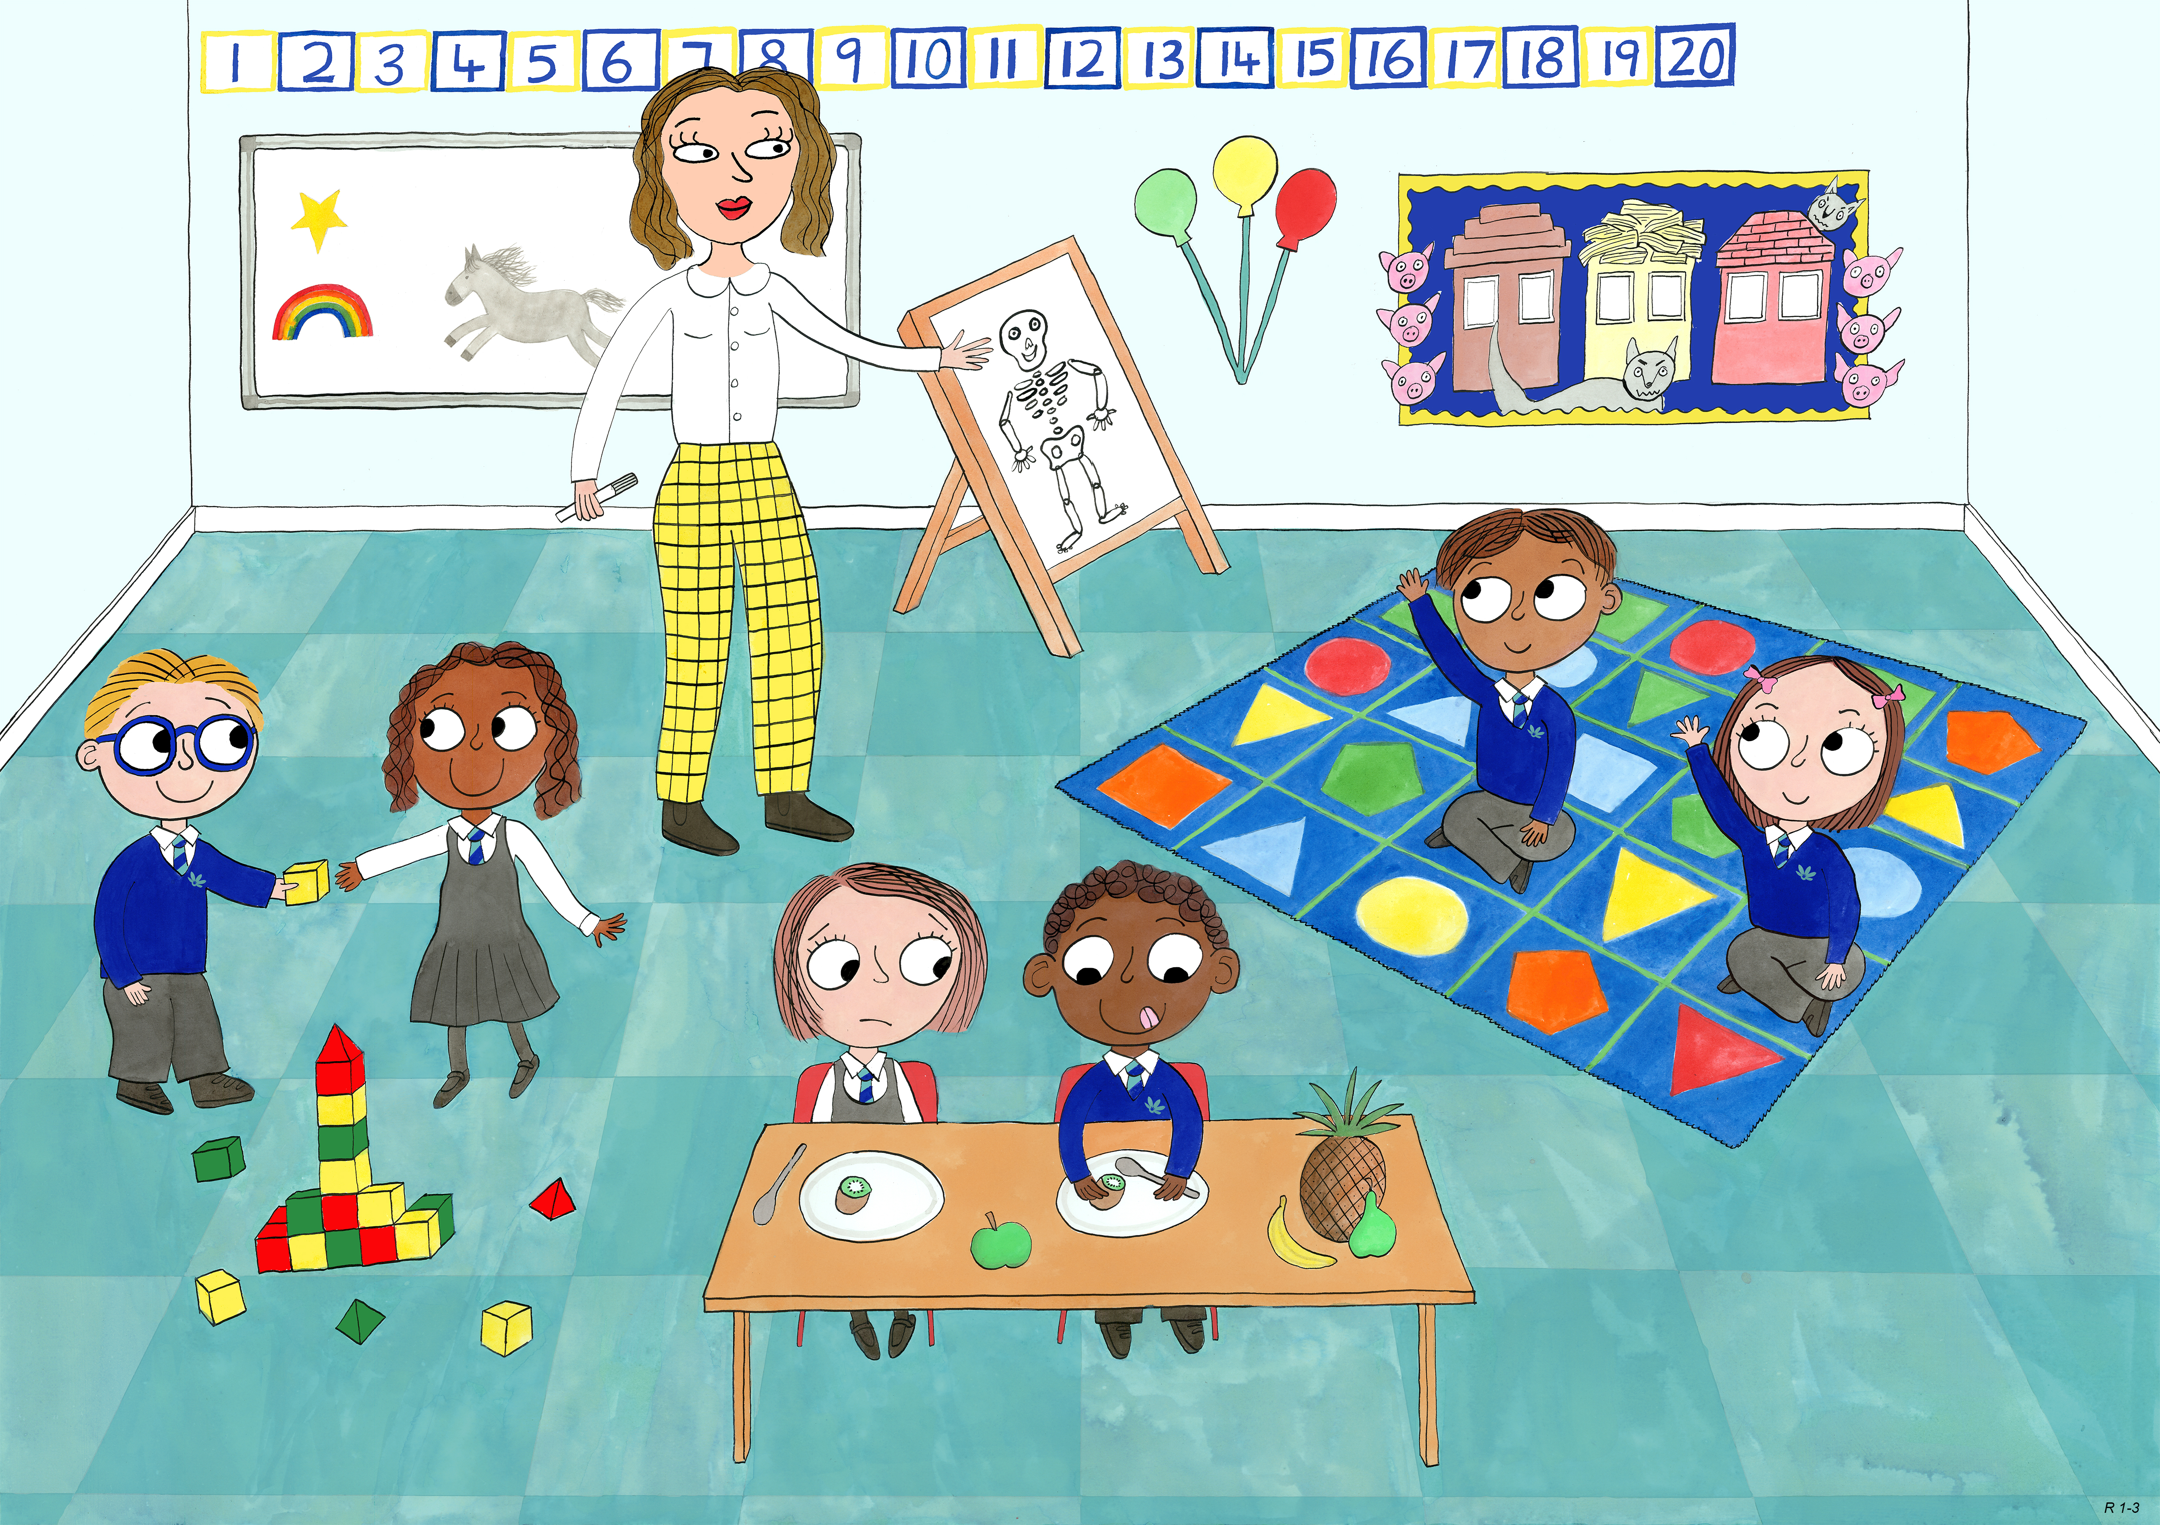
Reception: Autumn 1
Self Control, Bravery, Love and Kindness.

