Slide 1

Service Learning Project
Morning stimulus resources – Gratitude Tea Party

Slide 2
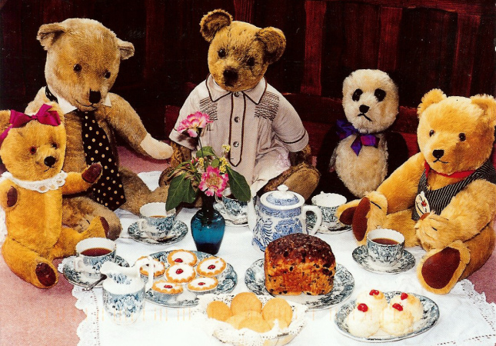
Stimulus theme: Teddy bears’ tea party
What is happening in the picture ?
What can you see on the table?
Notes for the Teacher:
The idea of afternoon tea first came about in the Victorian era when it was fashionable to have dinner at 8pm. Finding that she was hungry in the afternoon, the Duchess of Bedford, a friend of Queen Victoria, asked for a small selection of sandwiches and cakes to be brought to her bedroom with a pot of tea as a snack. Initially she took tea privately, but when she invited friends to join her afternoon tea became a popular occasion.
Tea was an expensive delicacy and it would be served in small highly decorated china cups.

Slide 4
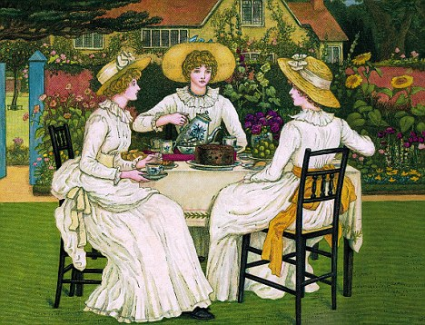
Stimulus theme: Victorian afternoon tea
How do you think the people in the picture feel?
Whose party do you think this is?
How can you tell?
Notes for the Teacher:
The idea of afternoon tea first came about in the Victorian era when it was fashionable to have dinner at 8pm. Finding that she was hungry in the afternoon, the Duchess of Bedford, a friend of Queen Victoria, asked for a small selection of sandwiches and cakes to be brought to her bedroom with a pot of tea as a snack. Initially she took tea privately, but when she invited friends to join her afternoon tea became a popular occasion.
Tea was an expensive delicacy and it would be served in small highly decorated china cups.

Slide 6
What is similar in the two pictures?
What differences can you see?

Slide 7
Stimulus theme: Alice’s Adventures in Wonderland
Click on the link https://www.youtube.com/watch?v=Tzqs1aRyCkw or go to www.youtube.com and type ‘Tea Party Scene – Alice in Wonderland’ into the search bar to find a 10 minute clip from the 1999 film.
Resources 2a and 2b are provided as visual prompts if the story is revisited.
Pause at 0.36:
Is it true there is no room?
What do you think of the way they have acted?
How do you think this made Alice feel?
What could the March Hare and Hatter have said instead?
Notes for the Teacher:
‘Alice’s Adventures in Wonderland’ by Lewis Carroll was first published in 1865.
The story follows the adventures of Alice when she falls down a rabbit hole into a fantasy world.
Famously Alice has a tea party with the March Hare, the Hatter and a very sleepy Dormouse where she gets very cross about the rudeness, endless riddles and nonsense ramblings of the other guests. The Hatter explains that Time was punishing him by stopping at 6pm and keeping him in perpetual teatime.
Play the video again and stop at 1:26:
Would you like to be a guest at this party? Why/ not?
How do you think Alice feels when the March Hare and Hatter are laughing?
Did Alice show good manners? Did she do anything rude?

Slide 8
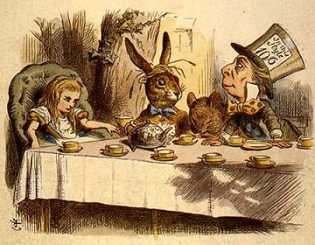

Slide 9
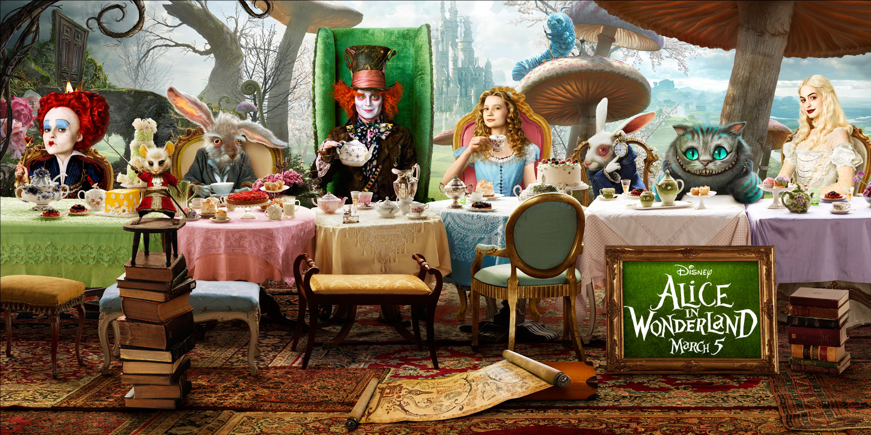
Stimulus Theme 2: 2cAlice’s Adventures in Wonderland

Slide 10
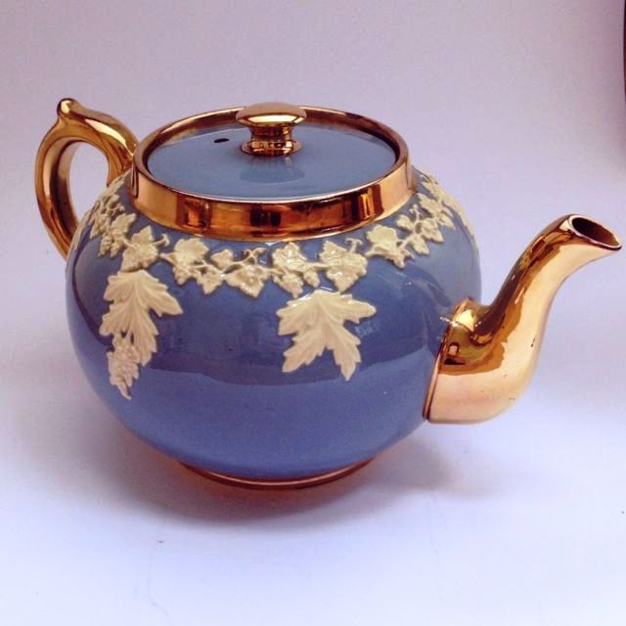
Stimulus theme: Tea in China
Look at a map or globe and show the class them where England is. Then show them where China is. Compare the sizes of the two countries.
How might we get there?
How long would it take?
What do you notice about the teapot?
Who do you think it belongs to?
Notes for the Teacher:
China is the world’s largest producer of tea. (India is the second largest).
In China pouring tea for someone is a sign of great respect and good will.
Serving tea is an important part of traditional Chinese marriage ceremonies as sharing tea together helps to connect the families.
Tea in Chinese weddings is often served in red cups and teapots because red is seen as a lucky colour in China.
Chinese Tea Ballads are traditional Chinese songs which celebrate the beauty of nature. They are modern versions of the simple field songs of the Chinese tea pickers.

Slide 12
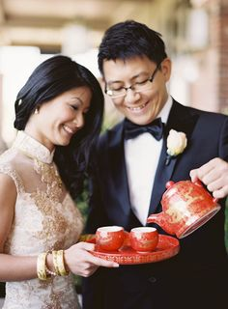
What could be happening in the picture?
Who do you think these people are?
Notes for the Teacher:
China is the world’s largest producer of tea. (India is the second largest).
In China pouring tea for someone is a sign of great respect and good will.
Serving tea is an important part of traditional Chinese marriage ceremonies as sharing tea together helps to connect the families.
Tea in Chinese weddings is often served in red cups and teapots because red is seen as a lucky colour in China.
Chinese Tea Ballads are traditional Chinese songs which celebrate the beauty of nature. They are modern versions of the simple field songs of the Chinese tea pickers.

Slide 13
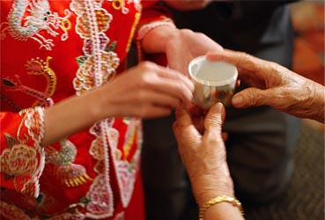

Slide 14
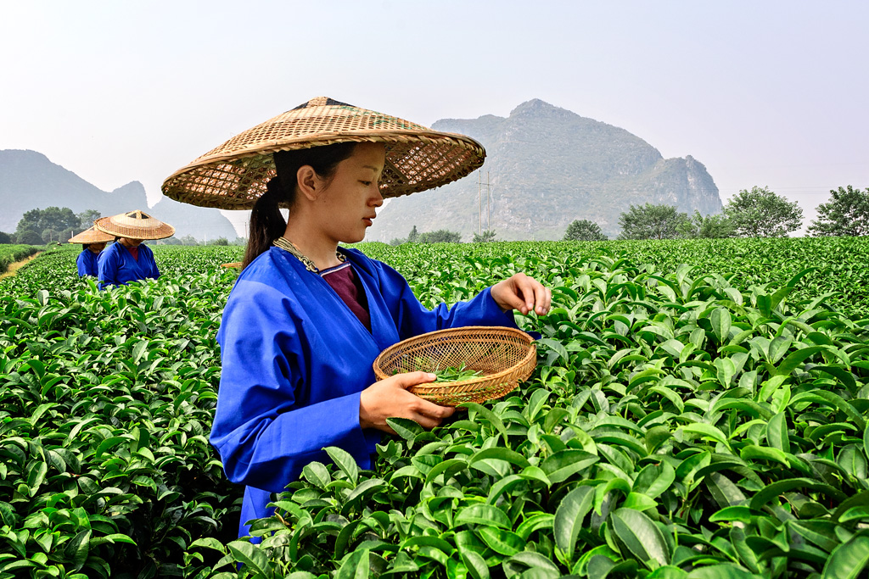
Stimulus theme: Tea Picking
What can you tell about this place from the picture?
Where could this be?
What do you think she is doing?
Notes for the Teacher:
China is the world’s largest producer of tea. (India is the second largest).
In China pouring tea for someone is a sign of great respect and good will.
Serving tea is an important part of traditional Chinese marriage ceremonies as sharing tea together helps to connect the families.
Tea in Chinese weddings is often served in red cups and teapots because red is seen as a lucky colour in China.
Chinese Tea Ballads are traditional Chinese songs which celebrate the beauty of nature. They are modern versions of the simple field songs of the Chinese tea pickers.

Slide 16
Song: I’m a Little Teapot
https://www.youtube.com/watch?v=qMjTZjAP1TQ
I’m a little teapot short and stout
Here’s my handle, here’s my spout.
When I get all steamed up hear me shout
tip me over and pour me out.
I’m a clever teapot, yes it’s true
Here let me show you what I can do.
I can change my handle and my spout
Just tip me over and pour me out.

