Slide 1

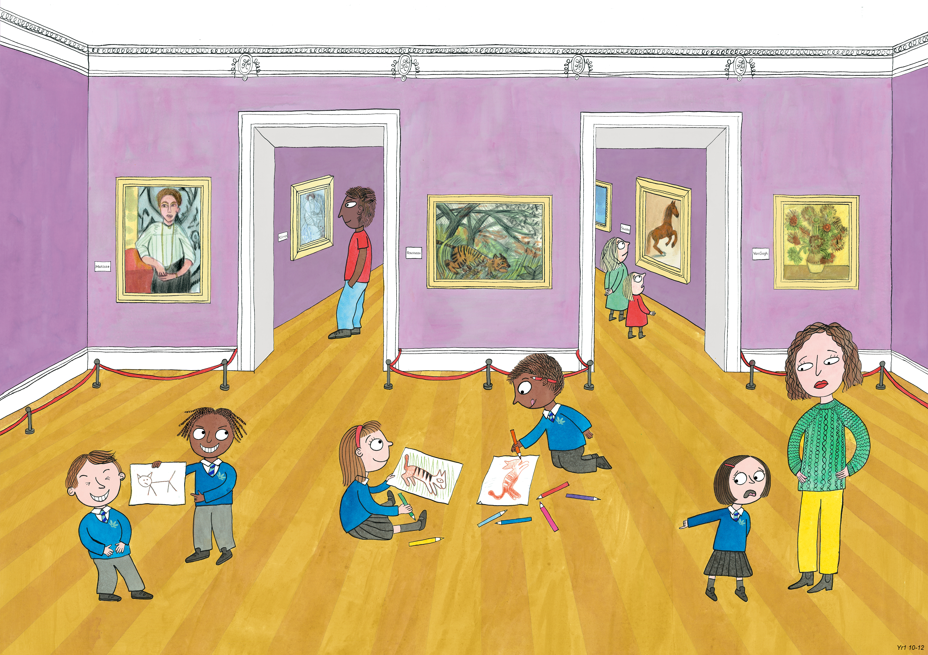
Year 1 Spring 2
Creativity, Honesty, Humour

Slide 2
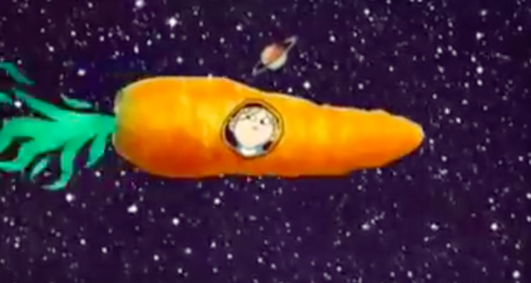
Orange twiglets from Jupiter
What do you think Charlie had been studying in school that week?

Slide 3
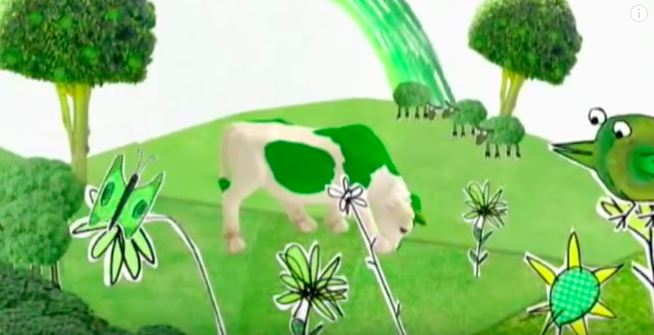
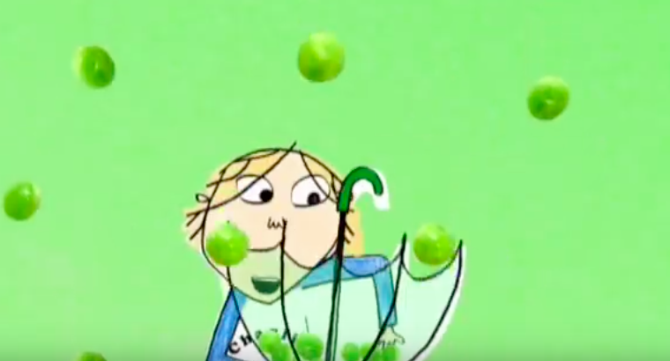
Greendrops from Greenland
There really is a country called Greenland (though everything isn’t green!). In which subject would Charlie have learned about Greenland?

Slide 5
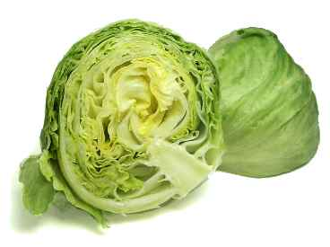

Slide 7
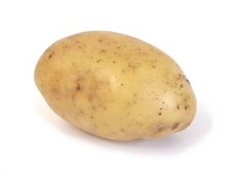

Slide 8
