Slide 1

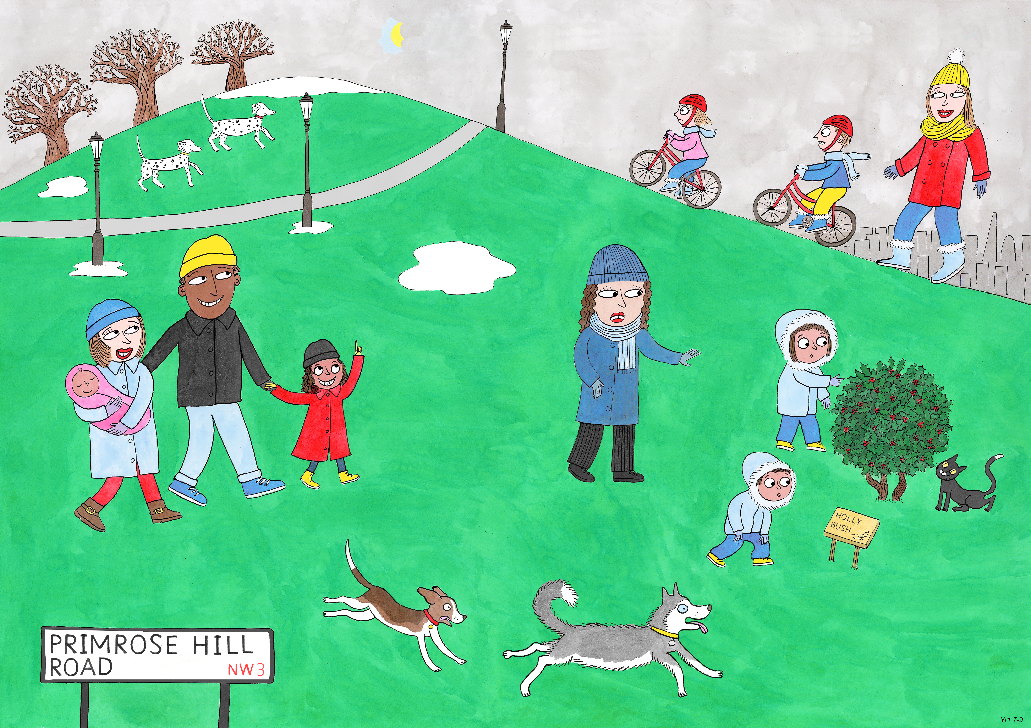
Year 1: Spring 1
Perseverance, Optimism and Joy, Curiosity

Slide 2
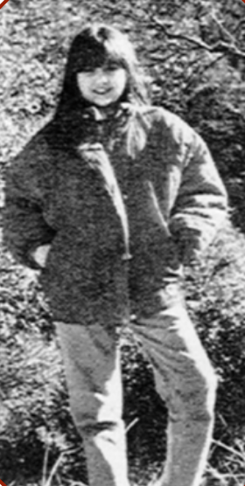
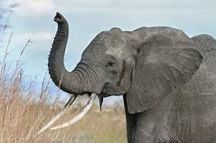
Kids Save the Elephants and Rhinos

Slide 3

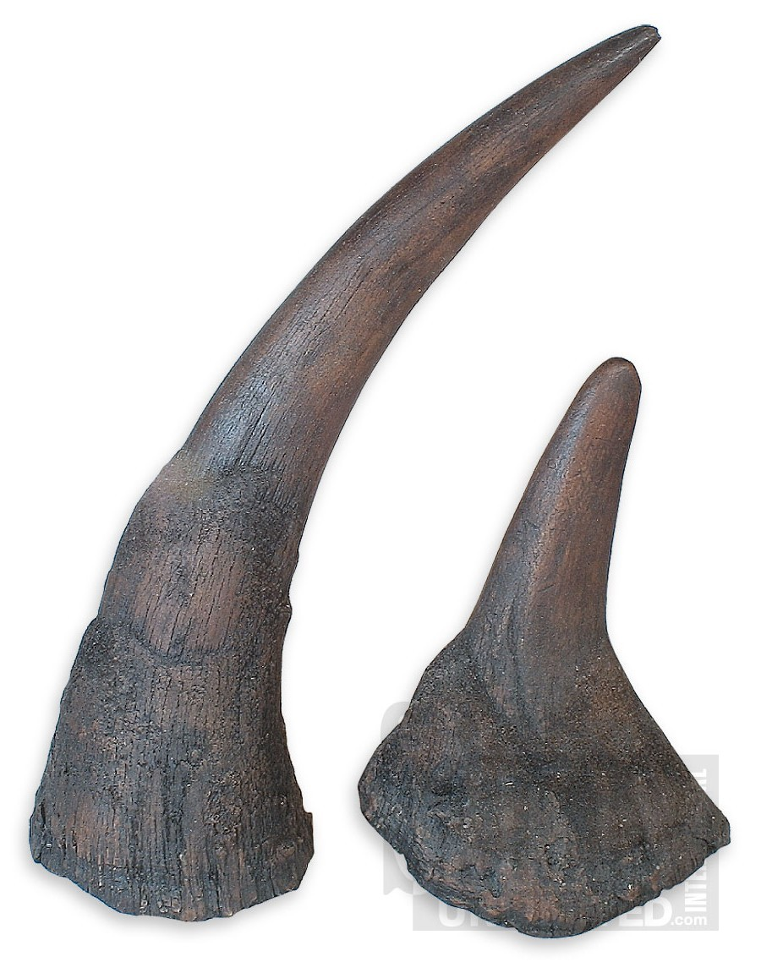
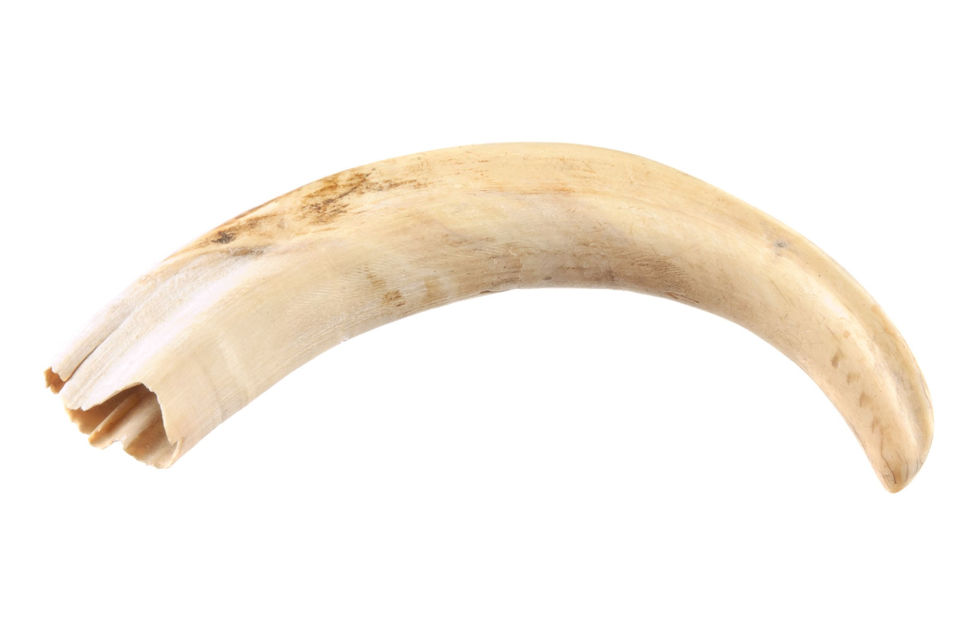
When Melanie Essary was seven years old , she learnt that elephants and rhinos were being killed.
‘Why?’ she asked her teacher.
‘People want their ivory and their horns.’ Her teacher told her.
Melanie learnt that people were shooting these animals in Africa and selling their tusks and horns for a lot of money. Melanie was very upset to learn about this and she wanted to find out more.

Slide 4


Melanie decided to do some research.
She watched a programme on the television about animals that are becoming extinct.
Then Melanie read a book about elephants and rhinos which helped her to understand more about what was happening.

Slide 5



Melanie discovered that the leaders of most countries in the world had signed a piece of paper to agree that tusks and horns could not be sold in their countries.
But as long as they could be sold somewhere the animals were still being killed.

Slide 6
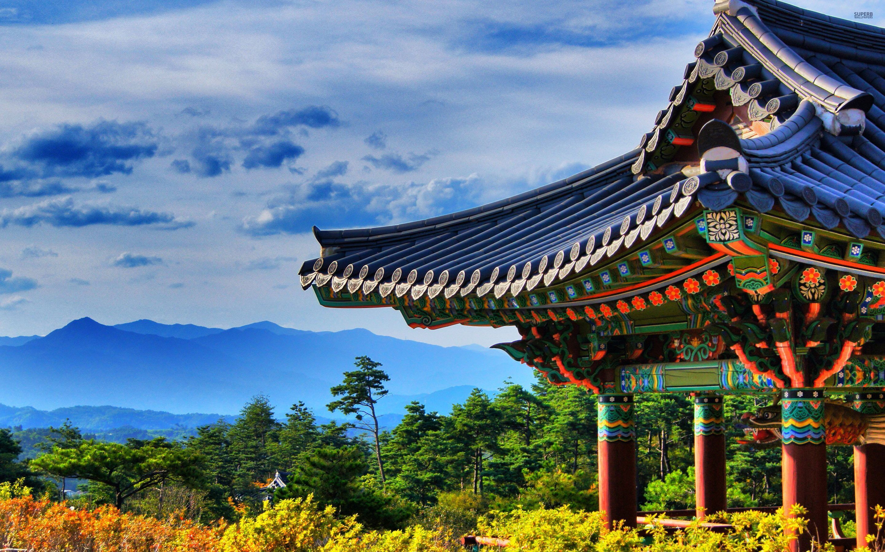
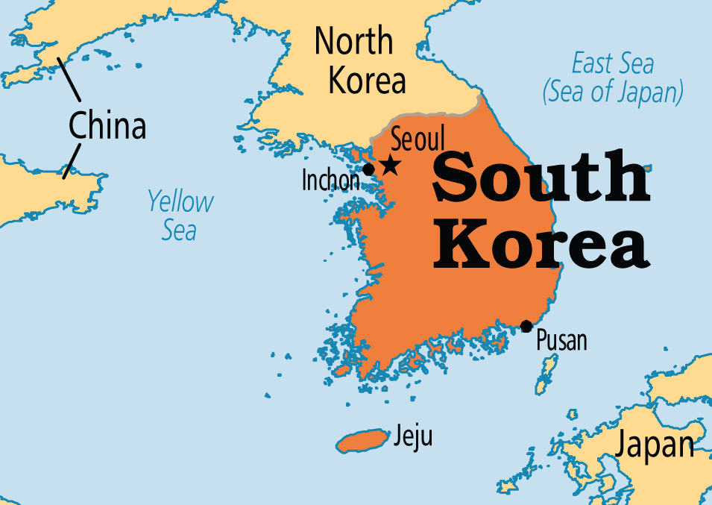

Melanie learnt that because the leaders of Korea had not signed the promise, most of the tusks and horns were being taken to Korea and then sold for lots of money.

Slide 7
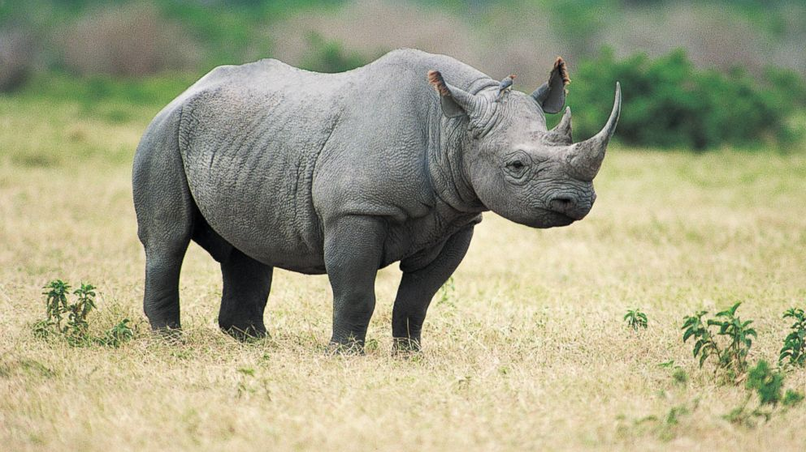

Melanie wanted to do something about that, so she started a club called Kids Save the Elephants and Rhinos.
What do you think they did?

Slide 8


Melanie and her friends got the address of the President of Korea.
They all wrote him letters asking him to sign the promise not to buy tusks and horns. Then Melanie wrote to newspapers and magazines and television stations.
She asked children everywhere to send letters to the President of Korea about the elephants and rhinos that were dying.

Slide 9
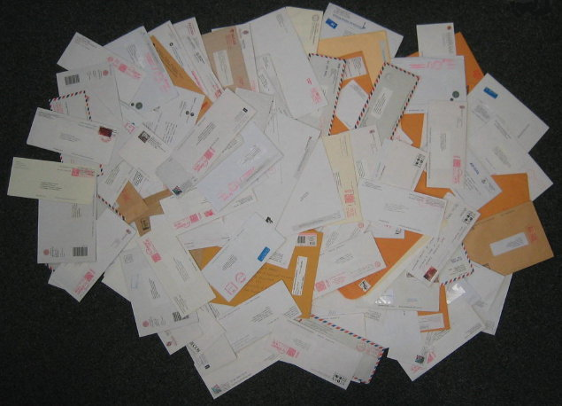
Soon, thousands of letters were piling up in the President’s office in Korea. The biggest newspaper in Korea even printed a message from Melanie’s club on the front page!

Slide 10
The President was getting cross. He asked someone to tell Melanie to stop the letters. Melanie said she would keep sending the letters until the President signed the promise.
So Melanie and her friends kept writing letters…

Slide 11

Until one day they got a letter back, all the way from Korea.
What could it be?

Slide 12


Melanie opened it. It was the promise, signed by the Korean President!

Slide 13
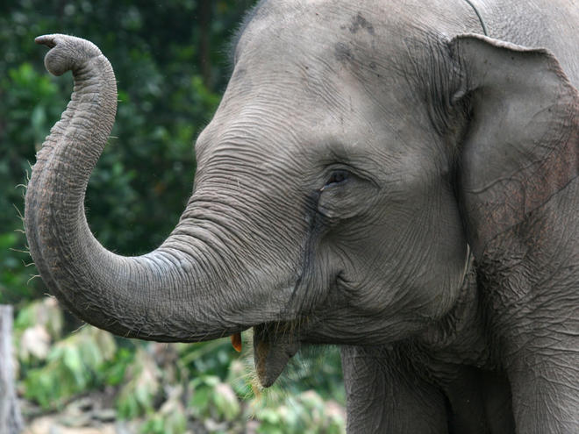
Lots of grown ups had tried to get the Korean President to sign the promise and they had all failed.
A seven year old girl and her friends had succeeded! People were amazed! Melanie’s club got thousands of new members and they still work hard to protect animals and the environment.
All of this happened because one girl was curious about elephants and rhinos!

Slide 14

I think the builder was curious about…

Slide 15

I think the doctor was curious about…

Slide 16
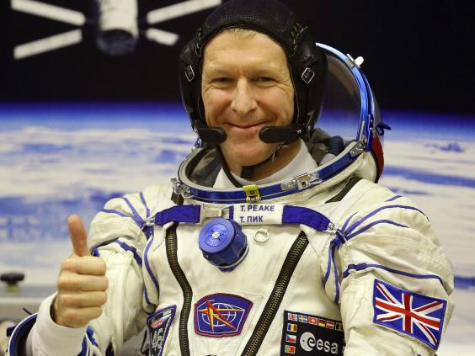
I think the astronaut was curious about…

Slide 17
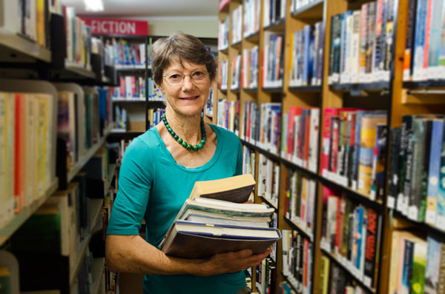
I think the librarian was curious about…

Slide 18
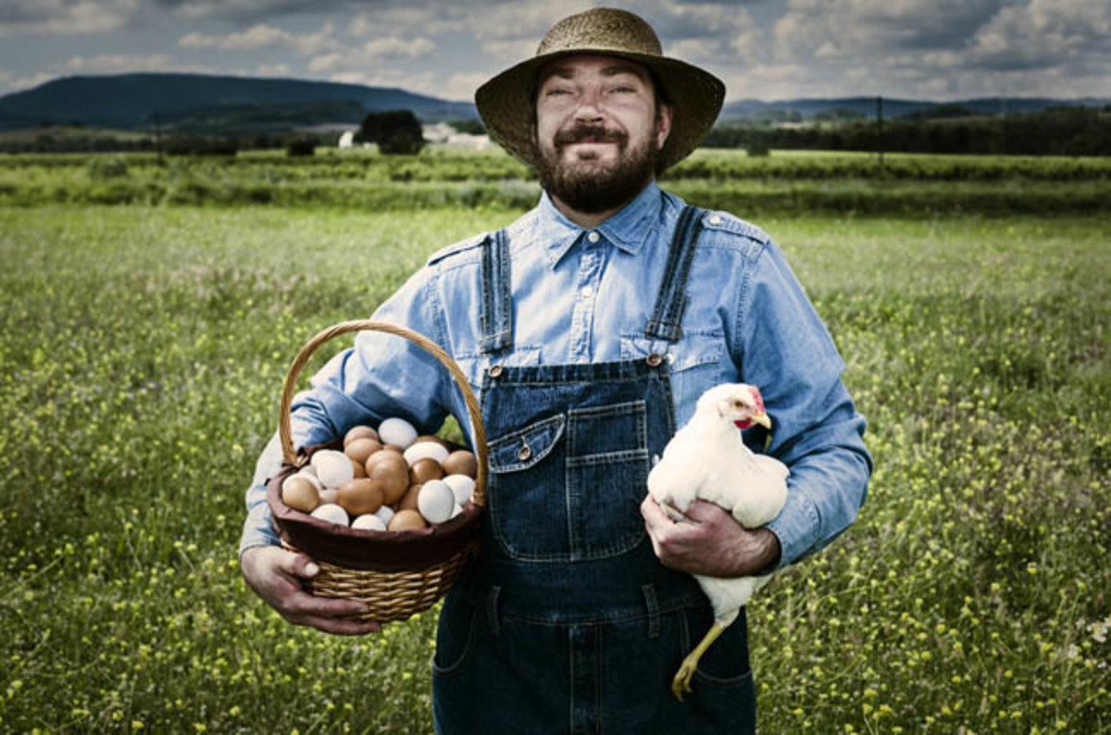
I think the farmer was curious about…

Slide 19
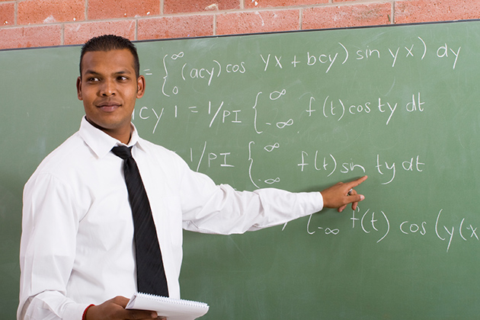
I think the teacher was curious about…

