Slide 1

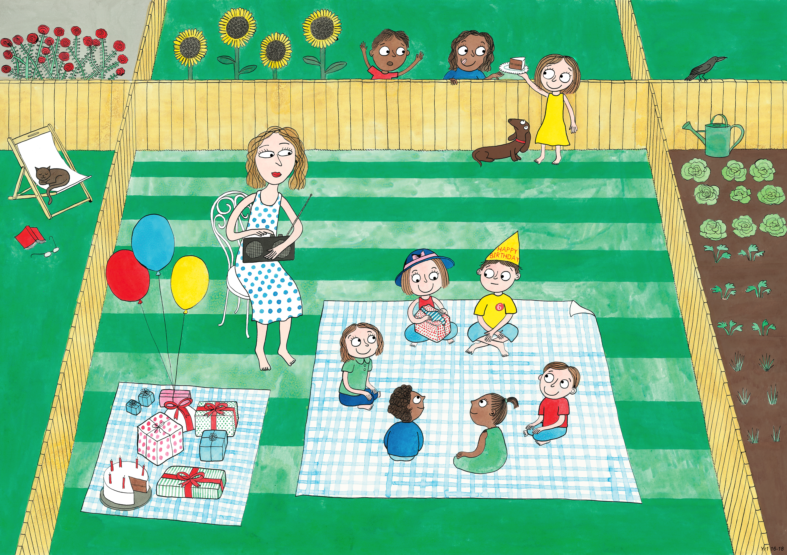
Year 1: Summer 2
Humility, Empathy and Perspective, Gratitude

Slide 2

From my perspective I can see…
Notes:
Ask children to say what they see, in a sentence beginning “From my perspective I can see …..”

Slide 3
From my perspective I can see two faces.
From my perspective I can see a vase.

Slide 4
Now look again.
From a different perspective I can see…
Notes:
Ask children to say what they see, in a sentence beginning “From my perspective I can see …..”

Slide 5

From my perspective I can see…

Slide 6
From my perspective I can see a duck.
From my perspective I can see a rabbit.

Slide 7
Now look again.
From a different perspective I can see…
Notes:
Ask children to say what they see, in a sentence beginning “From my perspective I can see …..”

Slide 8
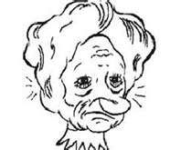
From my perspective I can see…

Slide 9
From my perspective I can see a sad clown.
From my perspective I can see a beautiful princess.

Slide 10
From a different perspective I can see…

Slide 11
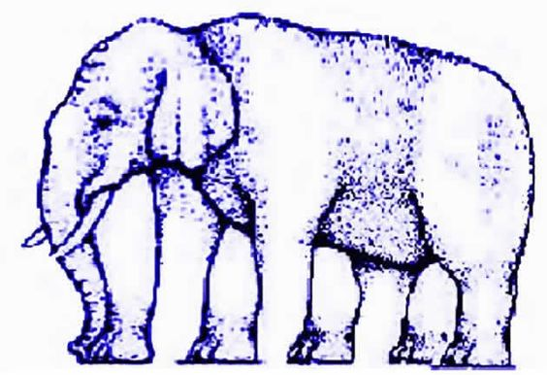
How many legs does the elephant
have?

Slide 12
From my perspective I can see…legs all together.

Slide 13
From a different perspective I can see…legs
all together.

Slide 14

Is the picture really moving?

Slide 15
From my perspective the picture…

Slide 16
From a different perspective the picture...

Slide 17
Is one line longer than the other?

Slide 18
From my perspective...

Slide 19
From a different perspective…

