Slide 1

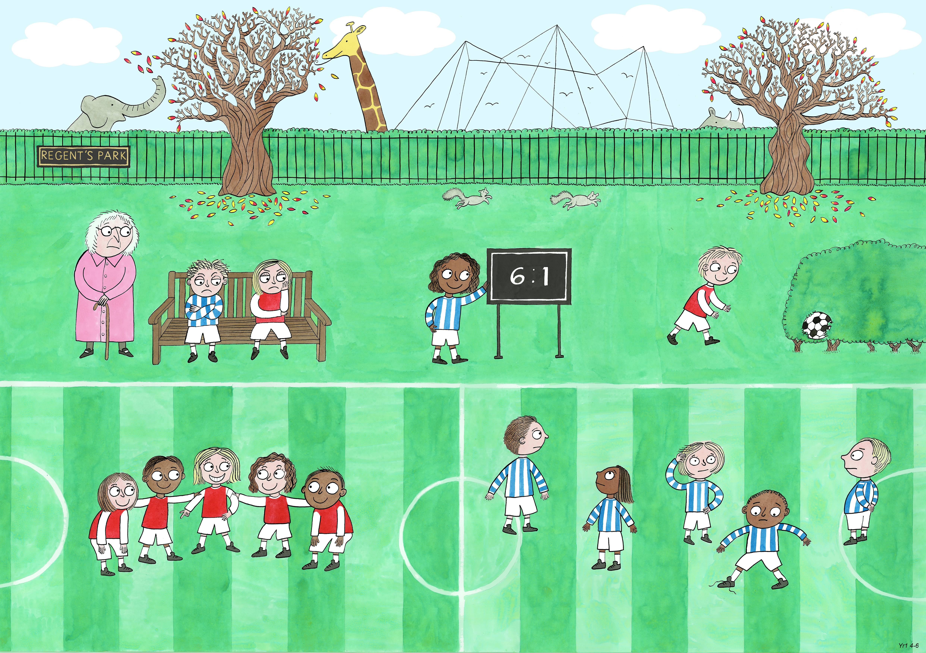
Year 1: Autumn 2
Leadership and Teamwork, Fairness, Service

Slide 2

Fantastic Mr Fox- Summary

Slide 3
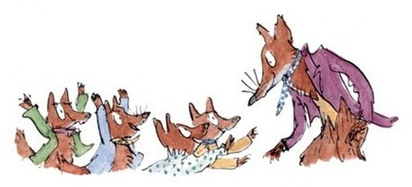
Mr Fox and his family need to eat.

Slide 4
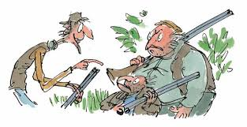
Boggis, Bunce and Bean are farmers. They each make their living keeping chickens, turkeys and geese, and by growing apples to make into cider. Boggis, Bunce and Bean are the meanest and nastiest farmers around!

Slide 5
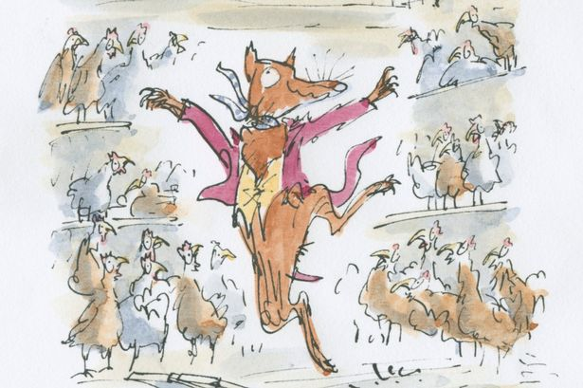
When Mr Fox’s family get hungry, he creeps out in the middle of the night and into the farmers’ storehouses…

Slide 6
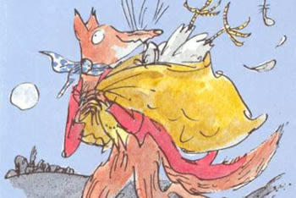
…and fills his bag with chickens to take back for his children’s dinner!

Slide 7
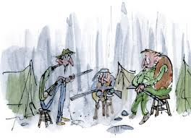
Nasty Boggis, Bunce and Bean destroyed Mr Fox’s home. They wanted to kill Mr Fox and his family and became obsessed with finding ways to catch him.

Slide 8

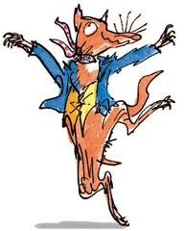
But Fantastic Mr Fox was too smart for them and he carried on feasting on their food!

Slide 9
“It is fair …because…”
“It is not fair…because…”

Slide 10

Is it fair to give one pupil 5/10 on a test and another pupil full marks?

Slide 11
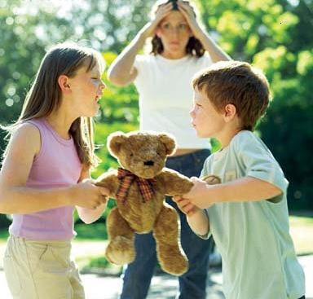
Is it fair to snatch something back if you had it first?

Slide 12
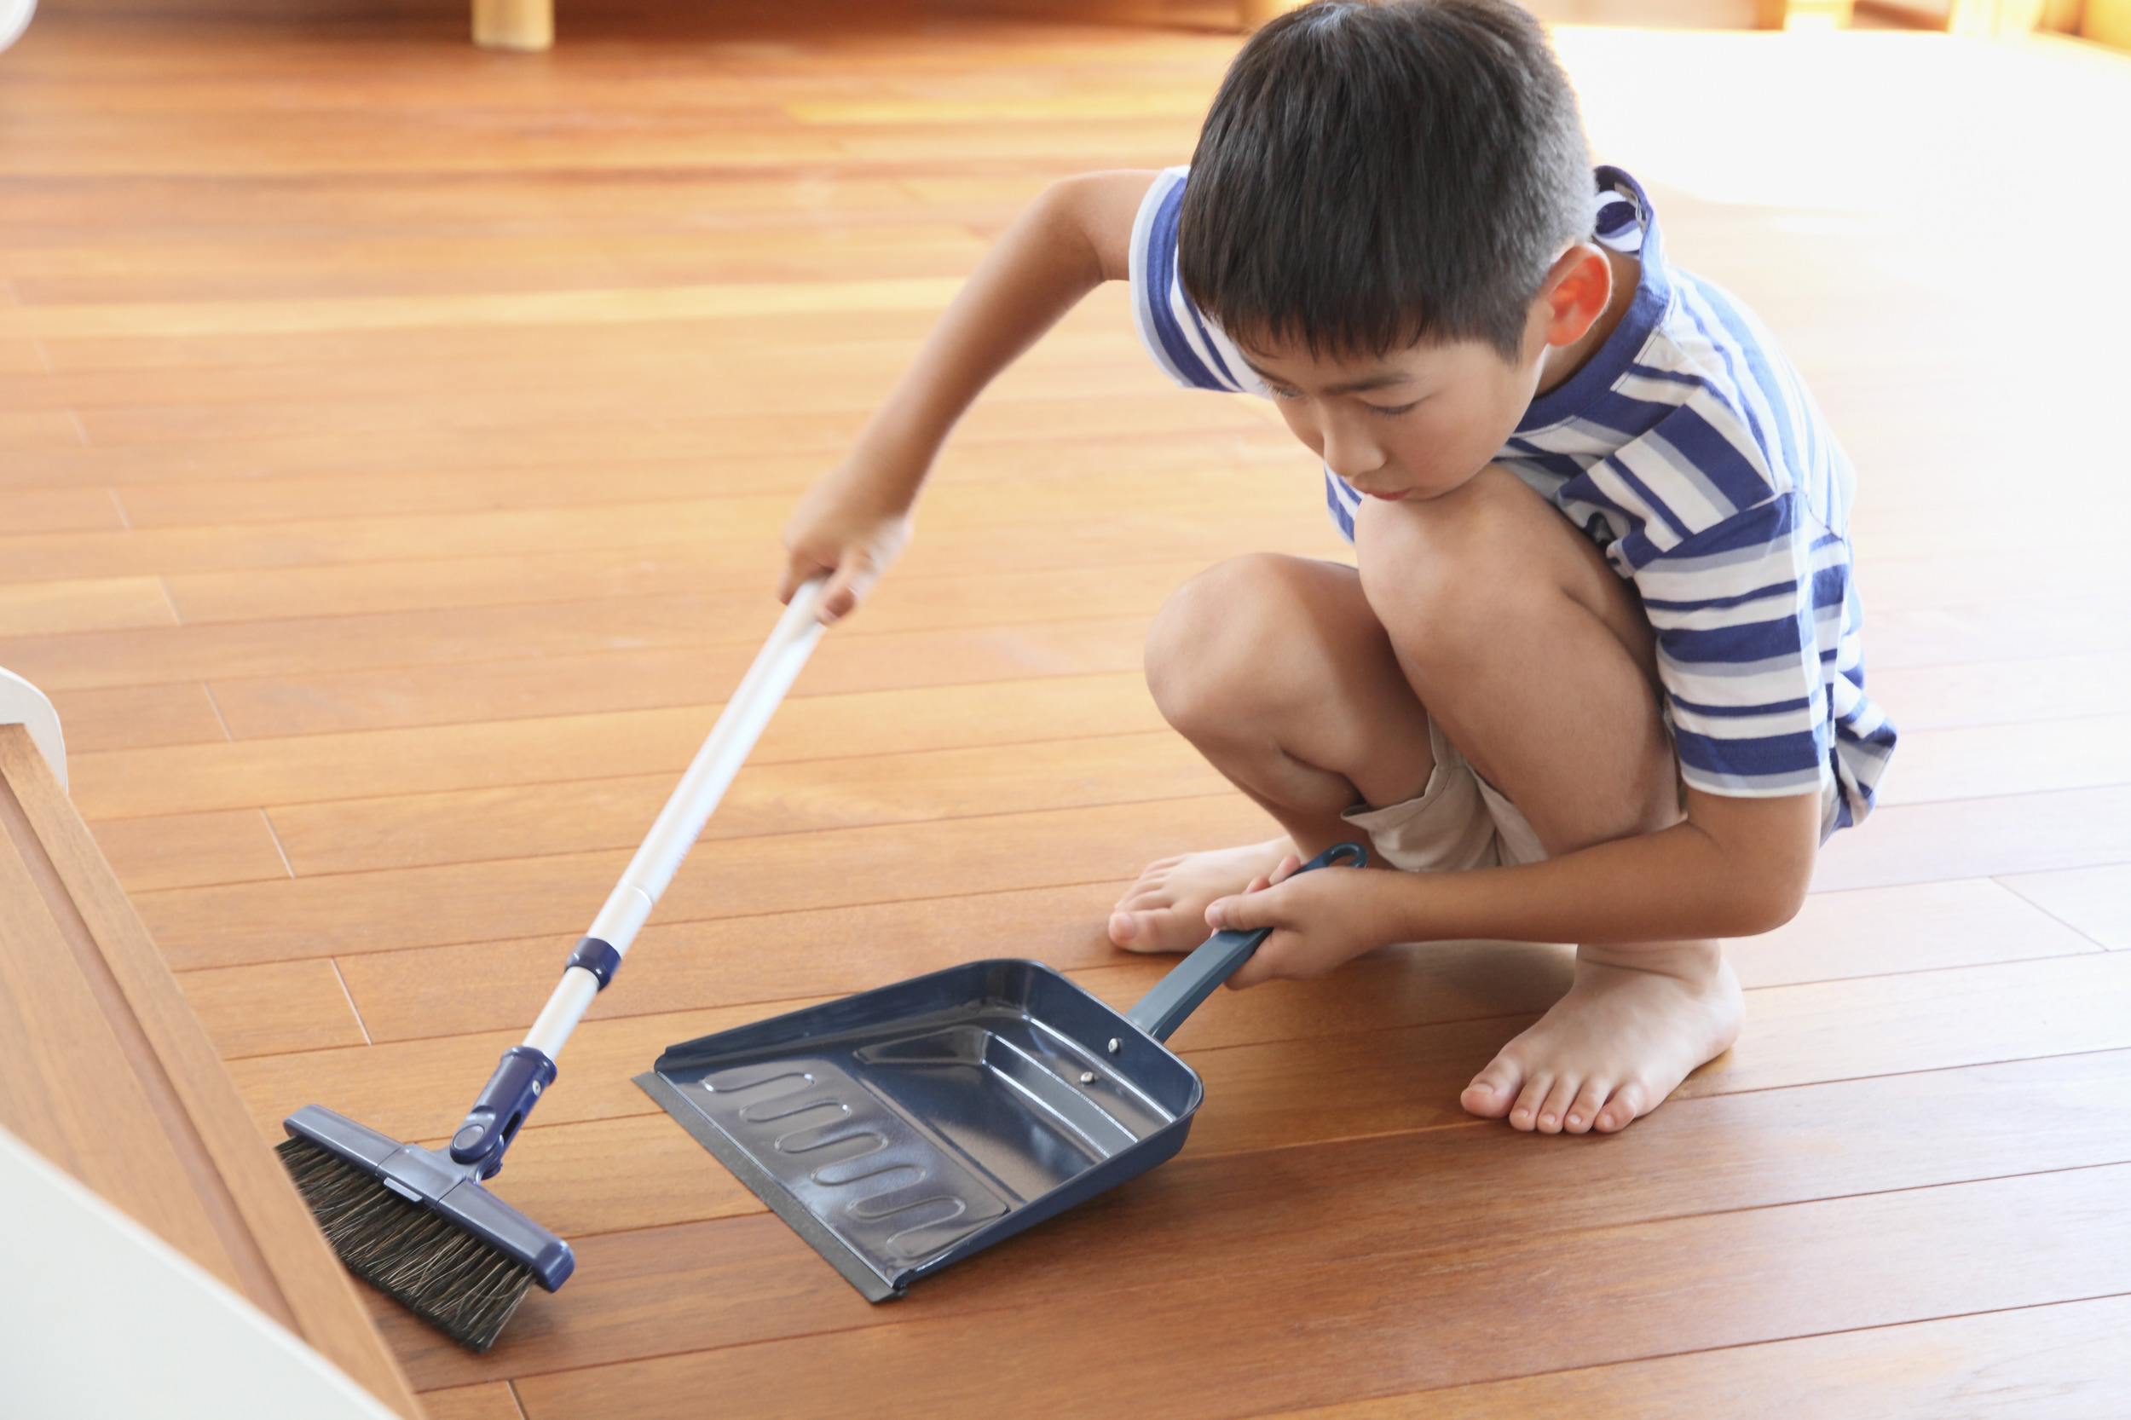
Is it fair for your mum to ask you to do a job but not ask your brother?

Slide 13
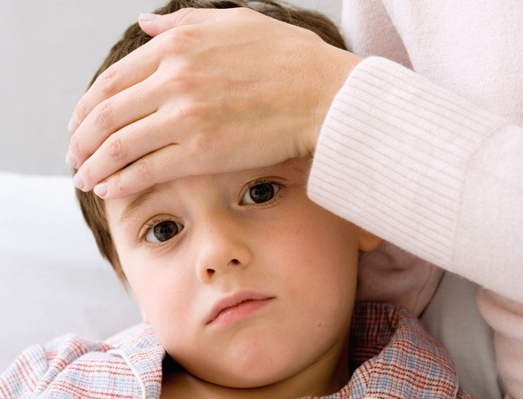
What if your brother is not feeling very well?

Slide 14
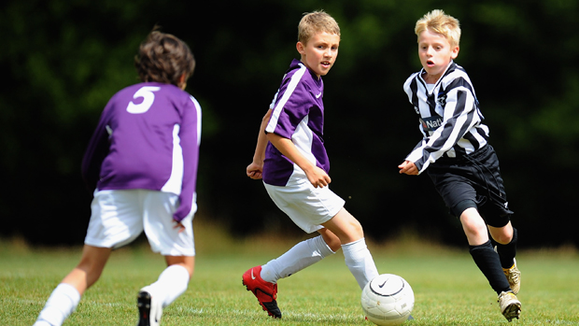
Is it fair to let boys go to football club but not girls?

Slide 15
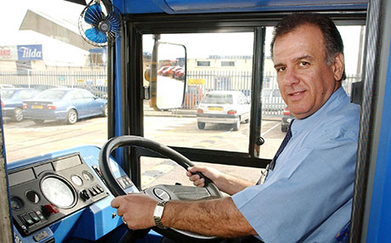
Is it fair for the driver to tell a passenger to give up their seat for his friend?

Slide 16
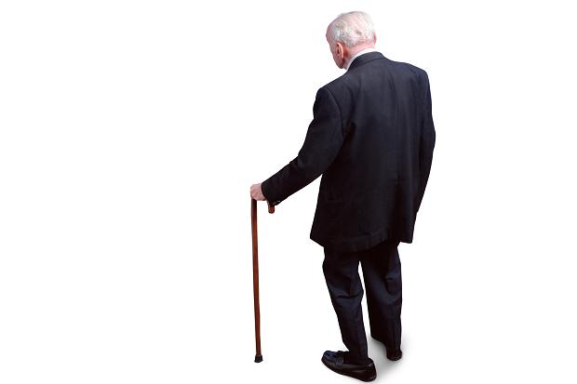
What if his friend had a walking stick?

Slide 17
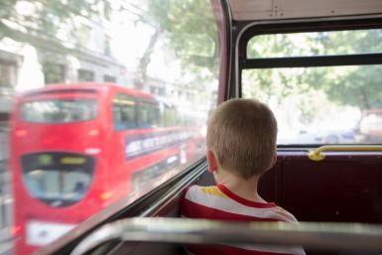
Is it fair for children to ride on the bus for free when adults have to pay?

