Slide 1

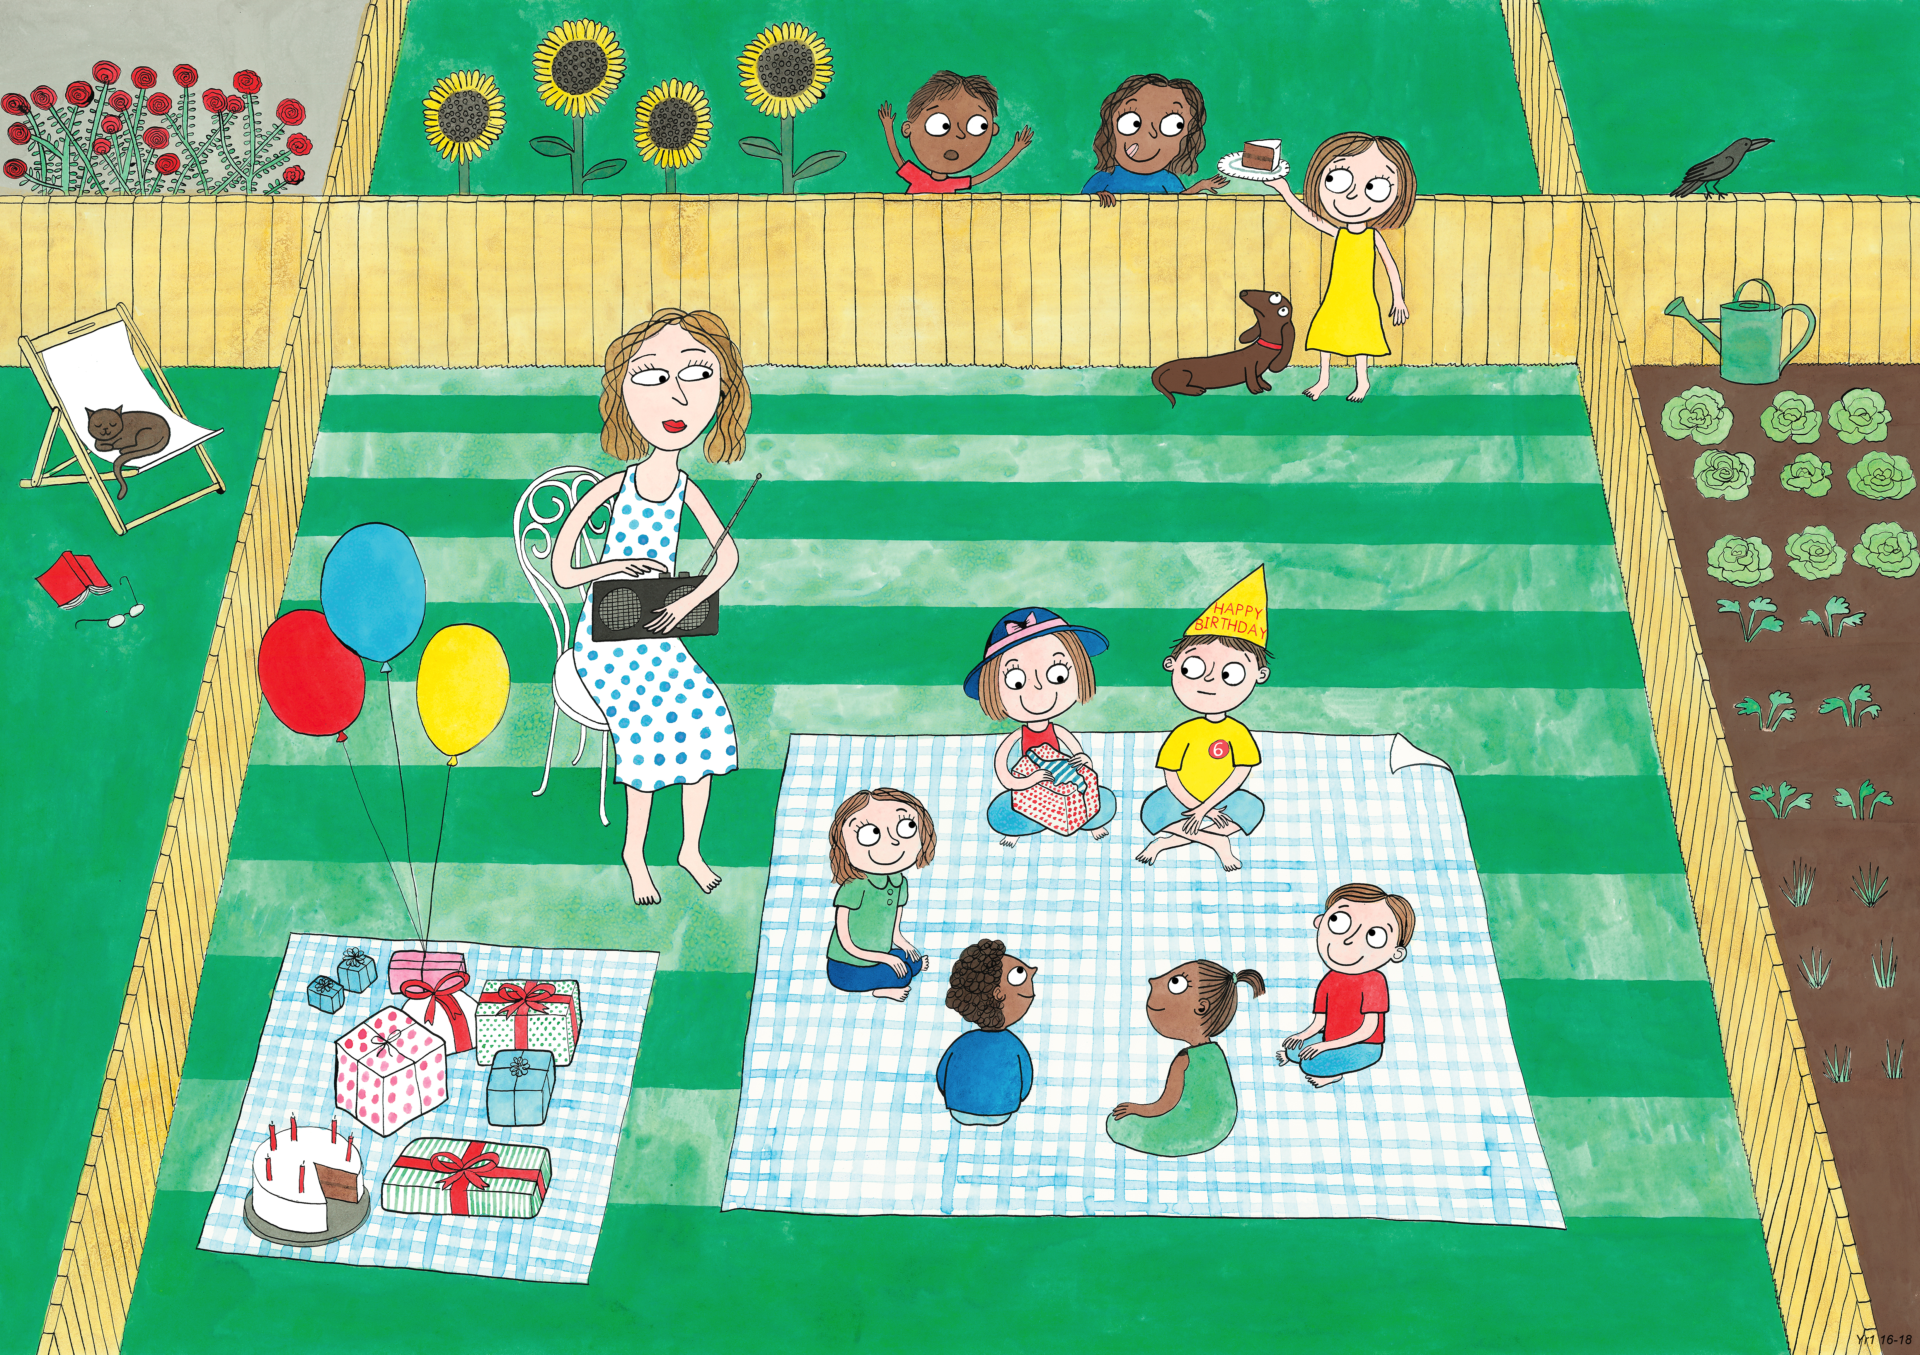
Year 1: Summer 2
Humility, Empathy and Perspective, Gratitude

Slide 2
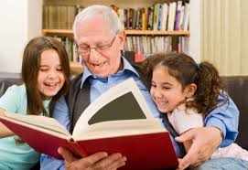
I am grateful for you reading my book with me.

Slide 3
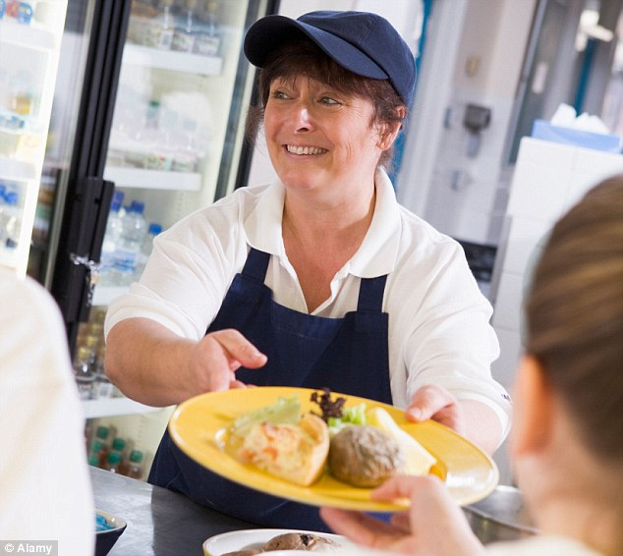
I am grateful for you serving me during family dining.

Slide 4
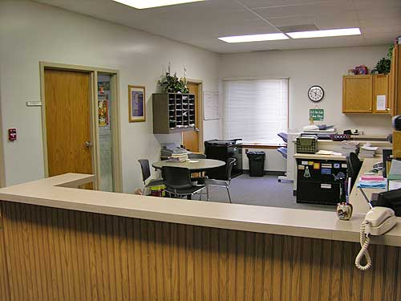
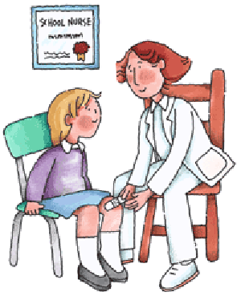
I am grateful for you helping us at school.

Slide 5
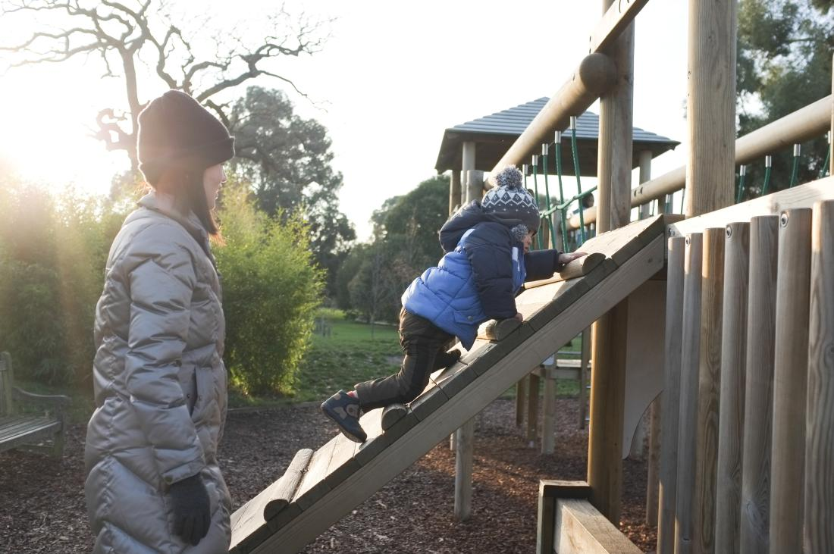
I am grateful for you taking me to the park.

Slide 6
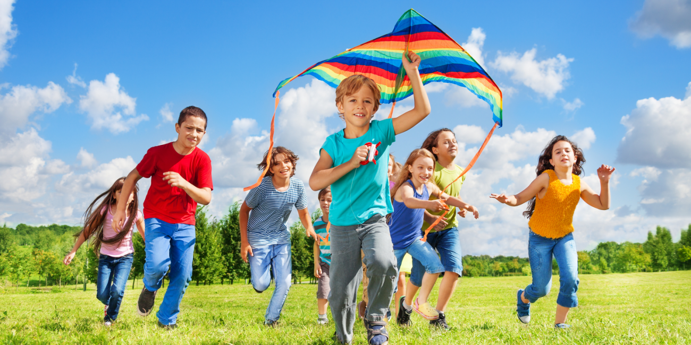
I am grateful for you playing outside with me.

Slide 7
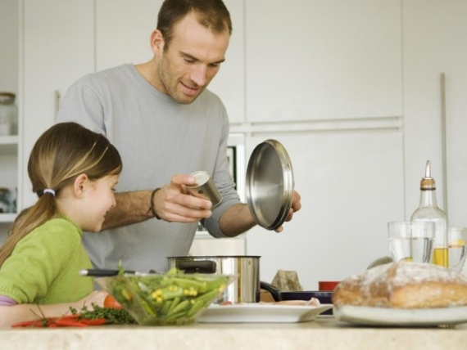
I am grateful for you making my dinner.

Slide 8
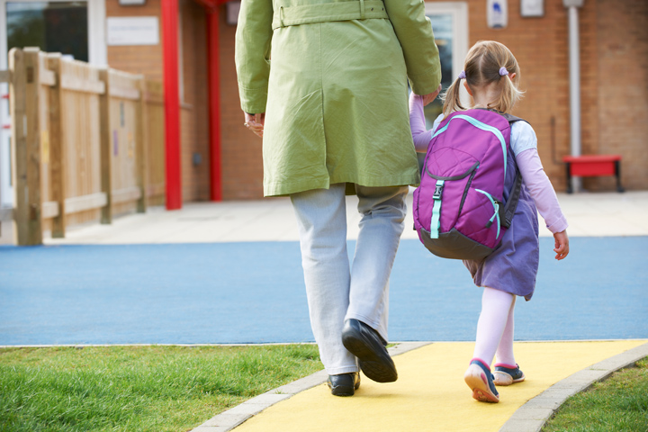
I am grateful for you taking me to school everyday.

Slide 9

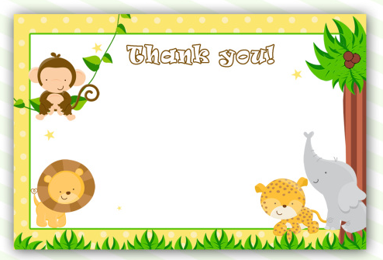


Slide 10


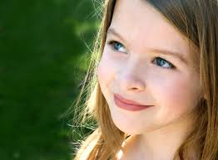
Show the person how special they are by…
Keeping your card in an envelope to protect it.
Presenting your card with two hands.
Making eye contact and smiling at them!

