Slide 1

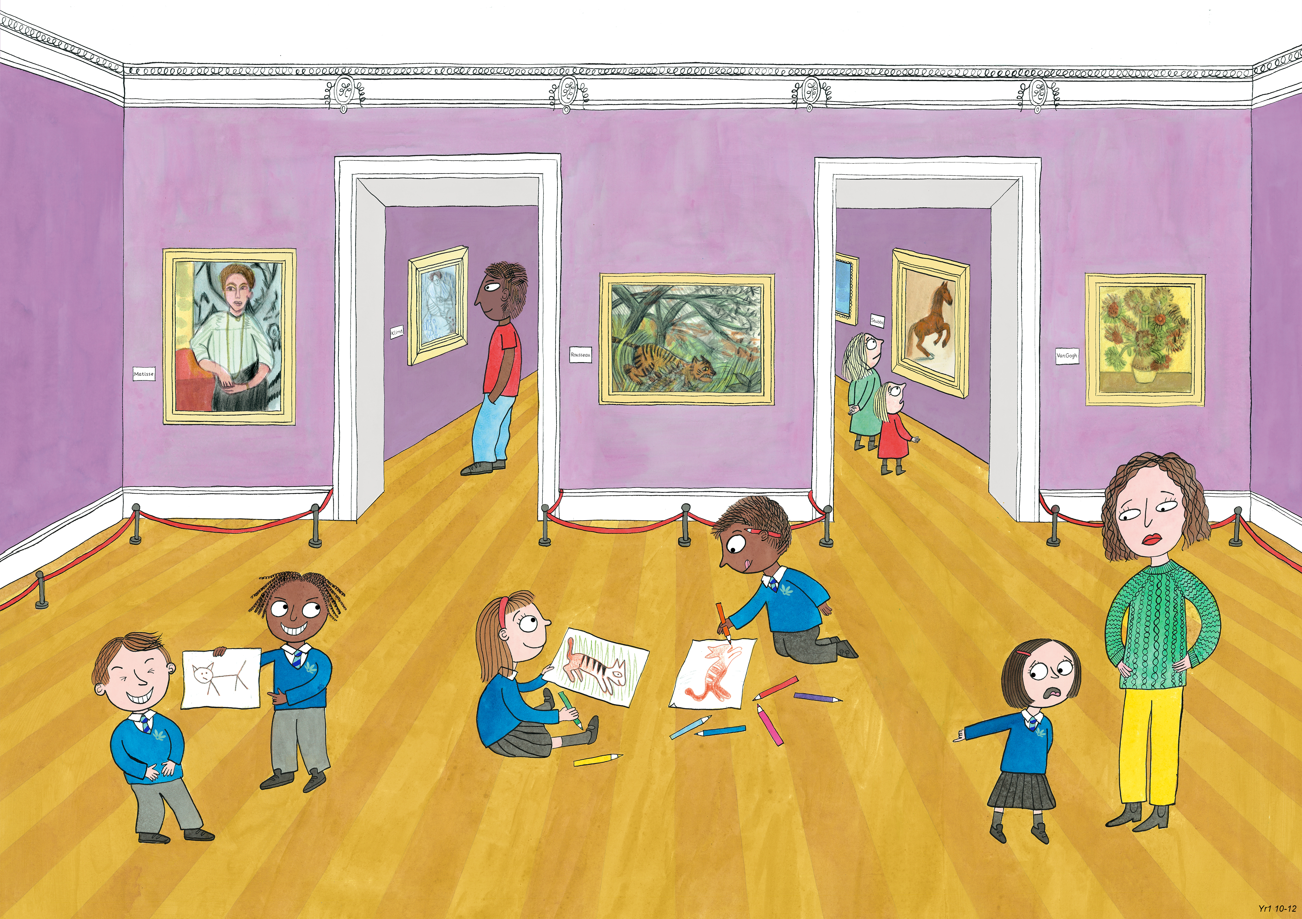
Year 1: Spring 2
Creativity, Honesty, Humour

Slide 2
Read through the following scenarios and discuss why the bullies might be behaving in this way.

Slide 3
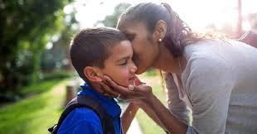
Jake’s mum drops him off at the school gate every morning and gives him a kiss on the cheek to say goodbye. ‘Have a good day!’ she always called after him. The other boys at the school made fun of him. ‘Have a good day!’ they called after him in silly voices whenever he was close by. They pretended to blow kisses at each other and burst out laughing when Jake walked past.

Slide 4
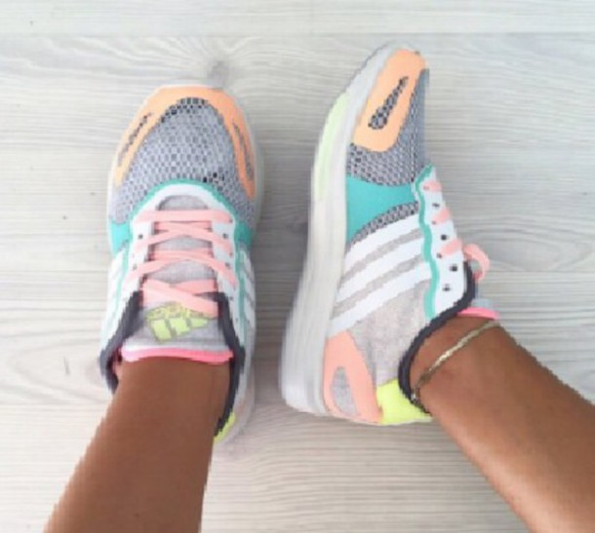
Some girls in Lisa’s class teased her because she wore her sister’s old trainers. When they all put their trainers on for PE the girls would giggle and whisper about Lisa. When Lisa was walking down the corridor they kicked her ankles and tried to trip her up.

Slide 5
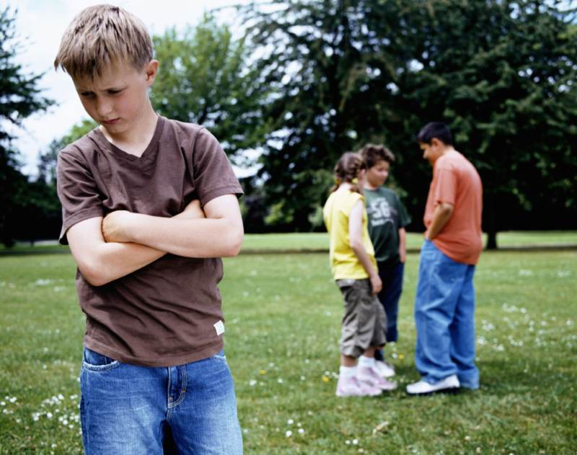
Timothy was top of the class. At playtime, the children left him out. He went over to ask the other children if he could join in their game, but they completely ignored him. He asked again, and again they ignored him. He asked a third time and the children ran away shouting ‘We don’t want to play with a geek! You’re too boring to join our game!’.

