Slide 1

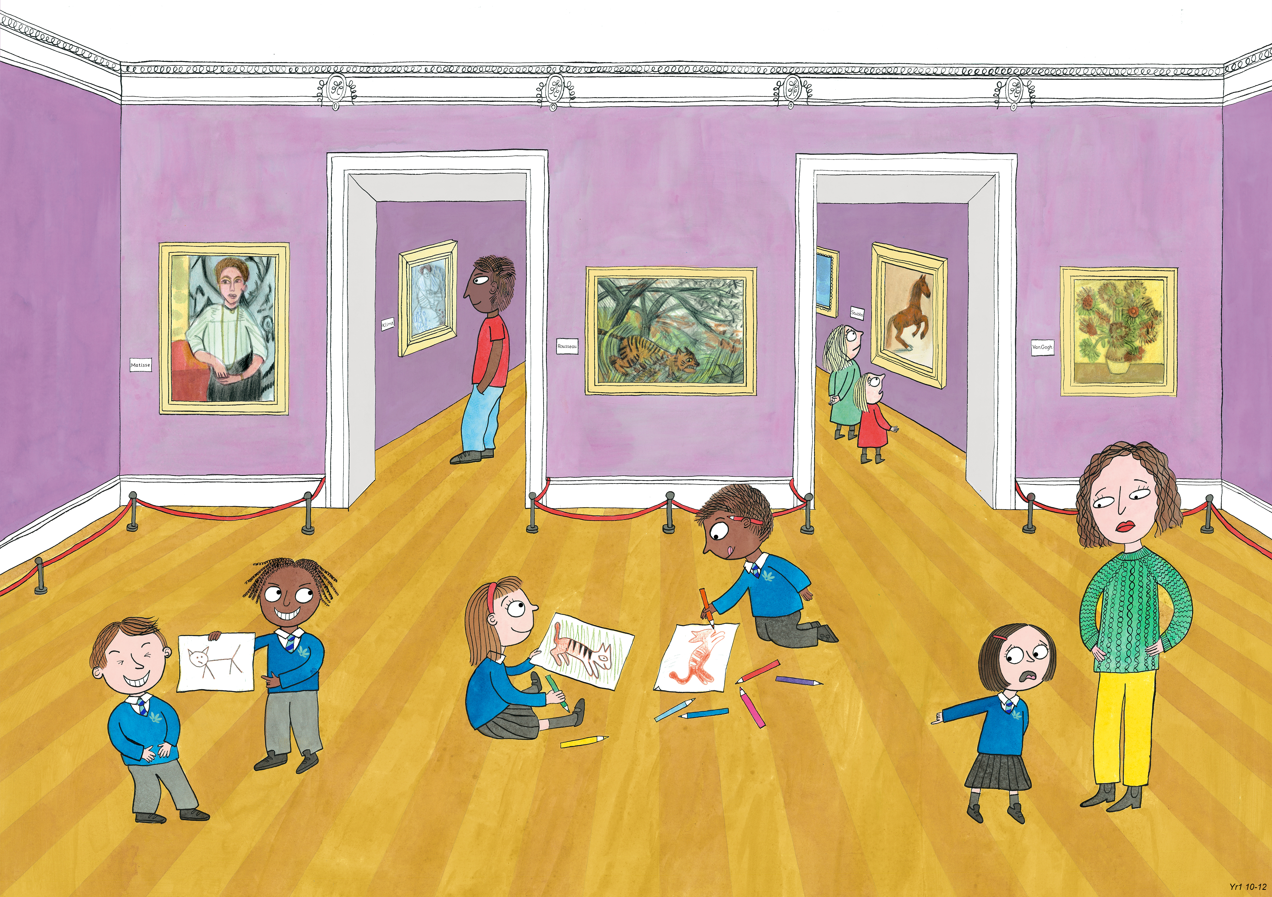
Year 1: Spring 2
Creativity, Honesty, Humour

Slide 2
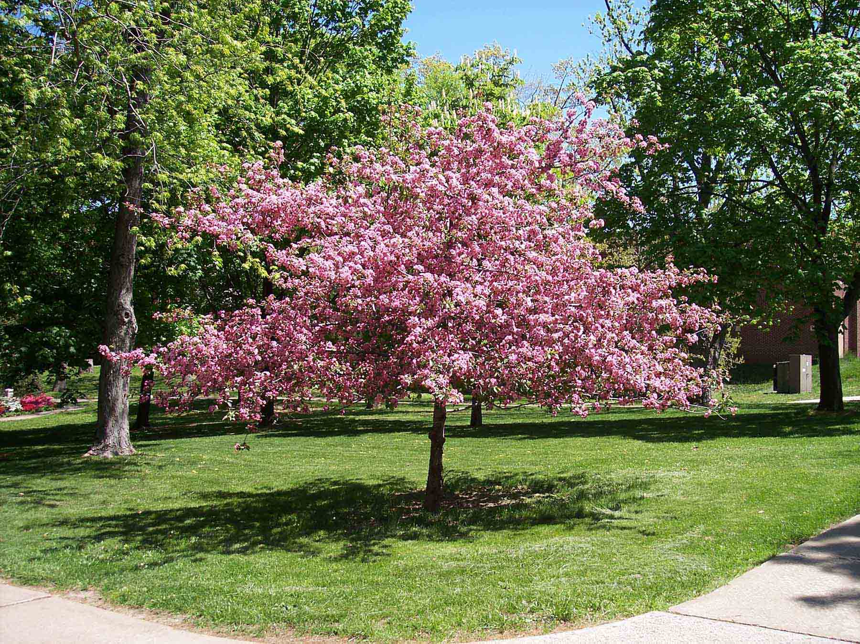
George Washington and the Cherry Tree

Slide 3
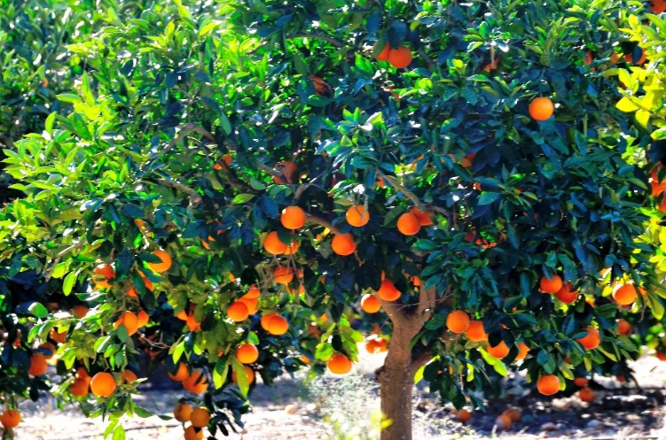
When George Washington was a little boy, he lived in a house with a large garden.
The garden was his father’s pride and joy.
It was filled with all kinds of plants and fruit trees.

Slide 4
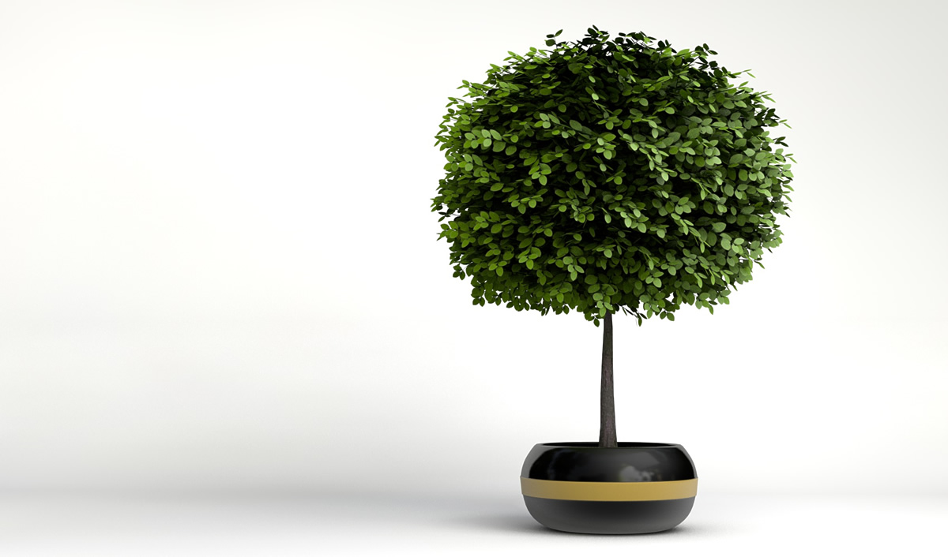
George’s father had a favourite tree.
It was the cherry tree. He had cared for it since it was a tiny sapling.

Slide 5
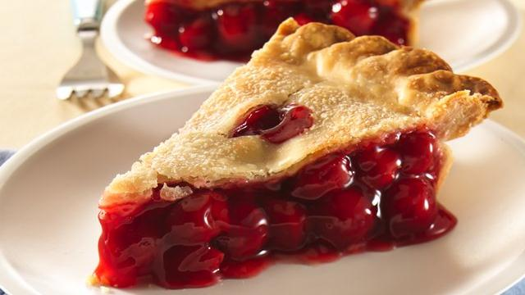
This year, the tree had some blossom. It might even grow some cherries! George’s father thought about all the cherry pies he could make.

Slide 6
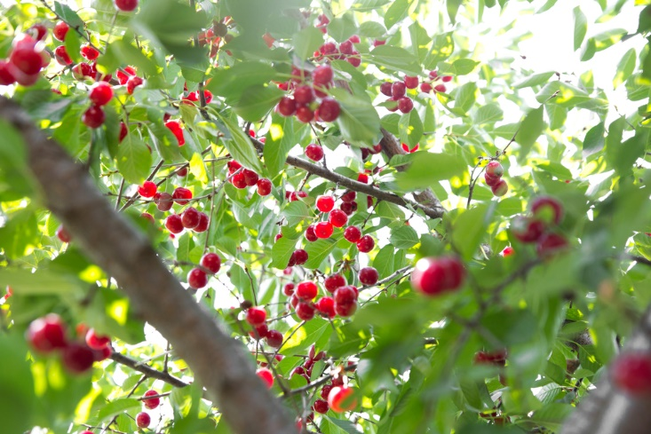
One day, George was playing in the garden.
He noticed the tree had lost lots of its blossom.
To his surprise, there were cherries there instead!

Slide 7
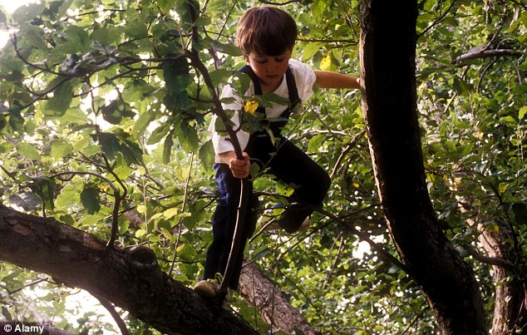
George pulled himself up into the tree to get a better look.

Slide 8
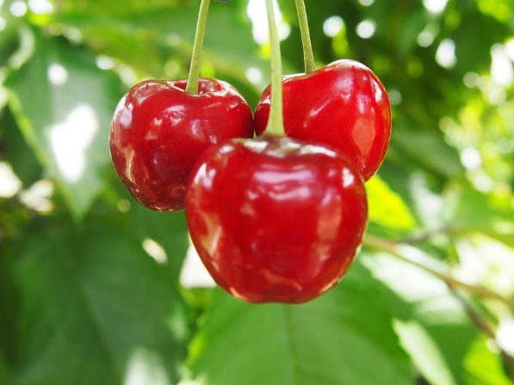
He thought he should try one of the fruits.
It was delicious!
He couldn’t wait to tell his father.

Slide 9
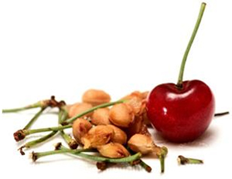
But before he knew it…
George had eaten all of the cherries!

Slide 10
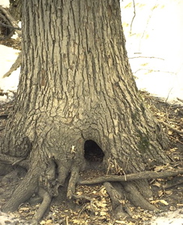
George was very ashamed.
He hid the cherry stones and stalks in a hole at the base of the tree, and ran back inside.

Slide 11
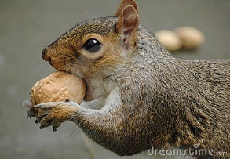
But the hole was the home of a squirrel.
When it found all the stones, the squirrel threw them out all over the grass!

Slide 12
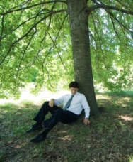
That evening, George’s father went into the garden to water the cherry tree.
He noticed the cherry stones scattered on the ground.

Slide 13
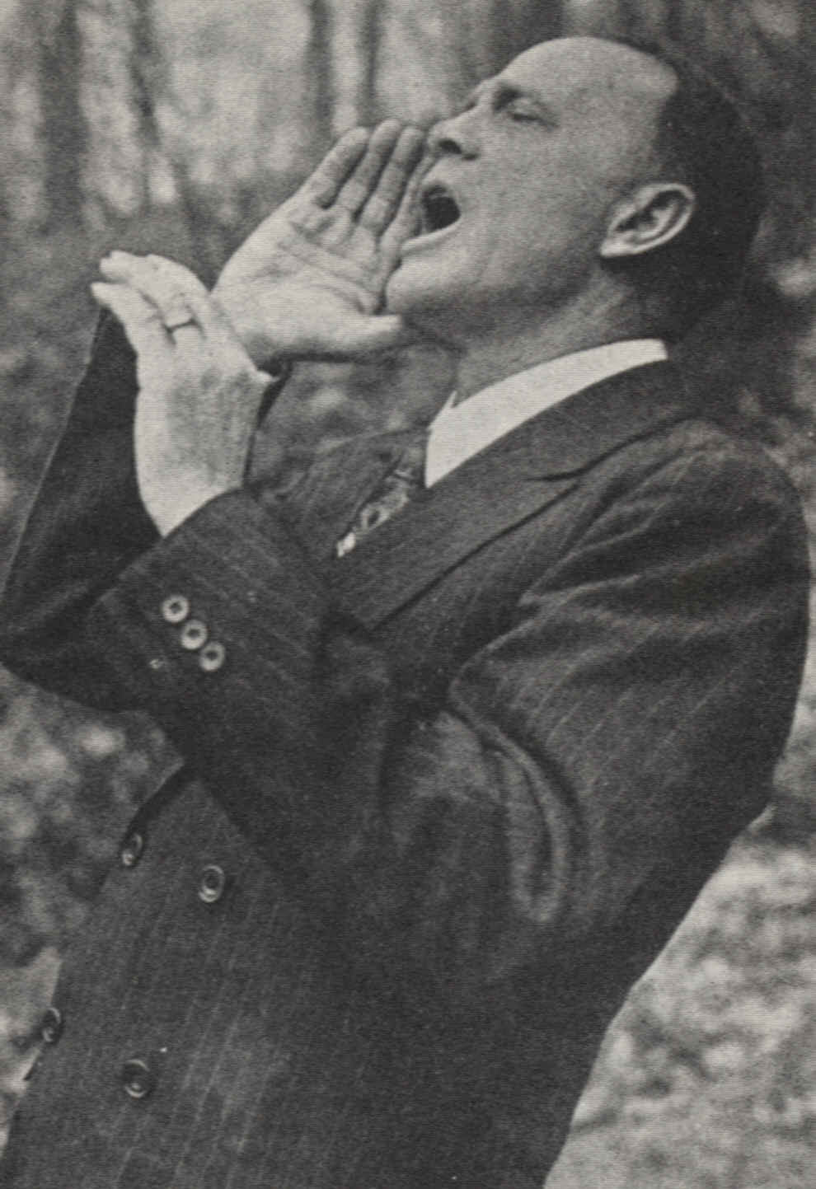

George’s father called immediately to his son.
“George, do you know anything about the cherries being eaten from my tree?”

Slide 14
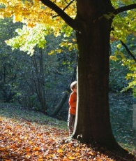
George felt terrible.
But he found that after seeing his father’s face, he had to tell the truth.
“I can’t tell a lie! I ate all of your cherries. I’m so sorry,” he sobbed.

Slide 15
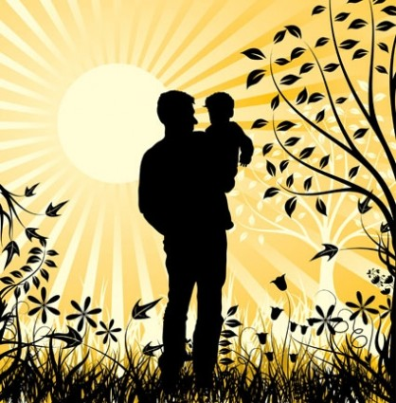
But to George’s surprise, his father smiled.
“You telling the truth means far more to me than some cherries,” he explained.
Instead of being angry, he gave George a big hug.

Slide 16
George Washington and the Cherry Tree - Activity

Slide 17
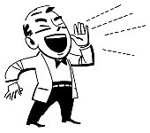
“George, do you know anything about the cherries being eaten from my tree?”

