Slide 1

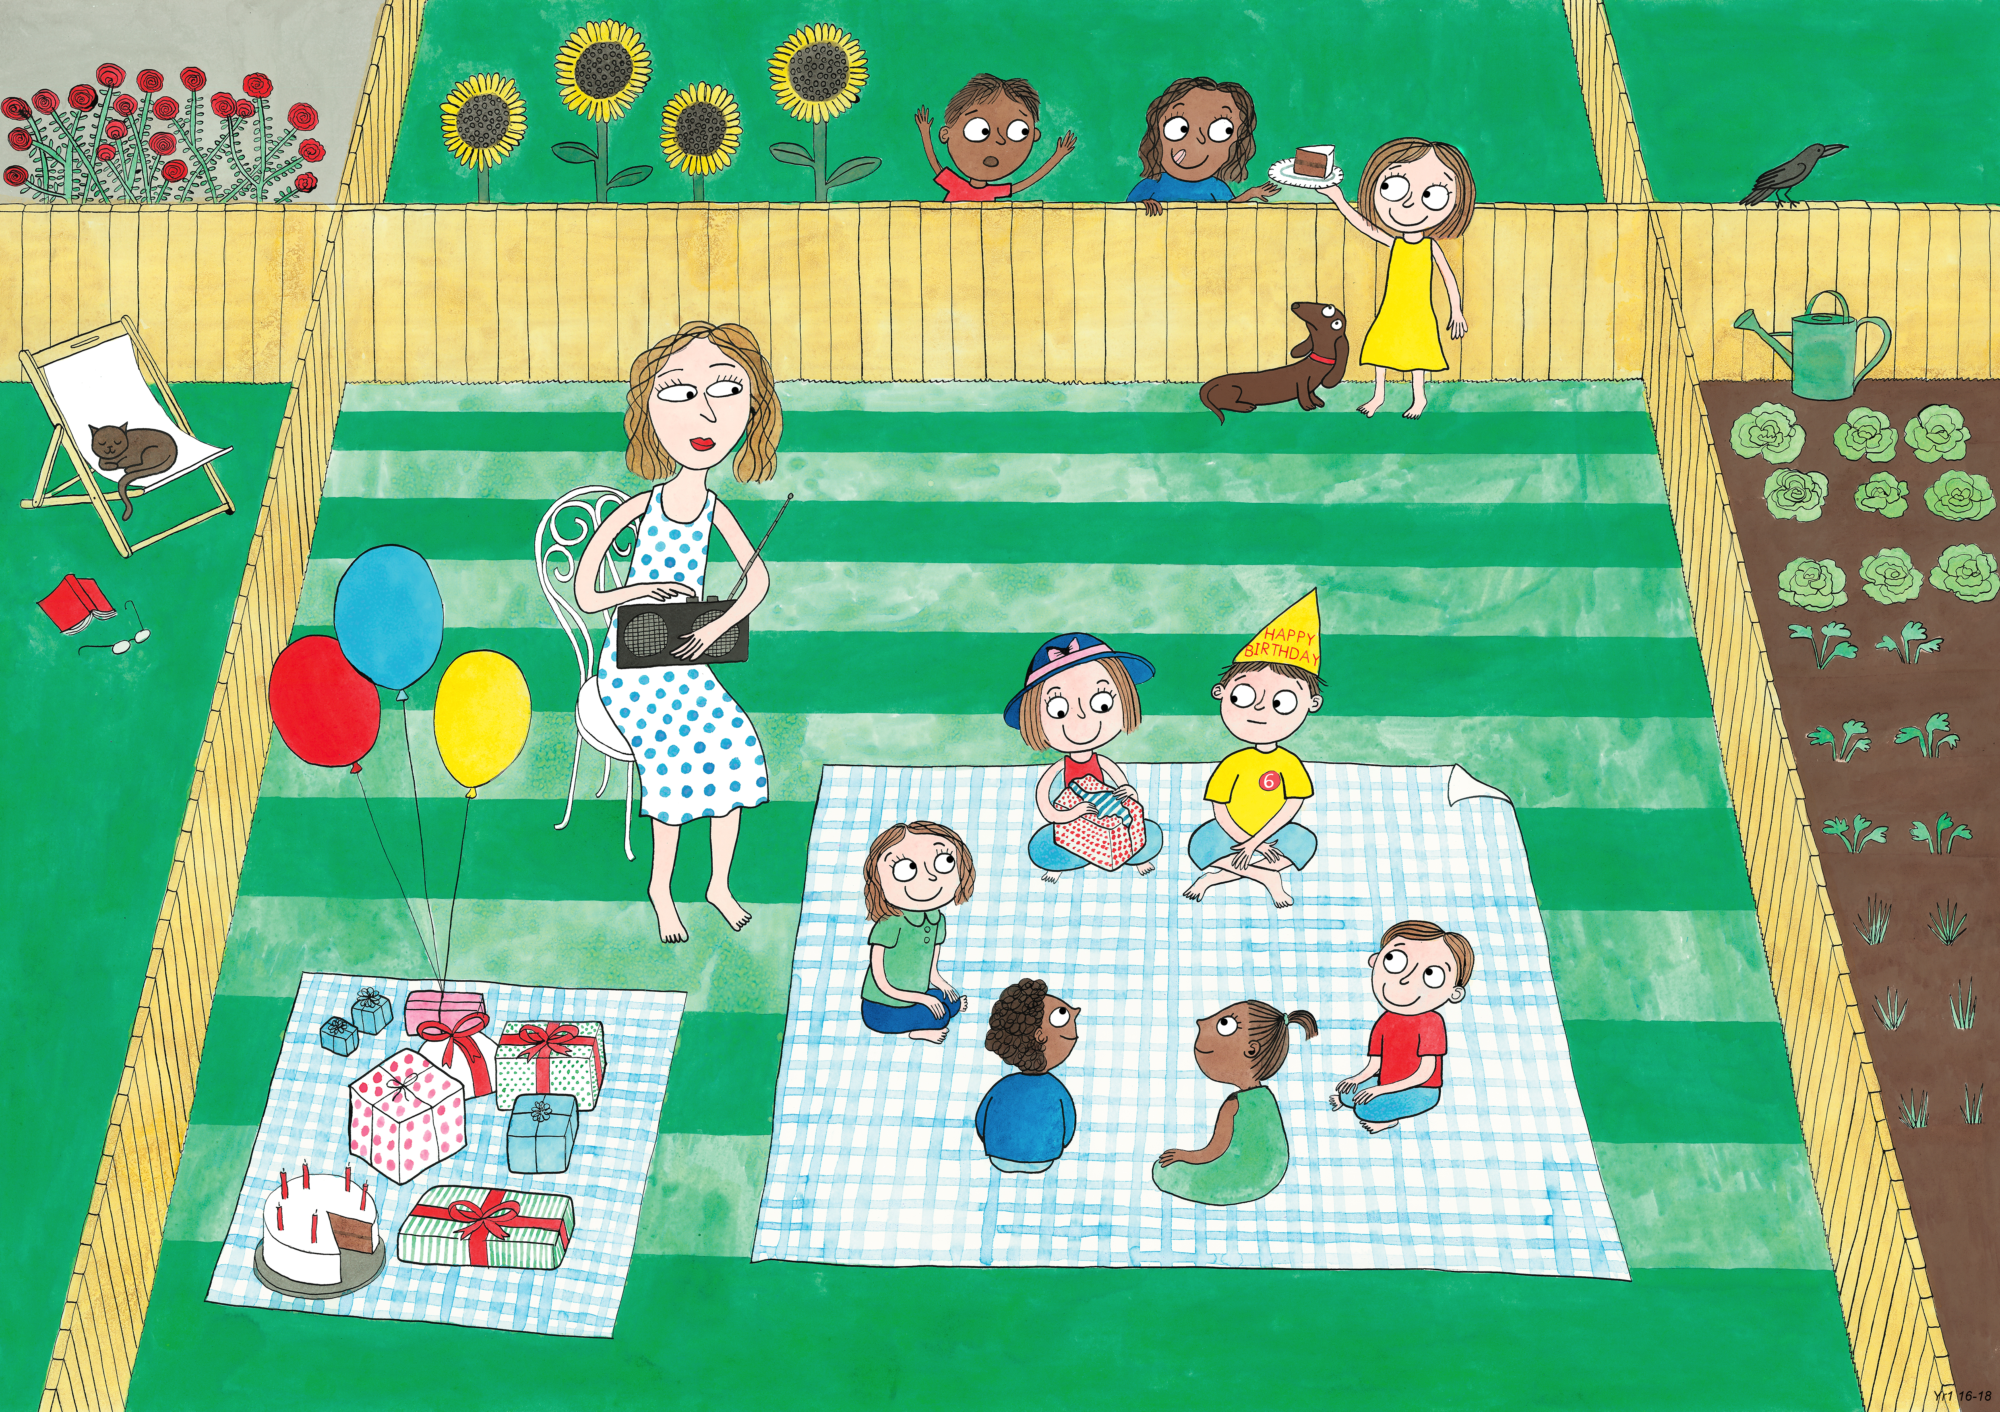
Year 1: Summer 2
Humility, Empathy and Perspective, Gratitude.

Slide 2
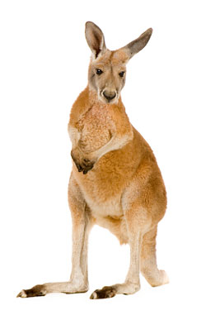
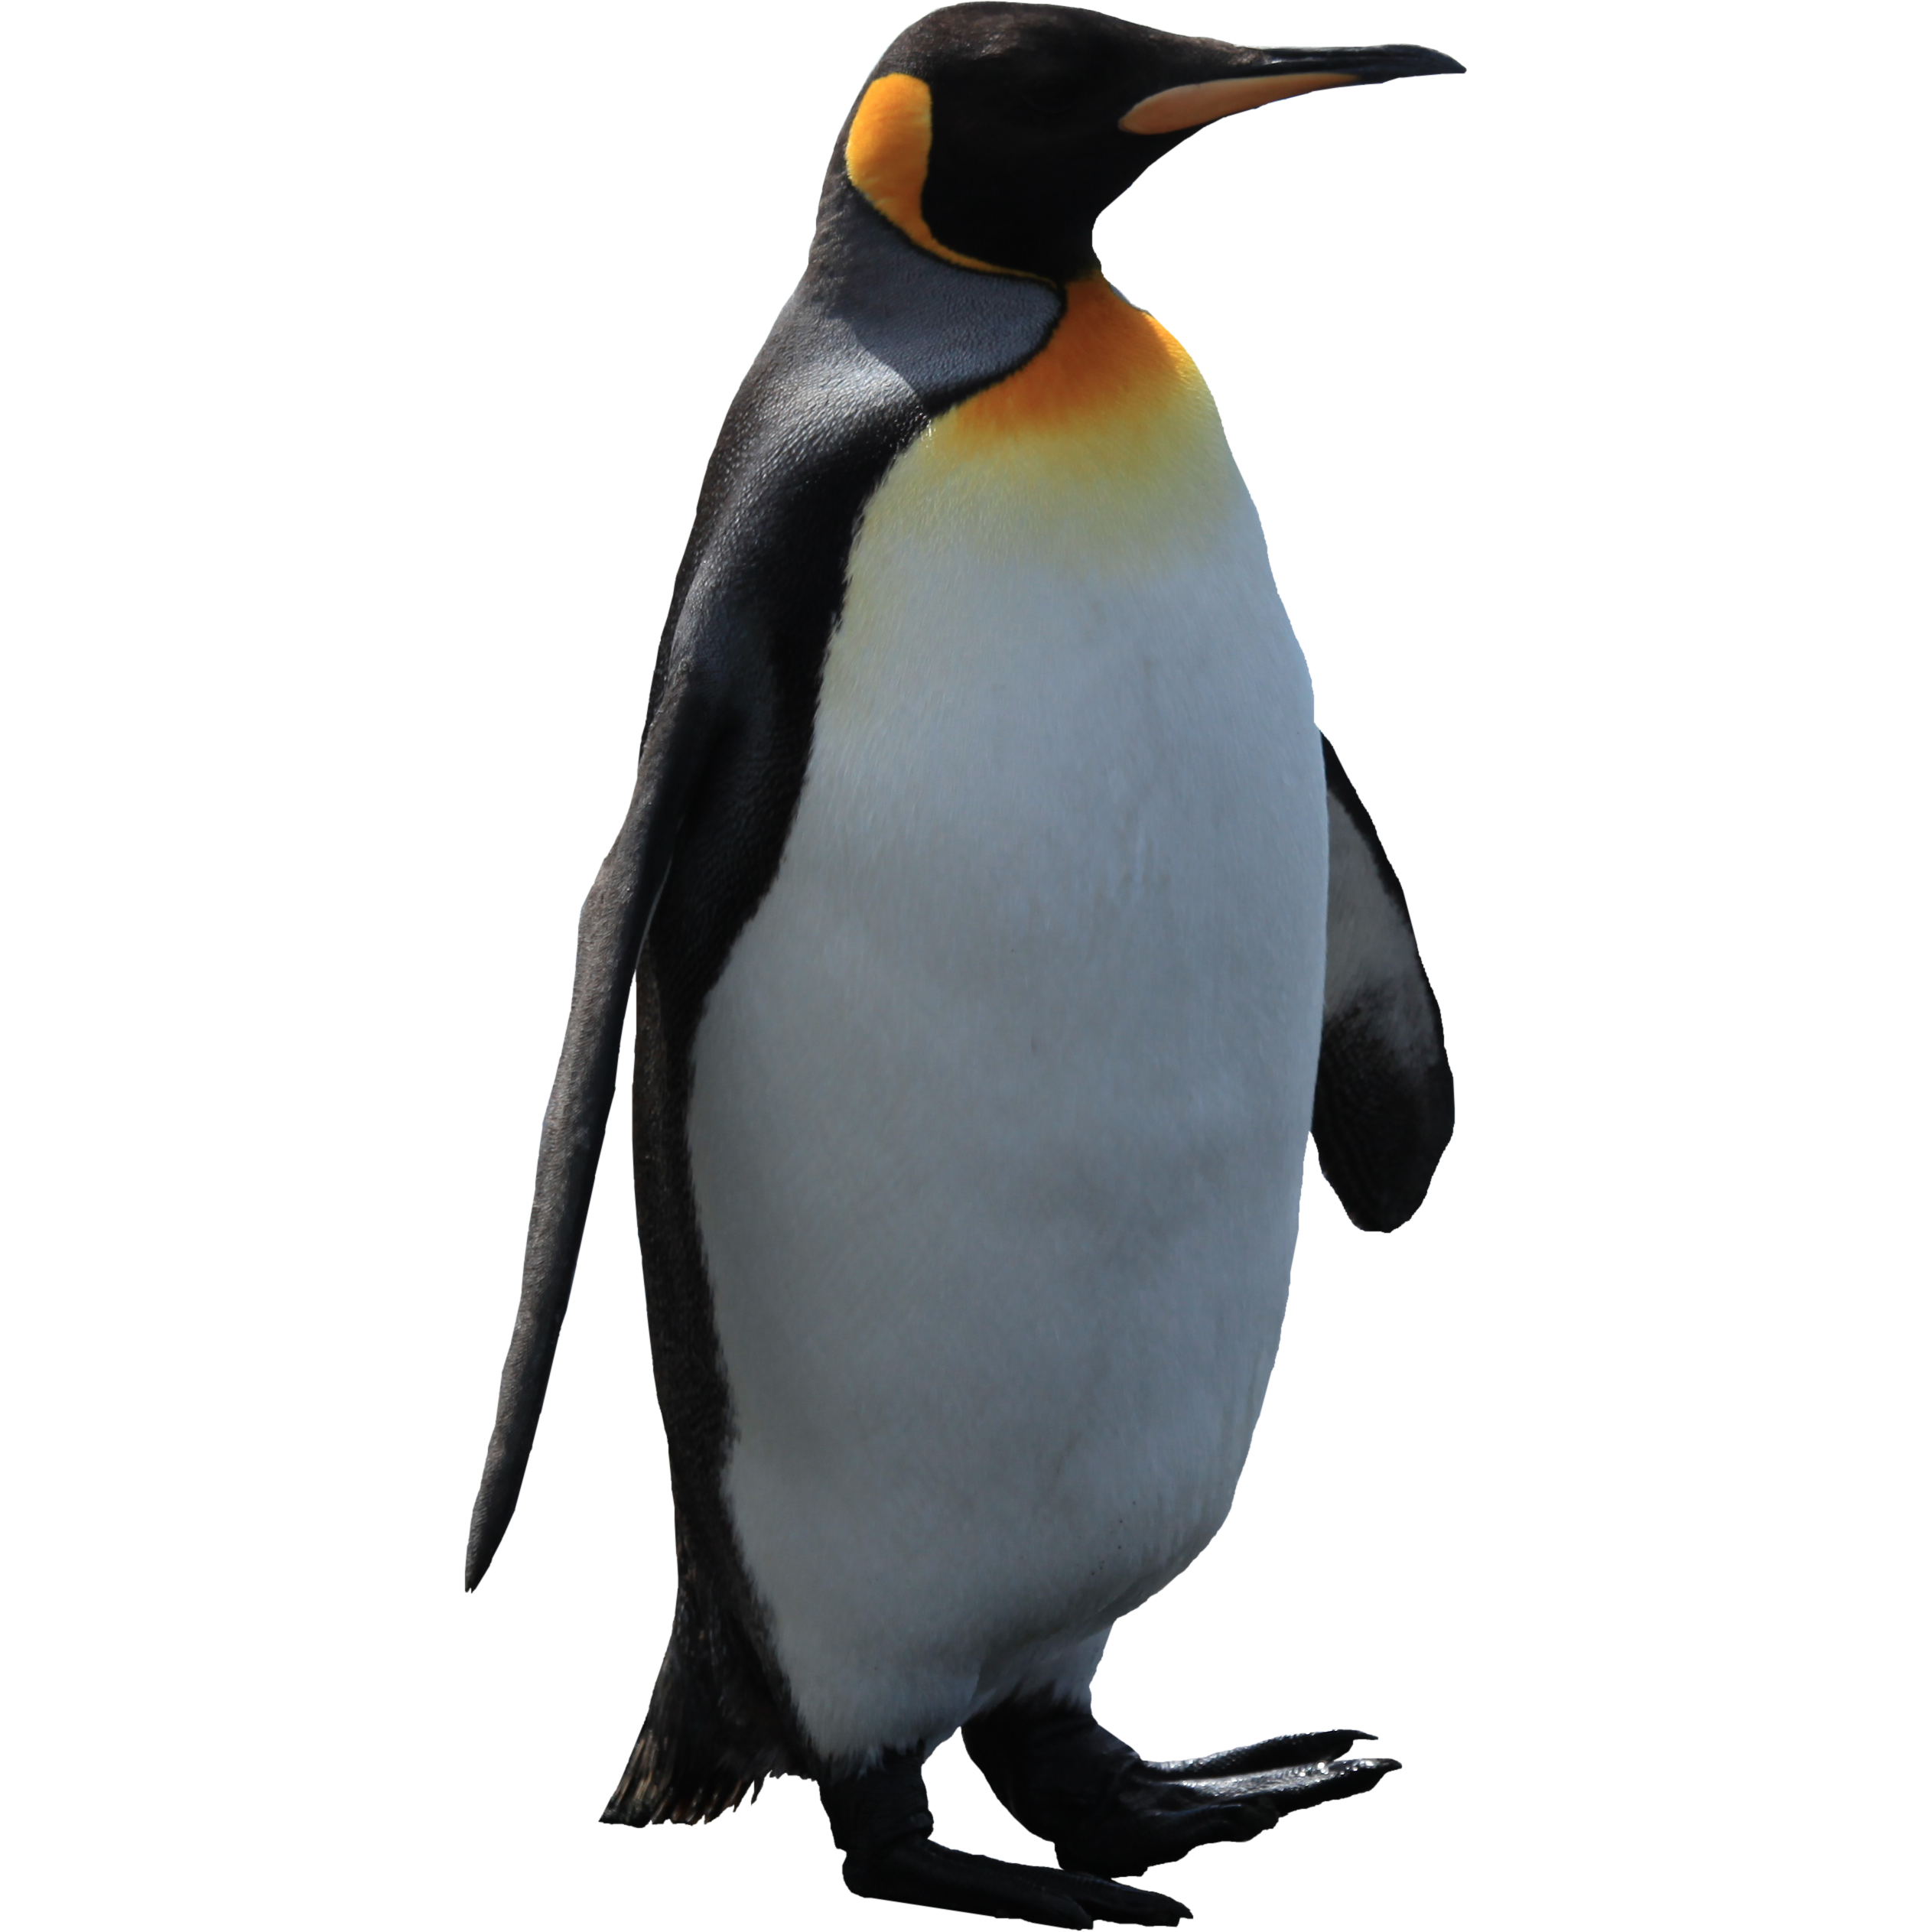
Kangaroo Loves Races
Humility

Slide 3
Kangaroo loved races. She always won.
Her legs were longer and bouncier than anyone else’s and she bounced and she leapt and she whizzed her way to the front.
‘I’m the champion!’ she would cry as
the others came in behind.

Slide 4
‘Let’s have a race!’ she would say to the animals almost every day.
And in every race, Kangaroo won, and Penguin lost.

Slide 5
Penguin hardly had any legs at all.
They were so short and stumpy that her feet seemed to come out from under her long fat body. – with no legs in between.

Slide 6
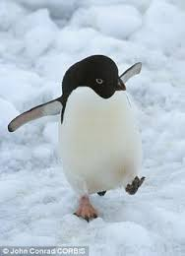
And whilst Kangaroo bounced and leapt and whizzed,
Penguin waddled.
She waddled and she waddled.
She waddled her way to the finishing line.
Always last.

Slide 7
Well done, Kangaroo!’ Penguin would say. ‘You are a real champion!’
‘You, Penguin, are not!’ Kangaroo would reply. ‘Surely you can do better than that.’
‘

Slide 8
The one day, a new race was announced a mile away, in a place where the animals had never been.
They all got ready on the starting line.

Slide 9
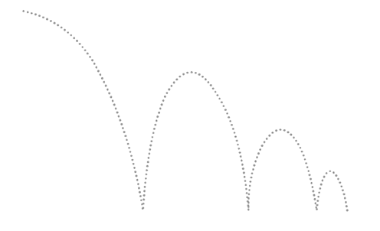
The whistle blew.
And Kangaroo was off!
Bouncing and leaping and whizzing her way to the front.

Slide 10
Penguin was off too. Waddling her way at the back.

Slide 11

But suddenly they came to a huge lake.
Kangaroo looked to the left and she looked to the right.
But the lake went on for miles.

Slide 12
Slowly the other animals ran into view.
And they found Kangaroo pacing to the left and pacing to the right, pacing to the left and pacing to the right.

Slide 13
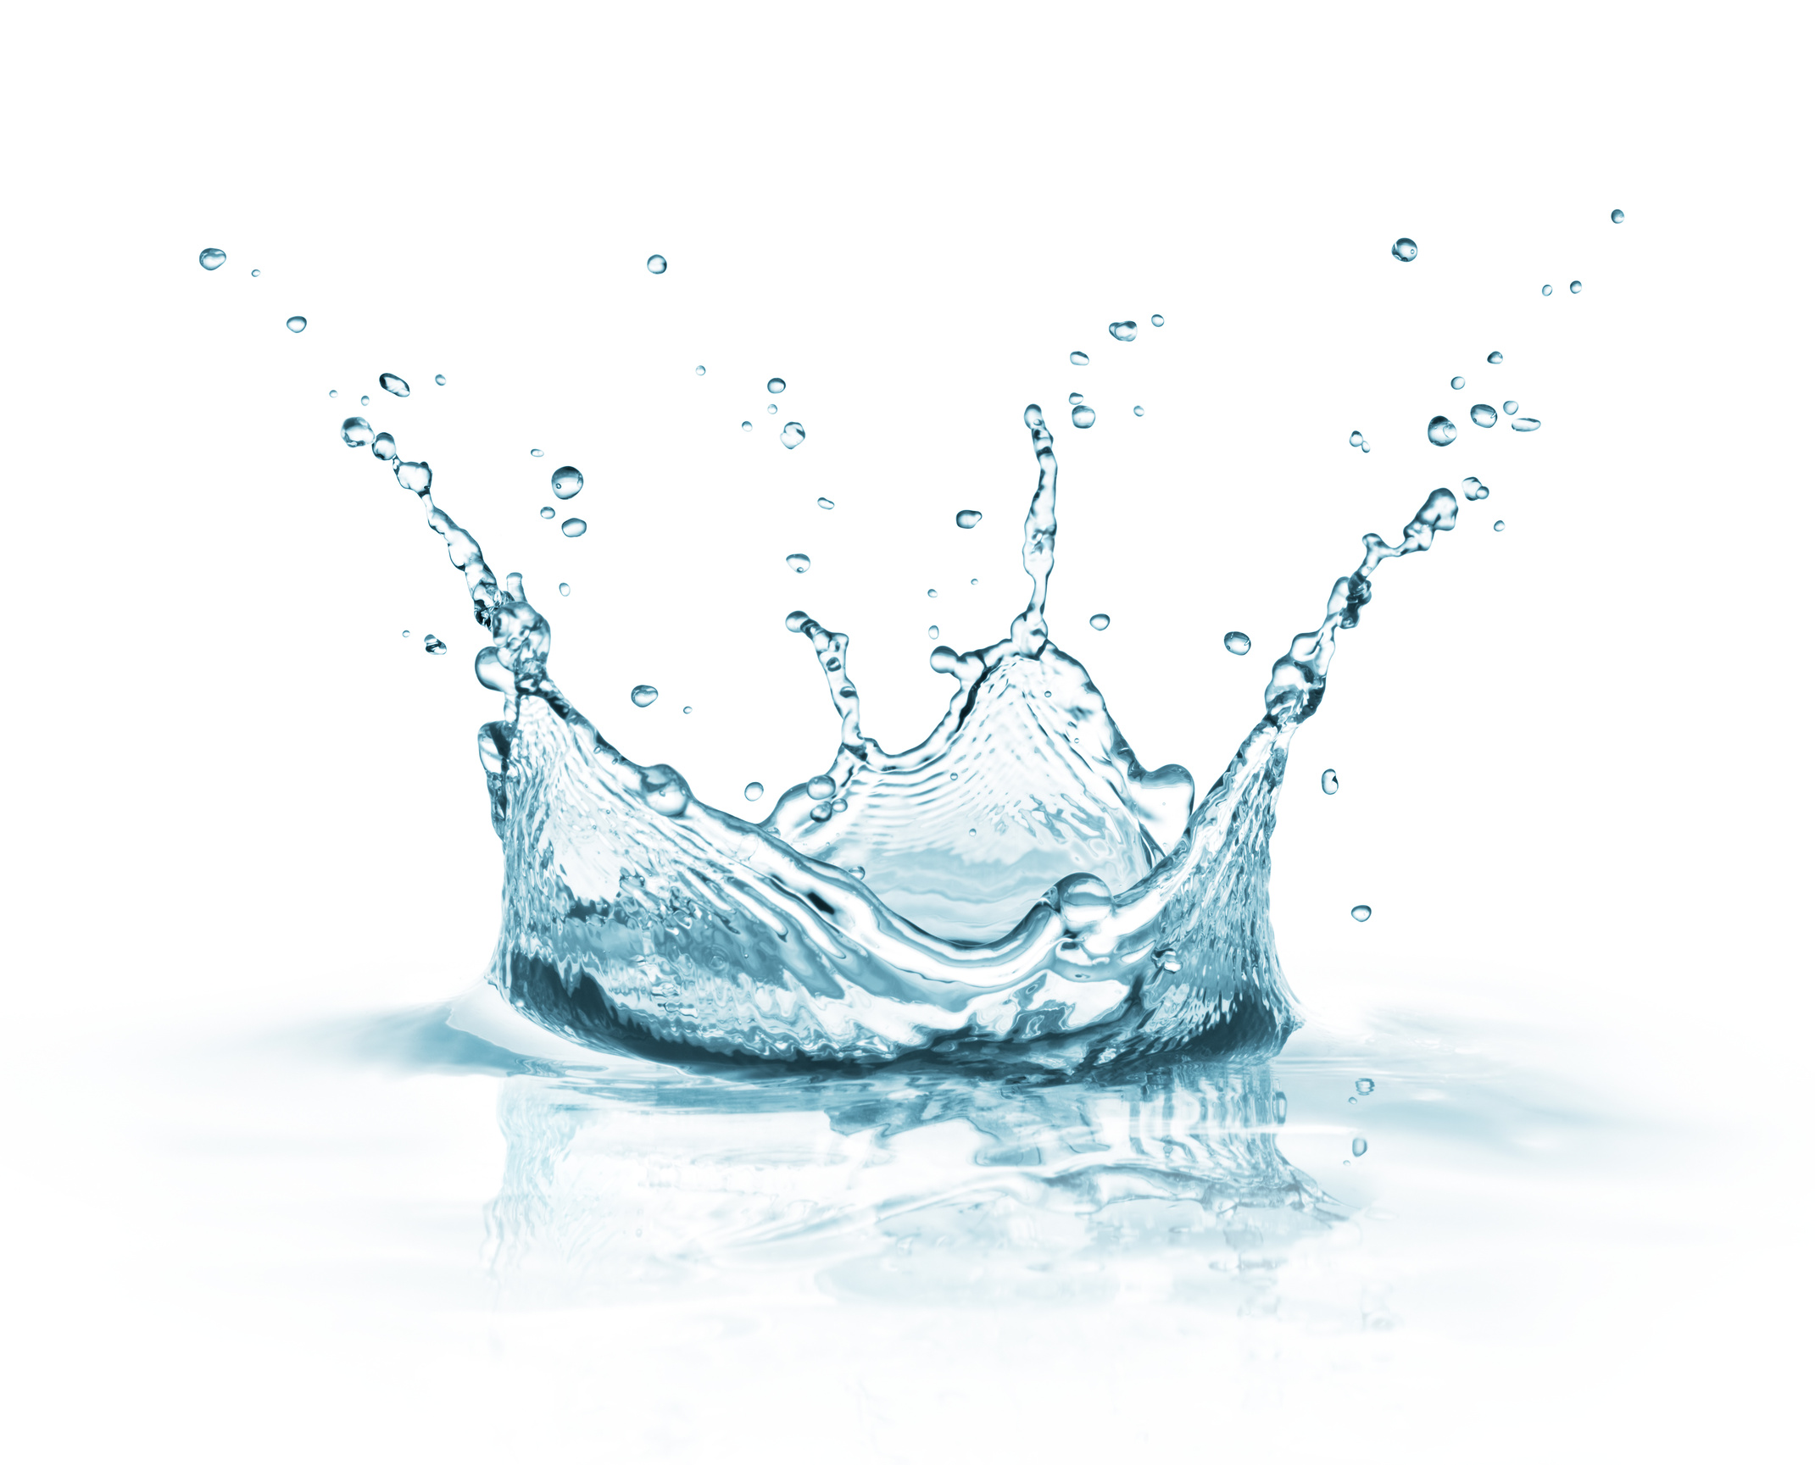
Finally Penguin appeared.
Penguin threw herself into the lake.
She threw out her flippers and her body became sleek and long.
And she raced so fast that the animals could see speed bubbles making trails in the water.
She reached the other side in record time.

Slide 14
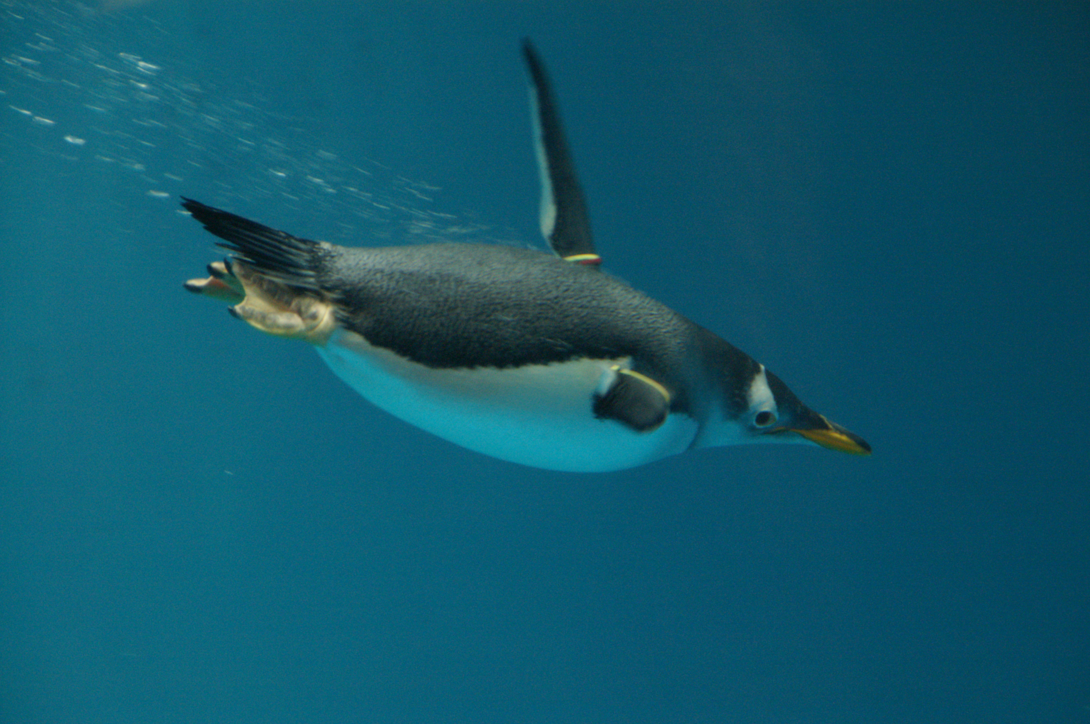

Slide 15
As none of the animals was there, she sped back underwater, and launched herself into the air like a dolphin, landing beside Kangaroo, who was pacing to the right and pacing to the left at the edge of the huge lake.

Slide 16
‘Kangaroo,’ said Penguin.
Would you like me to teach you to swim so that you too can enjoy the race?
The end.

Slide 17
Penguin is humble

Slide 19
Show off for your friend
Picture ideas

Slide 20


Slide 21


Slide 22


Slide 23
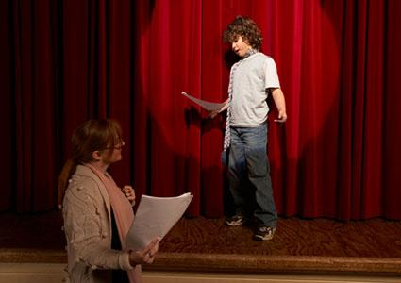

Slide 24
