Slide 1

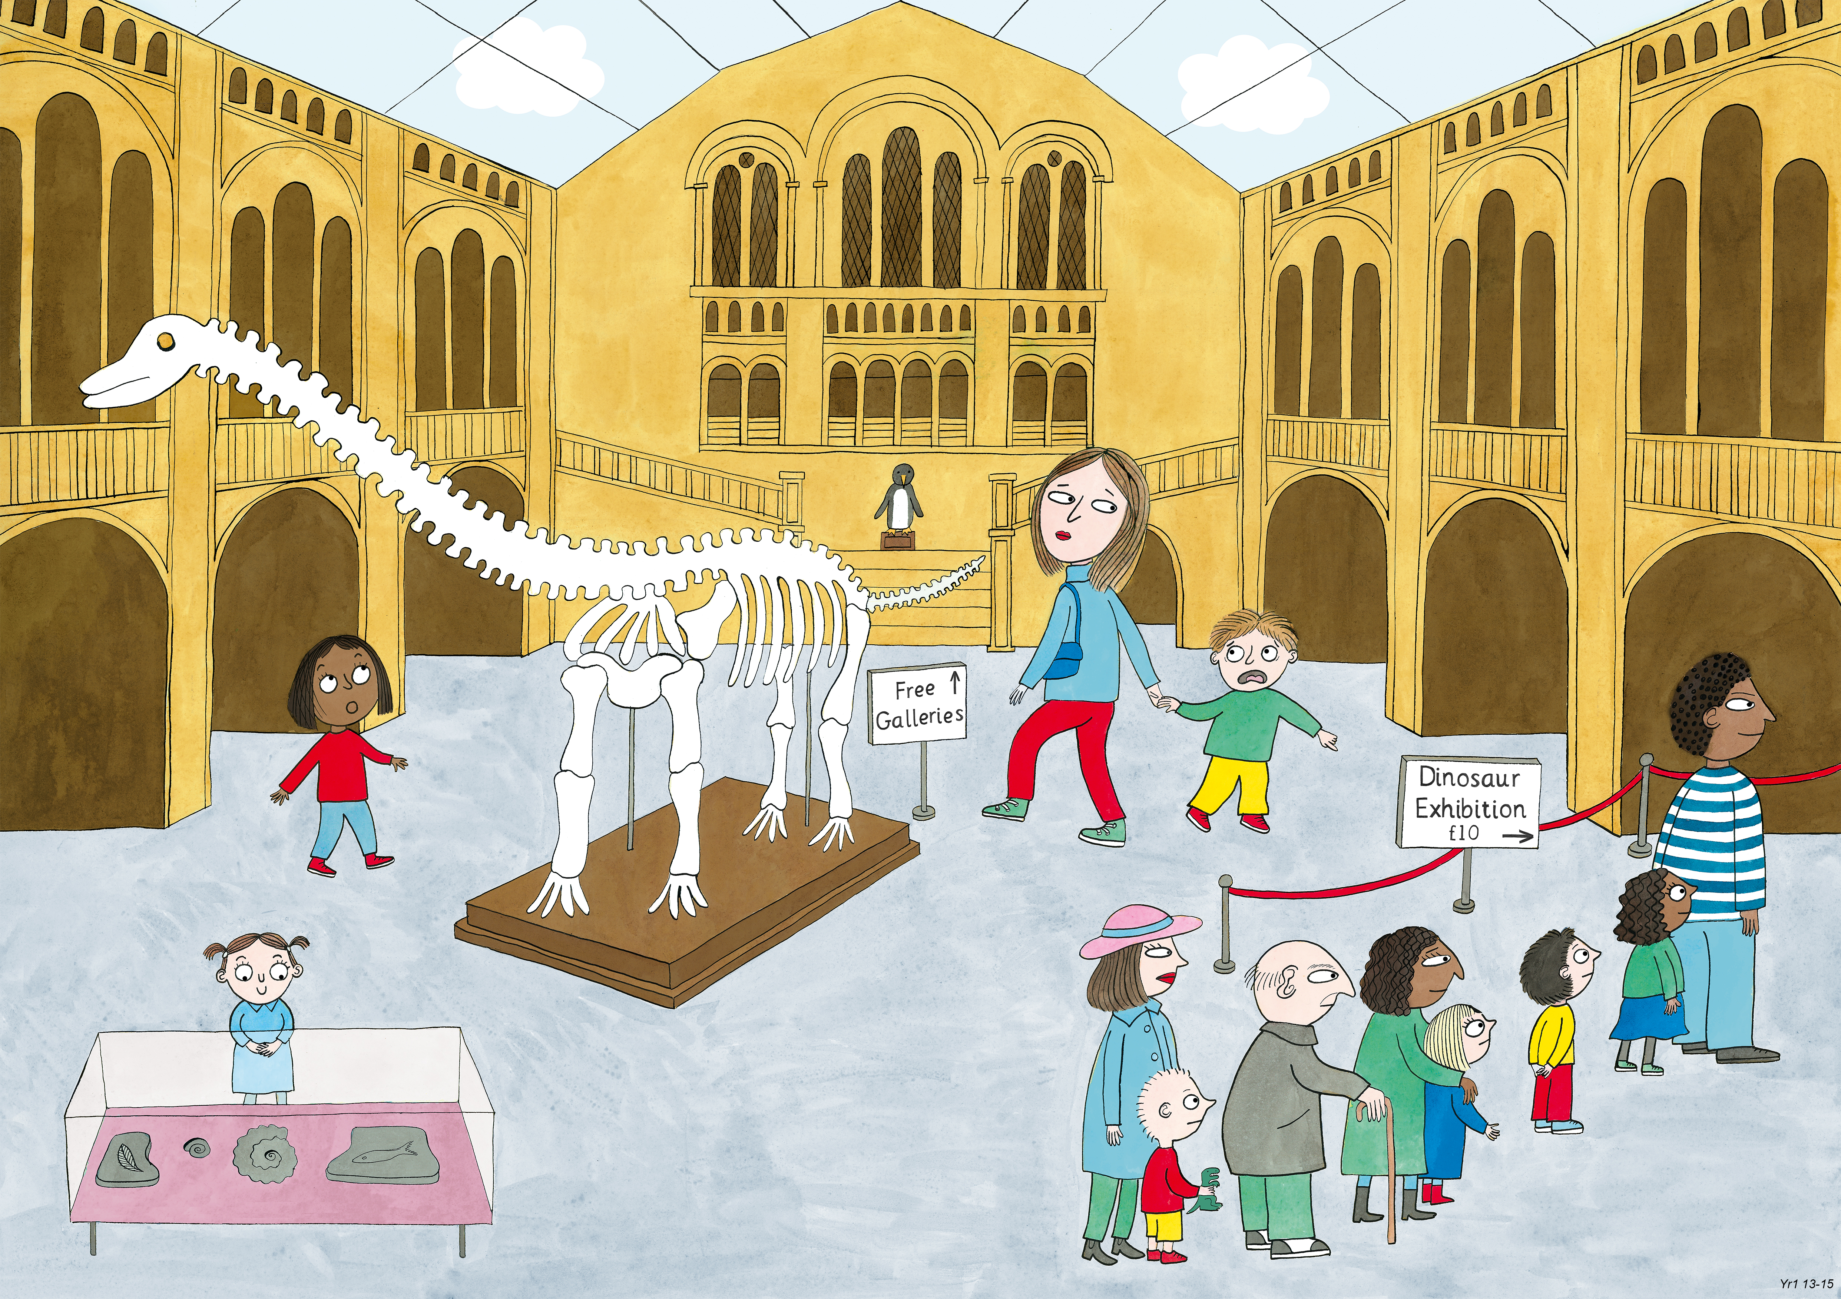
Year 1: Summer 1
Judgement and Prudence, Forgiveness, Appreciation and Awe.

Slide 2
How do the pictures make you feel?

Slide 3
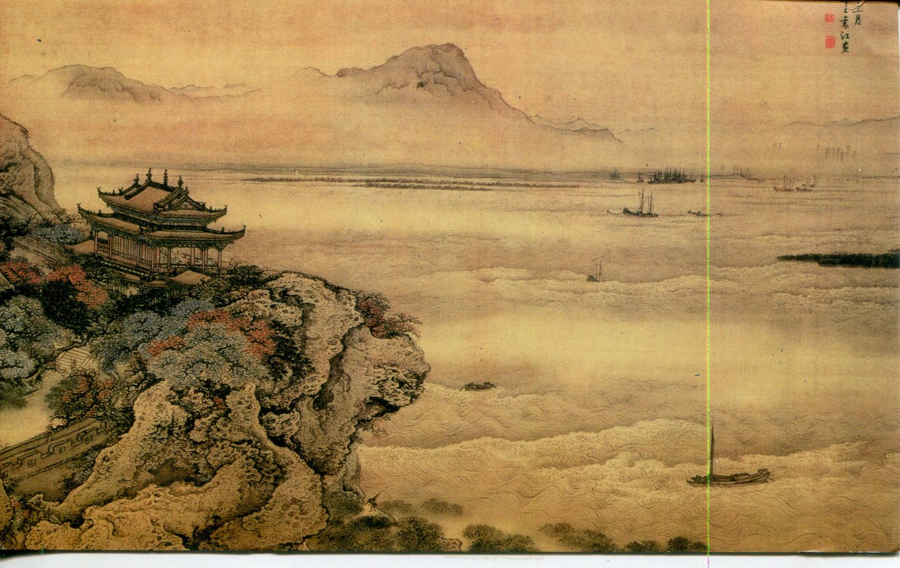
Ancient Chinese painting

Slide 4
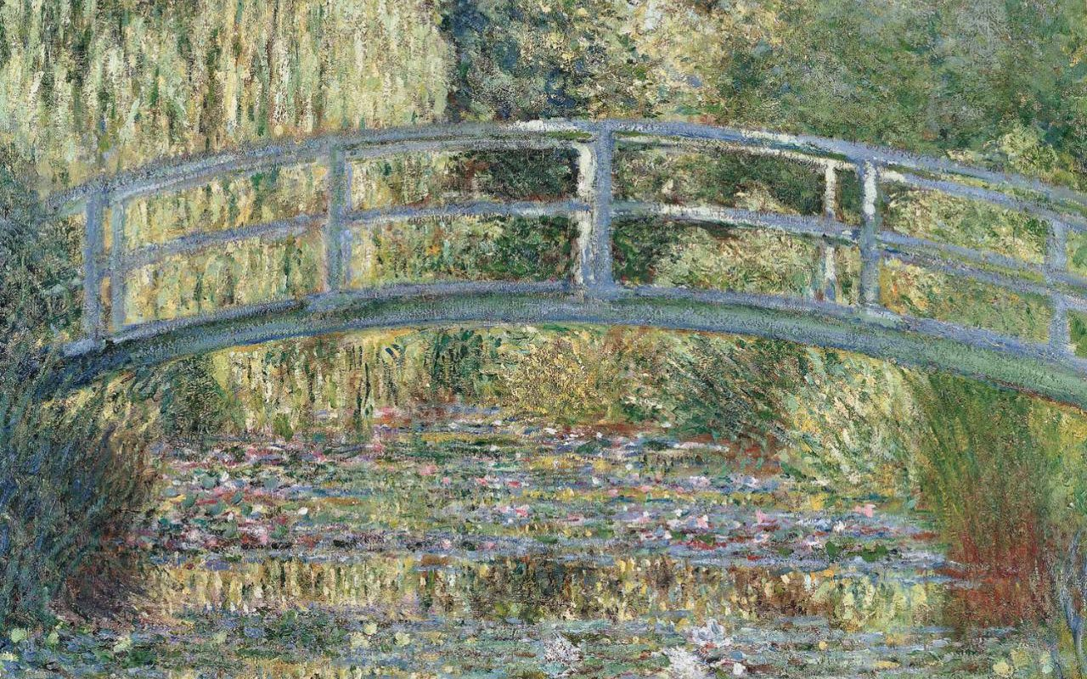
Claude Monet, Waterlillies

Slide 5
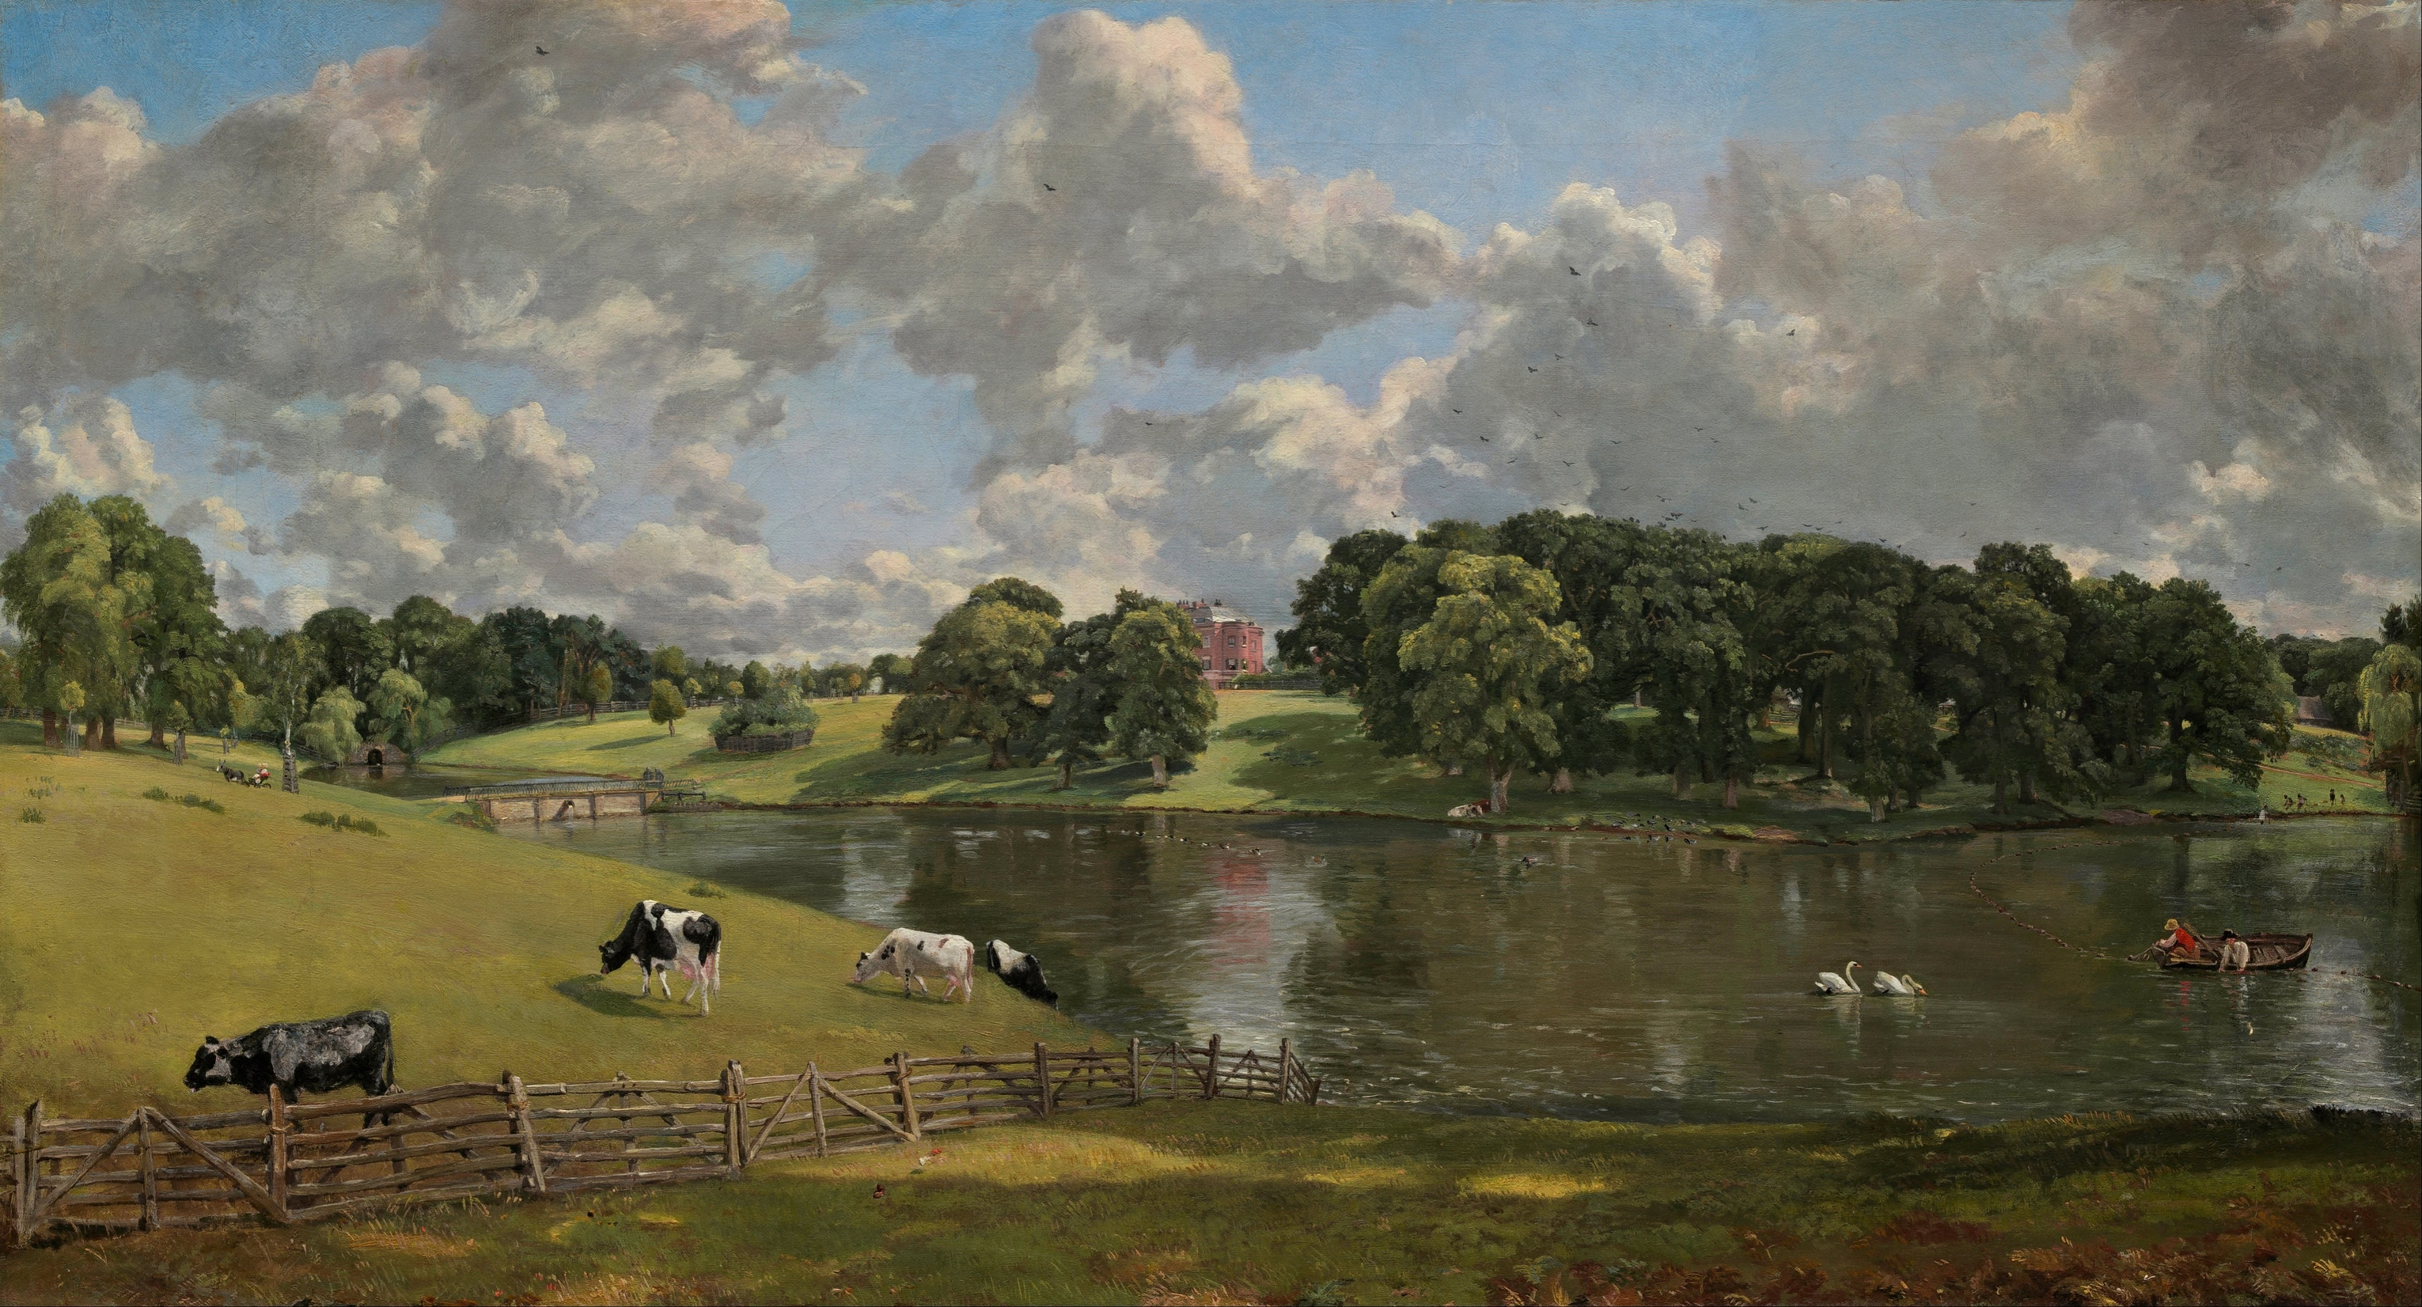
John Constable, Wivenhoe Park

Slide 6
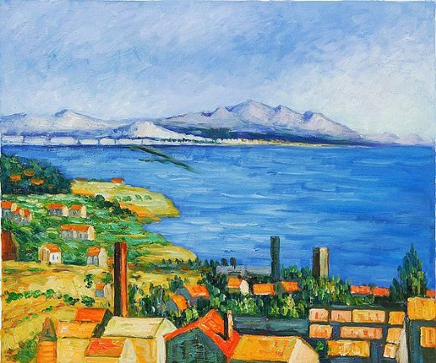
Paul Cezanne, The Bay of Marseilles

Slide 7
J.M.W. Turner, The Rainbow (1835)

