Slide 1

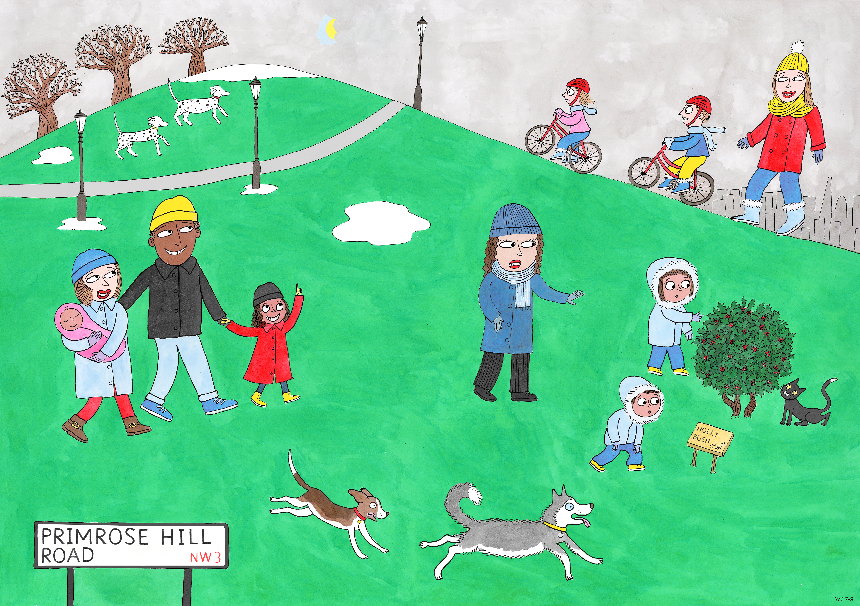
Year 1: Spring 1
Perseverance, Optimism and Joy, Curiosity

Slide 2
Is this a problem or an opportunity?
Notes:
If you think only one can play with the ball then this presents a problem. But, imagine what fun they could have if they shared the ball and made it into a game?

Slide 3
Close your eyes and imagine there are two children, and only one ice cream.
Is this a good situation or a bad one?
How could we make it into a good situation?

Slide 4
All the pairs in these pictures have one ice cream.
Which children are enjoying themselves?
Why do you think that is?
Notes:
One ice cream and two children could be a real problem! Which

Slide 5


