Slide 1

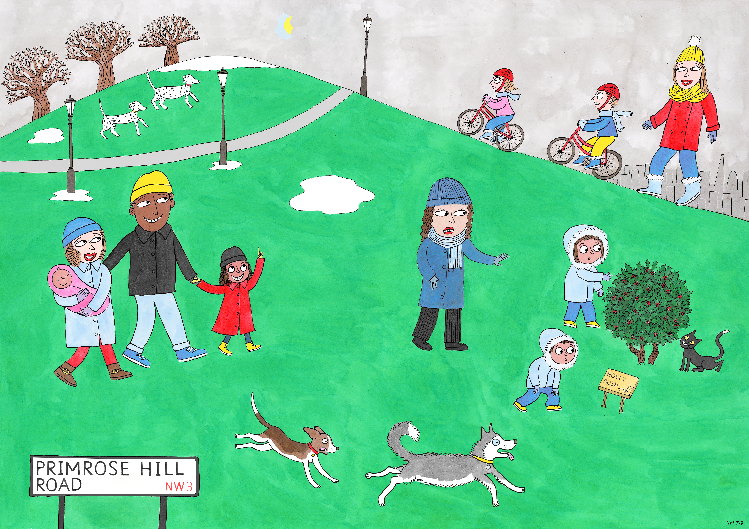
Year 1: Spring 1
Perseverance, Optimism and Joy, Curiosity

Slide 2
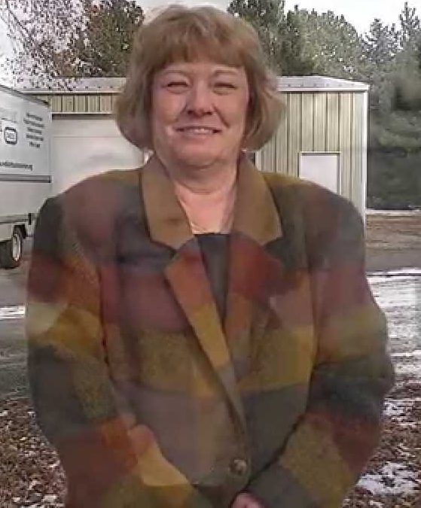
The Shoe Lady
Perseverance

Slide 3
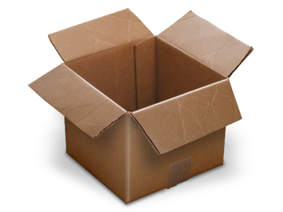
One day a woman called Ranya Kelly needed an empty cardboard box to post a package in. She knew lots of shops throw away boxes, so she went behind a shoe shop to look for a box.

Slide 4
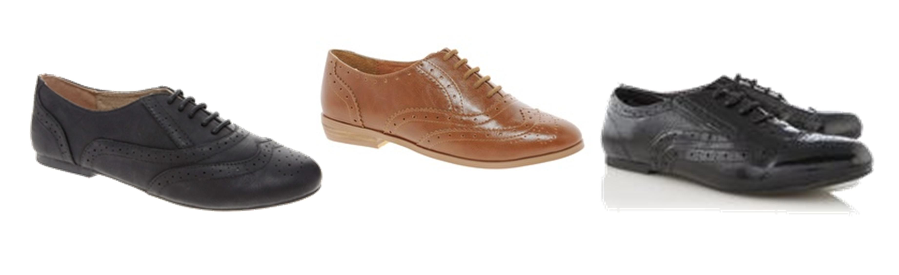
She could hardly believe her eyes!
Mixed in with all the rubbish were hundreds of brand new shoes!

Slide 5
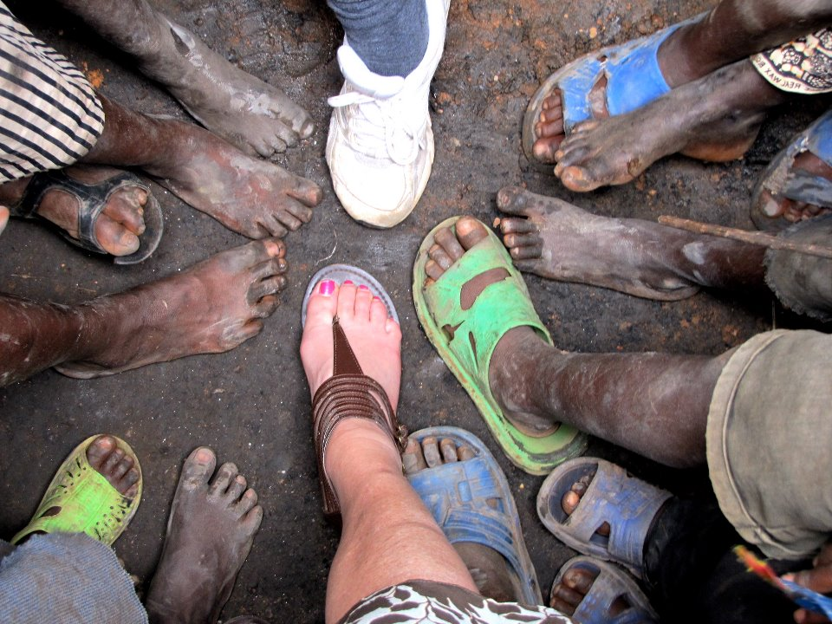
She knew there were lots of people who needed shoes but couldn’t afford to buy them. She took the shoes and gave them to people at a community centre so they could give them to families that needed them.

Slide 6
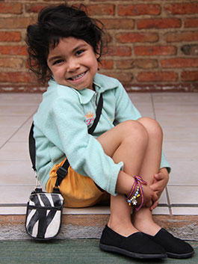
The people at the centre were so glad of the shoes.
Mrs Kelly went back to the shop again, and each time she found brand new shoes being thrown away, and she took them to the community centre.

Slide 7
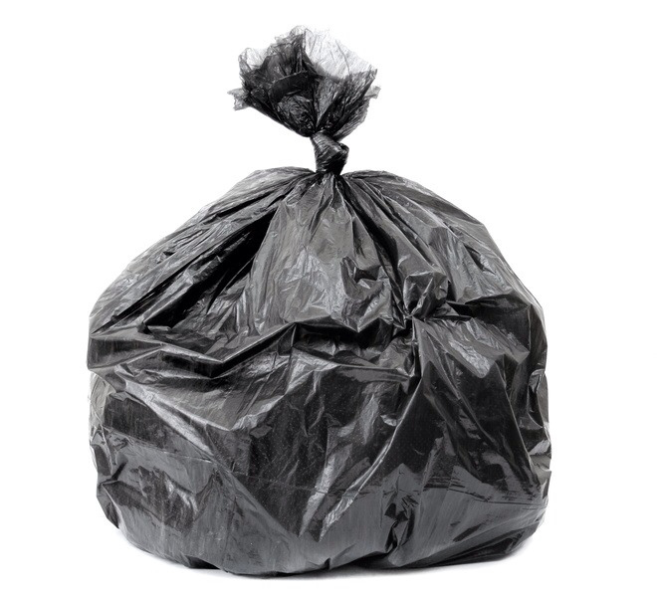
When the store manager found out he was really angry.
He said that he was throwing them away because he couldn’t sell them, so he didn’t want people to wear them.

Slide 8

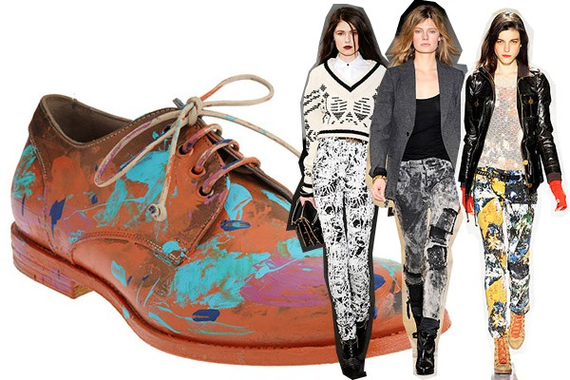
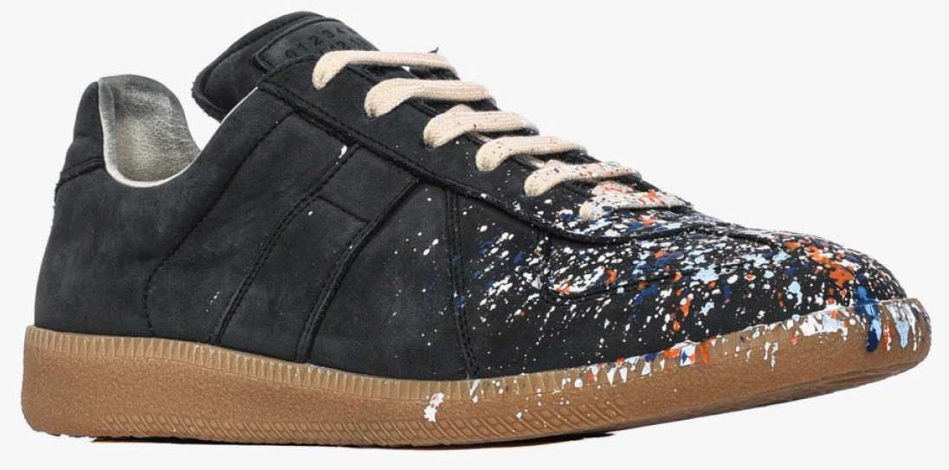
The next time Mrs Kelly went to the back of the store, the brand new shoes had all been cut up before they were put there!
Sometimes they were all covered in paint so people would be too embarrassed to wear them. Mrs Kelly just cleaned the paint off and made them nice shoes again.

Slide 9
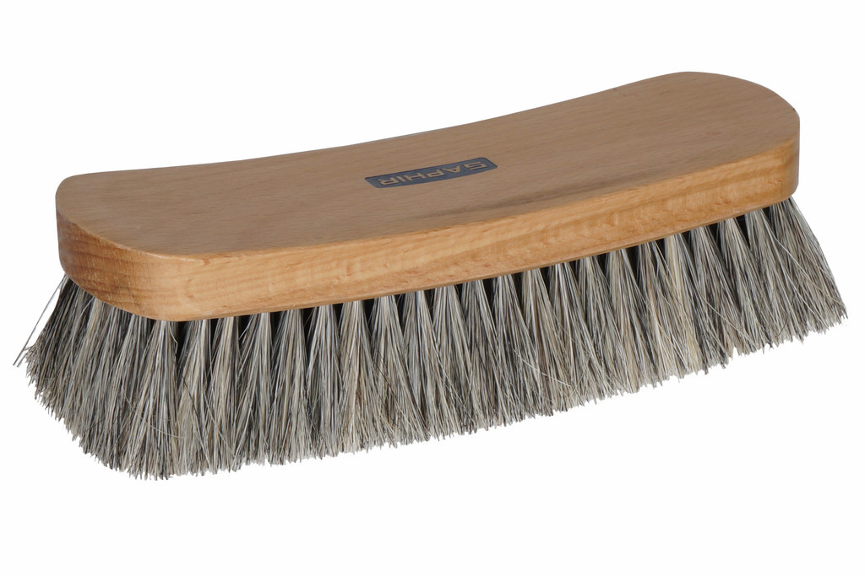
The store manager got even ANGRIER!
He said she was stealing from his shop. He said he would call the police if she took any more shoes.
Ranya Kelly was in trouble. It was a lot of work to sort hundreds of shoes and to clean them up. She was spending hours fixing shoes instead of being with her family and doing the things she enjoyed. Now – on top of all that – she might get arrested!

Slide 10
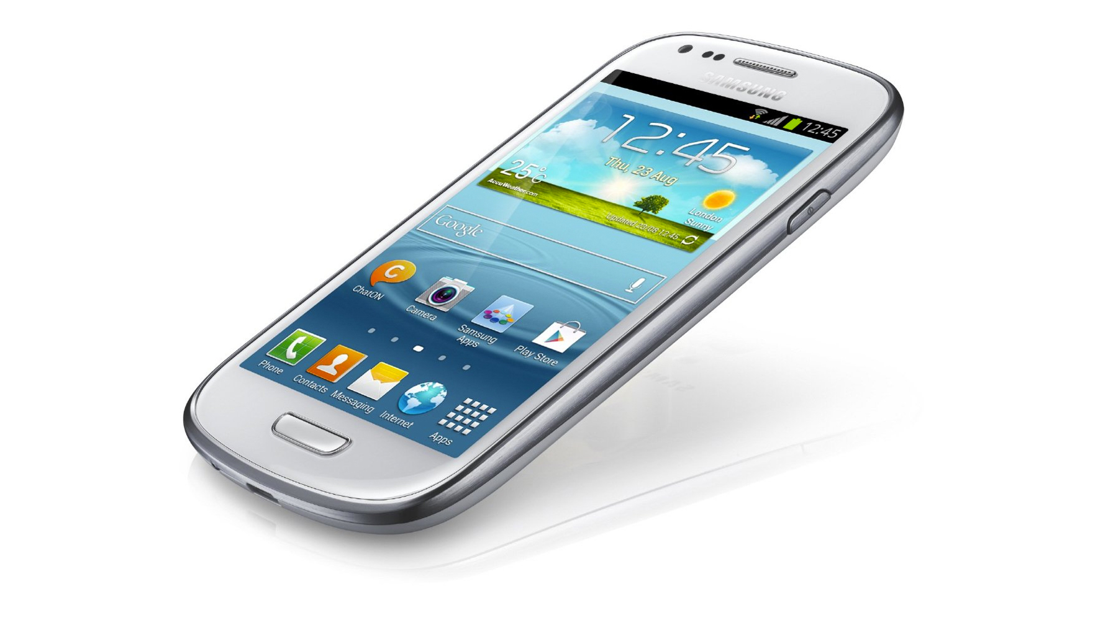

What a mess! But Ranya Kelly didn’t give up. She was so sure it was right to give those good shoes to people who really needed them that she kept on talking to the store manager.
She also talked to a newspaper reporter about all the shoes that were being destroyed.

Slide 11
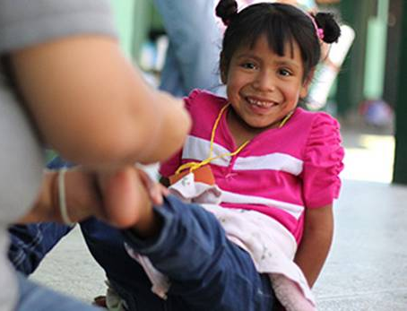
People who read the paper didn’t like it that good shoes were being wasted. Lots of people started to call Mrs Kelly and said they wanted to help her.

Slide 12
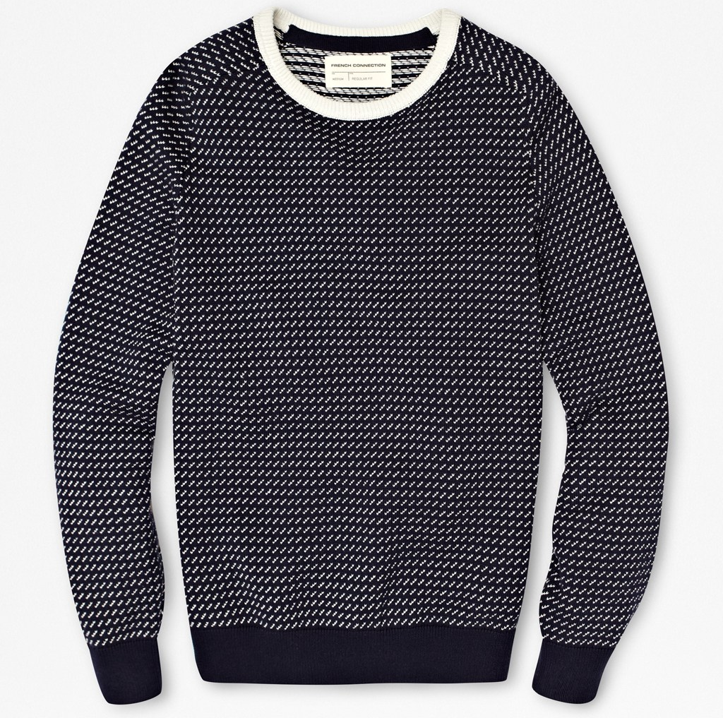
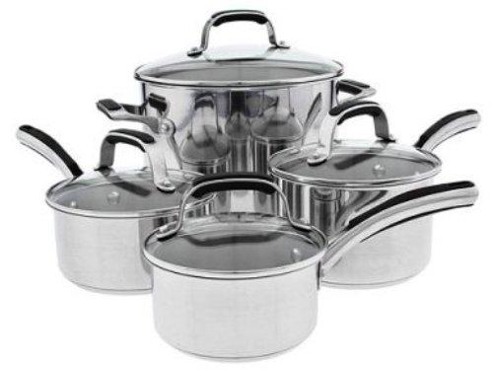
They said they would donate their good shoes, clothes, pots, pans and even furniture. They wanted to help poor families too. So the store manager eventually agreed to give the shoes to her. Lots of other shoe shops heard about Mrs Kelly and decided to help too.

Slide 13
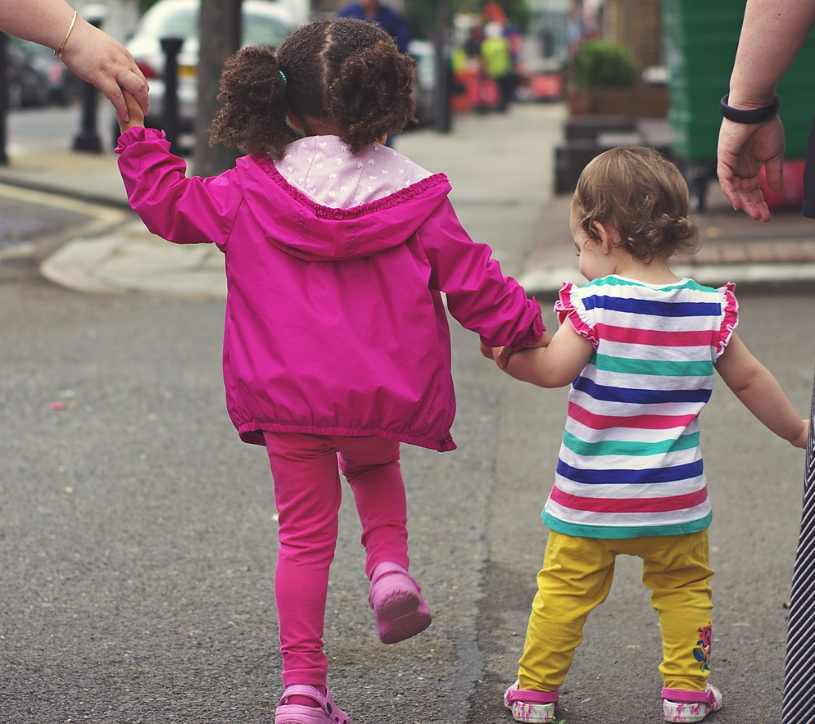
Mrs Kelly persevered, even when things were really difficult. She didn’t let one angry person stop her!
Thanks to her hard work, 100,000 pairs of shoes – and all kinds of other new things people can use – have been saved and given away to people who need it most.

Slide 15
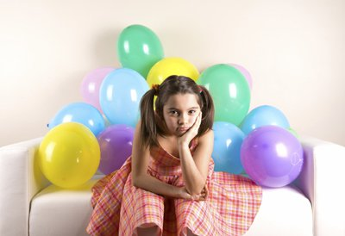
If someone doesn’t come to your party does it mean they don’t like you?

Slide 16
No, they might be busy on that day or they might not be allowed to come.

Slide 17
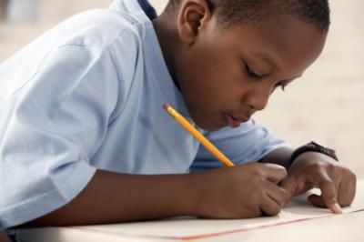
If you got 7/10 in a spelling test even though you studied really hard, does it mean you’ll never learn to spell those words?

Slide 18
No, mistakes help us to learn and improve. It just means you need to practise a bit more.
A week ago you’d have got 0/10!

Slide 19
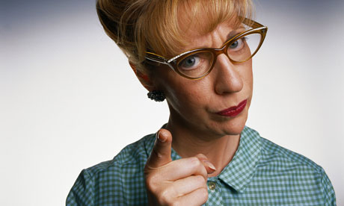
If someone tells you off does it mean they don’t like you?

Slide 20
No, it just means that you made the wrong choice that time.

Slide 21
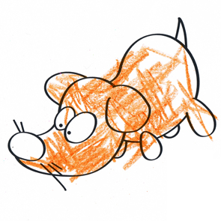
If you can’t colour within the lines does it mean you will never be good at drawing?

Slide 22
No, it means this is going to take some time and effort.
I need to practise.

Slide 23
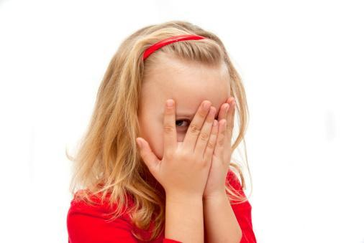
If speaking in front of the class makes you embarrassed, does it mean you will always be shy?

Slide 24
I find this difficult at the moment, but I can practise being confident.

