Slide 1

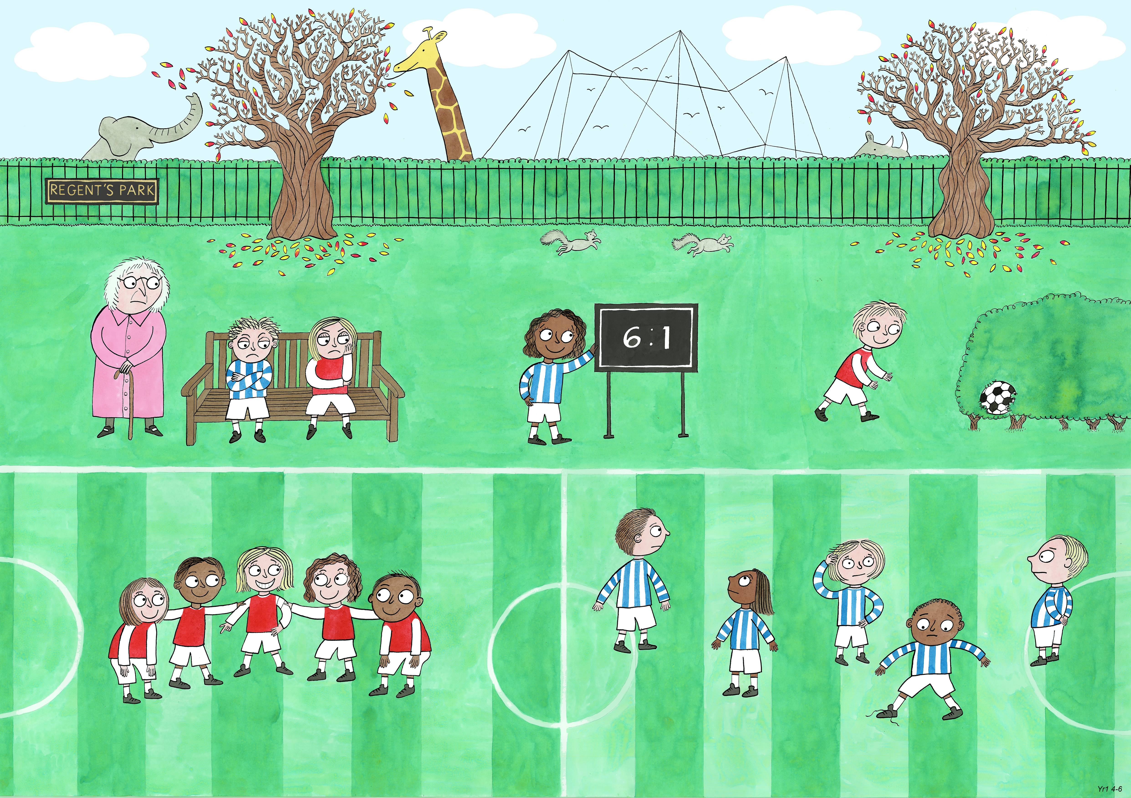
Year 1: Autumn 2
Leadership and Teamwork, Fairness, Service

Slide 2
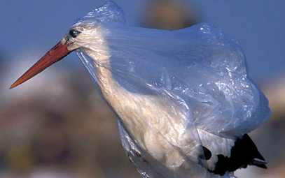

Slide 3
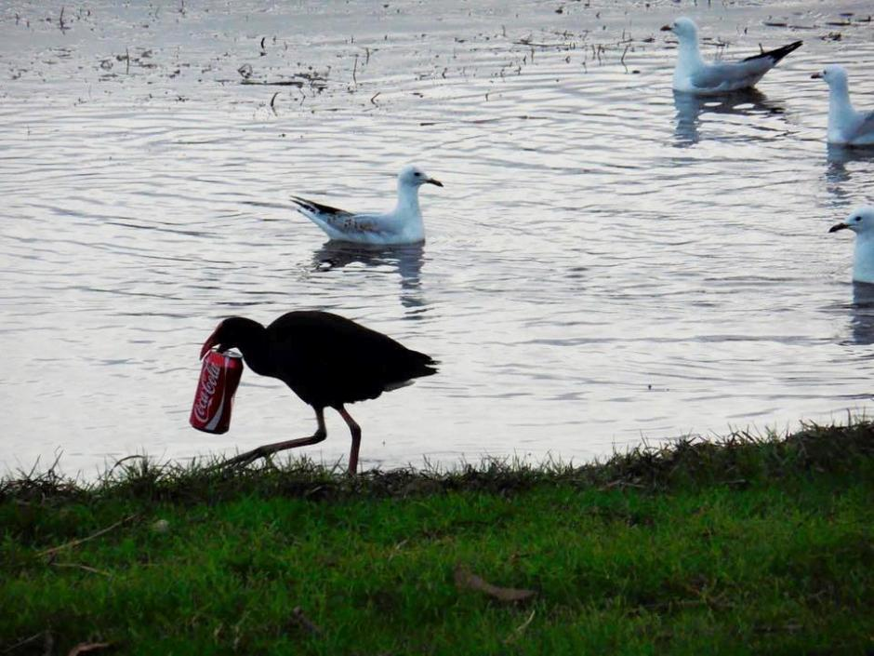

Slide 4
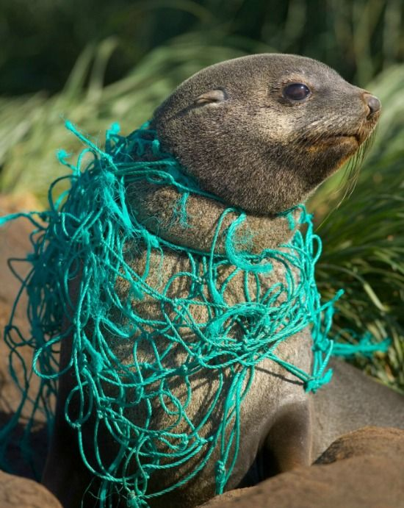

Slide 5
