Slide 1

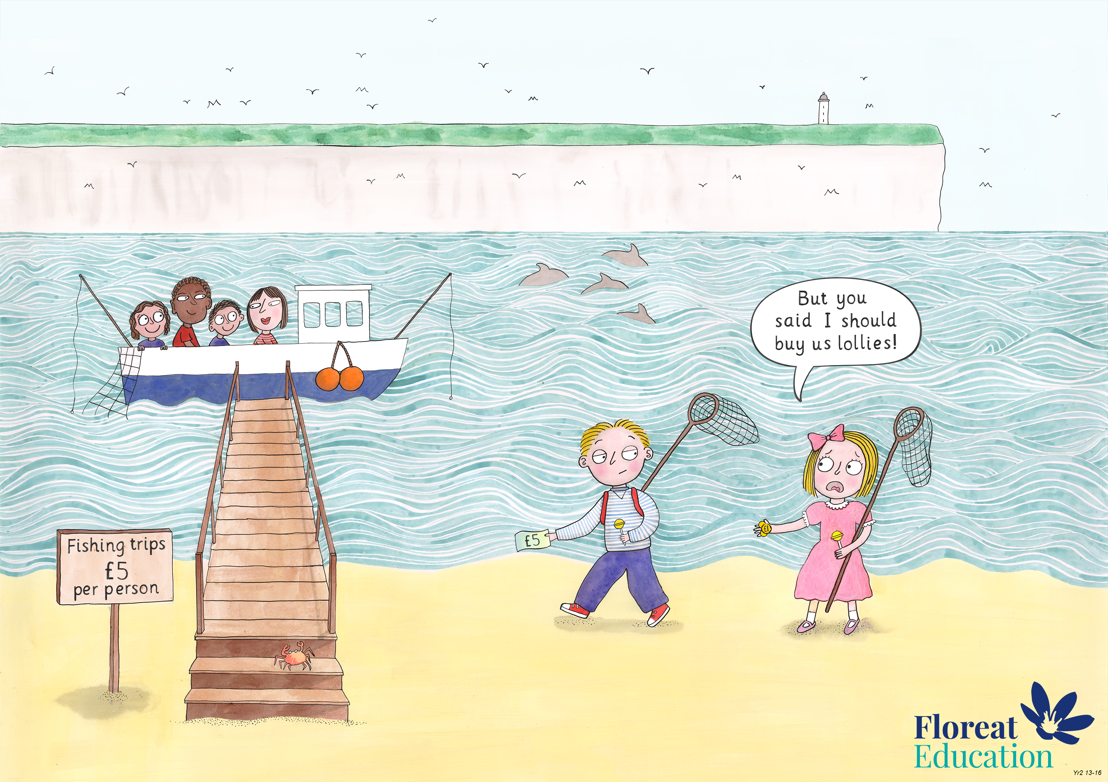
Year 2: Summer 1
Judgement and Prudence, Forgiveness, Appreciation and Awe

Slide 2
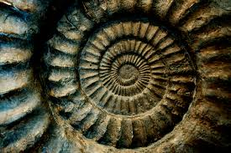

Slide 3
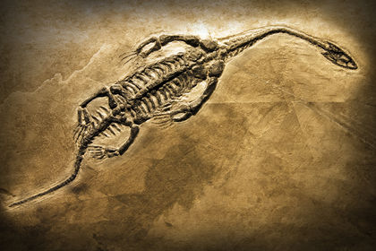

Slide 4
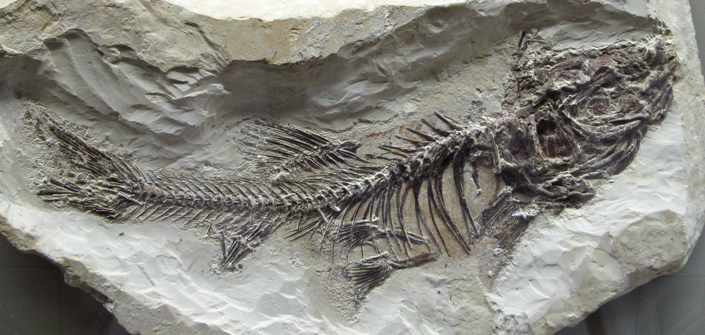

Slide 5
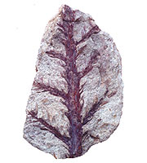
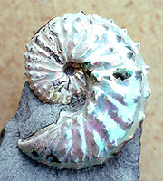
Fossils show us what living things were like millions of years ago.
Some fossils are the hard remains of living things like teeth or bones, and some fossils are traces of living things - like footprints.

Slide 6
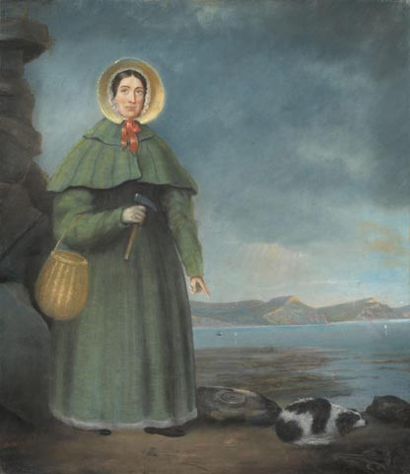
Interesting information
Fossils are clues about the past. 200 million years ago the place where Mary lived was beneath the sea. The sea was full of strange sea creatures that don’t exist anymore. Mary found their fossils.

Slide 7
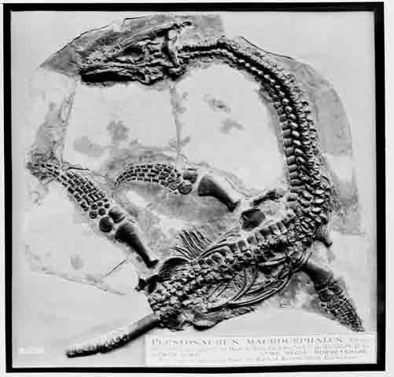
In 1811 Mary saw something sticking out of a rock, she used a hammer to chip away at it until she carefully uncovered a skeleton. It looked like a crocodile! She was the first person to discover this creature which is sometimes called a ‘fish lizard’.

Slide 8
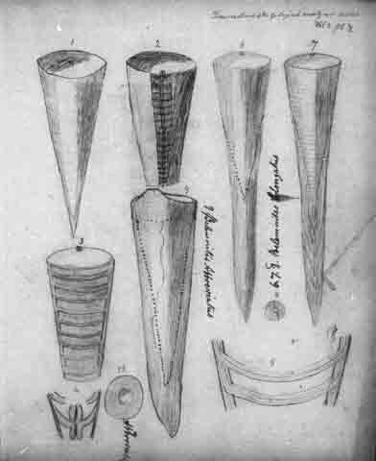
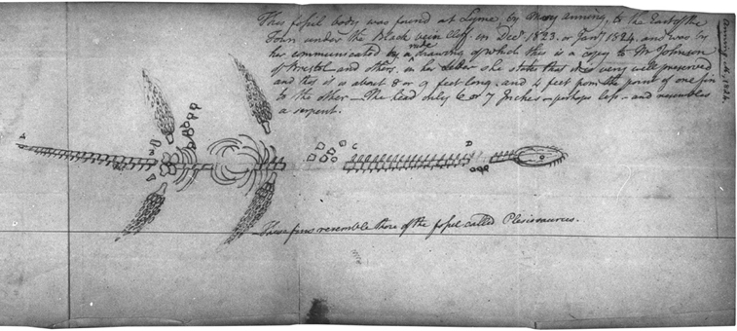
Mary’s discoveries helped scientists to discover more about the creatures that existed in the past. These are her sketches.

Slide 9
Interesting facts
The earth is 4.5 billion years old! Scientists think that life began in the seas many millions of years ago. The first fish swam around over 400 million years ago. The age of dinosaurs began about 240 million years ago and ended 65 million years ago.
Mary Anning didn’t go to school – her family was too poor. Instead she taught herself about fossils and rocks.
Prehistoric animals were not the same as living animals. Some animals died out. Different animals took their place. This is called evolution.
A scientist called Charles Darwin explained how evolution works not long after Mary Anning died. Her fossils had helped scientists understand how things began.

