Slide 1

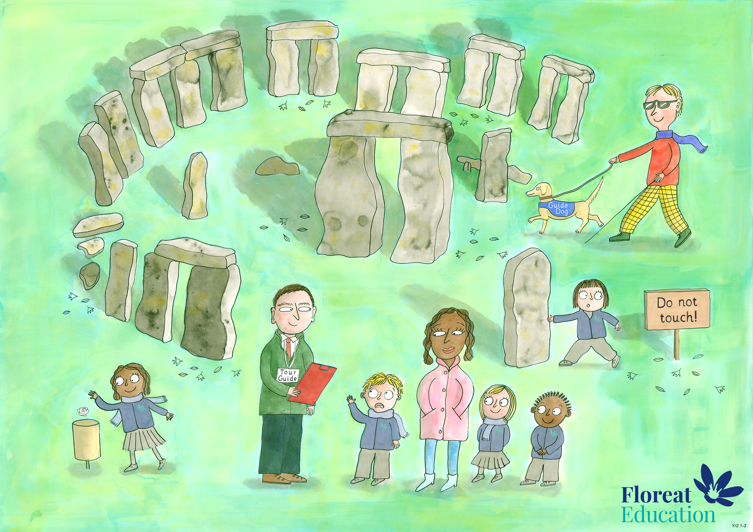
Year 2 Autumn 1
Self Control and Dignity, Bravery, Love and Kindness

Slide 2
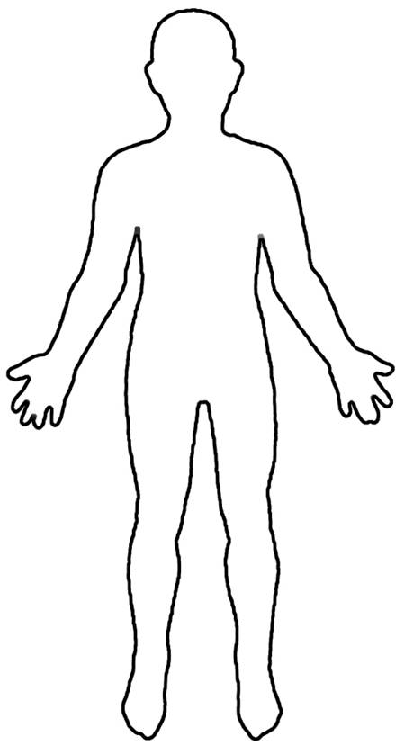
How do we feel at times we need to be brave?
Heart
Hands
Mouth
Stomach
Brain

