Slide 1

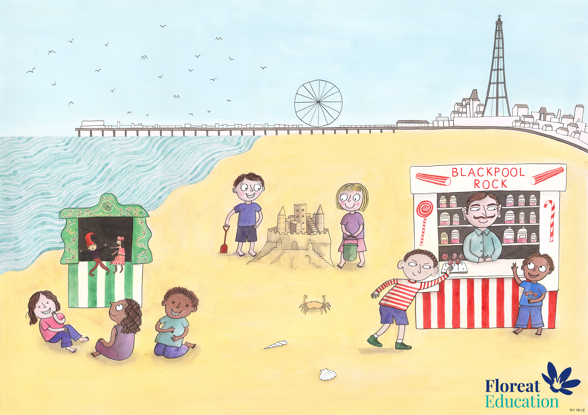
Year 2 Spring 2
Creativity, Honesty, Humour

Slide 2
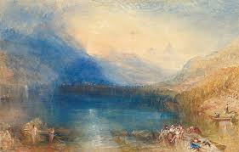
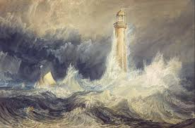
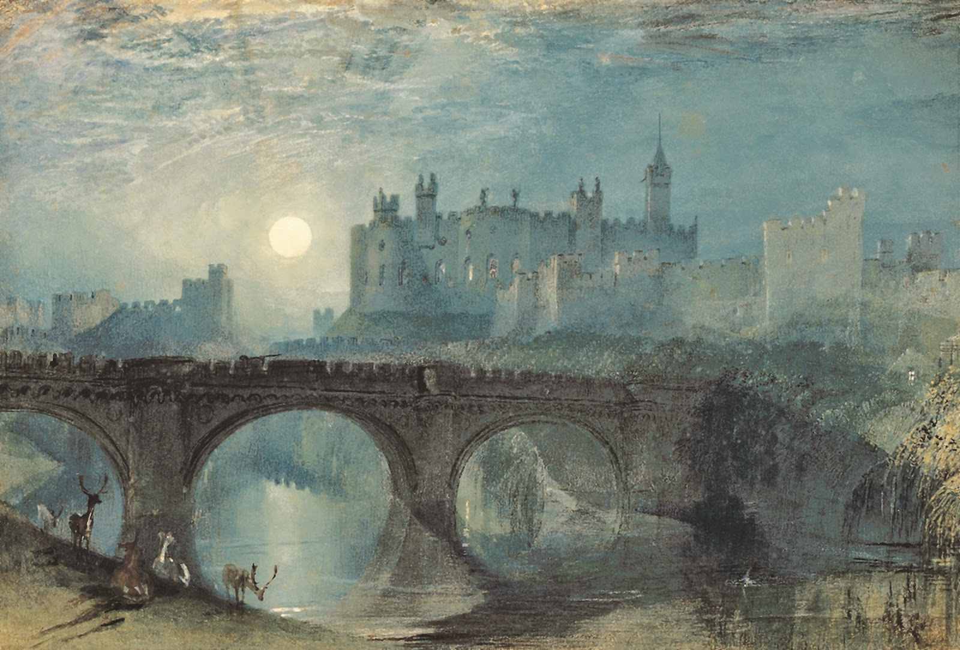
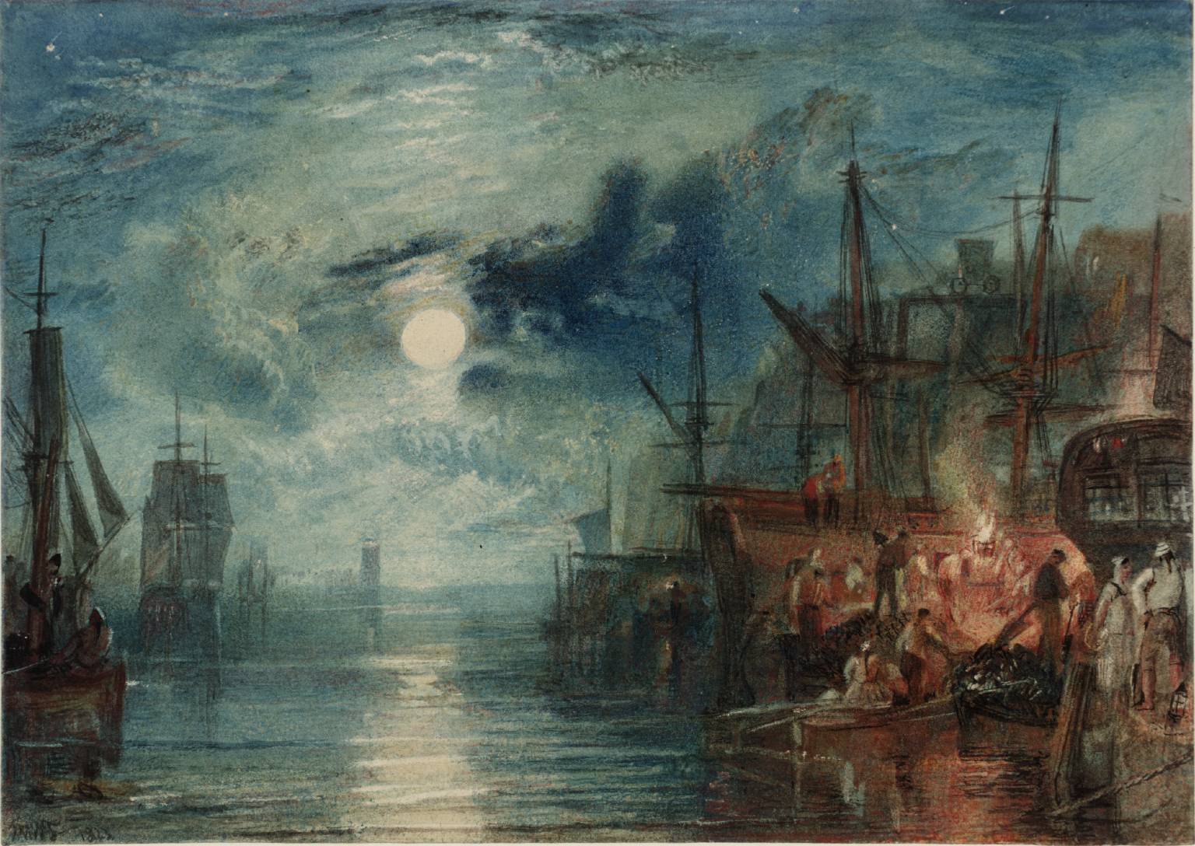
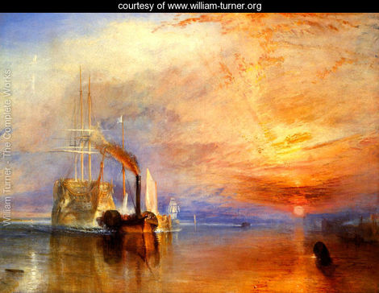
J.M.W. Turner
1775-1851
Turner is one of the most famous artists ever to have lived. His work has been enjoyed for hundreds of years and his landscapes are still considered some of the best ever painted.
The Turner Prize is an art prize named after him.

Slide 3
Turner studied at the Royal Academy of Arts and travelled around Europe meeting artists and learning about painting.
He looked carefully at work that he liked and tried to copy the techniques his favourite artists used.
Many people have pointed pointed out how similar his paintings are to the artists he copied.

Slide 4
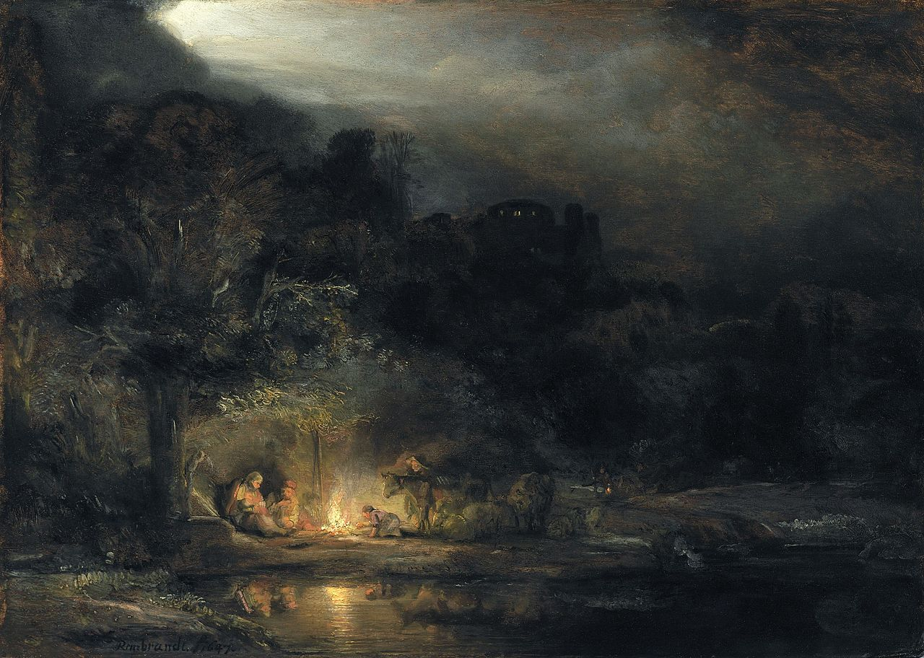
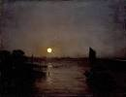
Turner looked closely at Rembrandt’s work and said ”I don’t only understand how he achieved his affect but I can do the same and in fact, I can do it better.”
Rembrandt
Landscape with the Rest on the Flight Into Egypt 1647
Turner
Moonlight, A Study At Millbank, in 1797

Slide 5
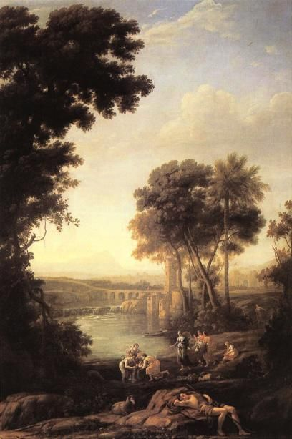
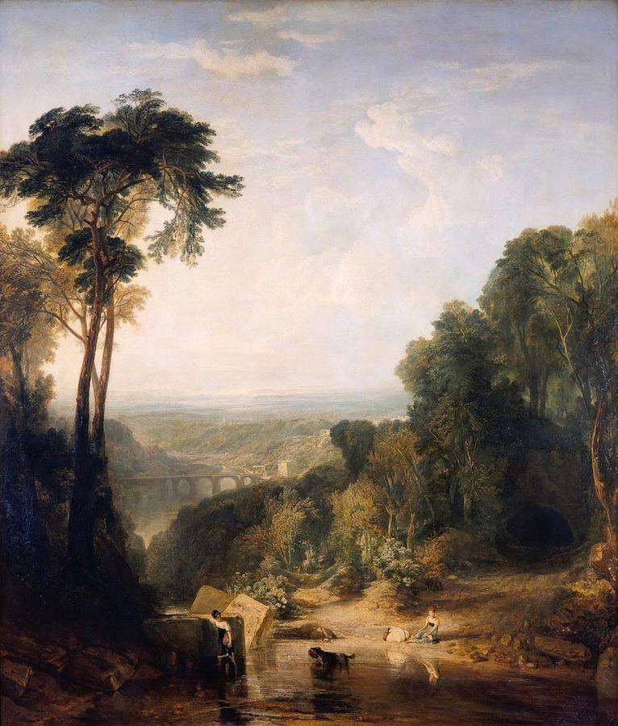
Lorrain
Moses Saved From the Waters 1639
Turner
Crossing the Brook 1815

Slide 7

I have used my creativity to make this into…

Slide 8

I have used my creativity to make this into…

Slide 9

I have used my creativity to make this into…

Slide 10
I have used my creativity to make this into…

Slide 11
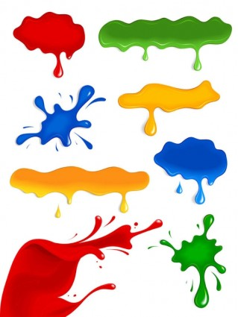
I have used my creativity to make this into…

Slide 12
I have used my creativity to make this into…

