Slide 1

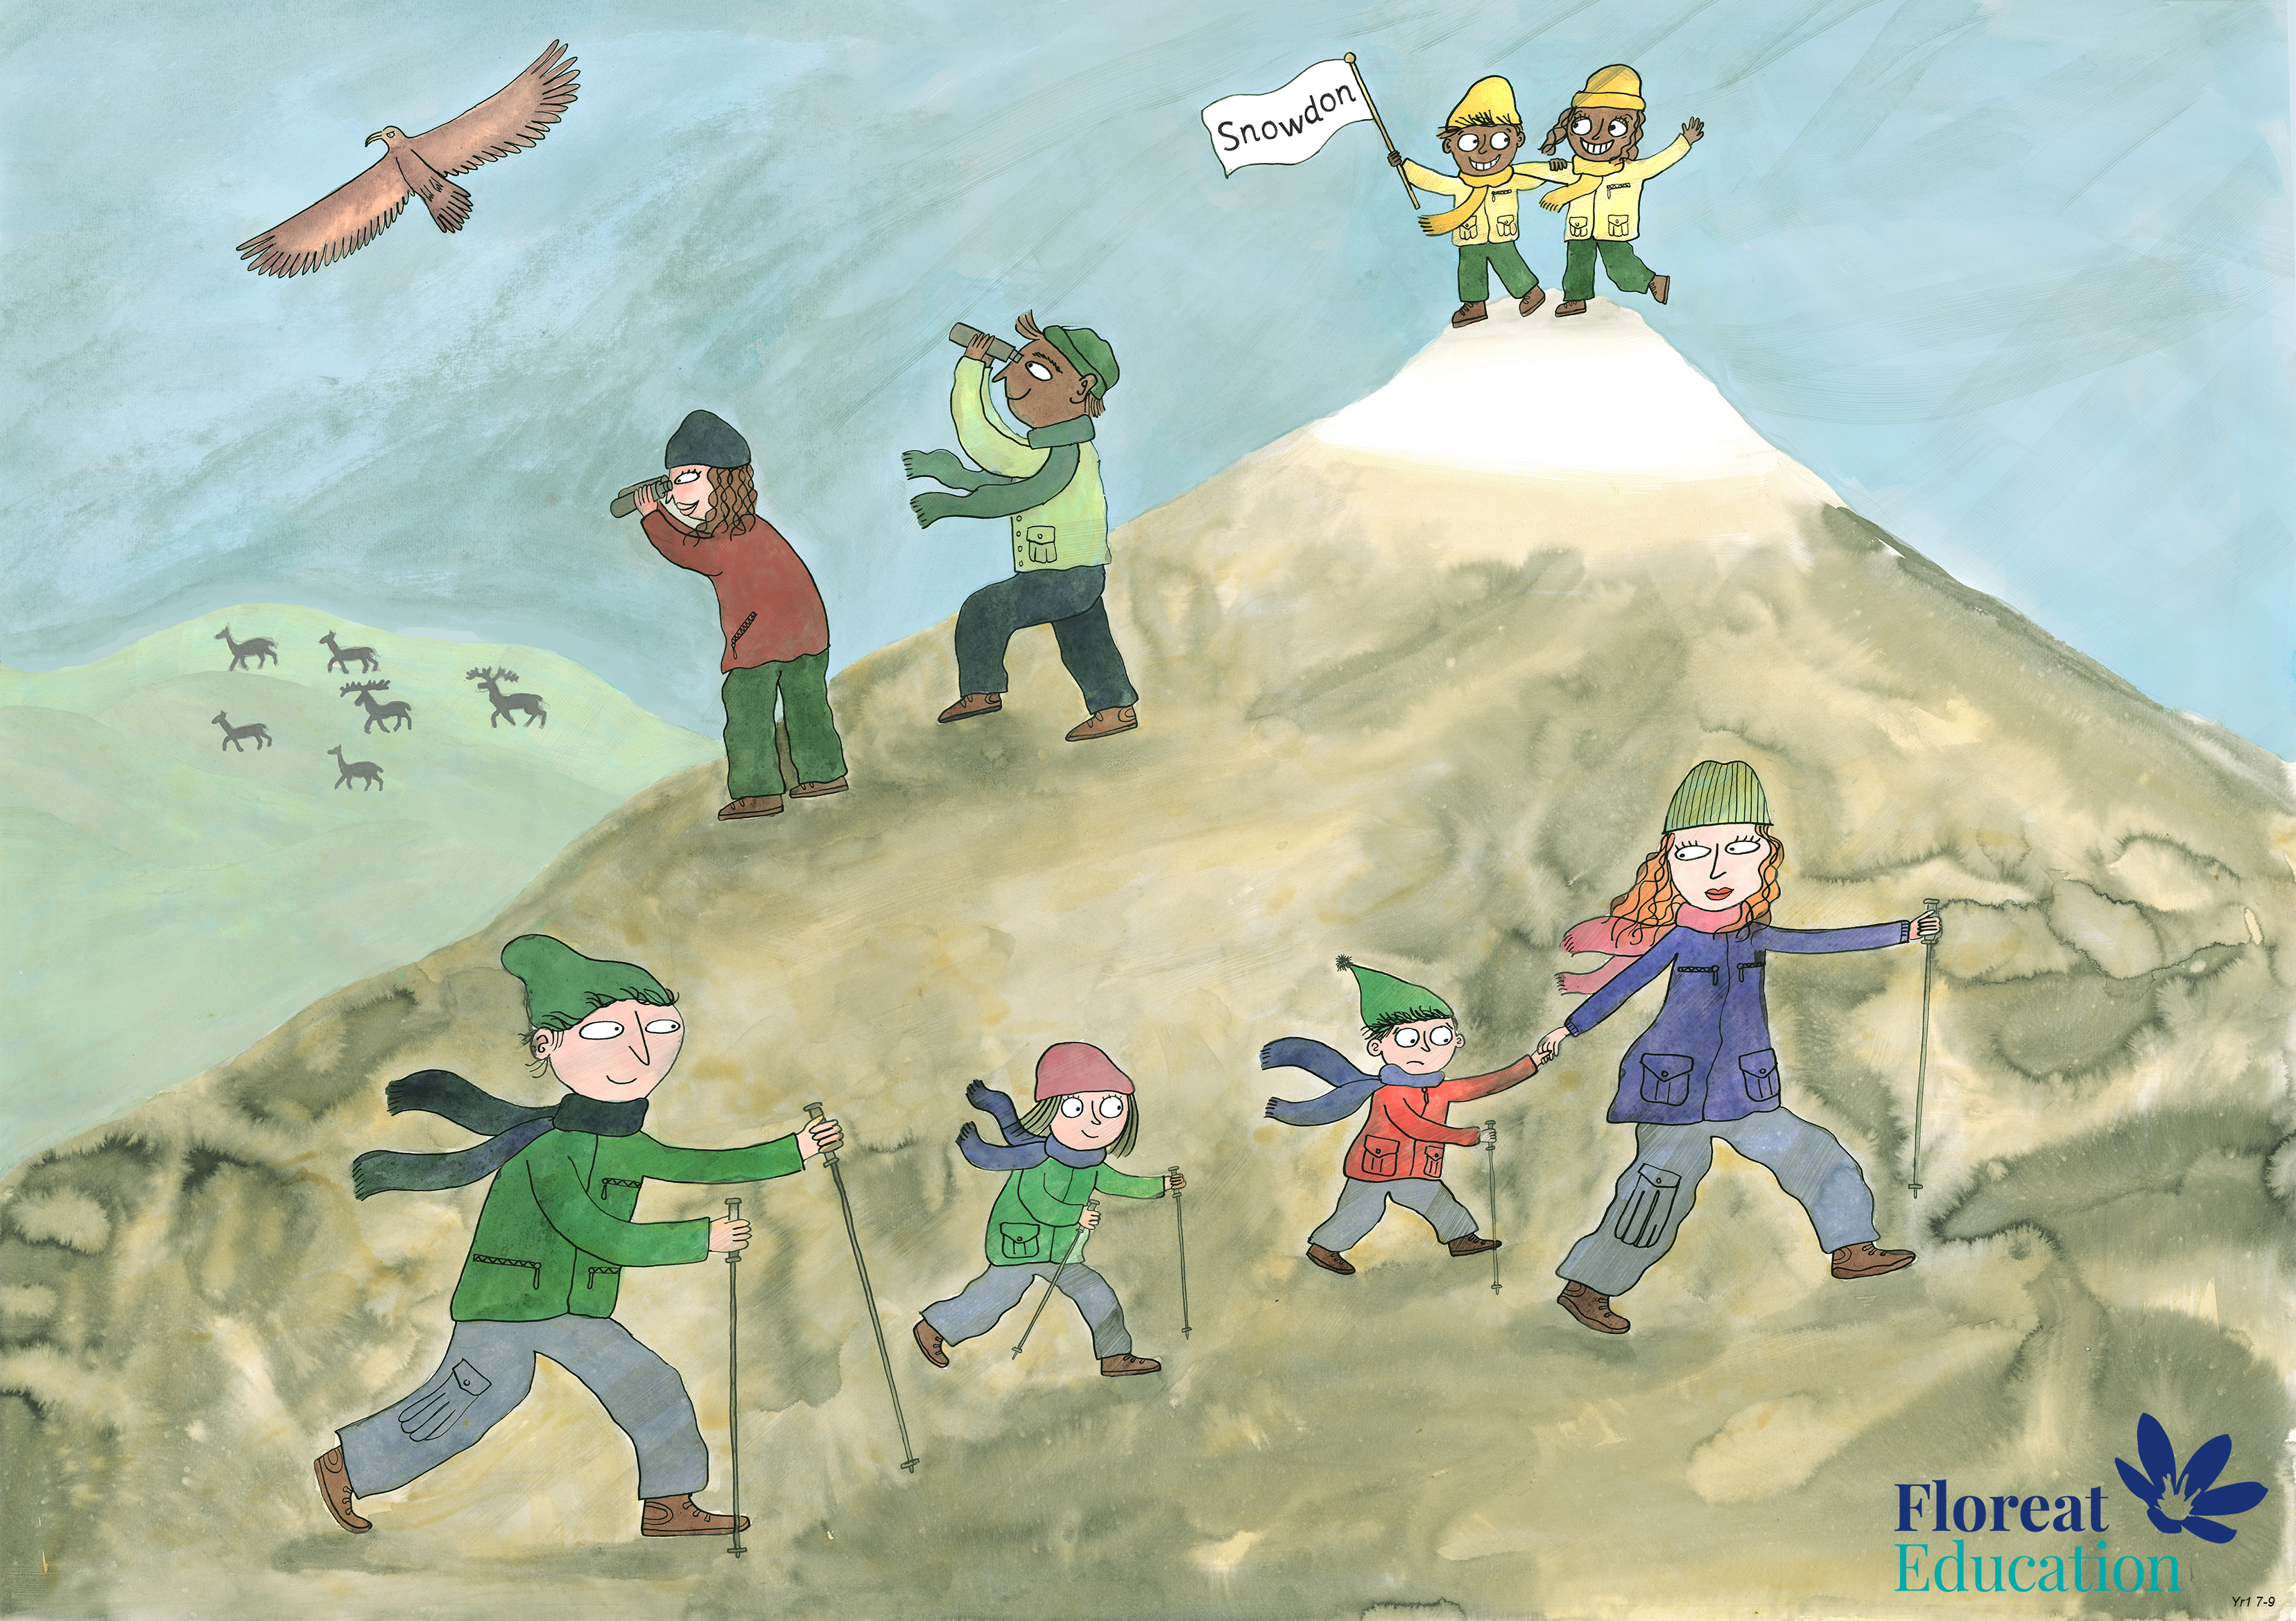
Year 2 Spring 1
Perseverance, Optimism and Joy, Curiosity

Slide 2
That’s Not Lemonade!

Slide 3
One Saturday afternoon, Henry was playing football in the garden with his friends. It was very hot outside and the children were tired and thirsty so they decided to take a break.

Slide 4
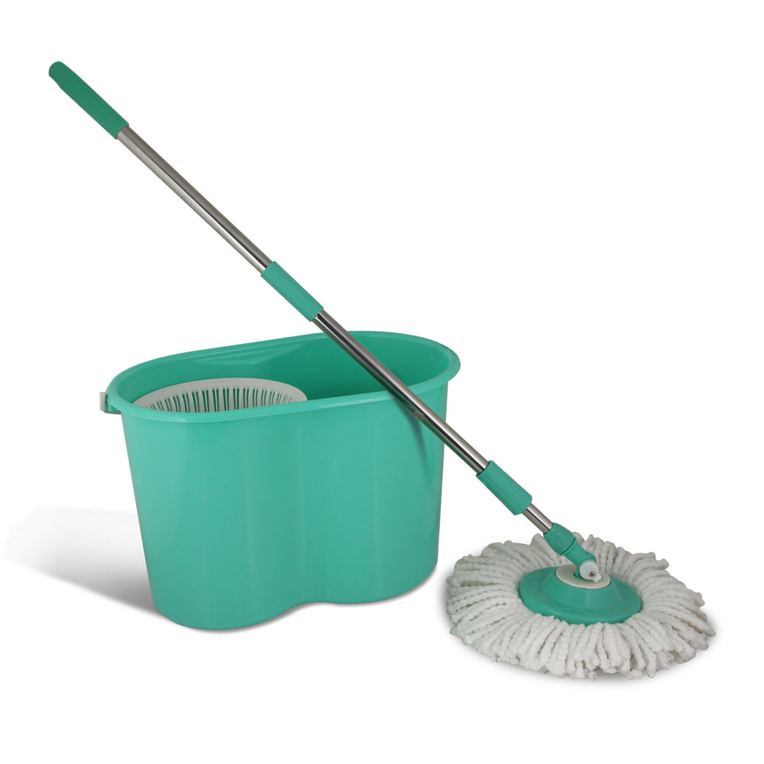
Henry went into his house to ask his Mum if she would make them some lemonade. Henry’s Mum was busy cleaning the kitchen floor. Just as Henry began to ask for the drinks, the phone rang.
“Henry,” his Mum said, “you and your friends are going to have to wait a few minutes.”

Slide 5
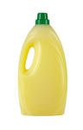
“But, it’s so hot!” cried Henry, “I just can’t wait another minute!”
While Henry’s Mum was answering the phone, Henry saw a bottle his mum had put on the side while she was cleaning the floor. The liquid inside was yellow like lemonade. Henry took the bottle outside to share with his friends.

Slide 6

What questions should Henry be asking himself to work out if the liquid is safe to drink?

Slide 7
Does this have a label on it?
Is it mine?
Did an adult say it’s ok?

Slide 8
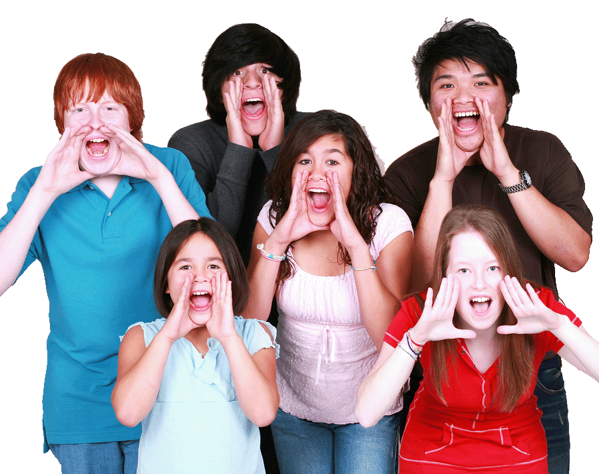
Just as Henry put the bottle to his lips ready to take a sip, Henry’s friends yelled “Stop! Henry, don’t drink it, that’s not lemonade!”

Slide 9
Why do you think Henry’s friends tried to stop him from drinking the yellow liquid?
What do you think was in the bottle? What should Henry’s friends tell him?

Slide 10
Sometimes adults use things in the house or in the garden which can make you very sick or even kill you if they get in your body. They can also hurt the outside of your body if they touch your eyes and skin.

Slide 11
What do the following symbols mean?
Where might you see them?

Slide 12

Notes:
Corrosive – will burn skin if touched

Slide 13

Notes:
Flammable – Can catch fire easily

Slide 14

Notes:
Toxic - Poisonous if swallowed or breathed in

Slide 15

Notes:
Irritant – Can cause soreness to skin, eyes or inside the body.

Slide 16
You have to be careful to ALWAYS check the label and ask an adult because some poisons look like things which are safe:

Slide 17
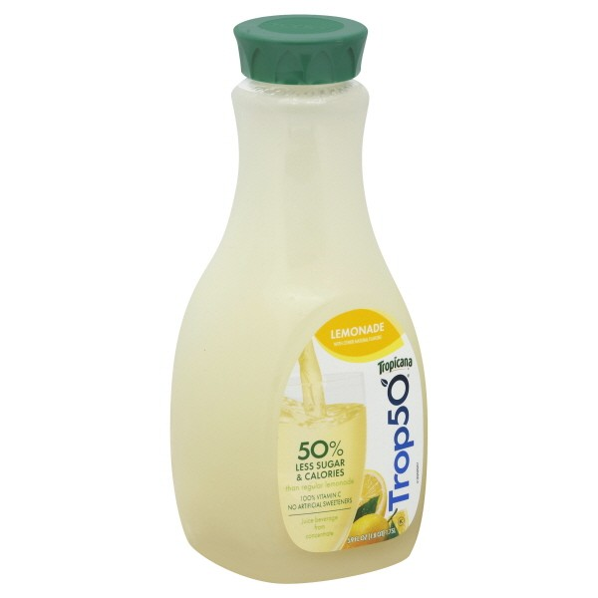
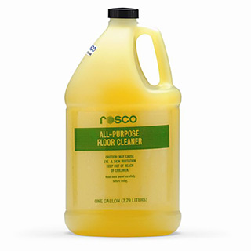
Lemonade and floor cleaner

Slide 18
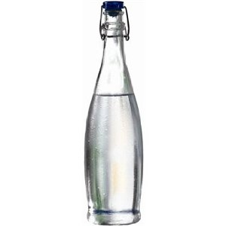
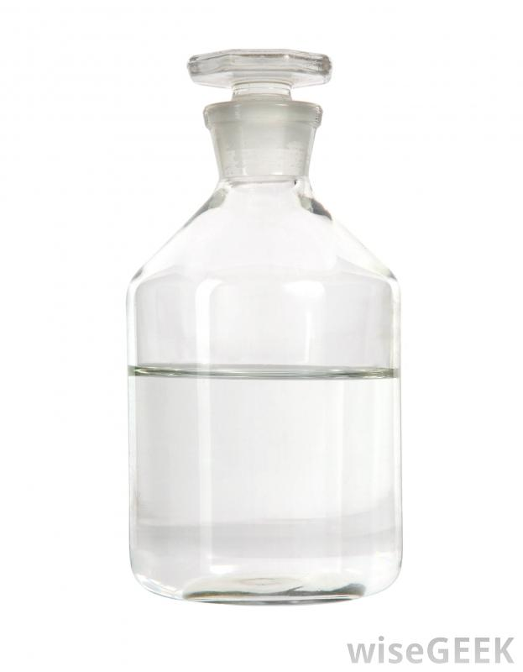
Water and cleaning fluid

Slide 19
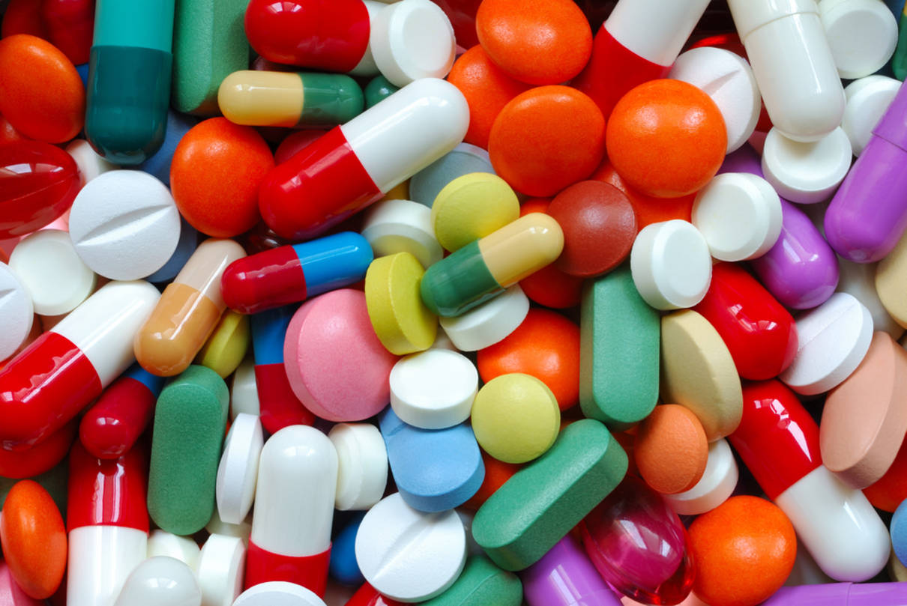
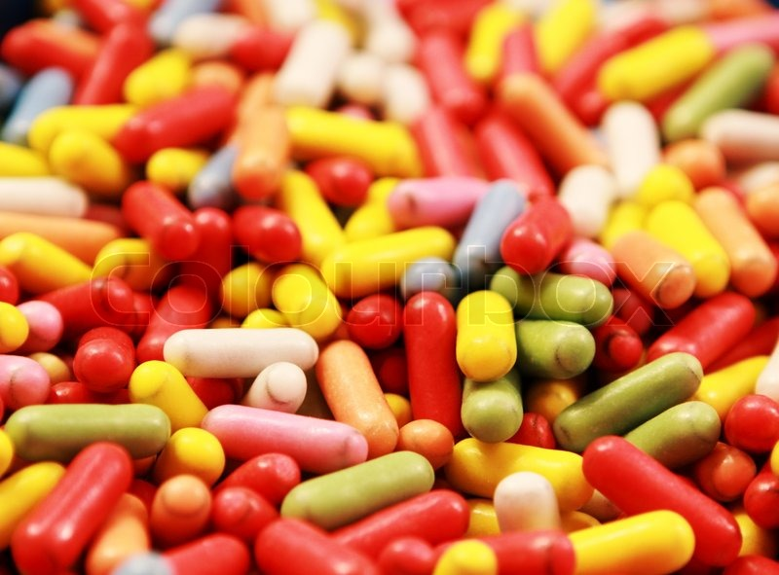
Some medicines can look like sweets

Slide 20
What could you do in an emergency?

Slide 21
Tell an adult immediately.
Call 999 and ask for an ambulance.

