Slide 1

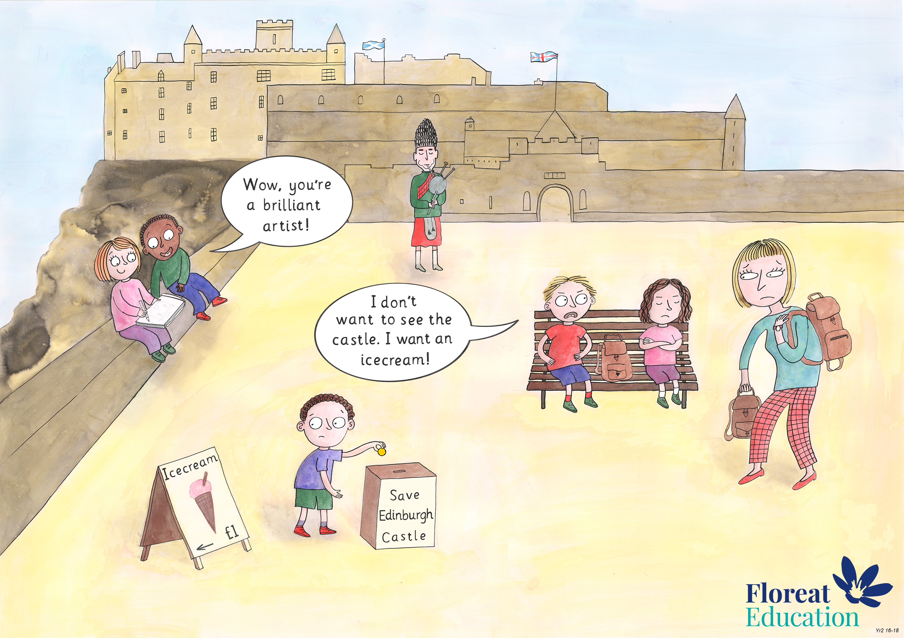
Year 2: Summer 2
Humility, Empathy and Perspective, Gratitude.

Slide 2

The 10th December 1948 was a very important day.

Slide 3
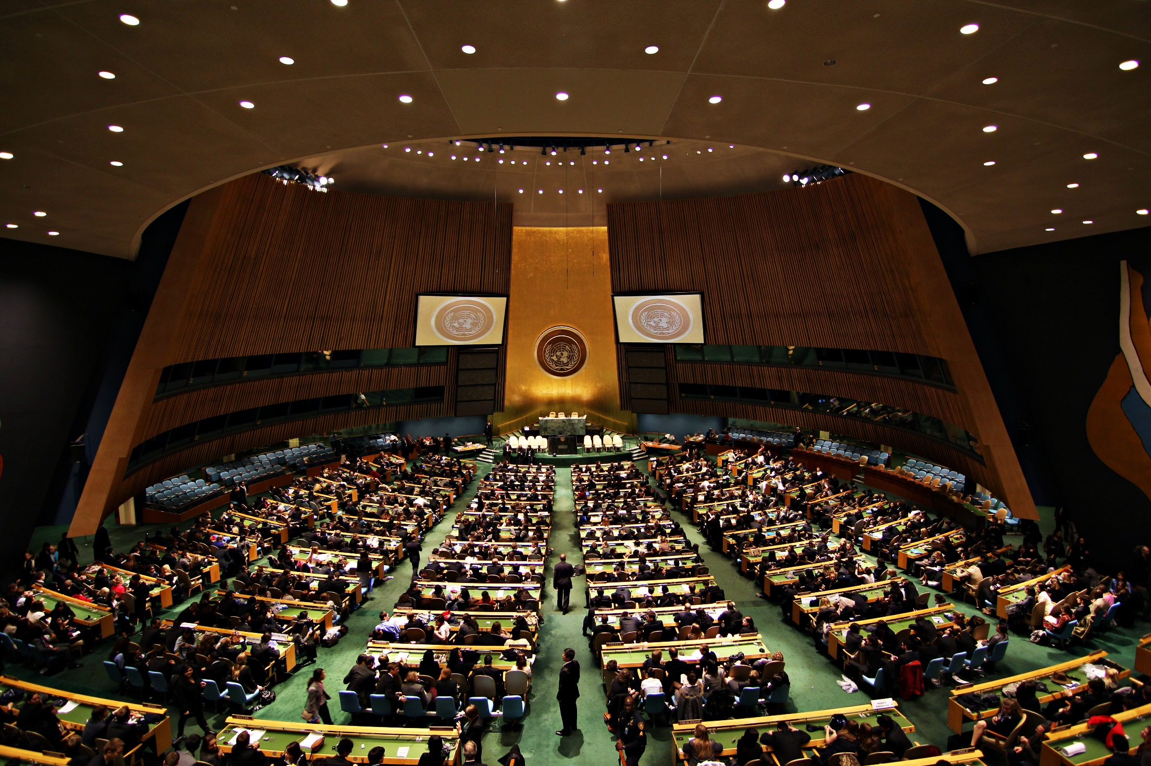


On that day a group of countries from all around the world met and made an important agreement.

Slide 4


Slide 5


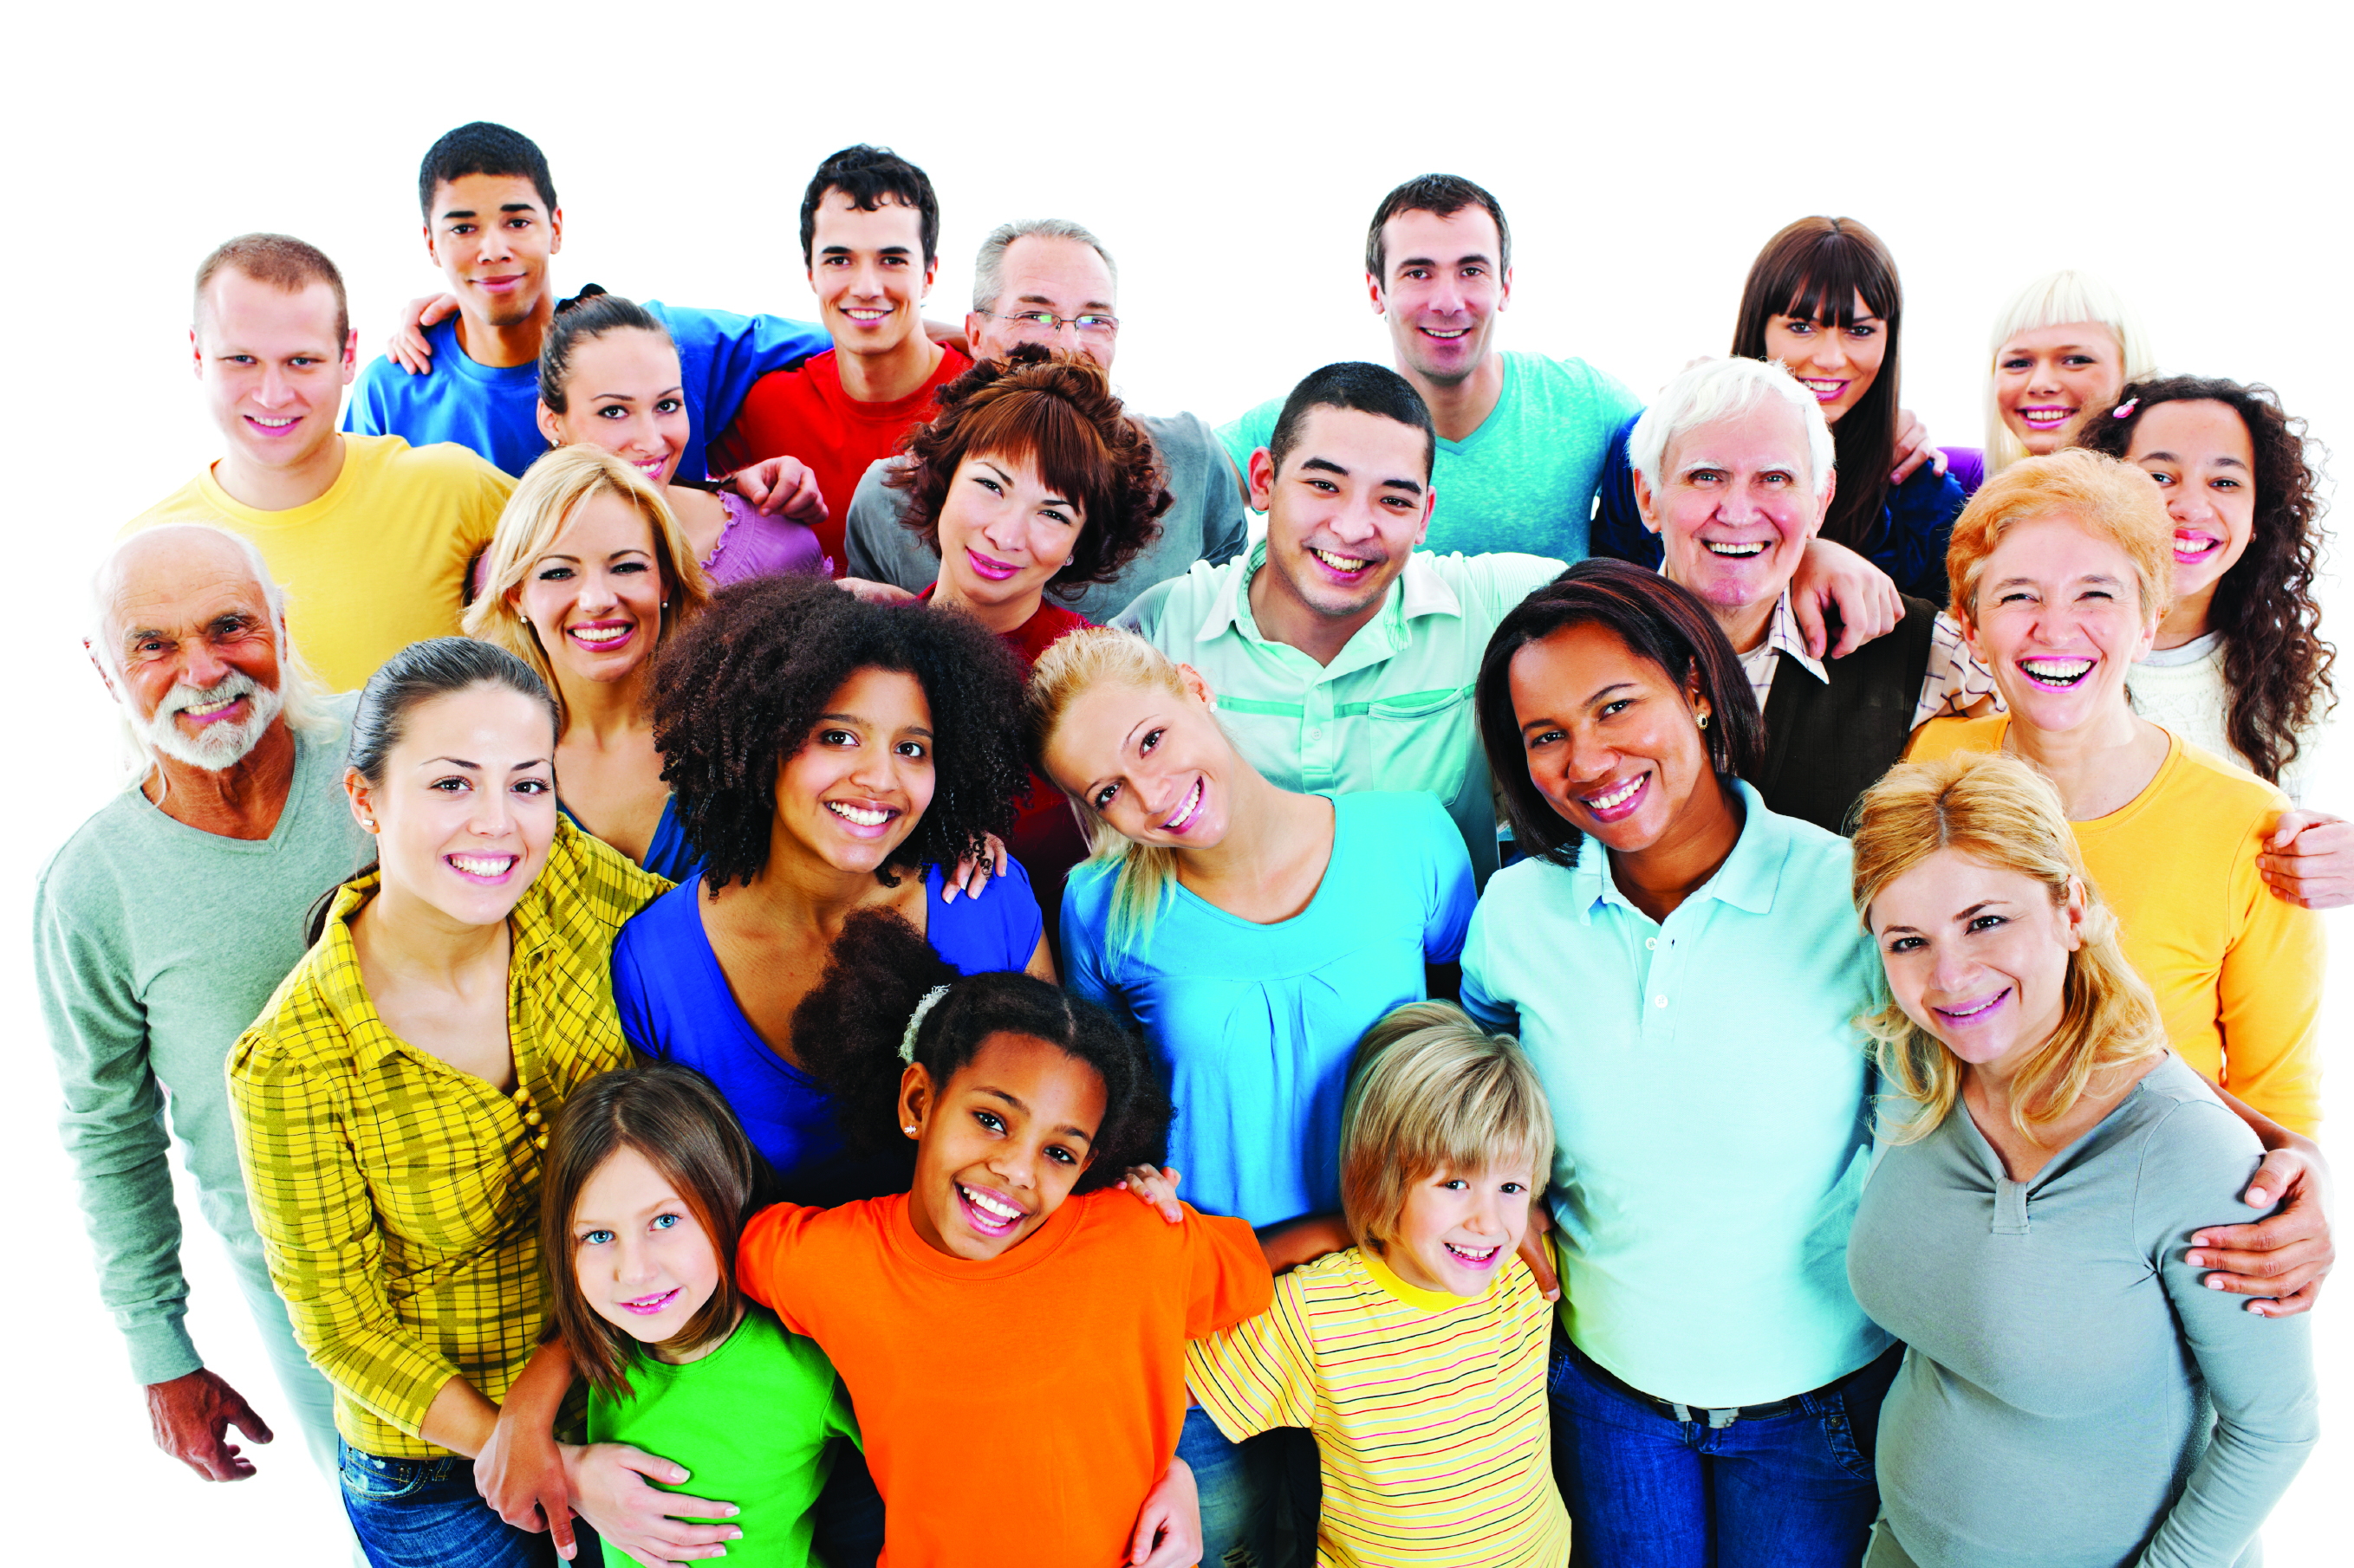
UNIVERSAL = all around the world
DECLARATION= a official statement
HUMAN = people
RIGHTS = things that you need which cannot be taken away

Slide 6
UNIVERSAL DECLARATION OF HUMAN RIGHTS
=
An agreement between lots of countries about the things that all people, all around the world, need which cannot be taken away.

Slide 7

The Universal Declaration on Human Rights has 30 sections, called articles.
1.
2.
3.
4.
5.
6.
7.
8.
9.
10
11.
12.
13.
14.
15.
16.
17.
18.
19.
20
21.
22.
23.
24.
25.
26.
27.
28.
29.
30

Slide 8
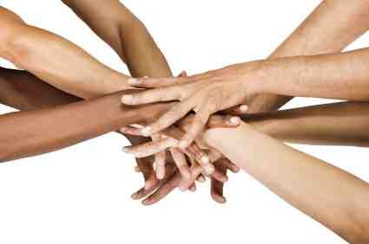
The 30 articles are 30 things that all the countries promised they would try to make sure all people across the whole world had.

Slide 9
Today we are going to talk about article 22.
1.
2.
3.
4.
5.
6.
7.
8.
9.
10
11.
12.
13.
14.
15.
16.
17.
18.
19.
20
21.
22.
23.
24.
25.
26.
27.
28.
29.
30

Slide 10
Article 22: Everyone as a person on this planet, has the right to have their basic needs met and should have whatever it takes to become the person they want to be and live with dignity.

Slide 11
Basic Needs
Food
Water
Shelter

Slide 12
Want?
Need?

Slide 13
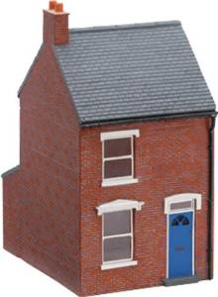
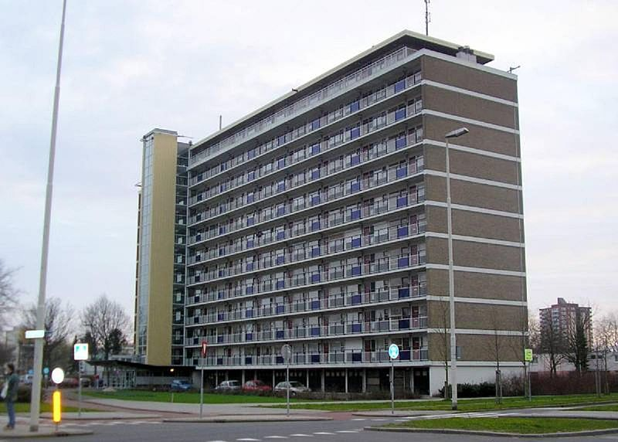

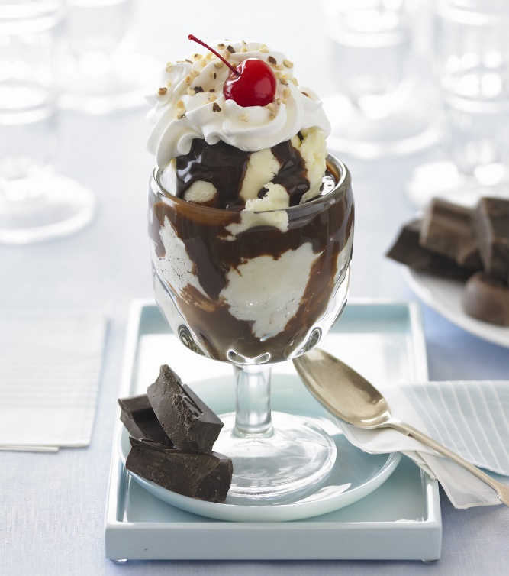
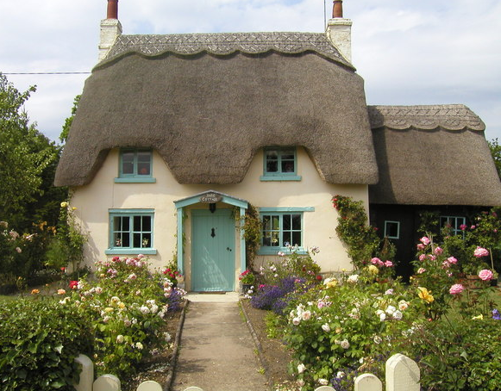
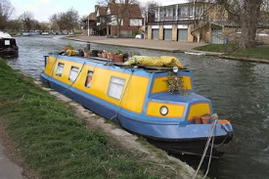
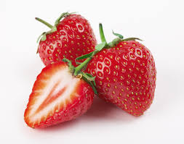


Shelter
Ice Cream
Books
Stawberries
Water
Fizzy drinks

Slide 14
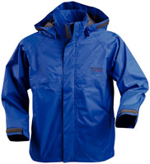
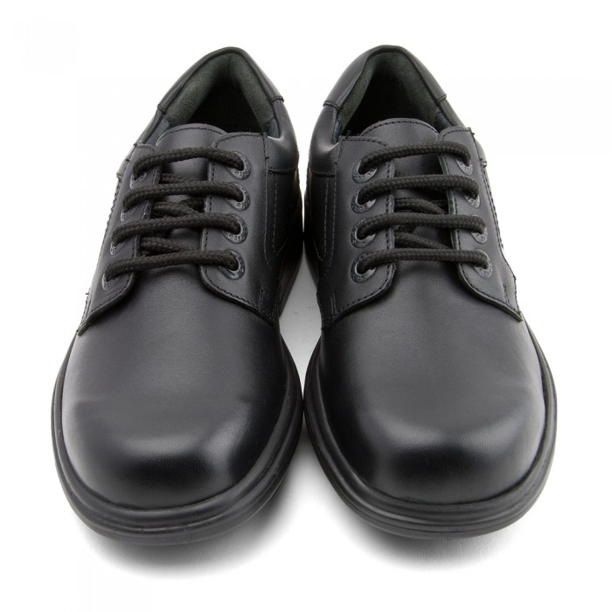
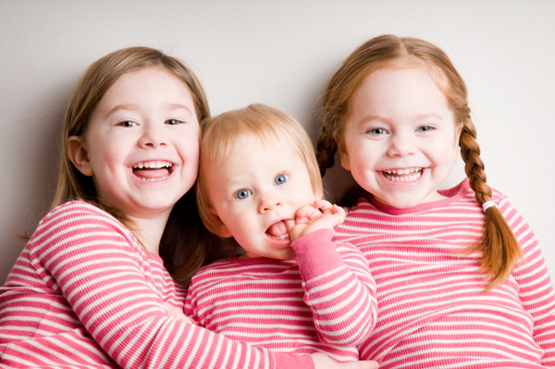

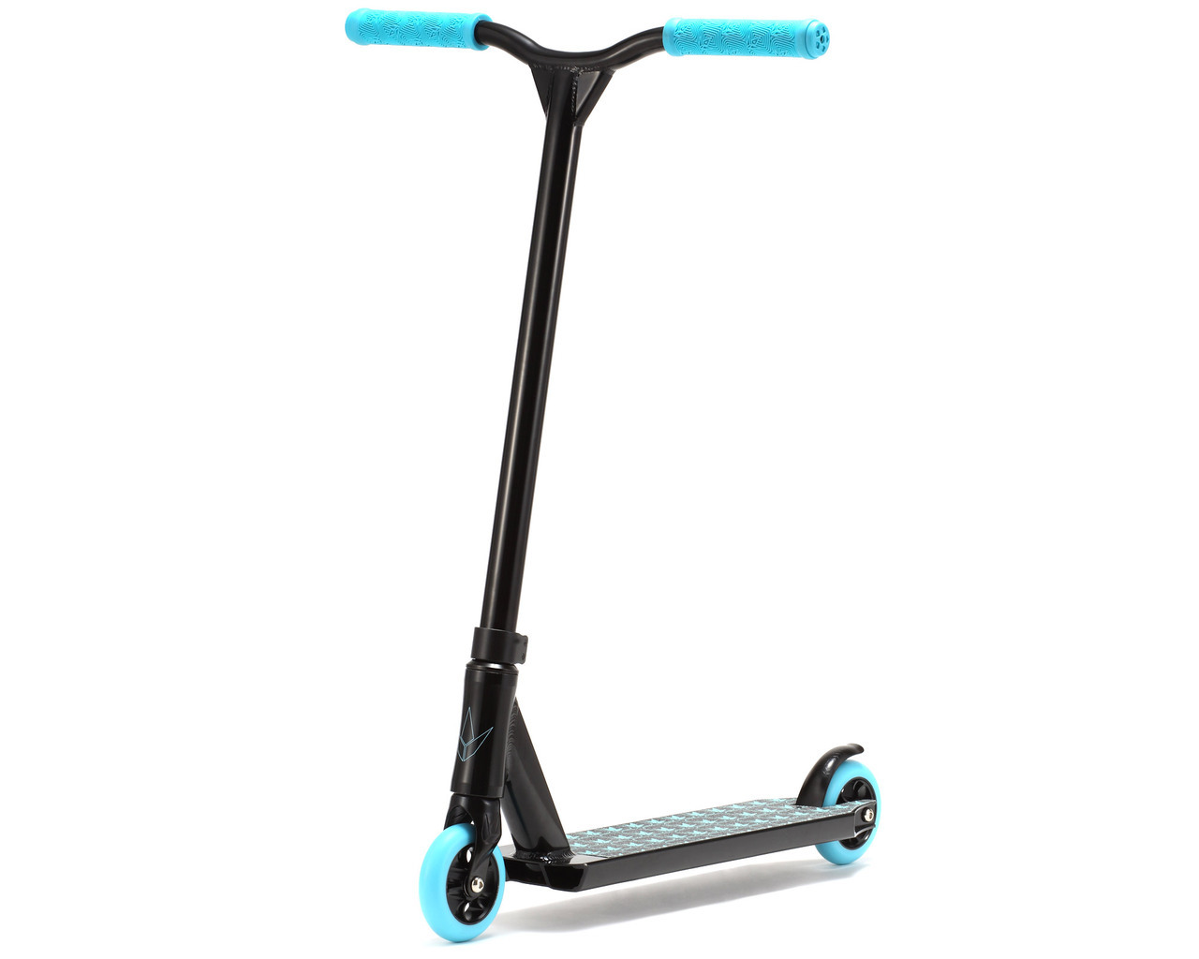
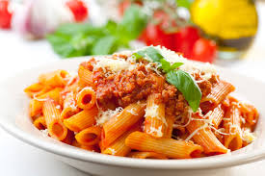
Coat
Shoes
Siblings
Scooter
Pasta
School

Slide 15
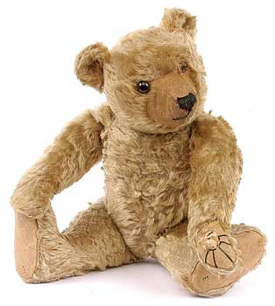
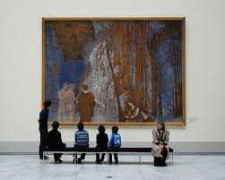
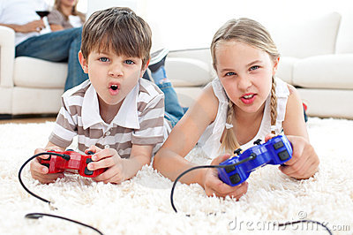
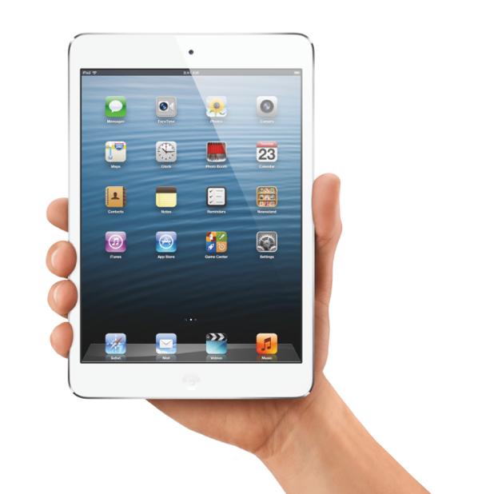

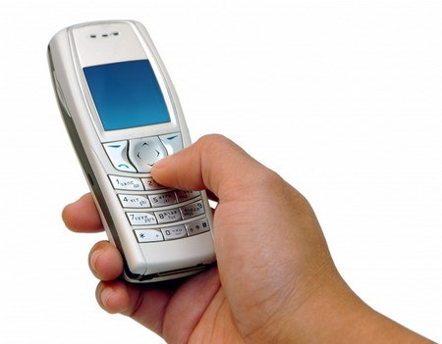
Teddy
Playstation
Art
Art
Music
iPad
Phone
iPad

Slide 16

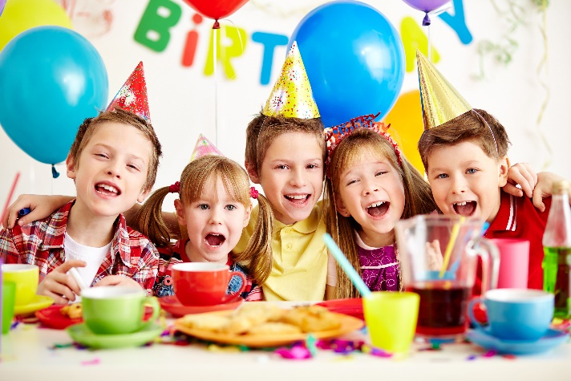
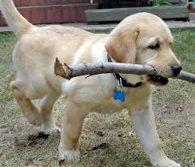


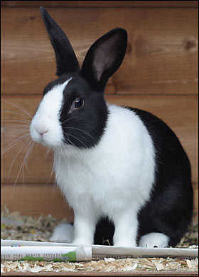
A birthday cake
A birthday party
Puppy
Your own bedroom
Garden
Rabbit

