Slide 1

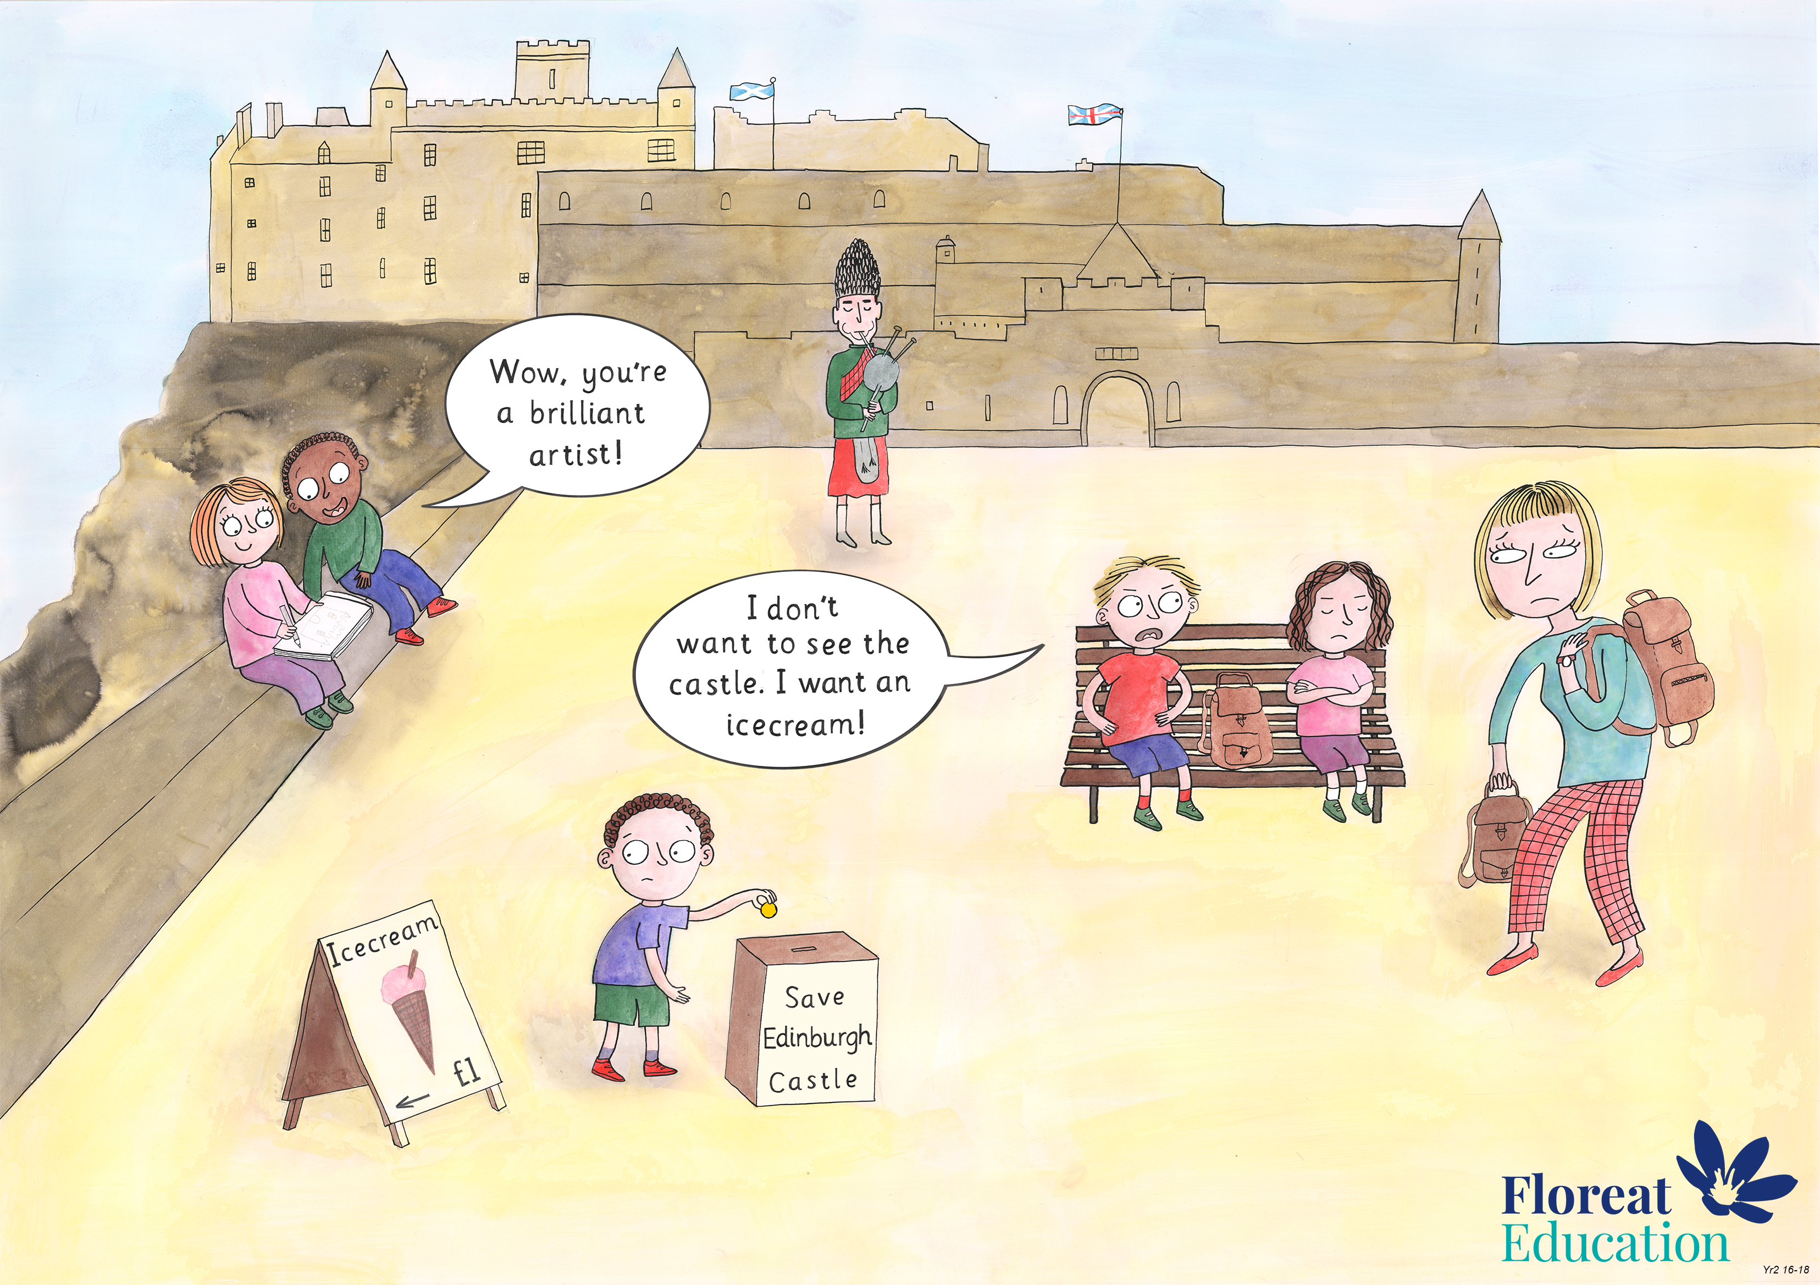
Year 2: Summer 2
Humility, Empathy and Perspective, Gratitude.

Slide 2

Gratitude Quotes Poster
Quotes are like road signs. They give you directions for your journey, and provide reminders, motivation and inspiration along the way. These quotes are about gratitude.
Ask the class to work in pairs.. Give each pair a sheet of paper with a quote on it. Ask the pupils to discuss with their partner what they think the quote means.
Choose some children to share their ideas with the class.
Remaining in pairs, ask the children to create a poster on sugar paper. The poster should be beautifully, presented and should include the original quote, the pupils’ interpretation in their own words, and a visual representation.
This lesson is adapted with gratitude from www.SpreadingGratitudeRocks.com

Slide 3
"I was complaining that I had no shoes till I met a man who had no feet."
–Confucius

Slide 4
“Life is not about waiting for the storms to pass … it’s about learning to dance in the rain!” - Unknown

Slide 5
“He is a wise man who does not grieve for the things which he has not, but rejoices for those which he has.”

Slide 6
“Gratitude is the ability to experience life as a gift. It liberates us from the prison of self-preoccupation.”
- John Ortberg

Slide 7
Gratitude is not only the greatest of virtues, but the parent of all the others.
- Cicero
I was complaining that I had no shoes till I met a man who had no feet.
- Confucius
Be the change you wish to see in the world.
- Ghandi
When you arise in the morning, give thanks for the morning light, for your life and strength. Give thanks for your food, and the joy of living. If you see no reason for giving thanks, the fault lies with yourself.
- Tecumseh, Shawnee Chief
To speak gratitude is courteous and pleasant, to enact gratitude is generous and noble, but to live gratitude is to touch Heaven.
- Johannes A. Gaertner
We tend to forget that happiness doesn’t come as a result of getting something we don’t have, but rather of recognizing and appreciating what we do have.
- Fredrick Koeing
If the only prayed you ever say is thank you, that would be sufficient.
- Meister Johann Eckhardt
Two kinds of gratitude: The sudden king we feel for what we take;; the larger kind for what we give.
- Edwin Arlington Robinson
Ingratitude produces pride while gratitude produces humility.
- Orrin Wood
Gratitude unlocks the fullness of life. It turns what we have into enough, and more. It turns denial into acceptance, chaos to order, confusion to clarity. It can turn a meal into a feast, a house into a home, a stranger into a friend.
- Melody Beattie
Gratitude is the ability to experience life as a gift. It liberates us from the prison of self-preoccupation.
- John Ortberg
Let us be grateful to people who make us happy; they are the charming gardeners who make our souls blossom.
- Marcel Proust
You simply will not be the same person two months from now after consciously giving thanks teach day for the abundance that exists in your life. And you will have set in motion an ancient spiritual law: the more you have and are grateful for, the more will be given you.
- Sarah Ban Breathnach
Life is not about waiting for the storms to pass… its about learning to dance in the rain!
- Unknown
He is a wise man who does not grieve for the things which he has not but rejoices for those which he has.
- Epictetus
If you concentrate on finding whatever is good in every situation, you will discover that your life will suddenly be filled with gratitude, a feeling that nurtures the soul.
- Rabbi Harold Kushner
Thankfulness is the beginning of gratitude. Gratitude is the completion of thankfulness. Thankfulness may consist merely of words. Gratitude is shown in acts.
-David O. McKay
Happiness cannot be travelled to, owned, earned, worn or consumed. Happiness is the spiritual experience of living every minute with love, grace and gratitude.
- Denis Wheatley
Feeling gratitude and not expressing it is like wrapping a present and not giving it.
- William Arthur Ward

