Slide 1

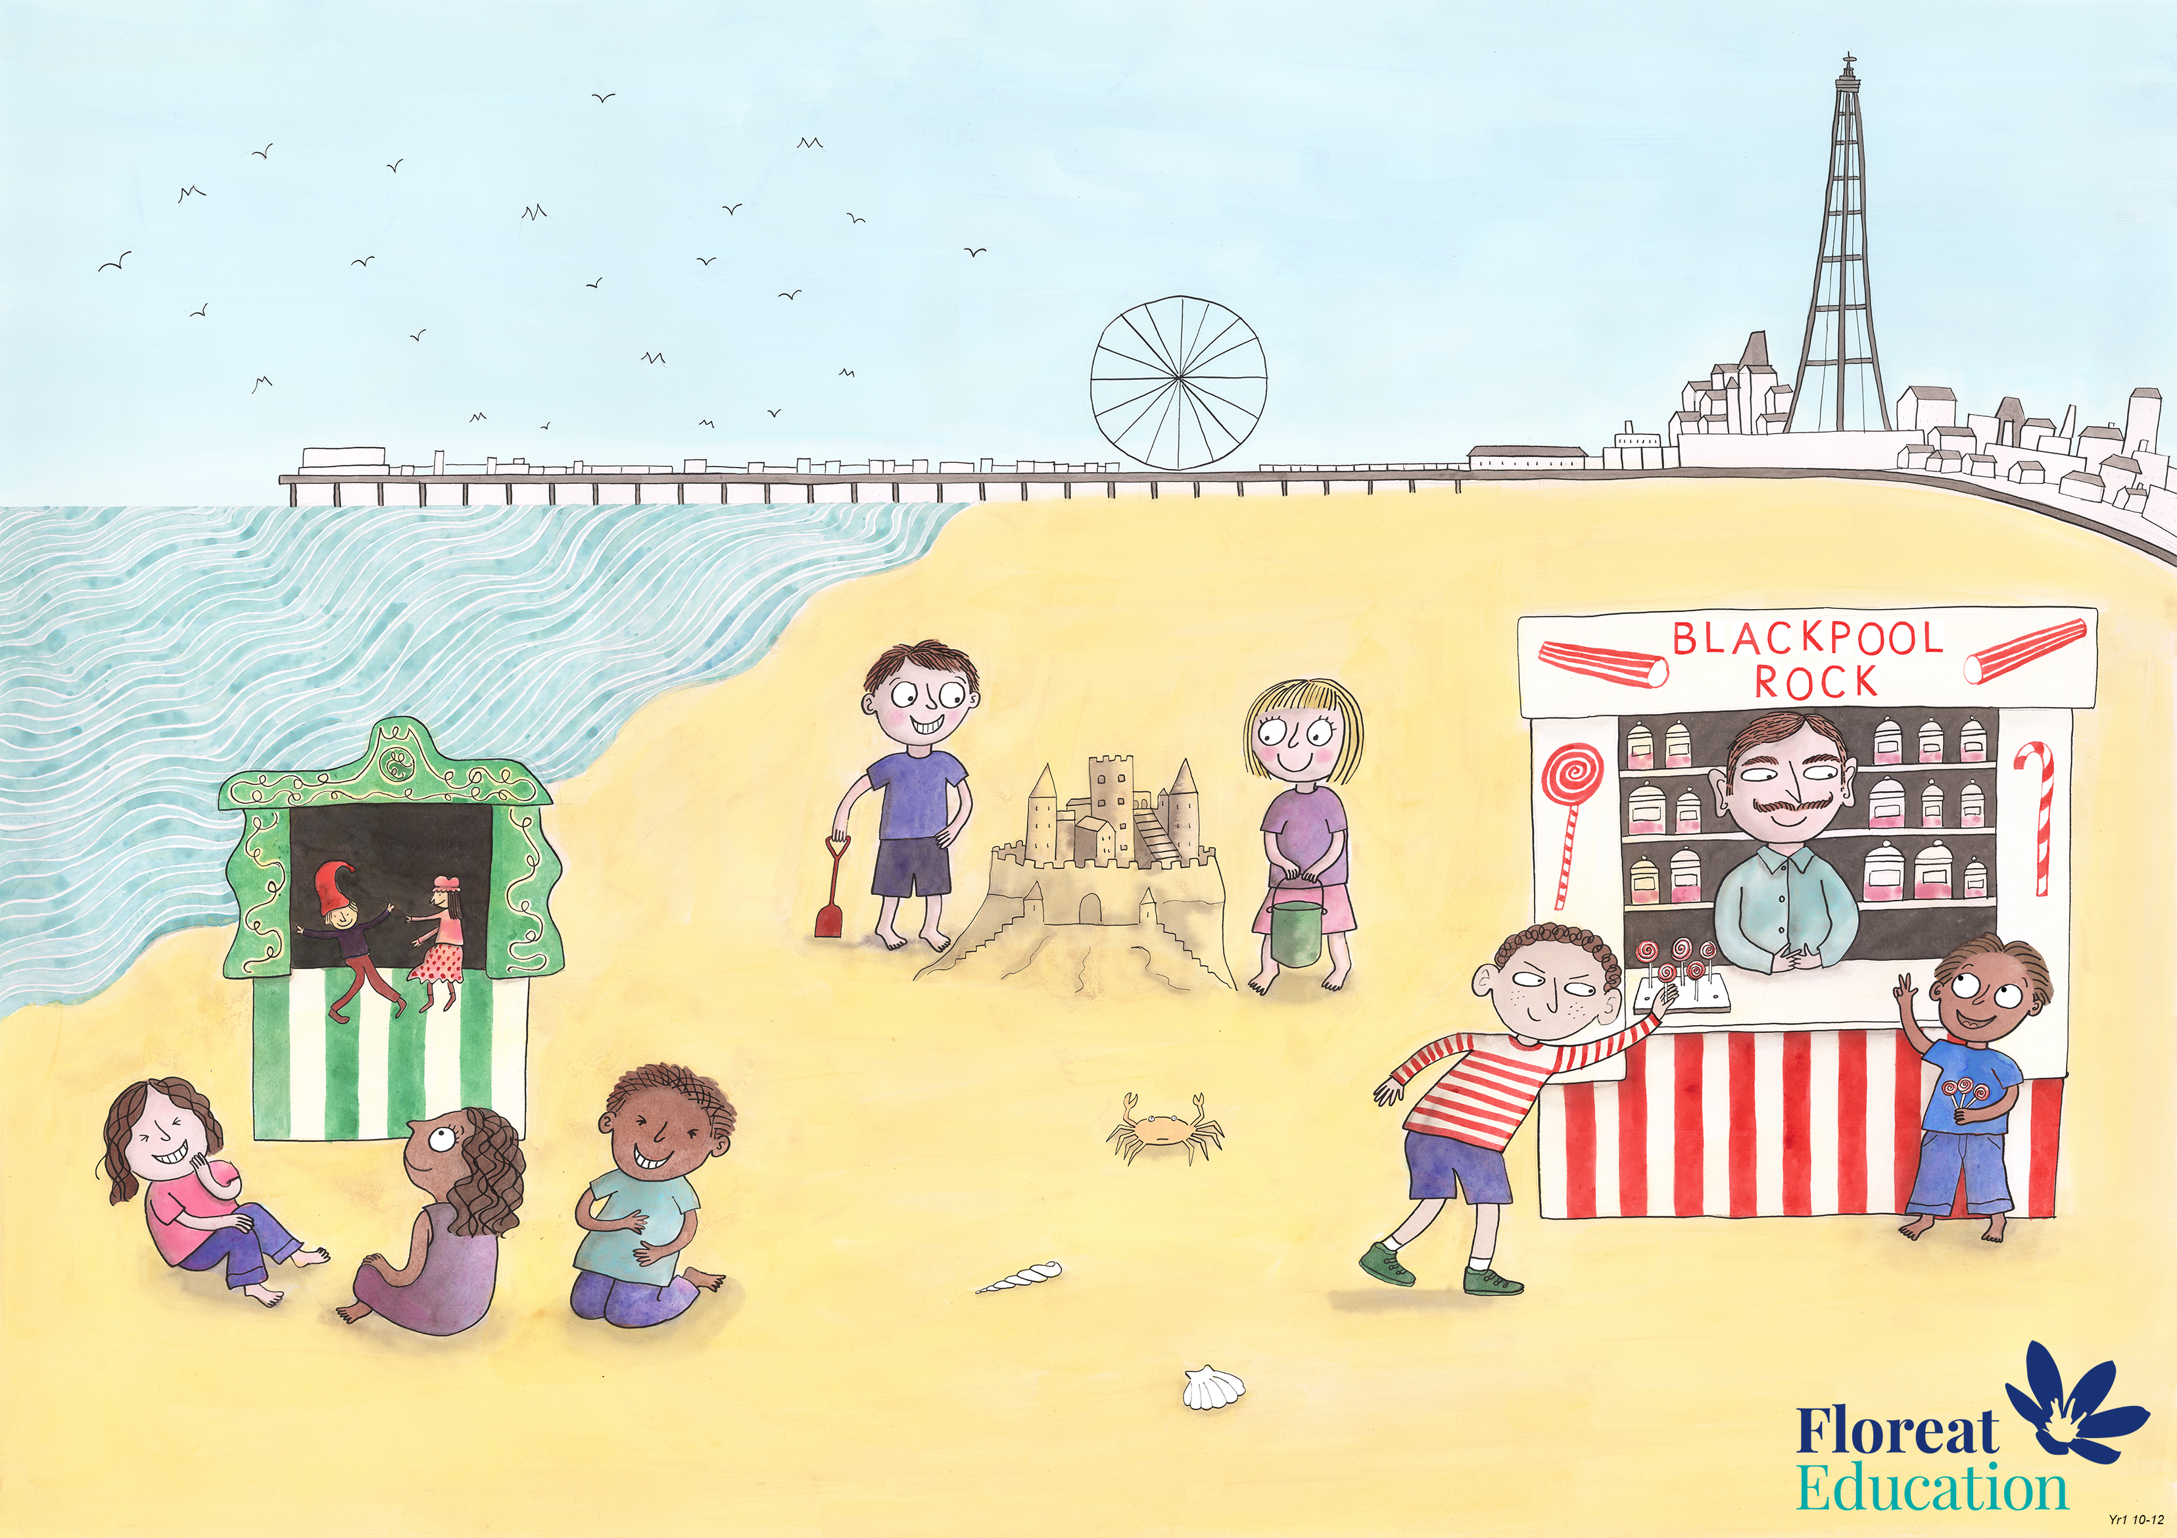
Year 2 Spring 2
Creativity, Honesty, Humour

Slide 2
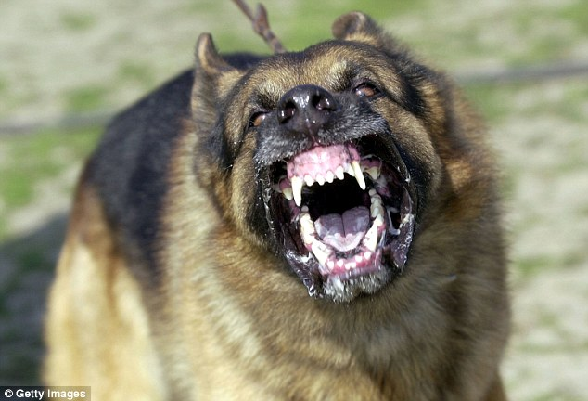
Dogs bark, bear their teeth and growl to look scary

Slide 3
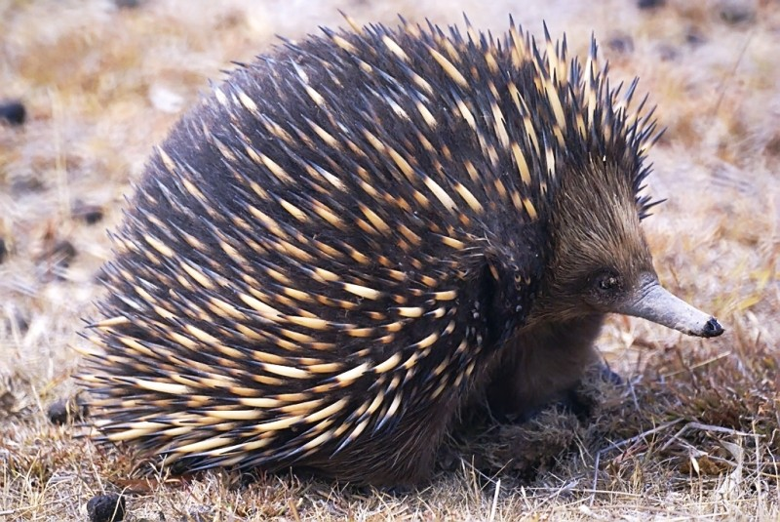
Echidnas raised their spines to look bigger

Slide 4
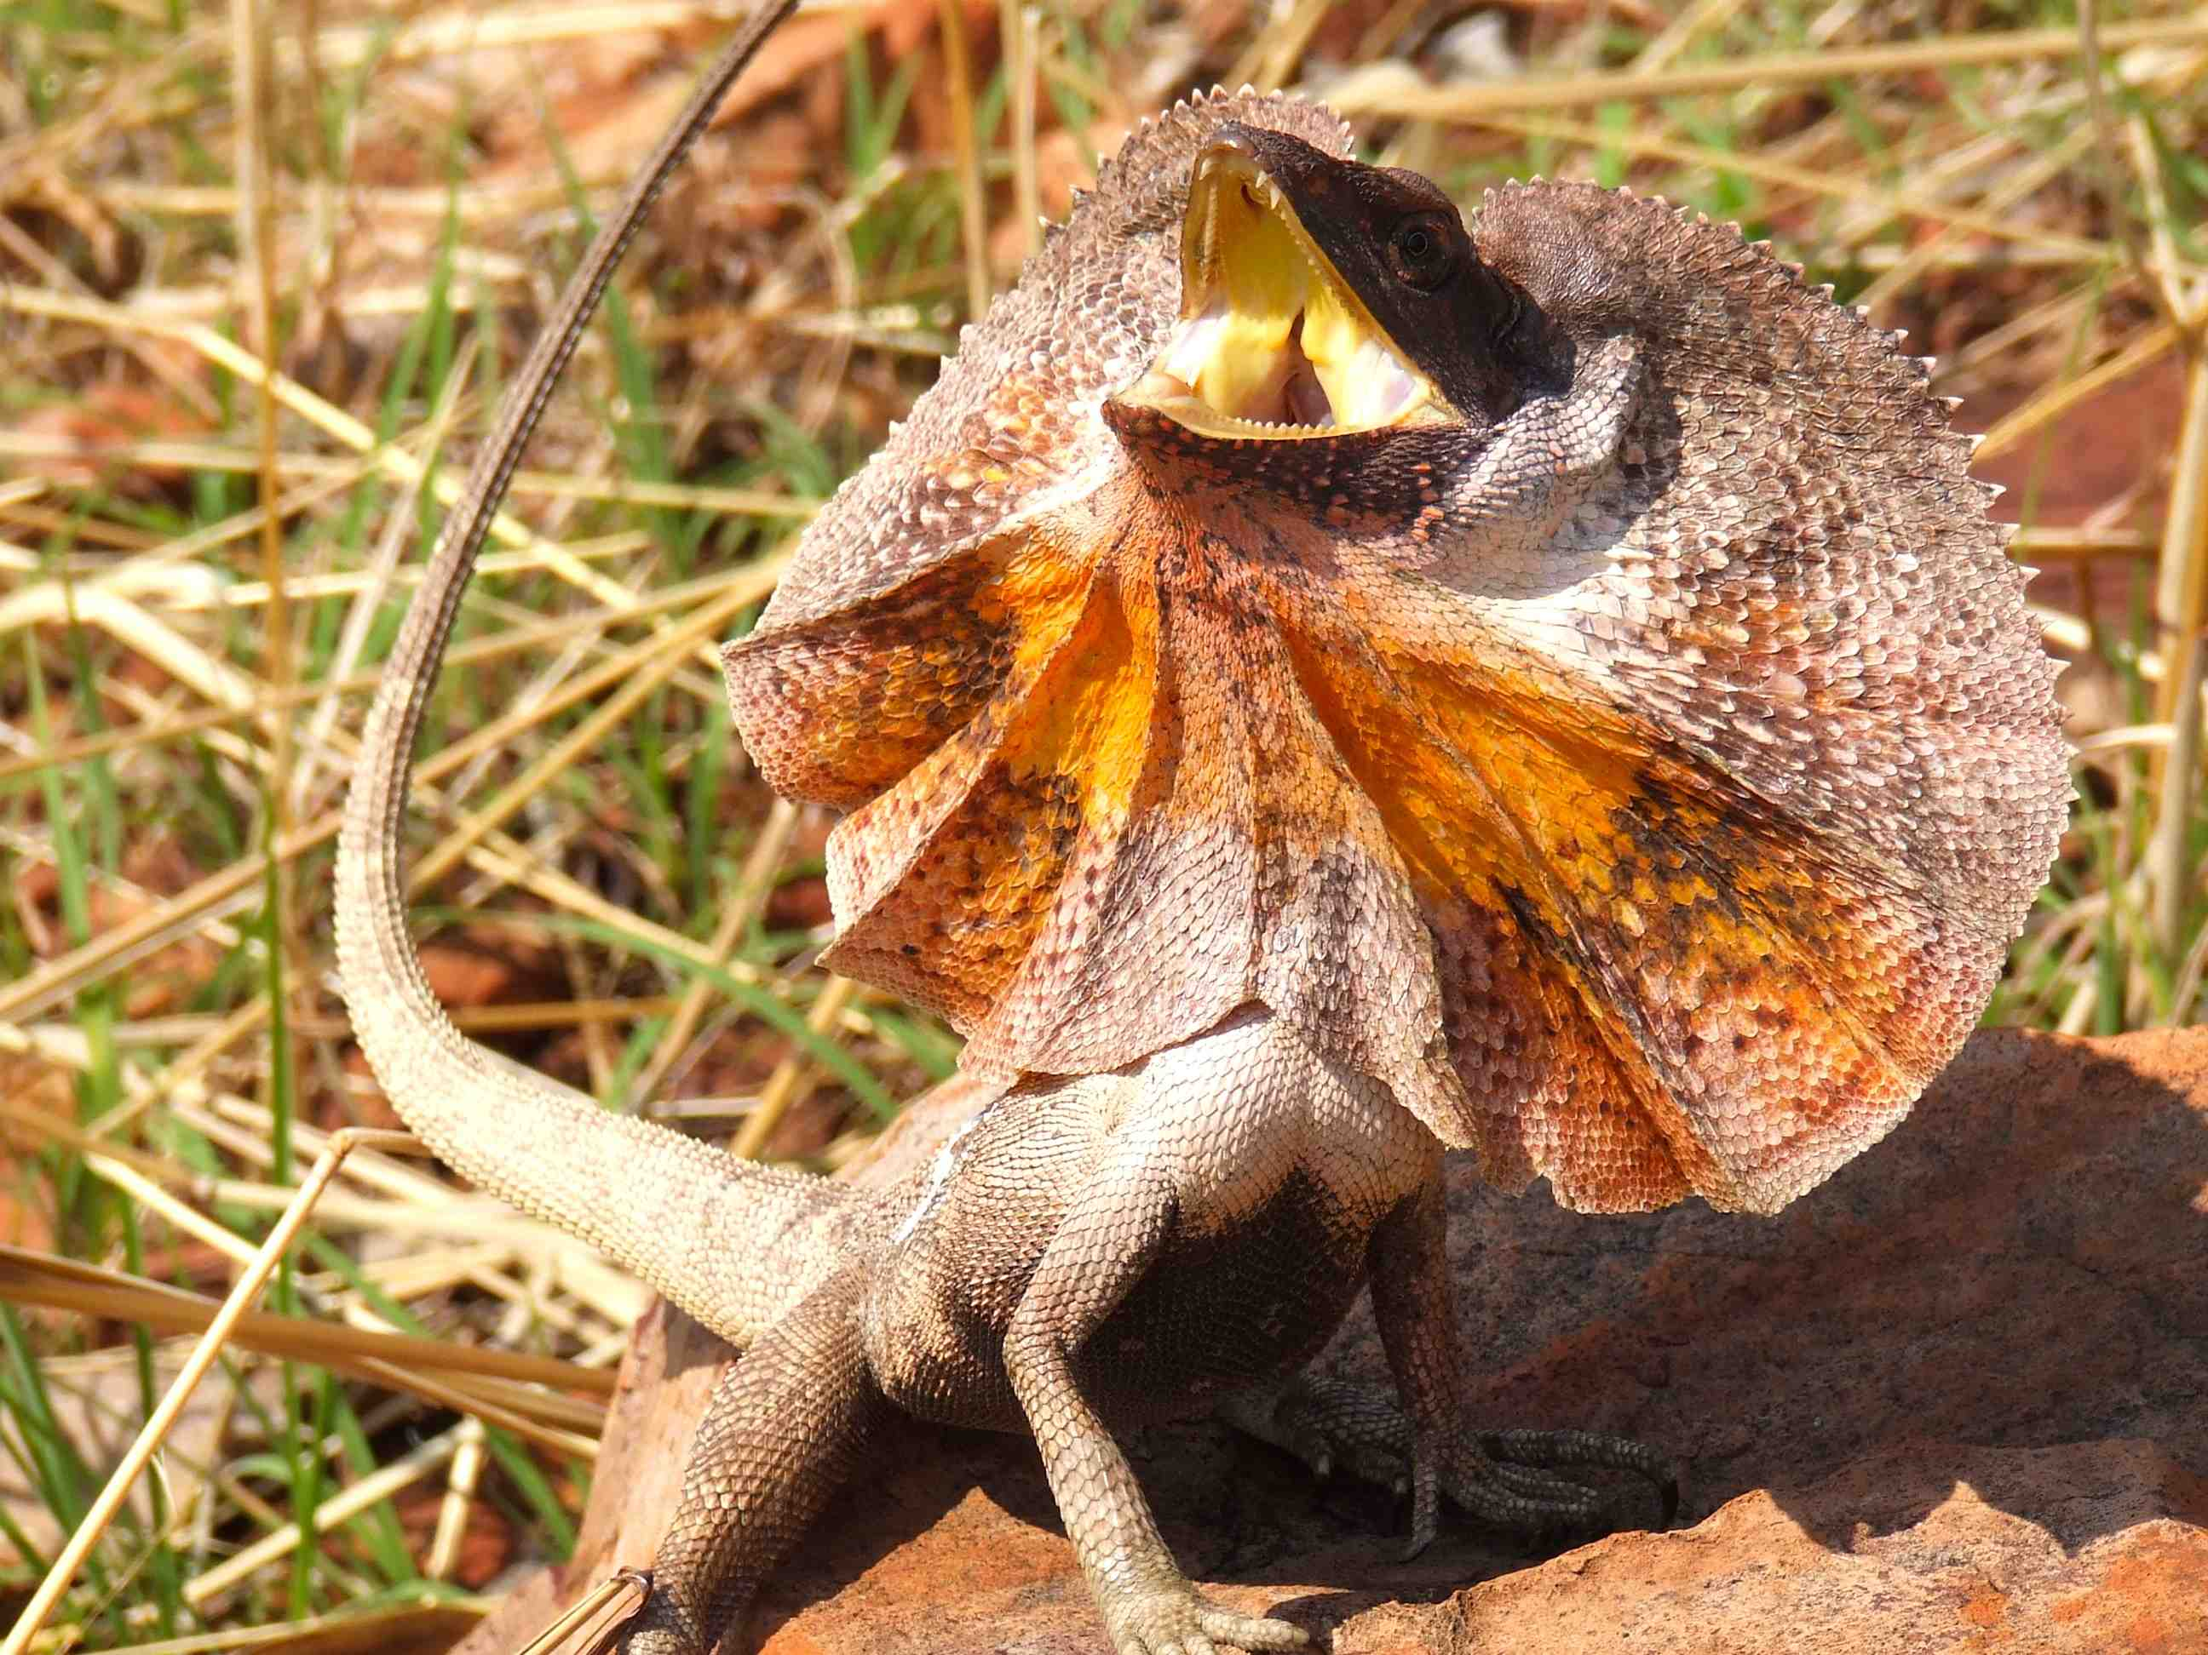
The frill necked lizard has to protect itself against animals that try to hurt it. Its only real defence is to look bigger than it really is. This is what it does:
Puffs out its cheeks
Hisses
Fans out the frill around its neck to look much bigger.
Stands up on its back legs to look taller.
Runs away or climbs up a tree.

Slide 5
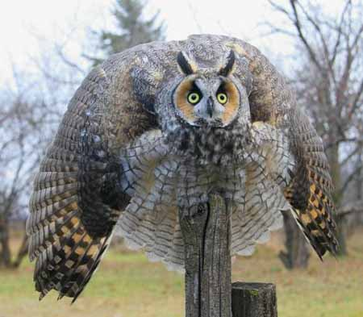

Slide 6
