Slide 1

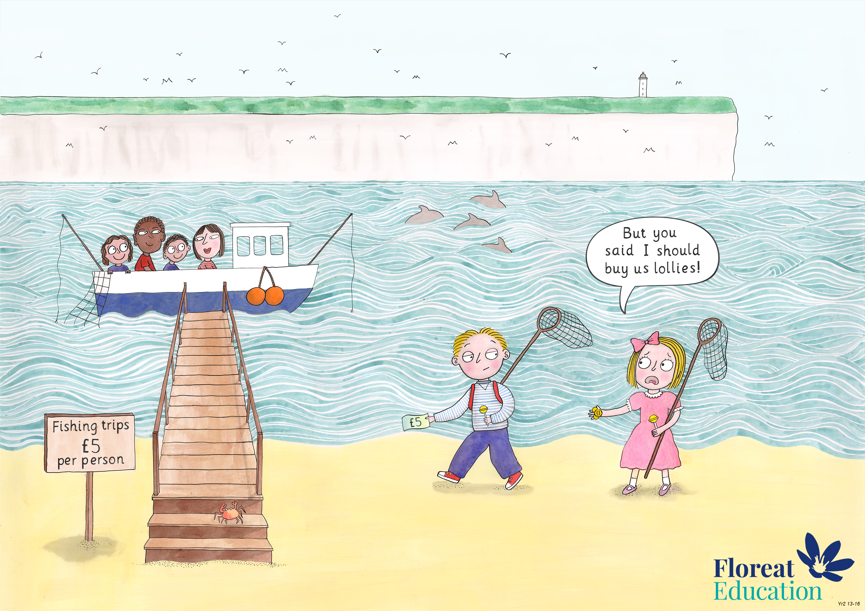
Year 2: Summer 1
Judgement and Prudence, Forgiveness, Appreciation and Awe

Slide 2

The Lost Coin
Adapted for Floreat from Luke 15: 8-10

Slide 3
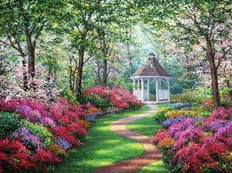
Once there was a lady who worked hard all year round on her beautiful garden.

Slide 4
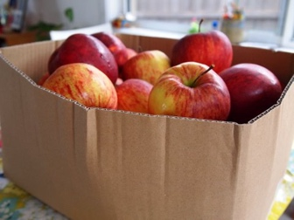
When summer came, her trees were full of crunchy, delicious apples.
She worked all day picking the apples. When she was finished, she sold a box of them to Mr Stevens who gave her one coin.

Slide 5
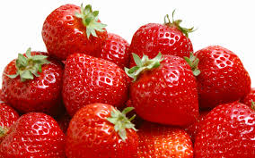
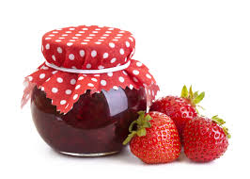
.
The lady also grew juicy red strawberries.
She worked hard all day in her kitchen, turning the strawberries into jam. When she was finished, she sold two jars of it to Mrs Gibson for two coins.

Slide 6
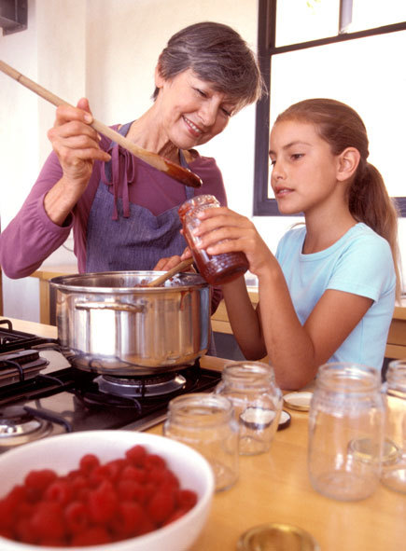
The neighbour’s children saw her making jam and asked the lady to show them how to make it too!
She worked all day teaching the children to make jam. When she was finished the children gave her three coins.

Slide 7
What were the different ways the lady earned money?

Slide 8
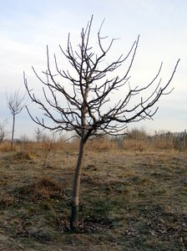
But soon the wind and rain came. In the winter it was too cold for strawberries and the apple tree was bare!
The lady couldn’t earn any money - how do you think she survived through the winter?

Slide 9
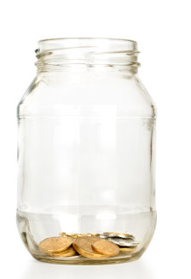
In her house the lady keeps a special little jar.
In that jar are 10 shiny coins.

Slide 10
Why do you think she keeps the coins in a jar?

Slide 11
Why doesn’t she spend her coins?

Slide 12
One day she was counting her coins when she suddenly gasped
‘Oh no!’ one of them is missing!

Slide 13
The lady is very prudent, and saves her money carefully.

Slide 14
She still has 9 coins left, does it matter about the missing one?

Slide 15
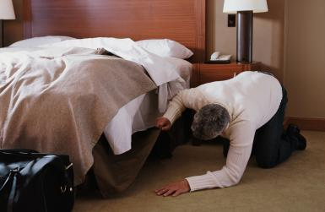
The lady got down on her hands and knees and she searched the whole house from top to bottom.

Slide 16
Why did she bother to search so much when she had nine other coins ?

Slide 17
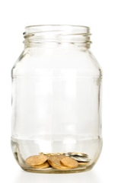
When she found the coin she was so happy. She put the coin in the jar and screwed the lid on tightly.

Slide 18
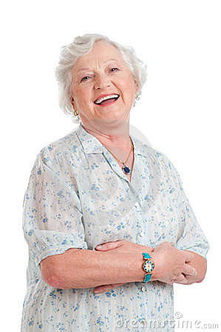
The lady felt very happy knowing that her coins were there, just in case she needed them one rainy day.

