Slide 1

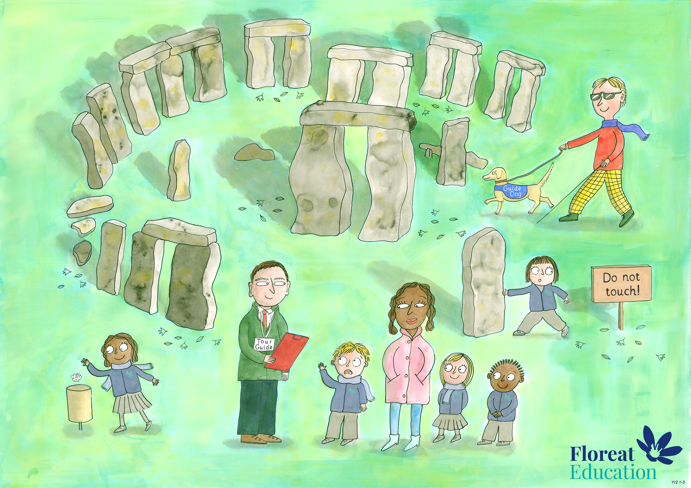
Year 2 Autumn 1
Self Control and Dignity, Bravery, Love and Kindness

Slide 2
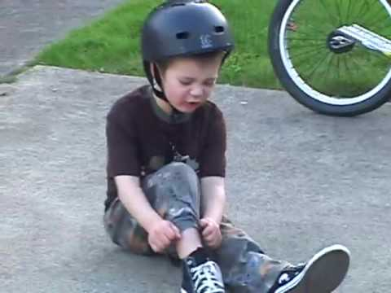
Your friend has fallen off their bike
To show love and kindness I would…..

Slide 3
Your friend is carrying lots of heavy books
To show love and kindness I would…..

Slide 4
Your friend has dropped their ice cream
To show love and kindness I would…..

Slide 5
You have cleared your toys but someone else has not finished
To show love and kindness I would…..

Slide 6
Some children have forgotten to put their chairs under the table
To show love and kindness I would…..

Slide 7
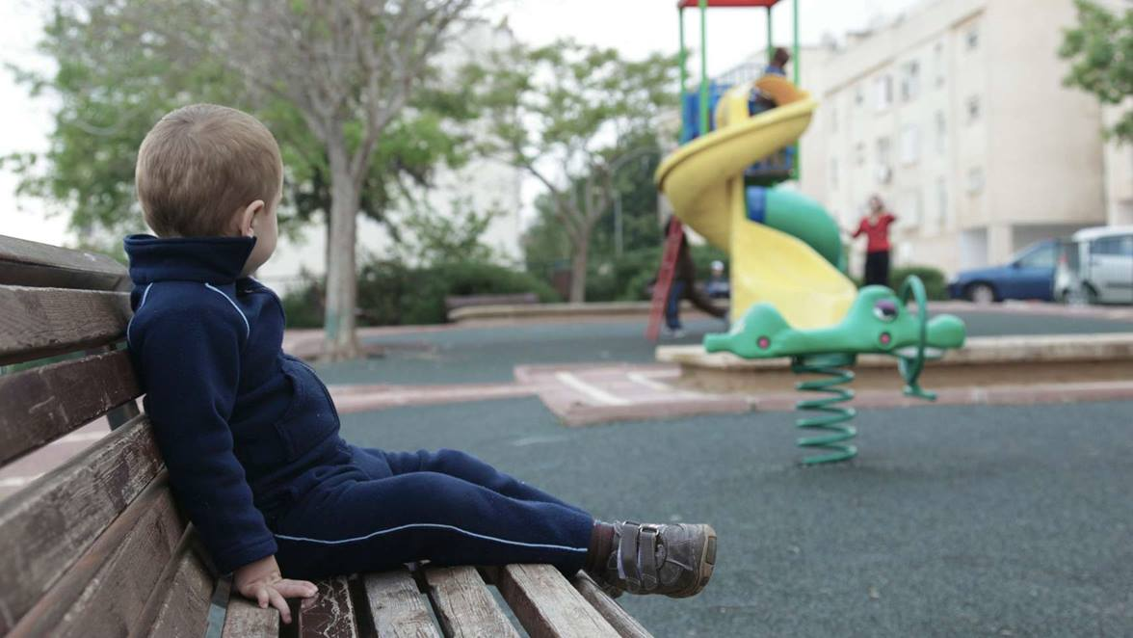
A child is on their own at playtime
To show love and kindness I would…..

Slide 8
The classroom is messy
To show love and kindness I would…..

Slide 9

A member of your friend’s family is in hospital
To show love and kindness I would…..

Slide 10
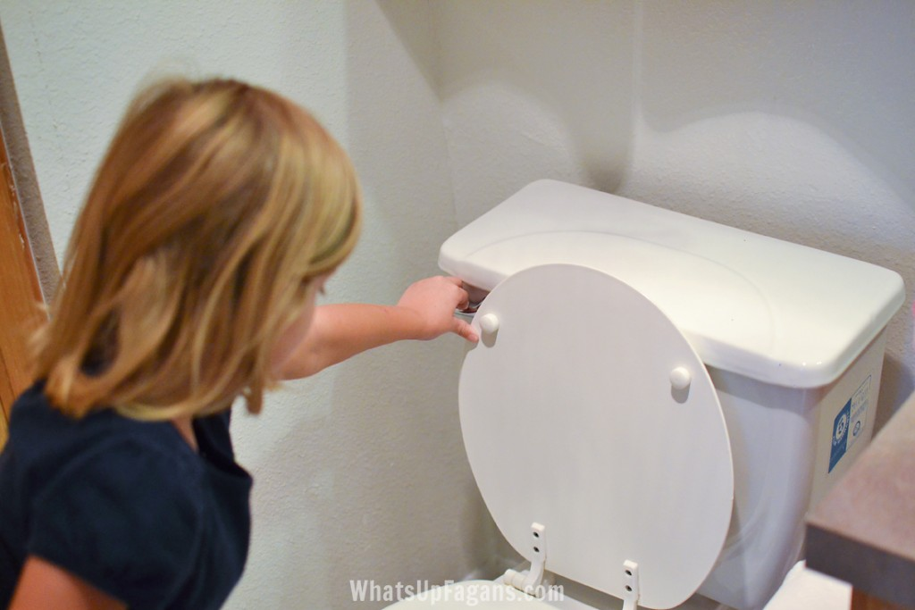
You have used the toilet
To show love and kindness I would…..
Notes:
This is an opportunity to remind children of the importance of flushing the toilet after they have used it. The discussion can focus on being kind by showing consideration to others and leaving things in a better condition than you found them.

Slide 11
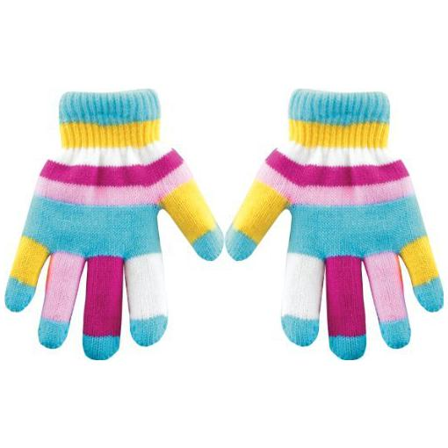
A classmate is crying because she has lost her gloves
To show love and kindness I would…..

Slide 12
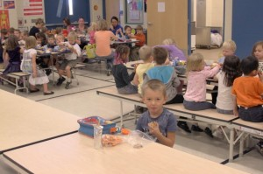
A new child at school hasn’t made any friends yet
To show love and kindness I would…..

Slide 13
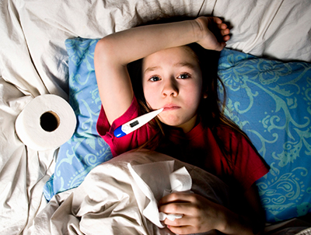
Your friend has been ill and away from school

Slide 14
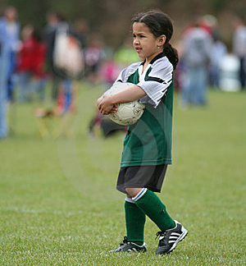
A child has been waiting to play with the football you are playing with
To show love and kindness I would…..

Slide 15
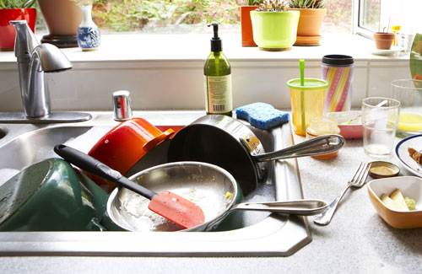
Your mum and dad have lots of washing up to do and they also need to get ready to go out
To show love and kindness I would…..

Slide 16
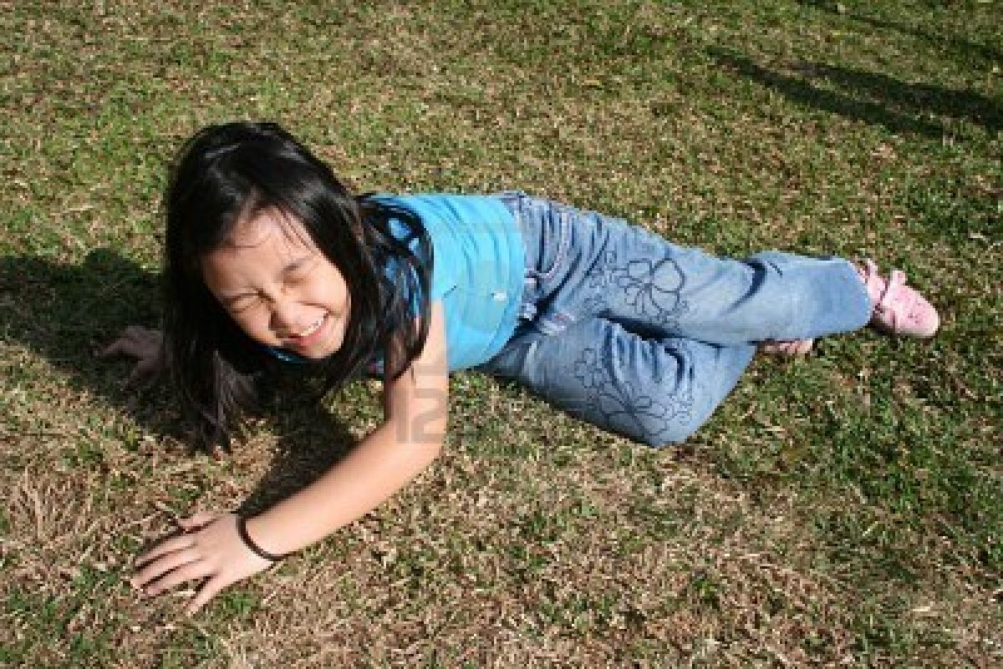
You are playing tag and accidentally knock someone over
To show love and kindness I would…..

Slide 17
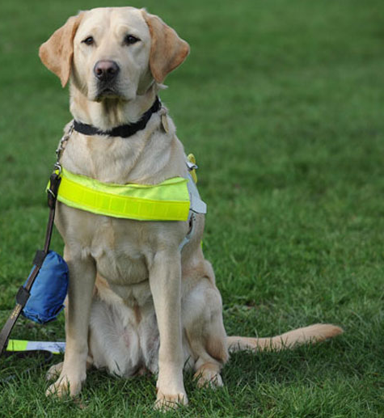
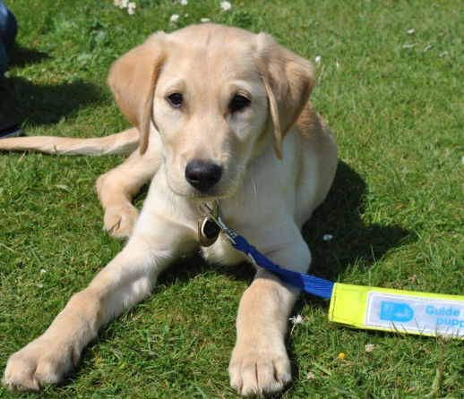
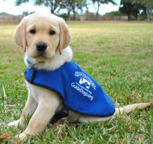
Raising Assistance Dogs

Slide 18
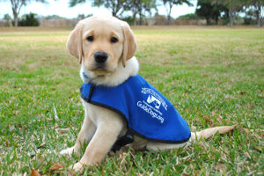
Puppy raisers get an assistance puppy when it is about 8 weeks old. It is their job to help it grow up to be a good assistance dog.
What does this puppy need from it's raiser?

Slide 19
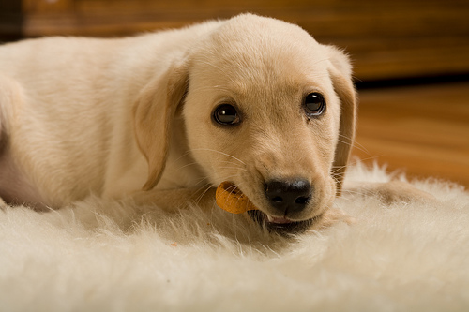
Food
Puppies love dog treats. Would it be loving and kind to feed the puppy treats all day?

Slide 20
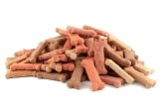
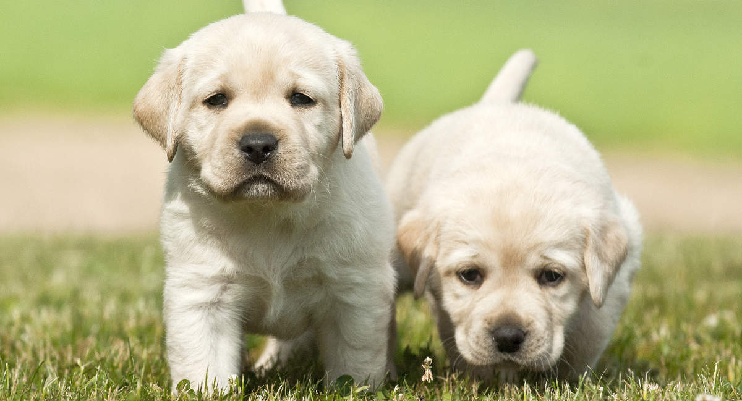
Food
Too many treats make the puppies overweight which isn't good for them.

Slide 21
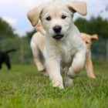
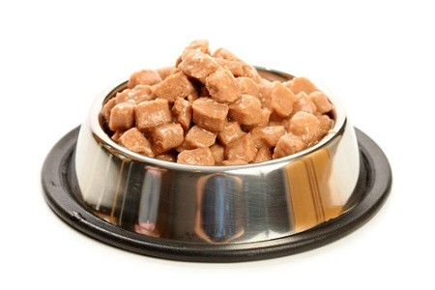
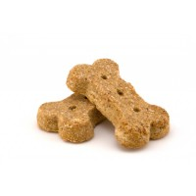
Food
Puppies need a balanced diet and lots of exercise to grow up healthy.
A loving puppy raiser says ‘No’ to treats sometimes.

Slide 22
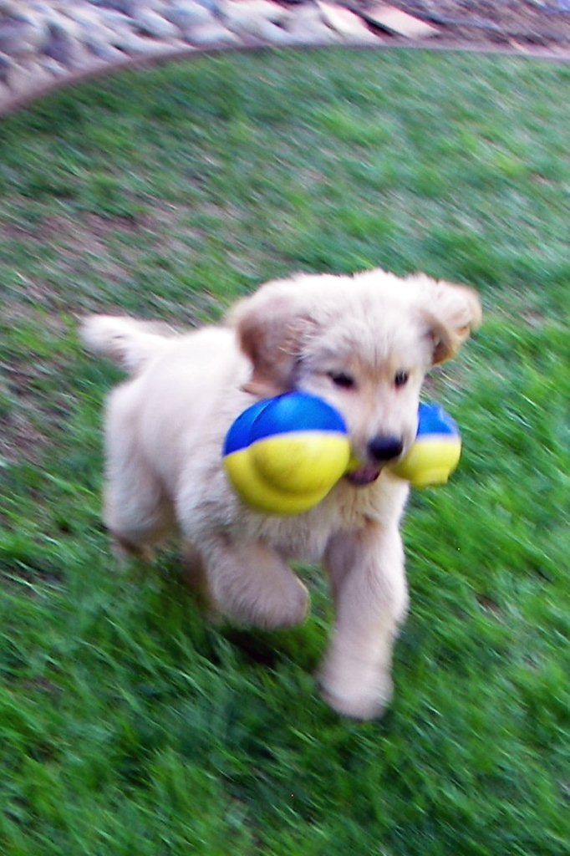
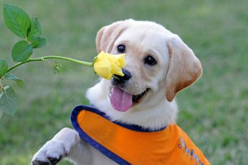
Work and Play
Puppies love to play. Would it be loving and kind to let the puppy play all day?

Slide 23
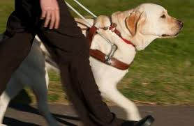
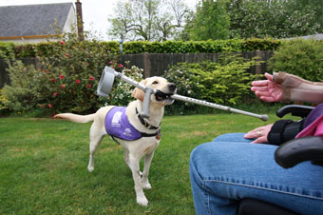
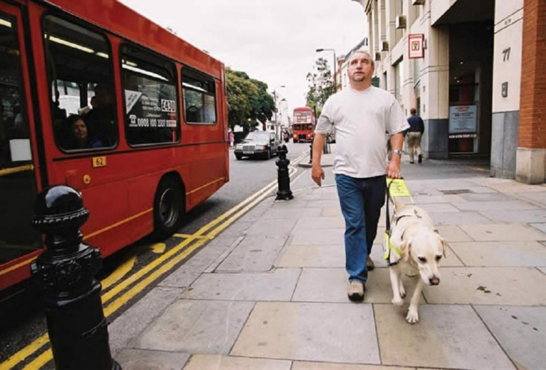
Work and Play
Assistance dogs have a very important job to do to help people. They need to be very well behaved.

Slide 24
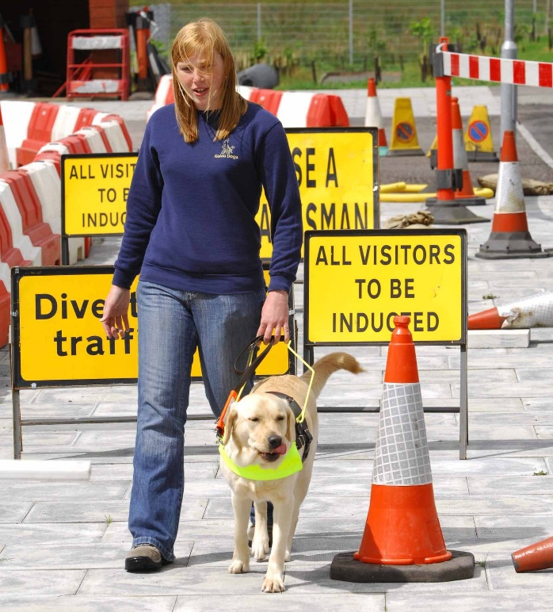
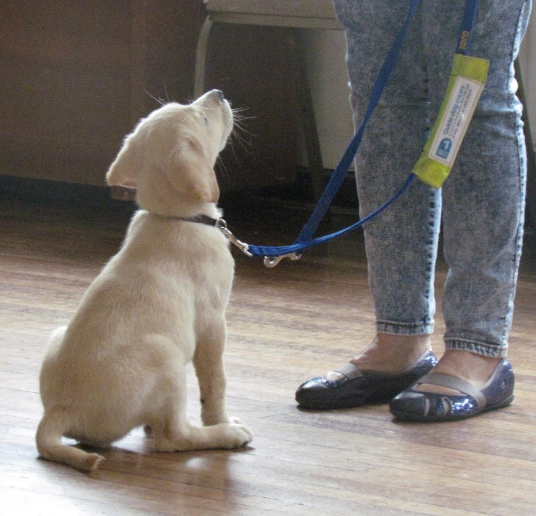
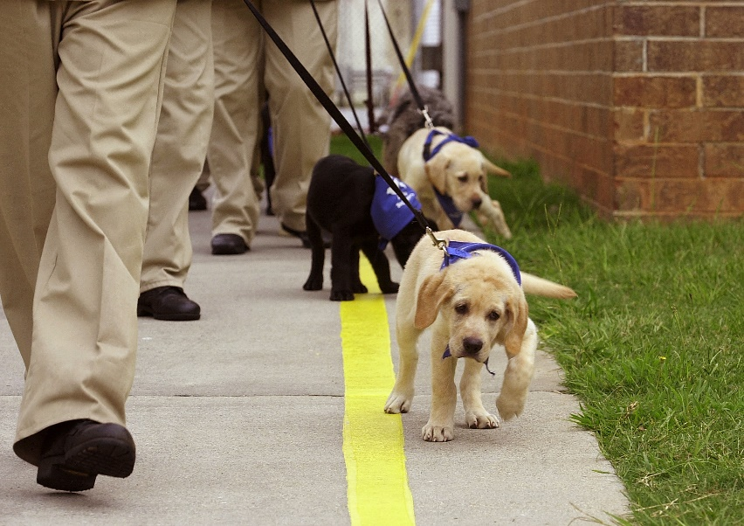
Work and Play
Good puppy raisers have to be strict sometimes to teach the puppy to follow instructions. They cannot play all day.

Slide 25

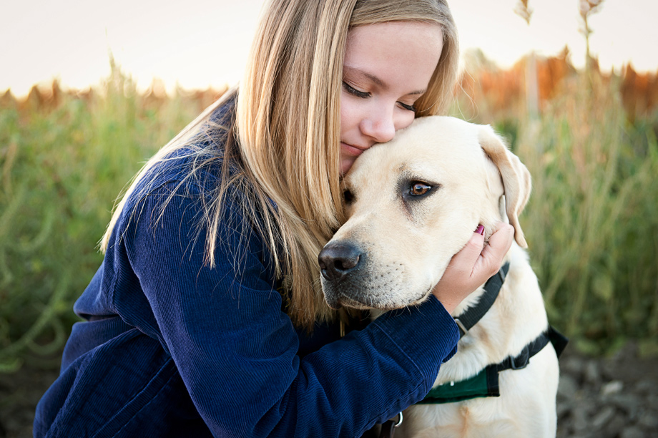
Time to say goodbye
Once the assistance dog is old enough they have to be given to the person who needs them.
How do you think the raiser feels about this?

Slide 26
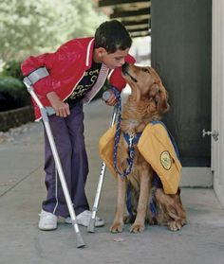
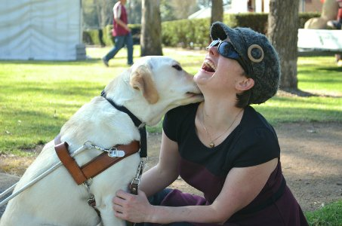
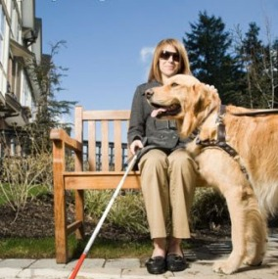
Time to say goodbye
A loving and kind puppy raiser will always love the dog but they still give it away to someone who needs it more.

