Slide 1

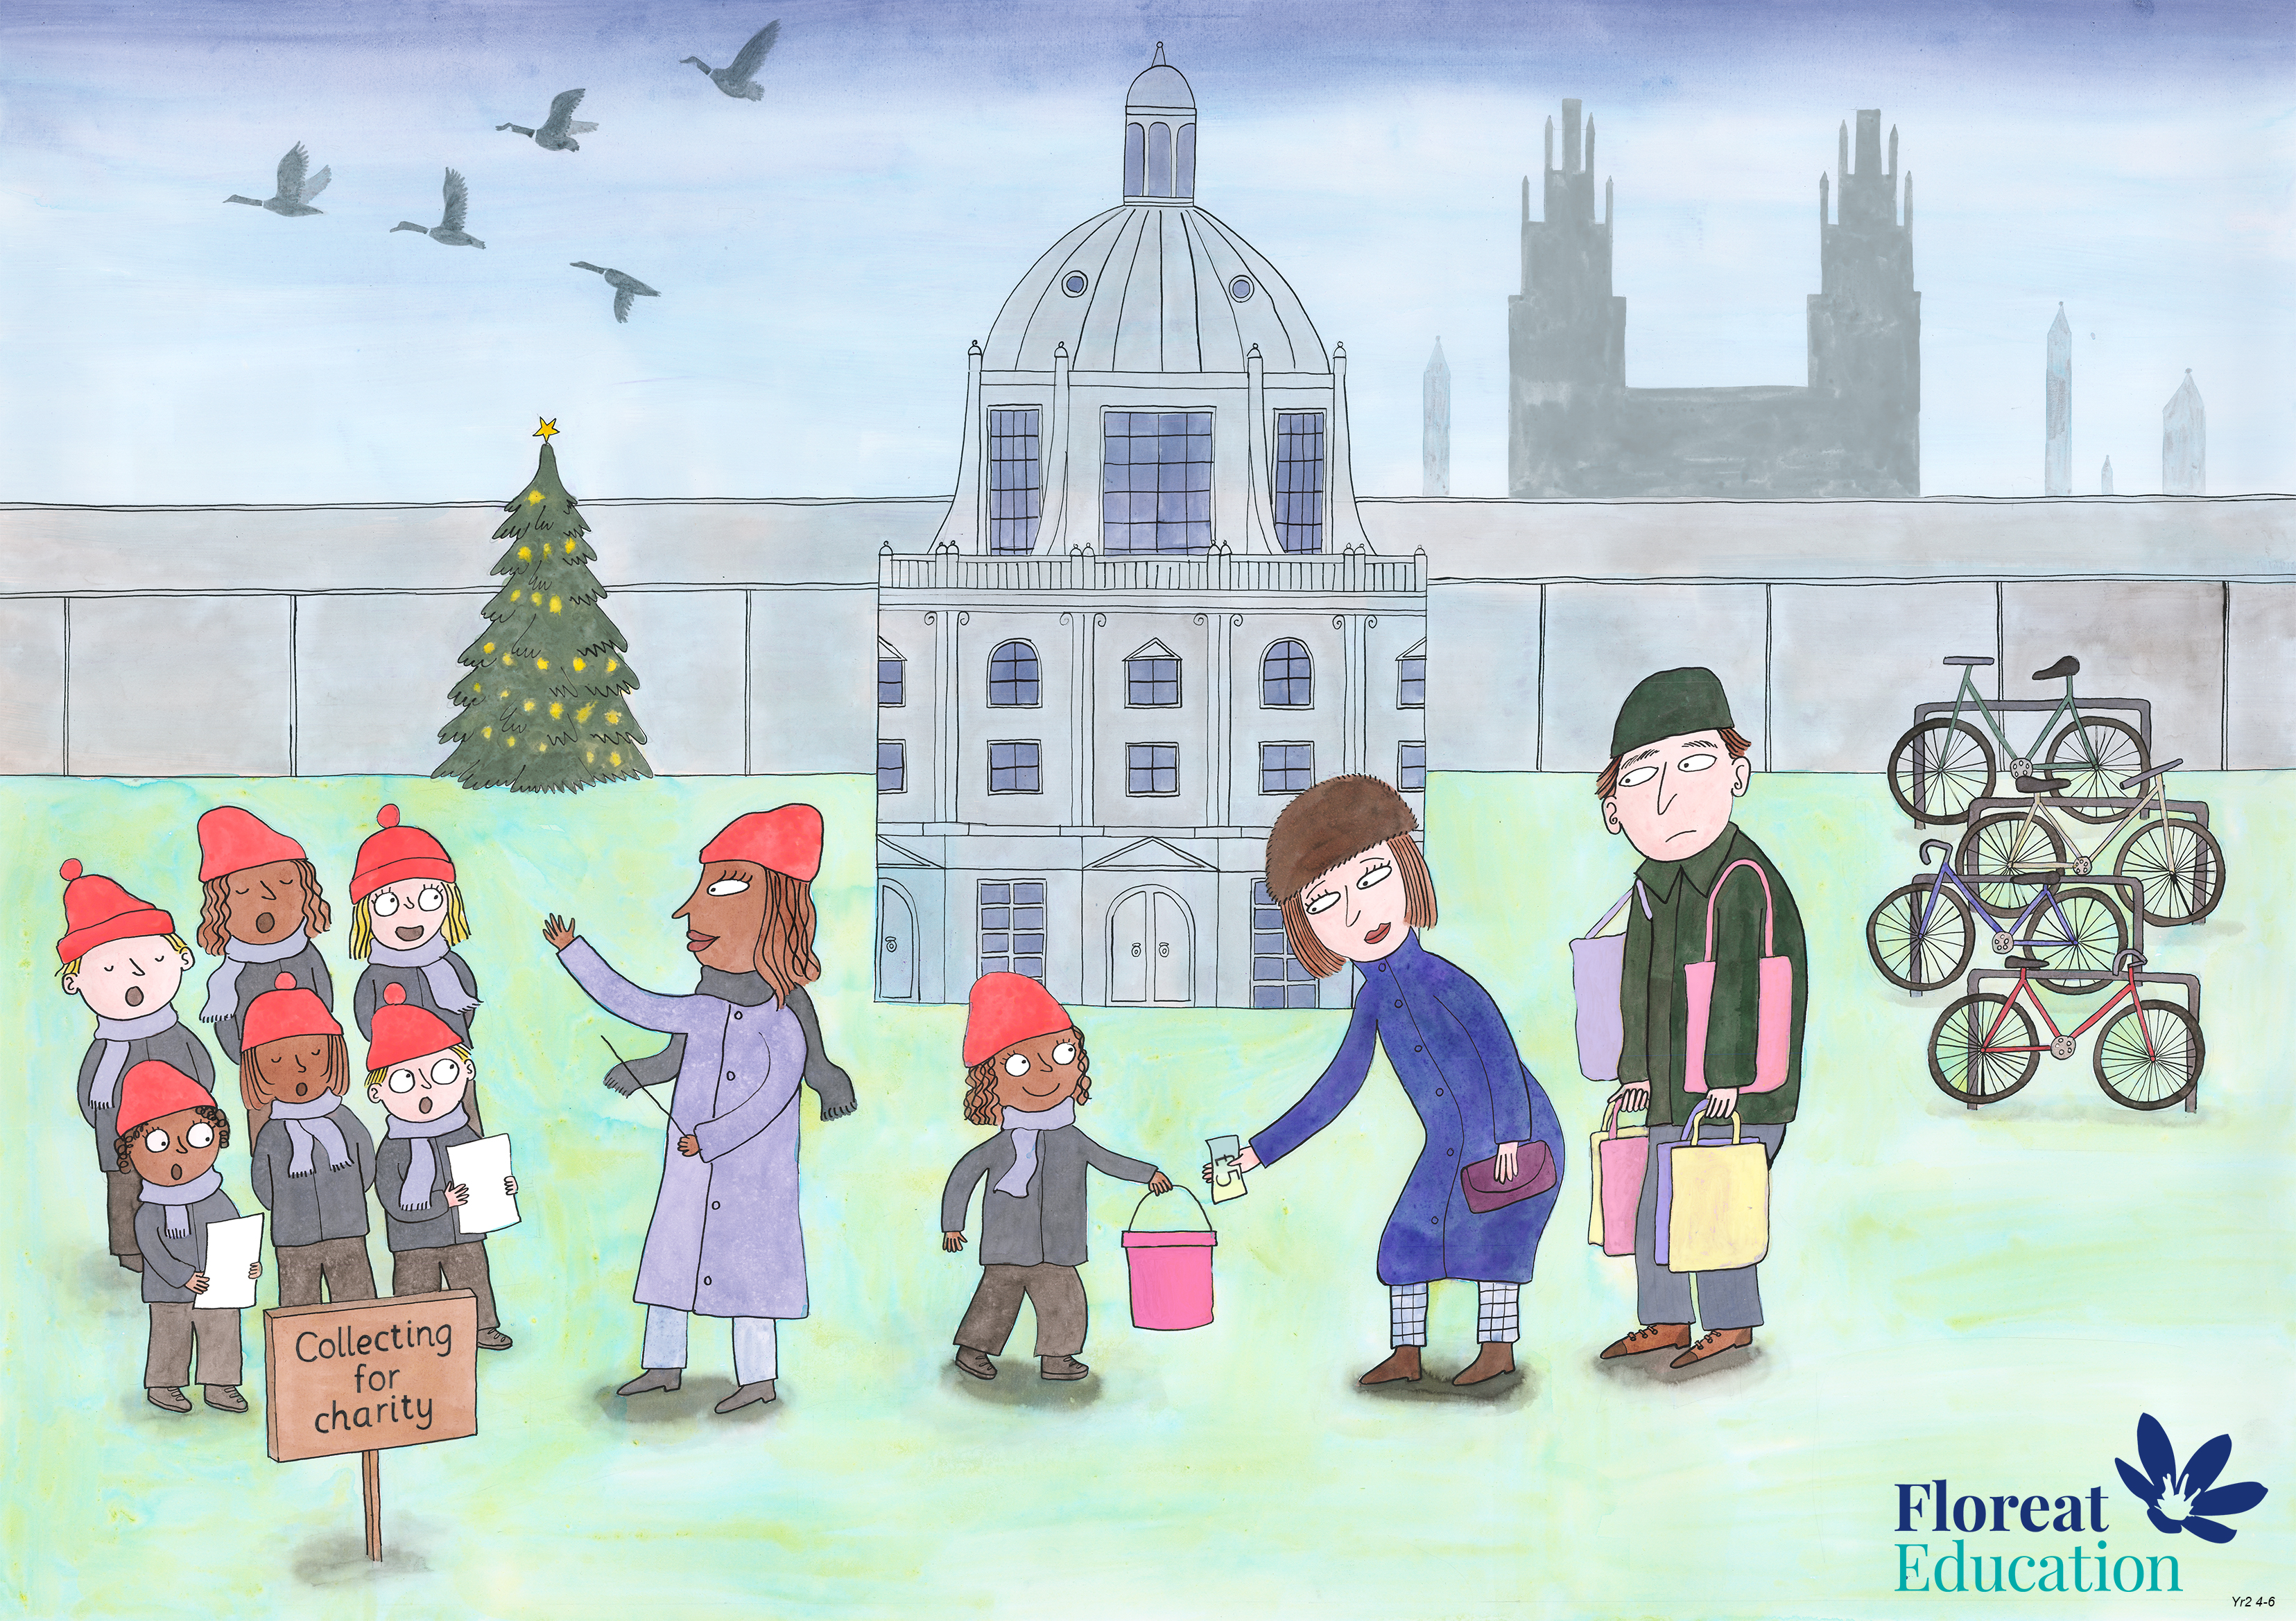
Year 2 Autumn 2
Leadership and Teamwork, Fairness, Service

Slide 2
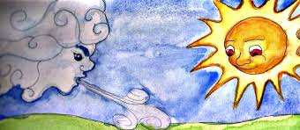
The North Wind and the Sun

Slide 3
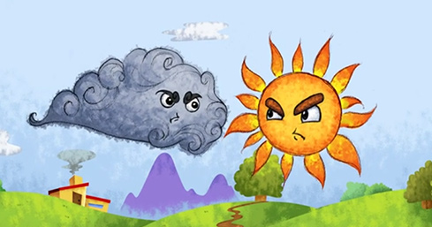
The North Wind and the Sun were very competitive.

Slide 4
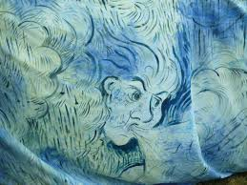
The North Wind boasted that he had the greater strength.
He could blow down trees and houses!

Slide 5
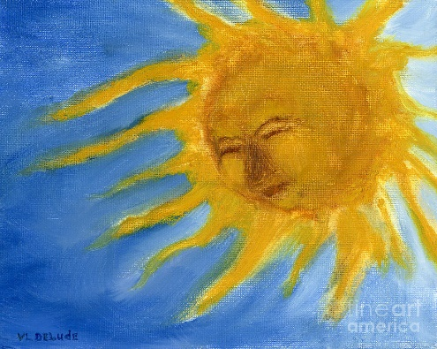
But the Sun was certain that his gentleness was more powerful.
“Let’s have a contest to decide!” he suggested.

Slide 6
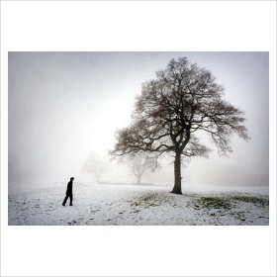
The Sun and the North Wind looked below them. A man was walking through the snow.The Sun suggested that their competition could be to make the man remove his coat.

Slide 7
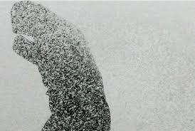
The North Wind laughed. It would be so easy to blow his coat off by force!
But as the North Wind whipped the snow through the air, the man just clutched his coat tighter to himself.

Slide 8
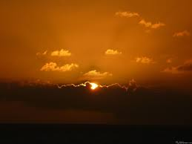
But then the Sun came out from behind the clouds.
He grew slowly brighter and brighter.

Slide 9
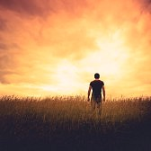
The man was confused. The snow was melting!
As he walked further, he began to get too hot.

Slide 10
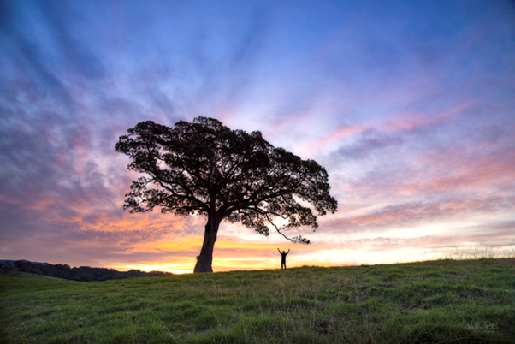
The man took off his coat and rested in the shade of a tree

Slide 11
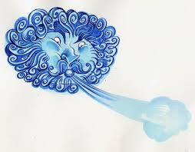
The North Wind frowned in disbelief. The man took off his coat and rested in the shade of a tree
“How did you do that?” he asked.

Slide 12
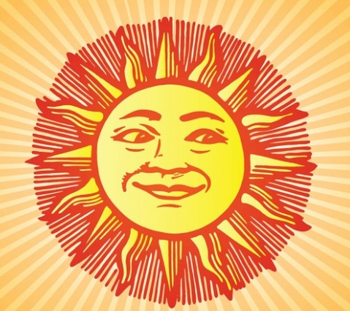
The Sun smiled serenely.
“I won by making him want to take off his coat, instead of forcing him.”

