Slide 1

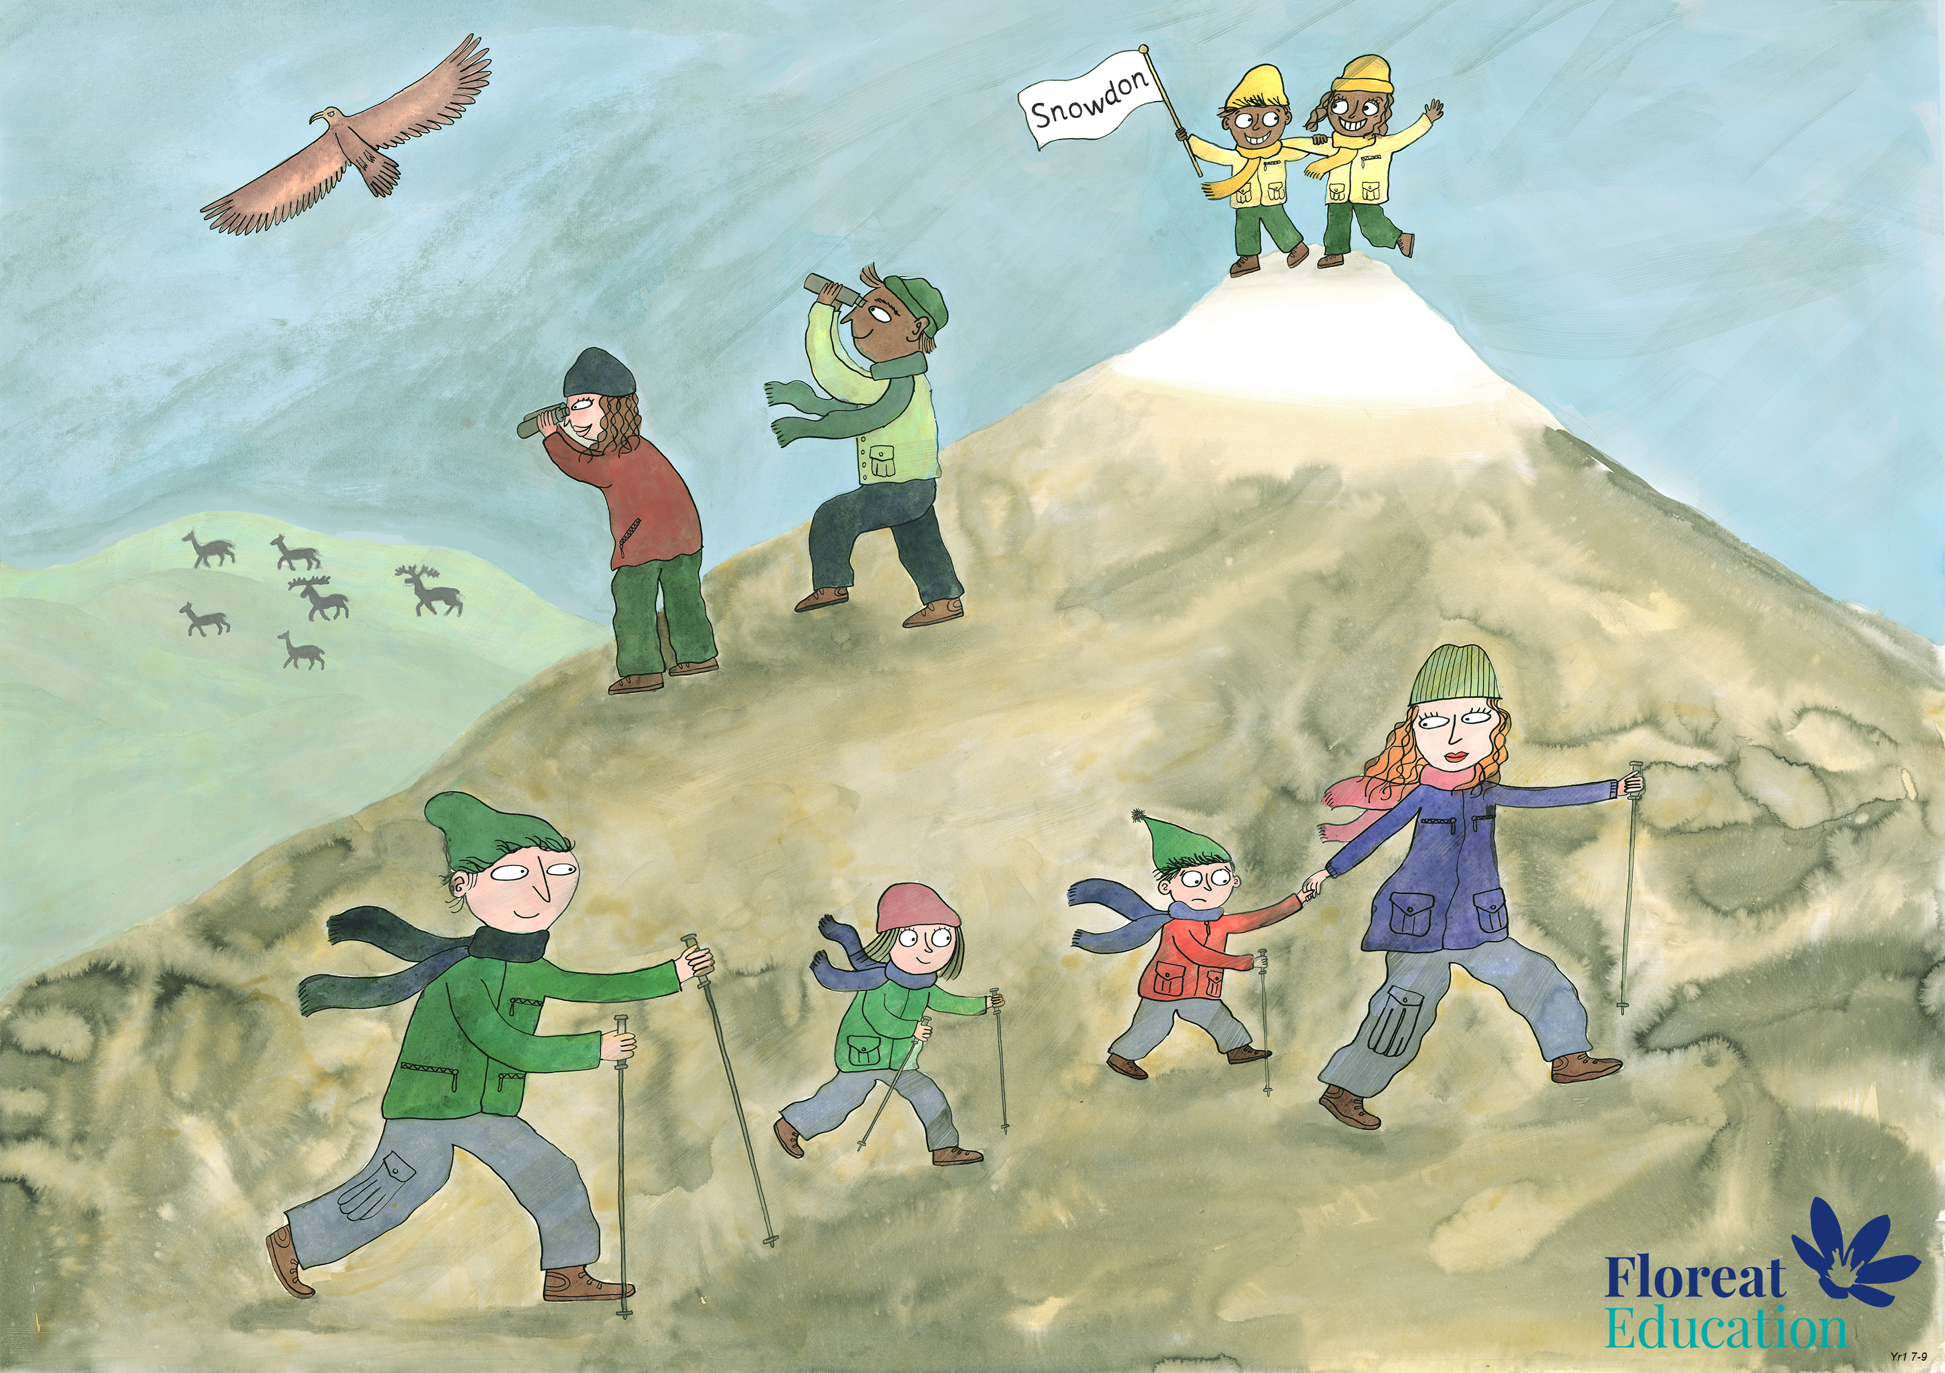
Year 2 Spring 1
Perseverance, Optimism and Joy, Curiosity

Slide 2
Today was the absolute worst day ever
And don’t try to convince me that
There’s something good in every day
Because, when you take a closer look,
This world is a pretty evil place.
Even if, some goodness does shine through once in a while
Satisfaction and happiness don’t last.
And it’s not true that
It’s all in the mind and heart
Because
True happiness can be obtained
Only if one’s surroundings are good
It’s not true that good exists
I’m sure you can agree that
The reality
Creates
My attitude
It’s all beyond my control
And you’ll never in a million years hear me say that
Today was a good day

Slide 3
Now read the poem starting with the bottom line working up to the top.
The same words are on the page, but looking at them in a different way helps us to feel more optimistic!

