Slide 1

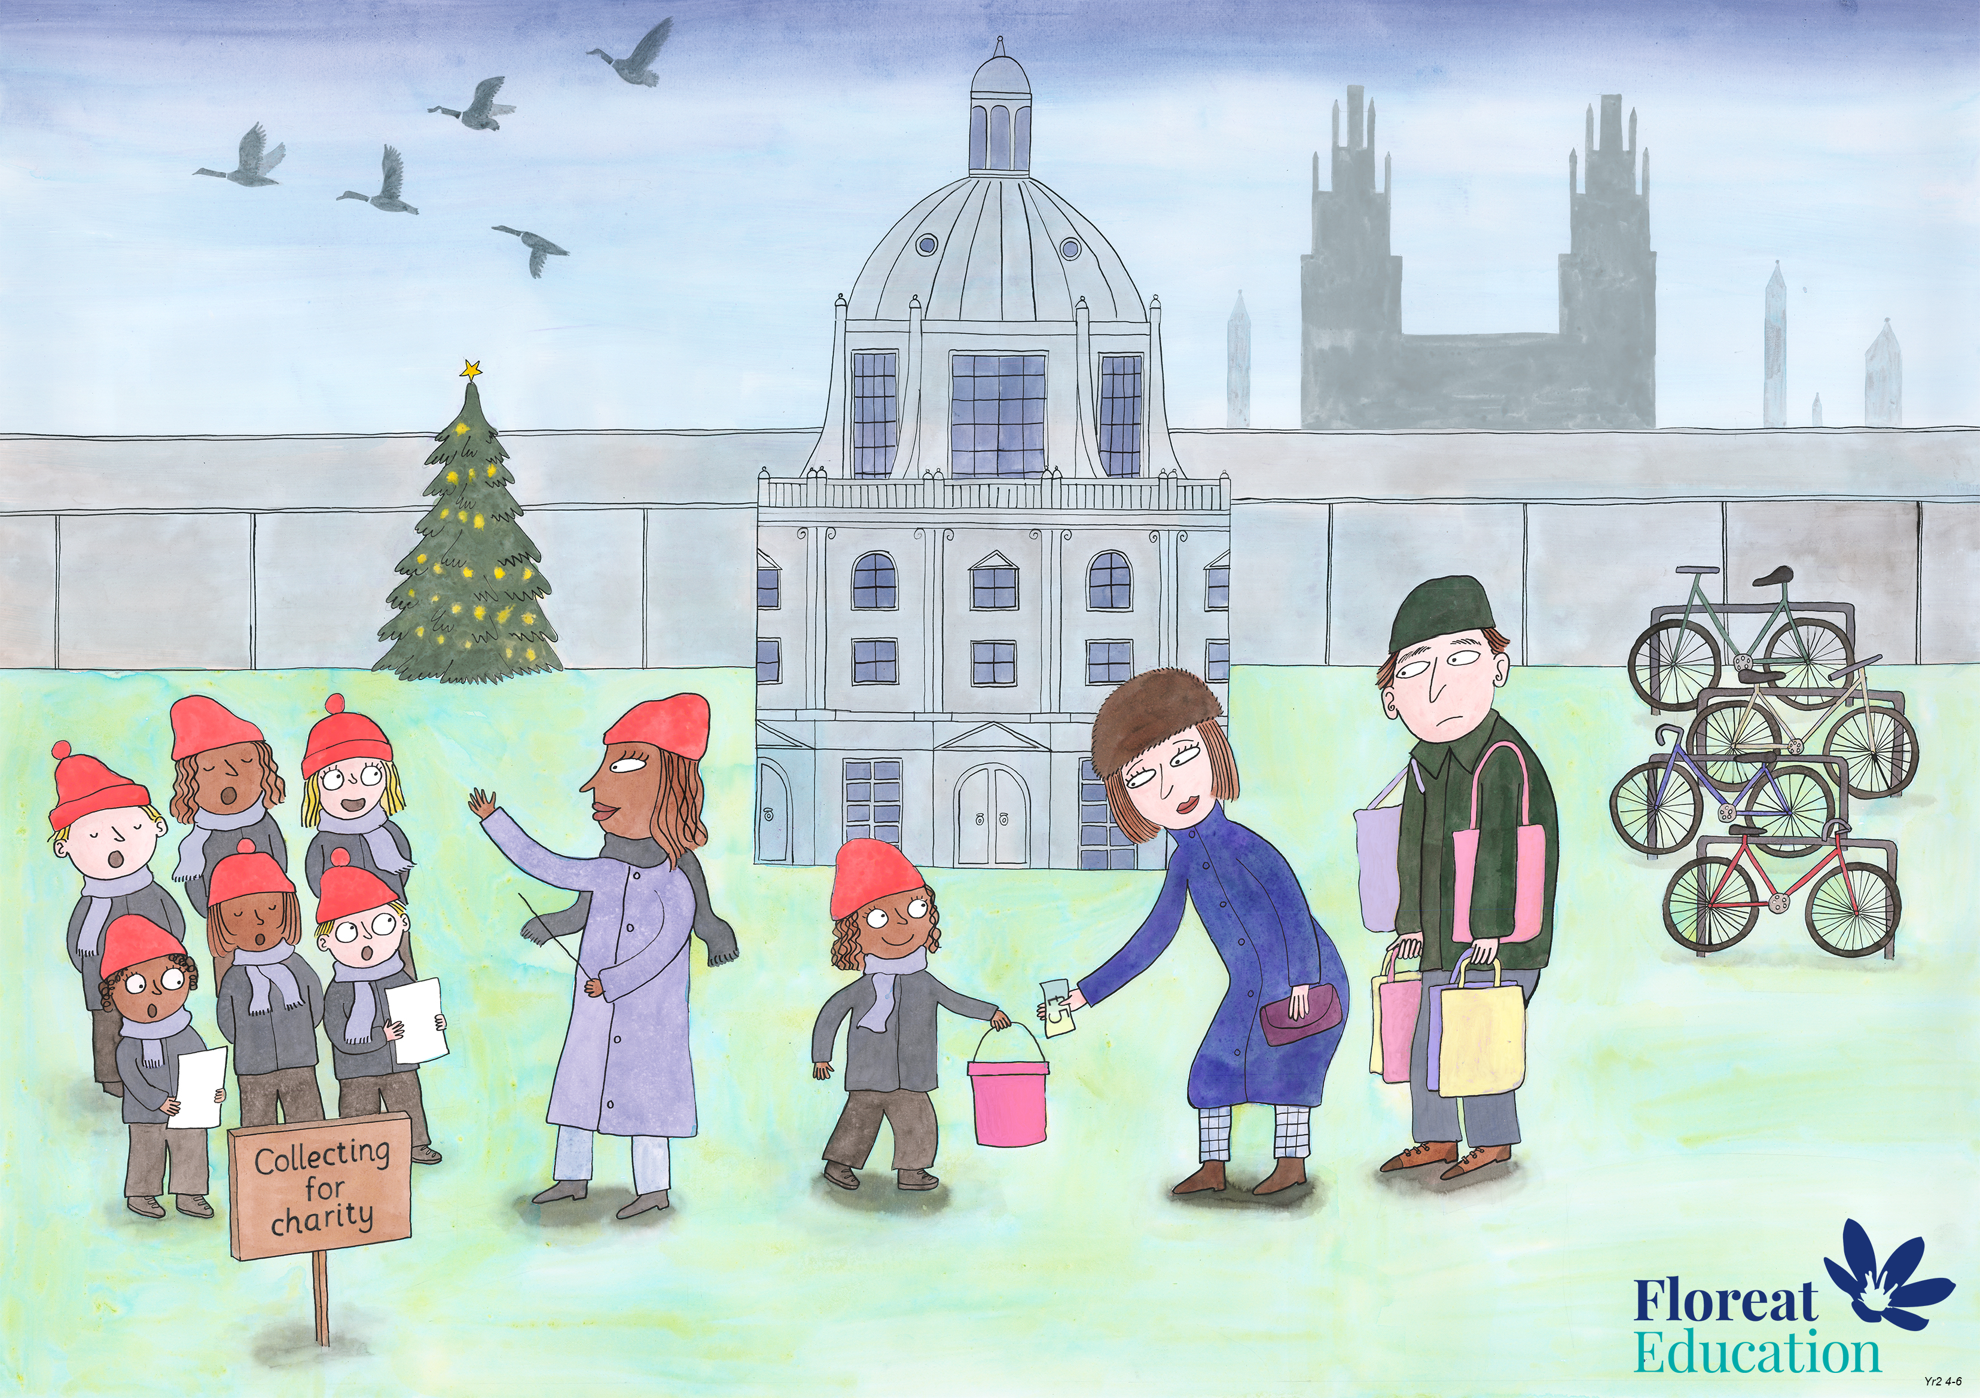
Year 2 Autumn 2
Leadership and Teamwork, Fairness, Service

Slide 2
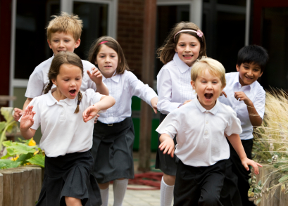

It is breaktime. Your teacher needs help carrying books into another classroom, but you want to go and play. How could you serve others?

Slide 3
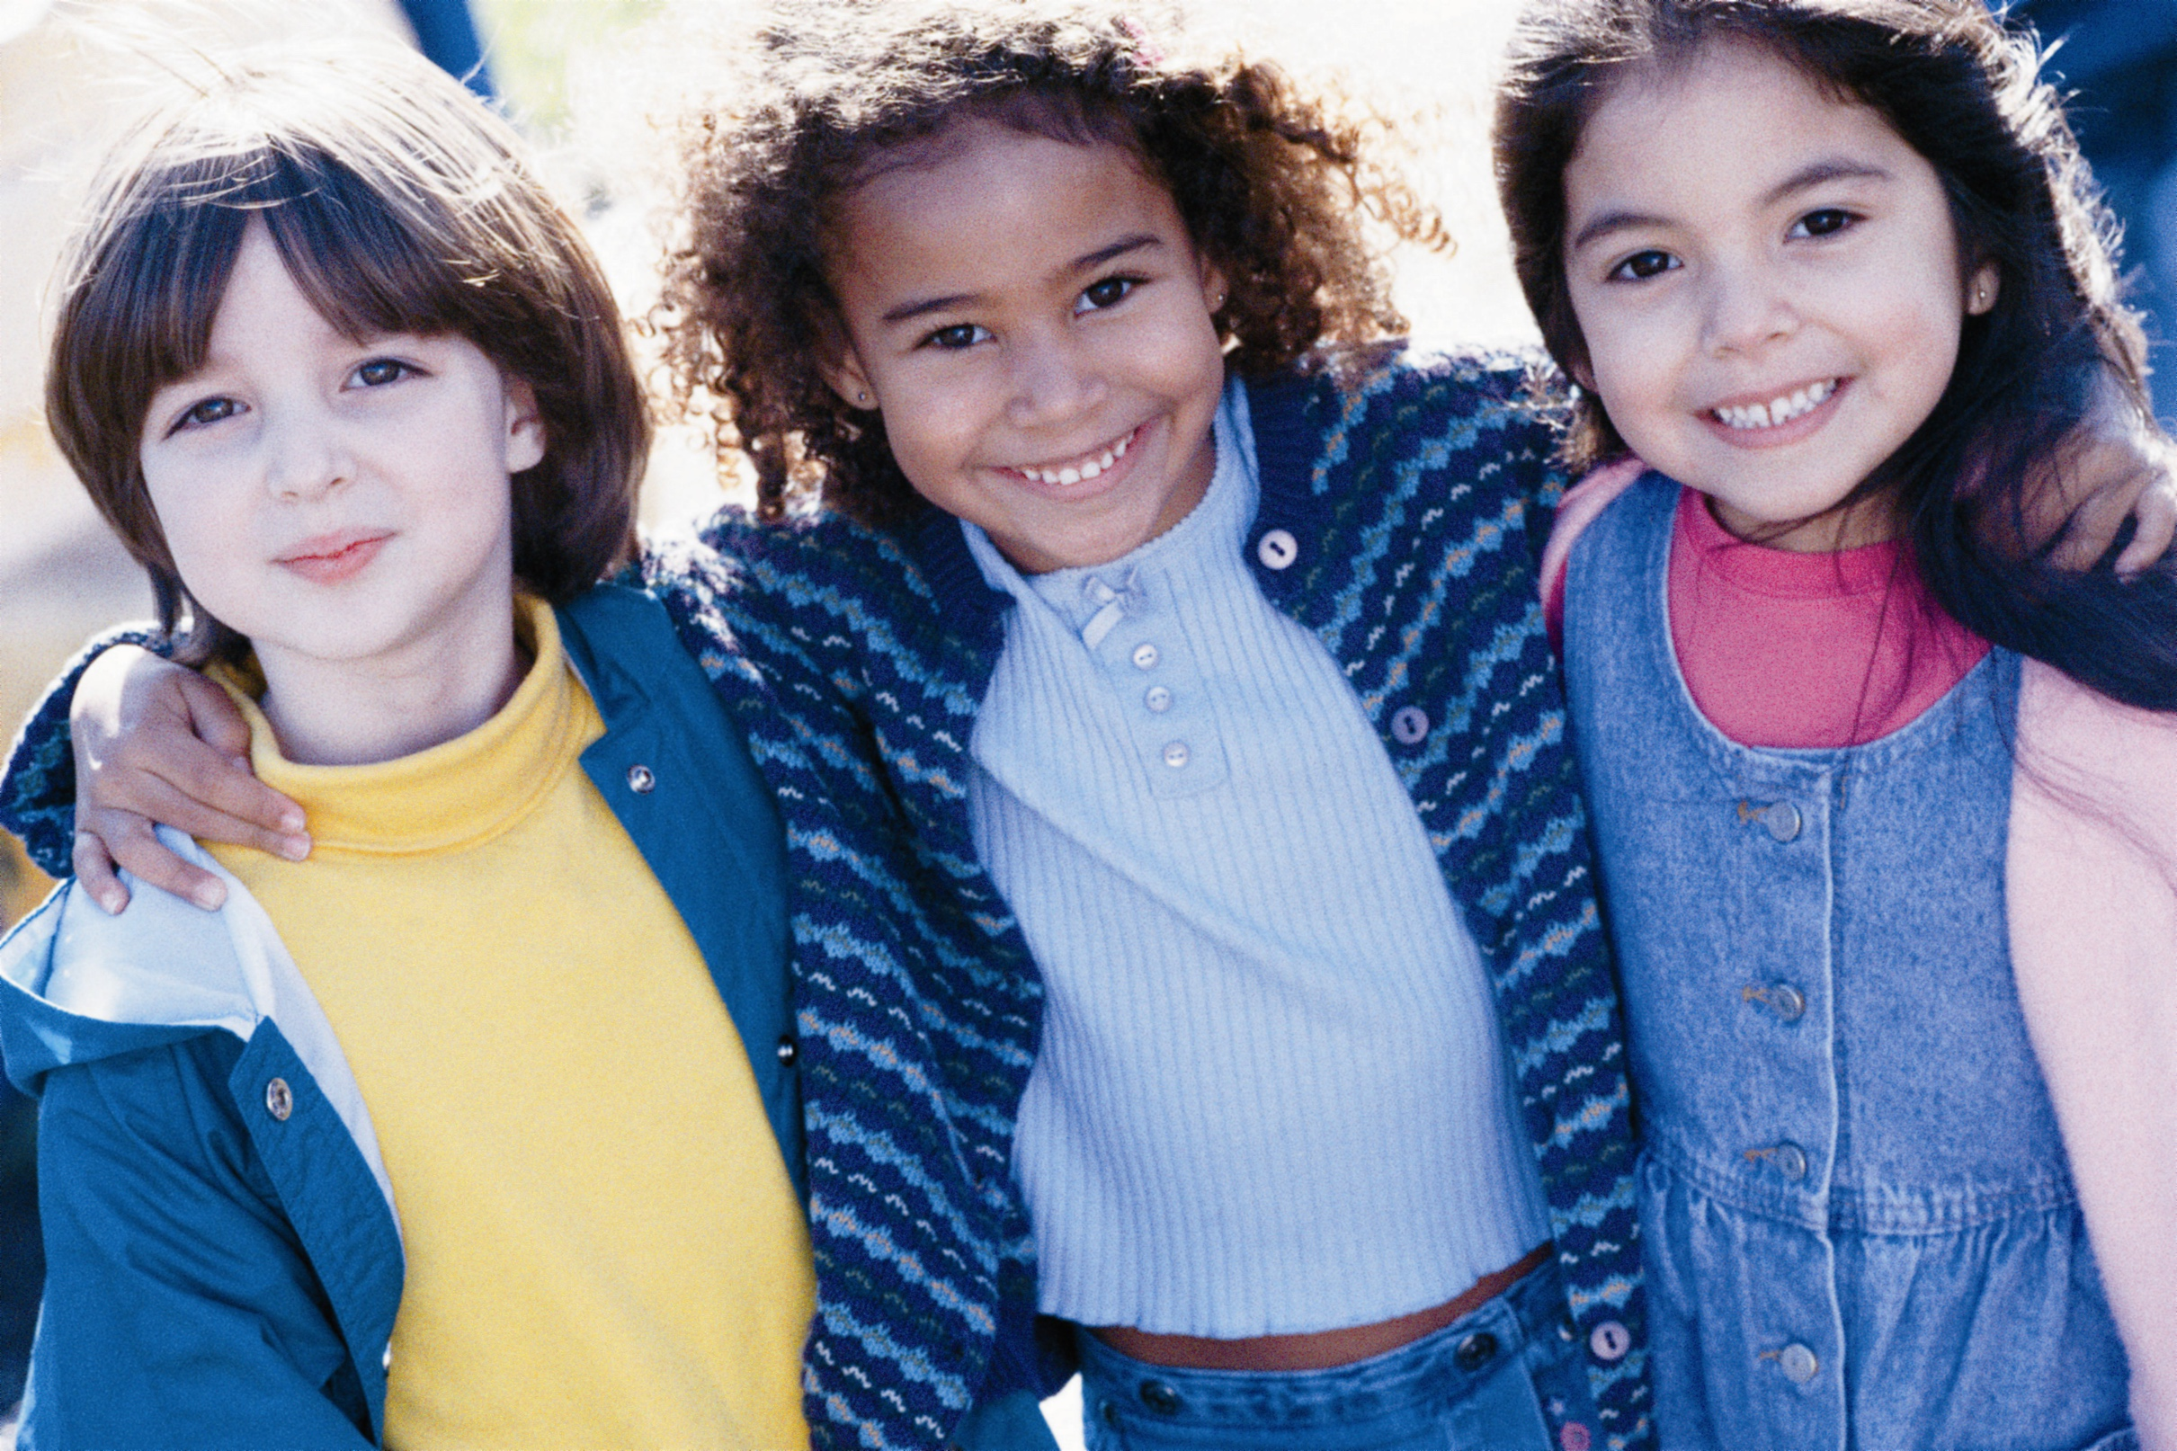
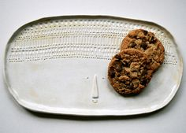
You are with two of your friends. You discover there are only 2 biscuits left. How could you serve others?

Slide 4
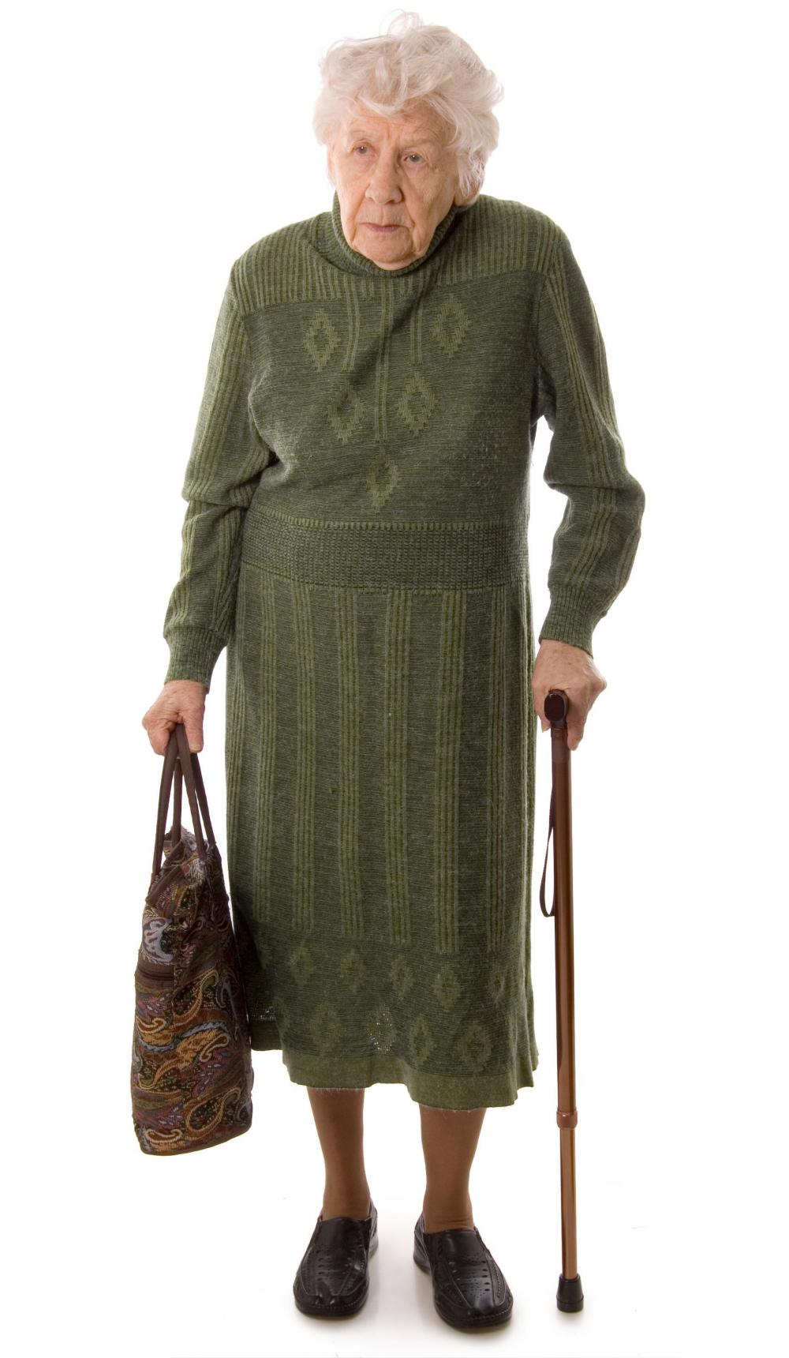
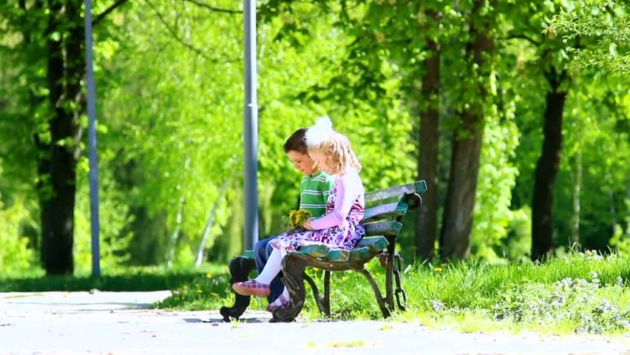
You are tired so you rest on a bench when you see an old lady walking past. She looks tired too. What will you do?

Slide 5
Your dad told you to clean up your toys, but you're having fun. You don't want to stop playing. Besides, the room is messy, and you don't feel like cleaning up. What will you do?

Slide 6
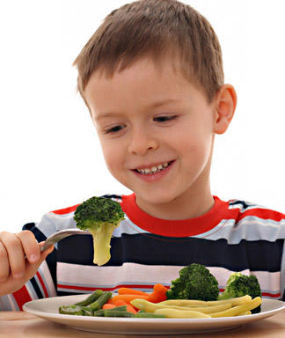
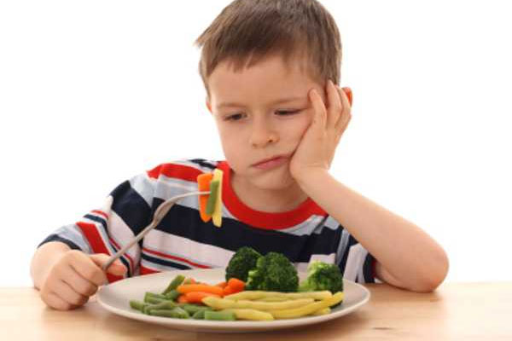
If you had dinner at your friend’s house and their mum served something you don’t like, would you eat it?

Slide 7
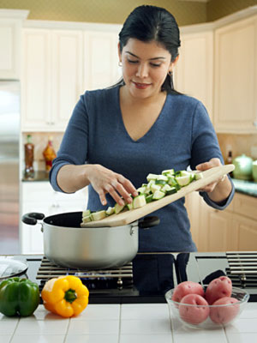
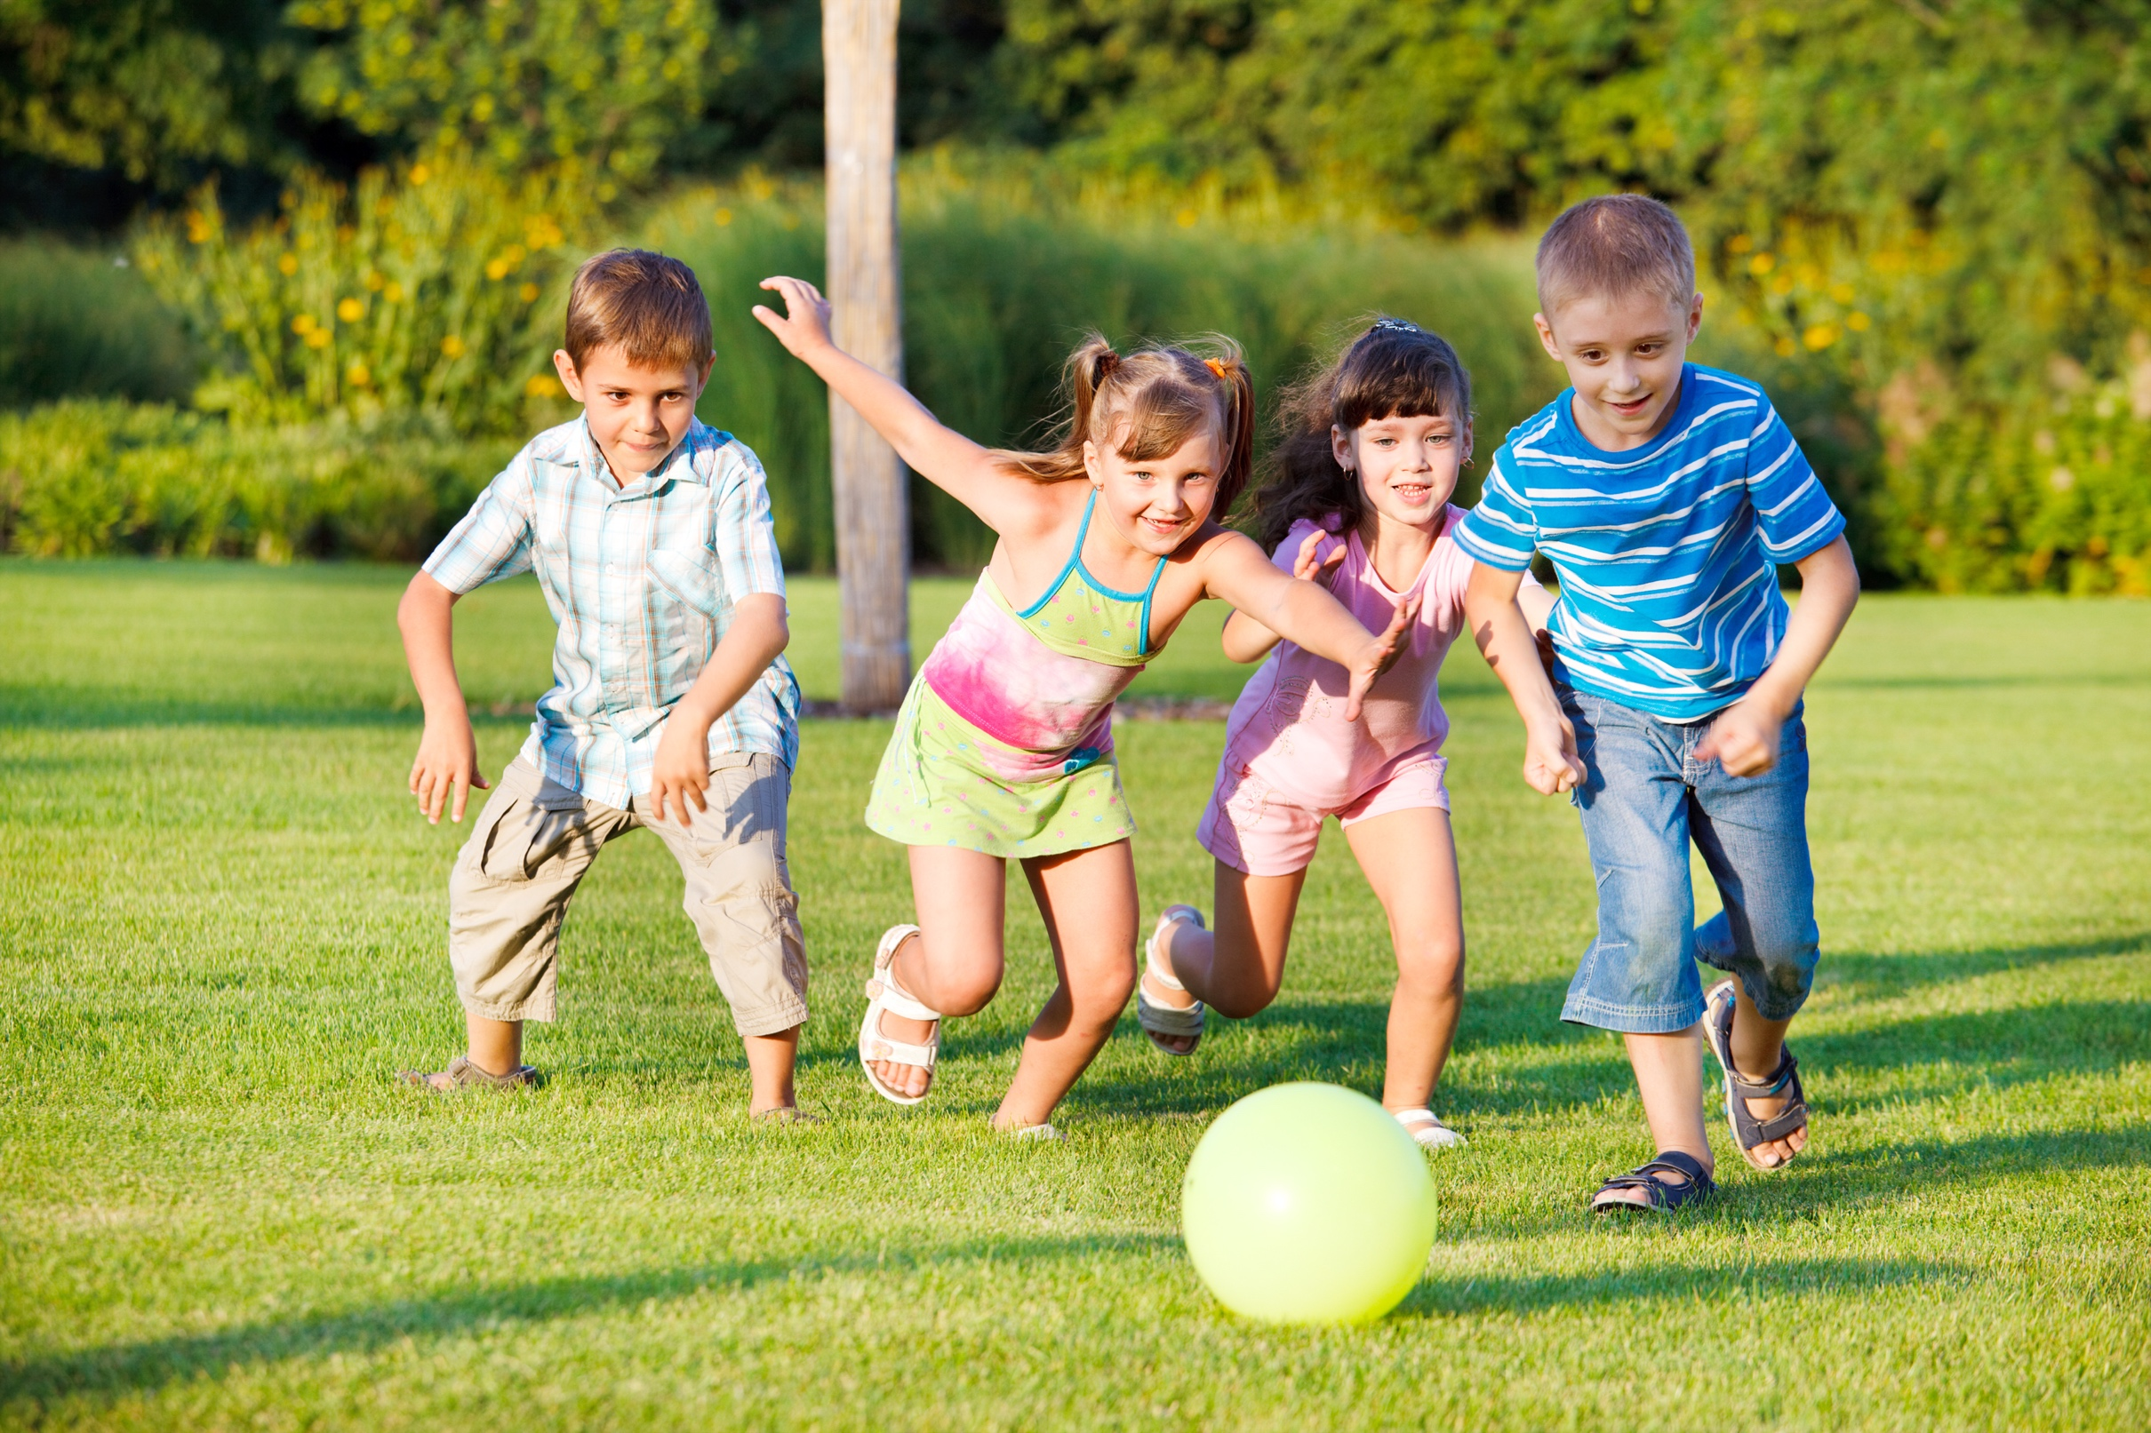
Your mum is busy preparing dinner for visitors. She needs help but you’re in the middle of a game. What will you do?

