Slide 1

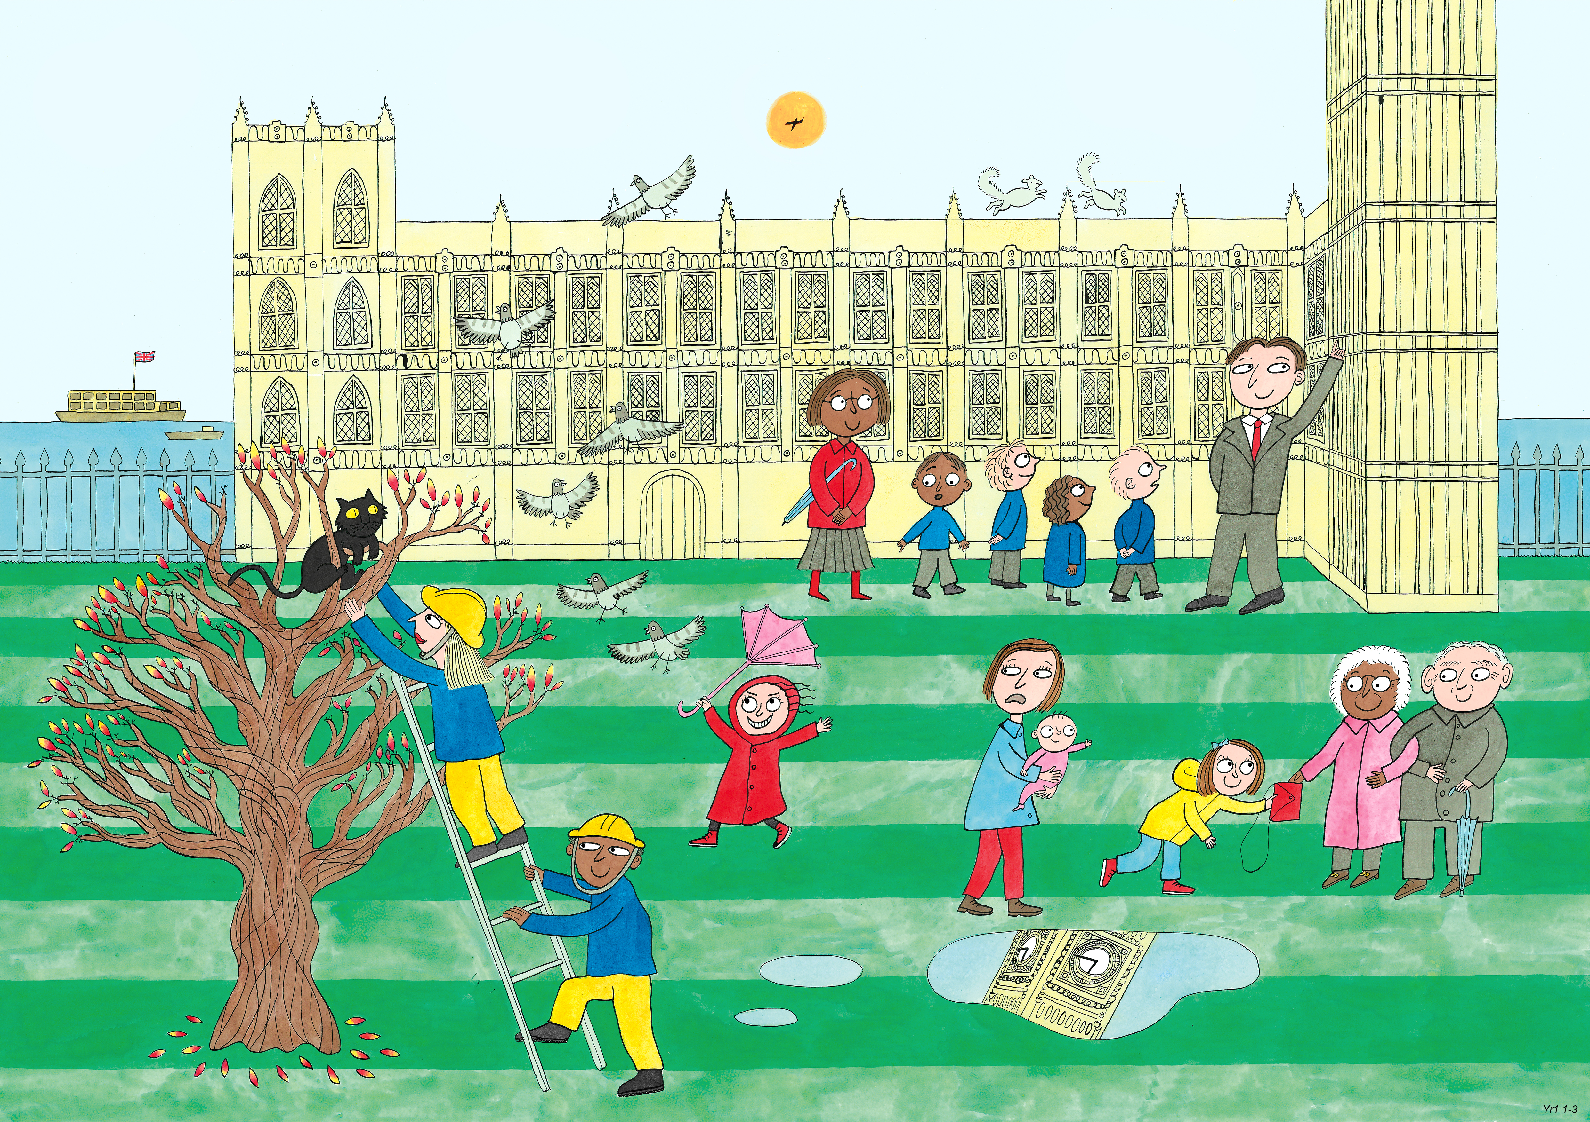
Year 1: Autumn 1
Self Control, Bravery, Love and Kindness

