Slide 1
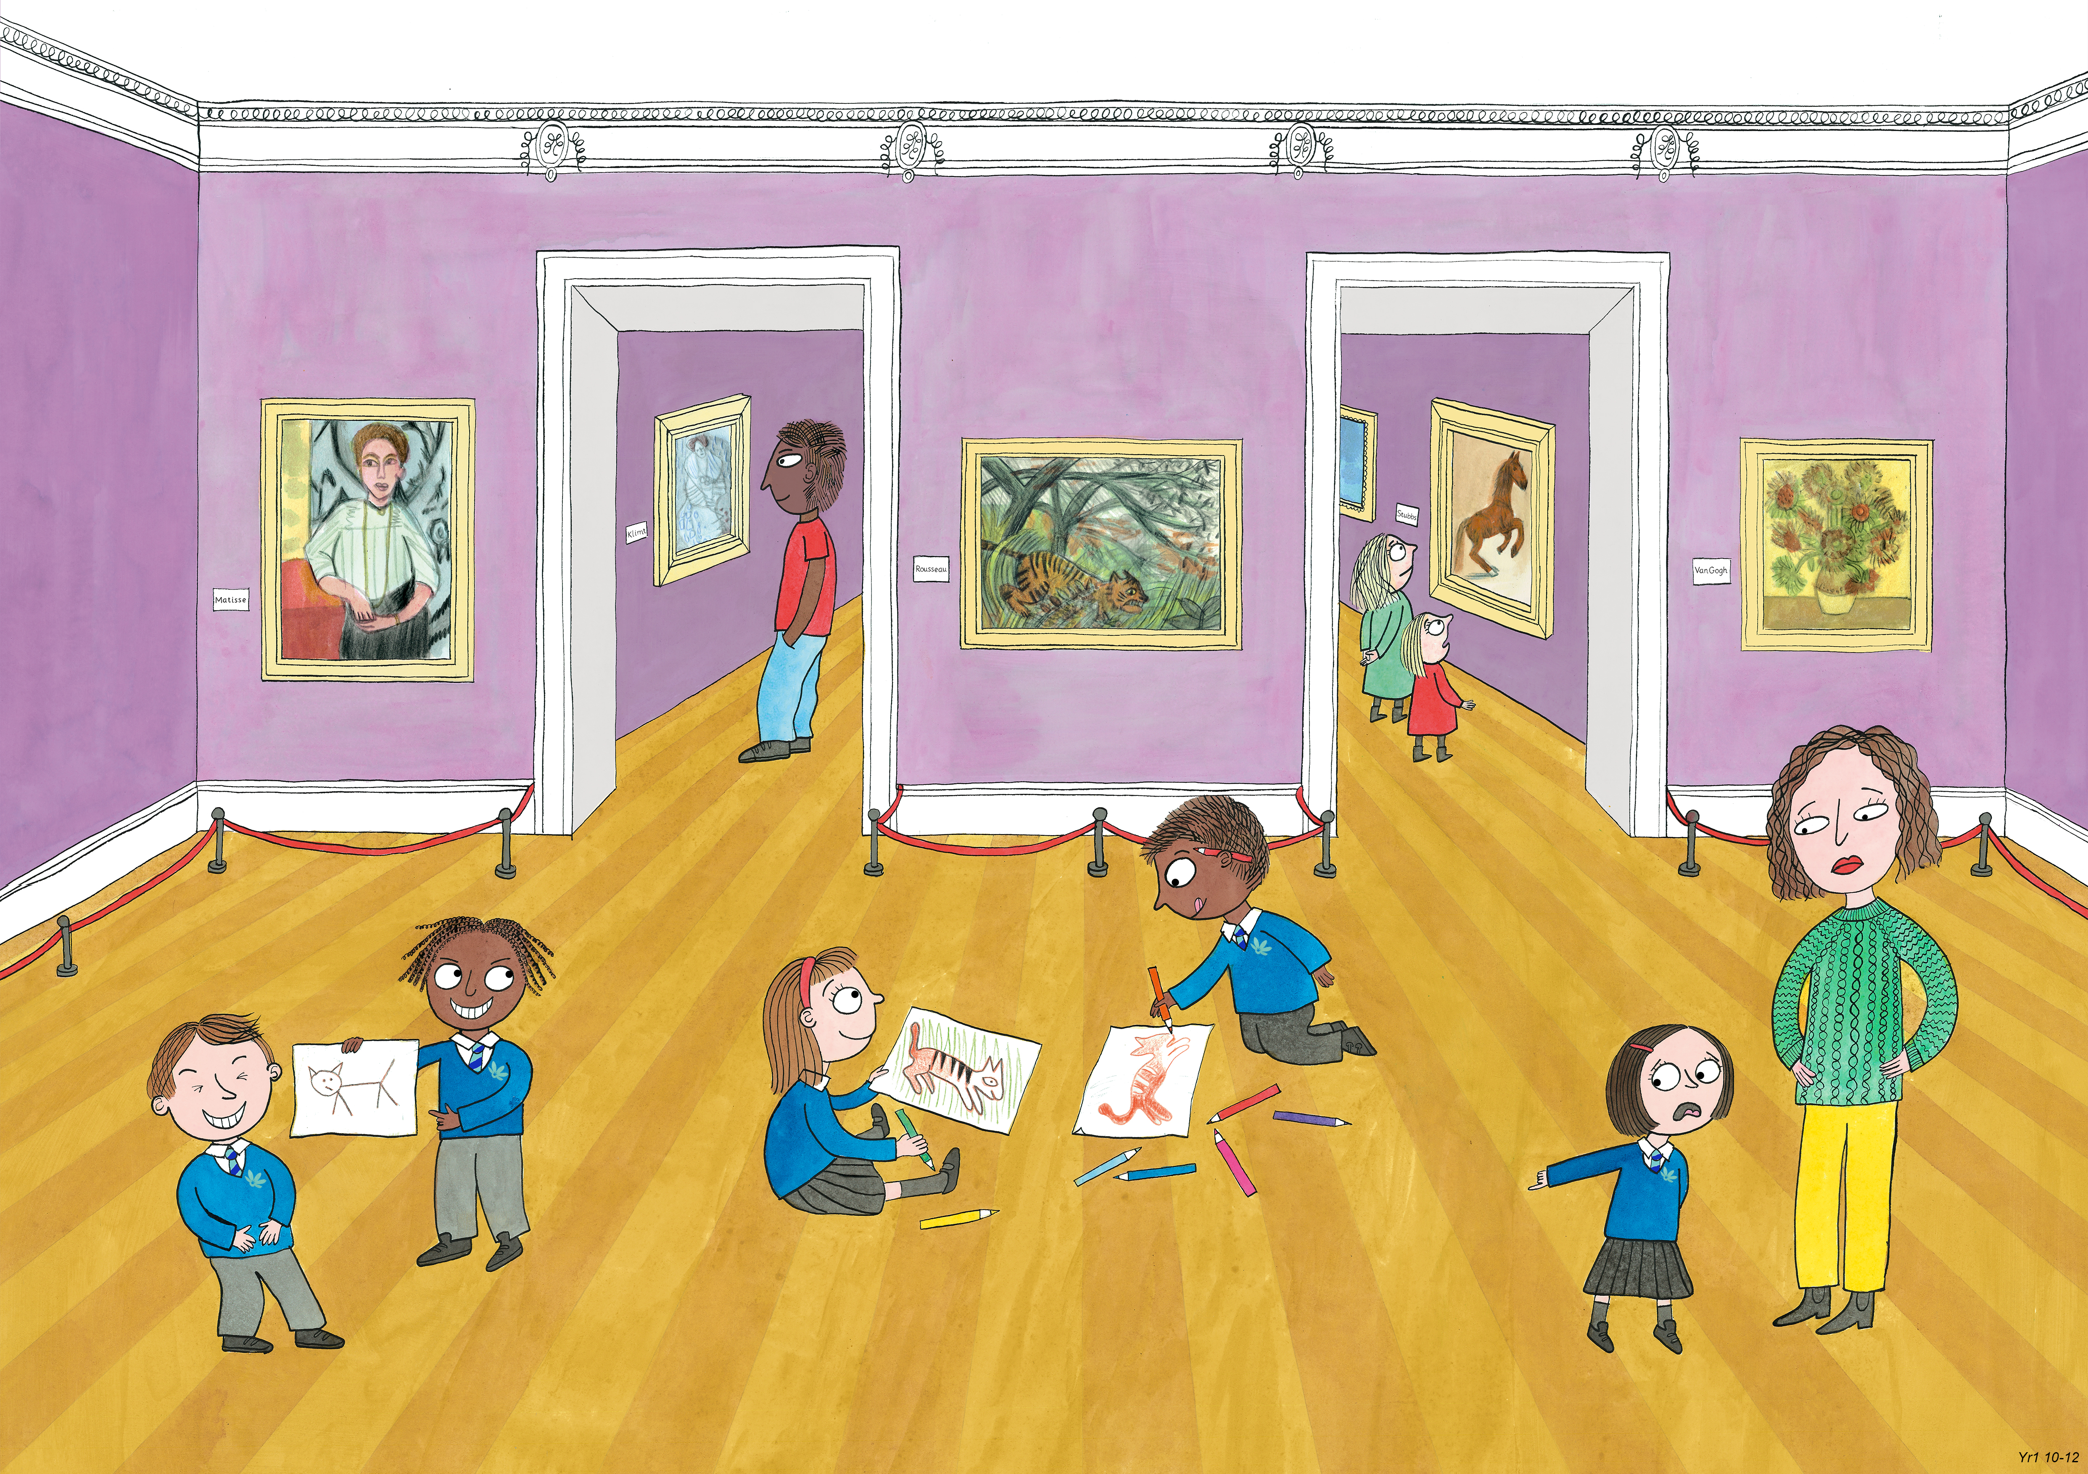
Year 1: Spring 2
Creativity, Honesty, Humour

