Slide 1
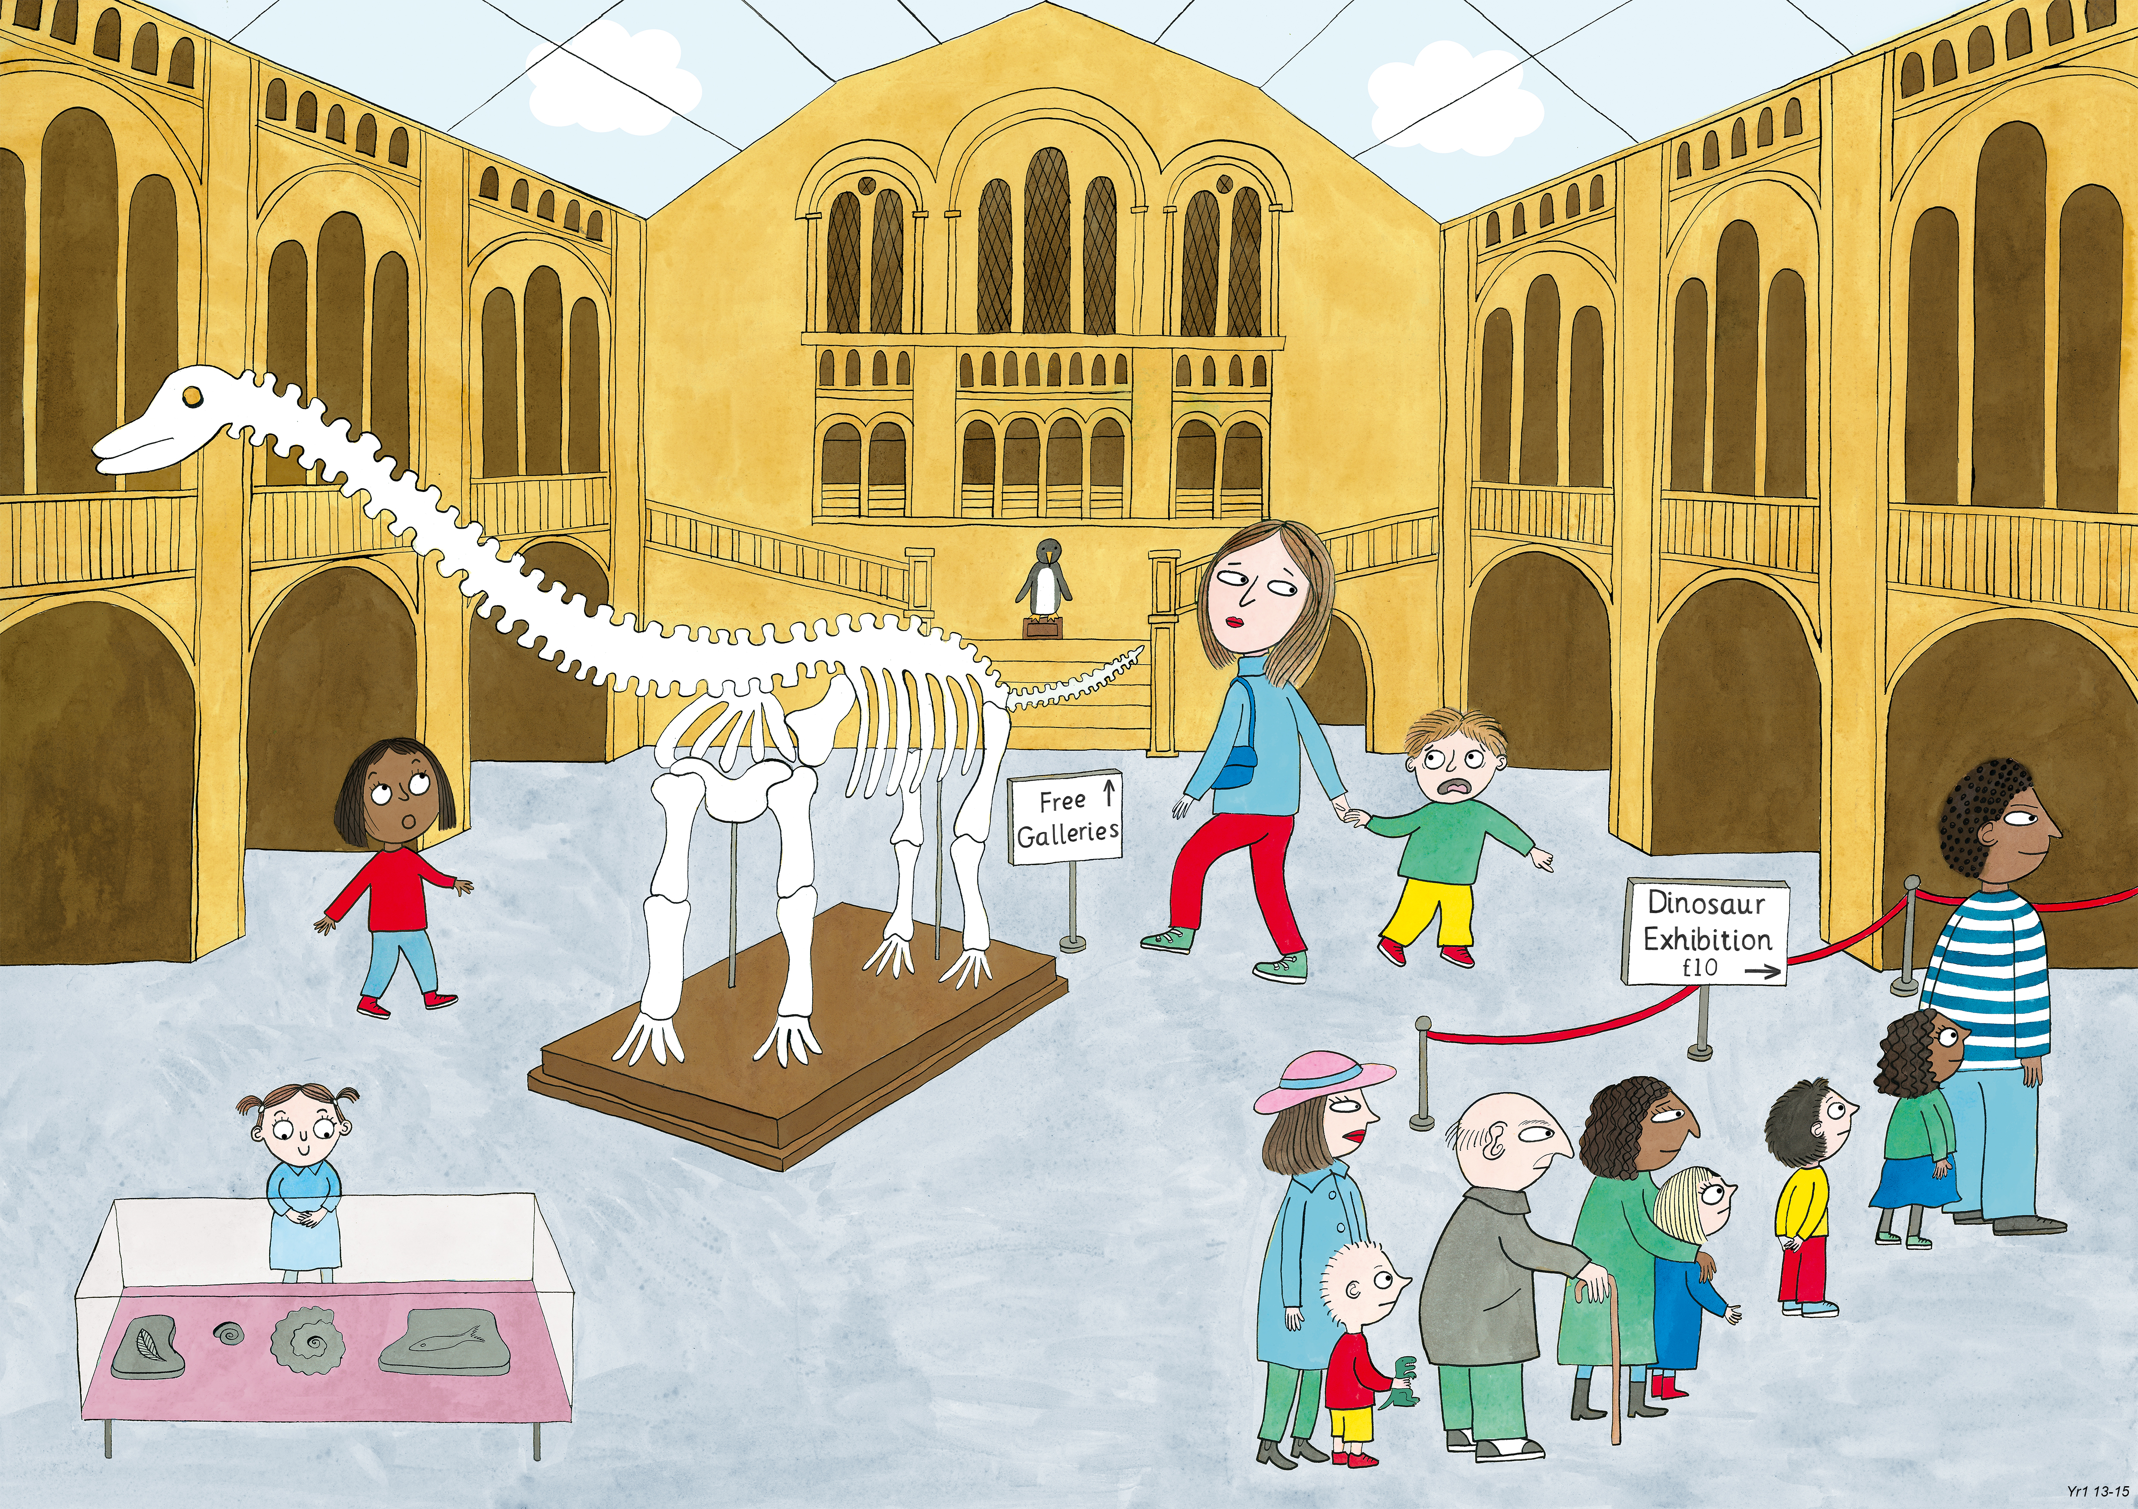
Year 1: Summer 1
Judgement and Prudence, Forgiveness, Appreciation and Awe

