Slide 1

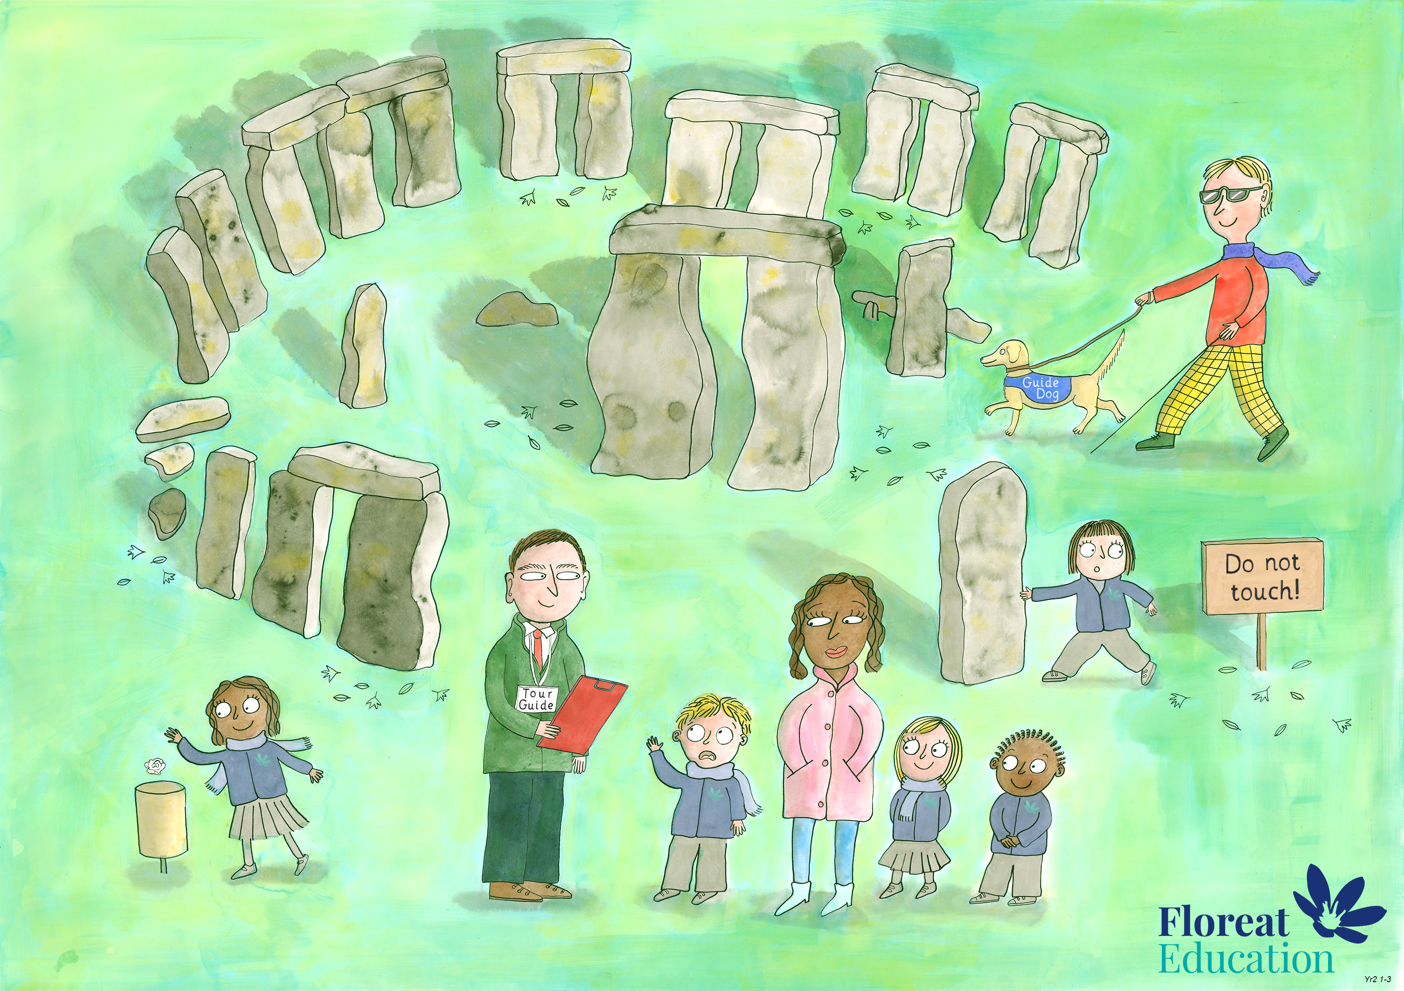
Year 2 Autumn 1
Self Control and Dignity, Bravery, Love and Kindness

