Slide 1

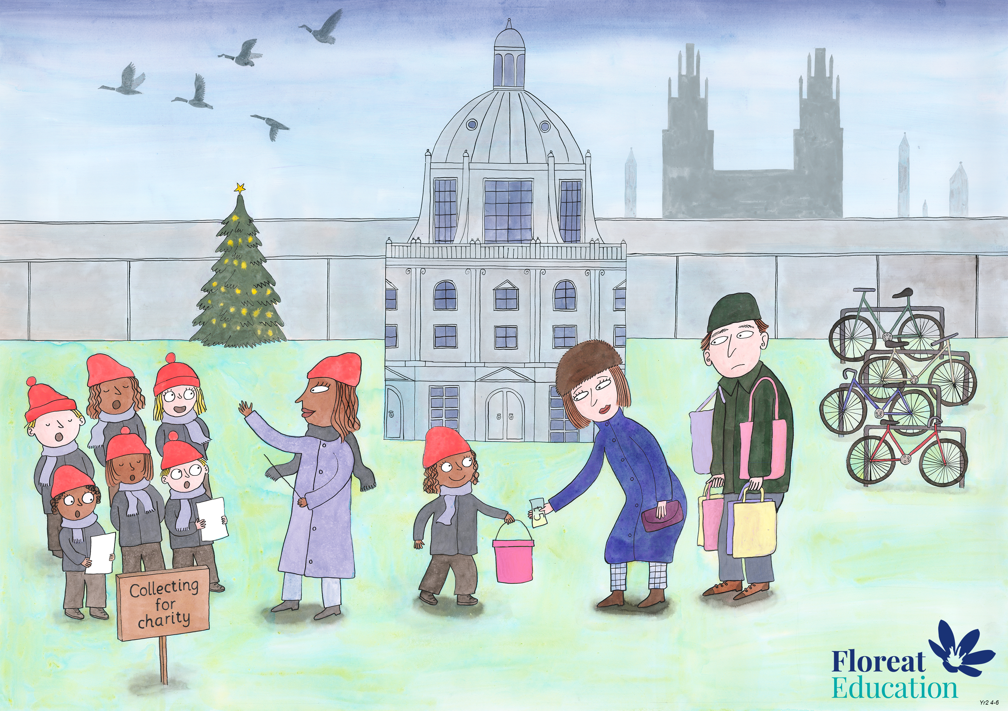
Year 2 Autumn 2
Leadership and Teamwork, Fairness, Service

