Slide 1
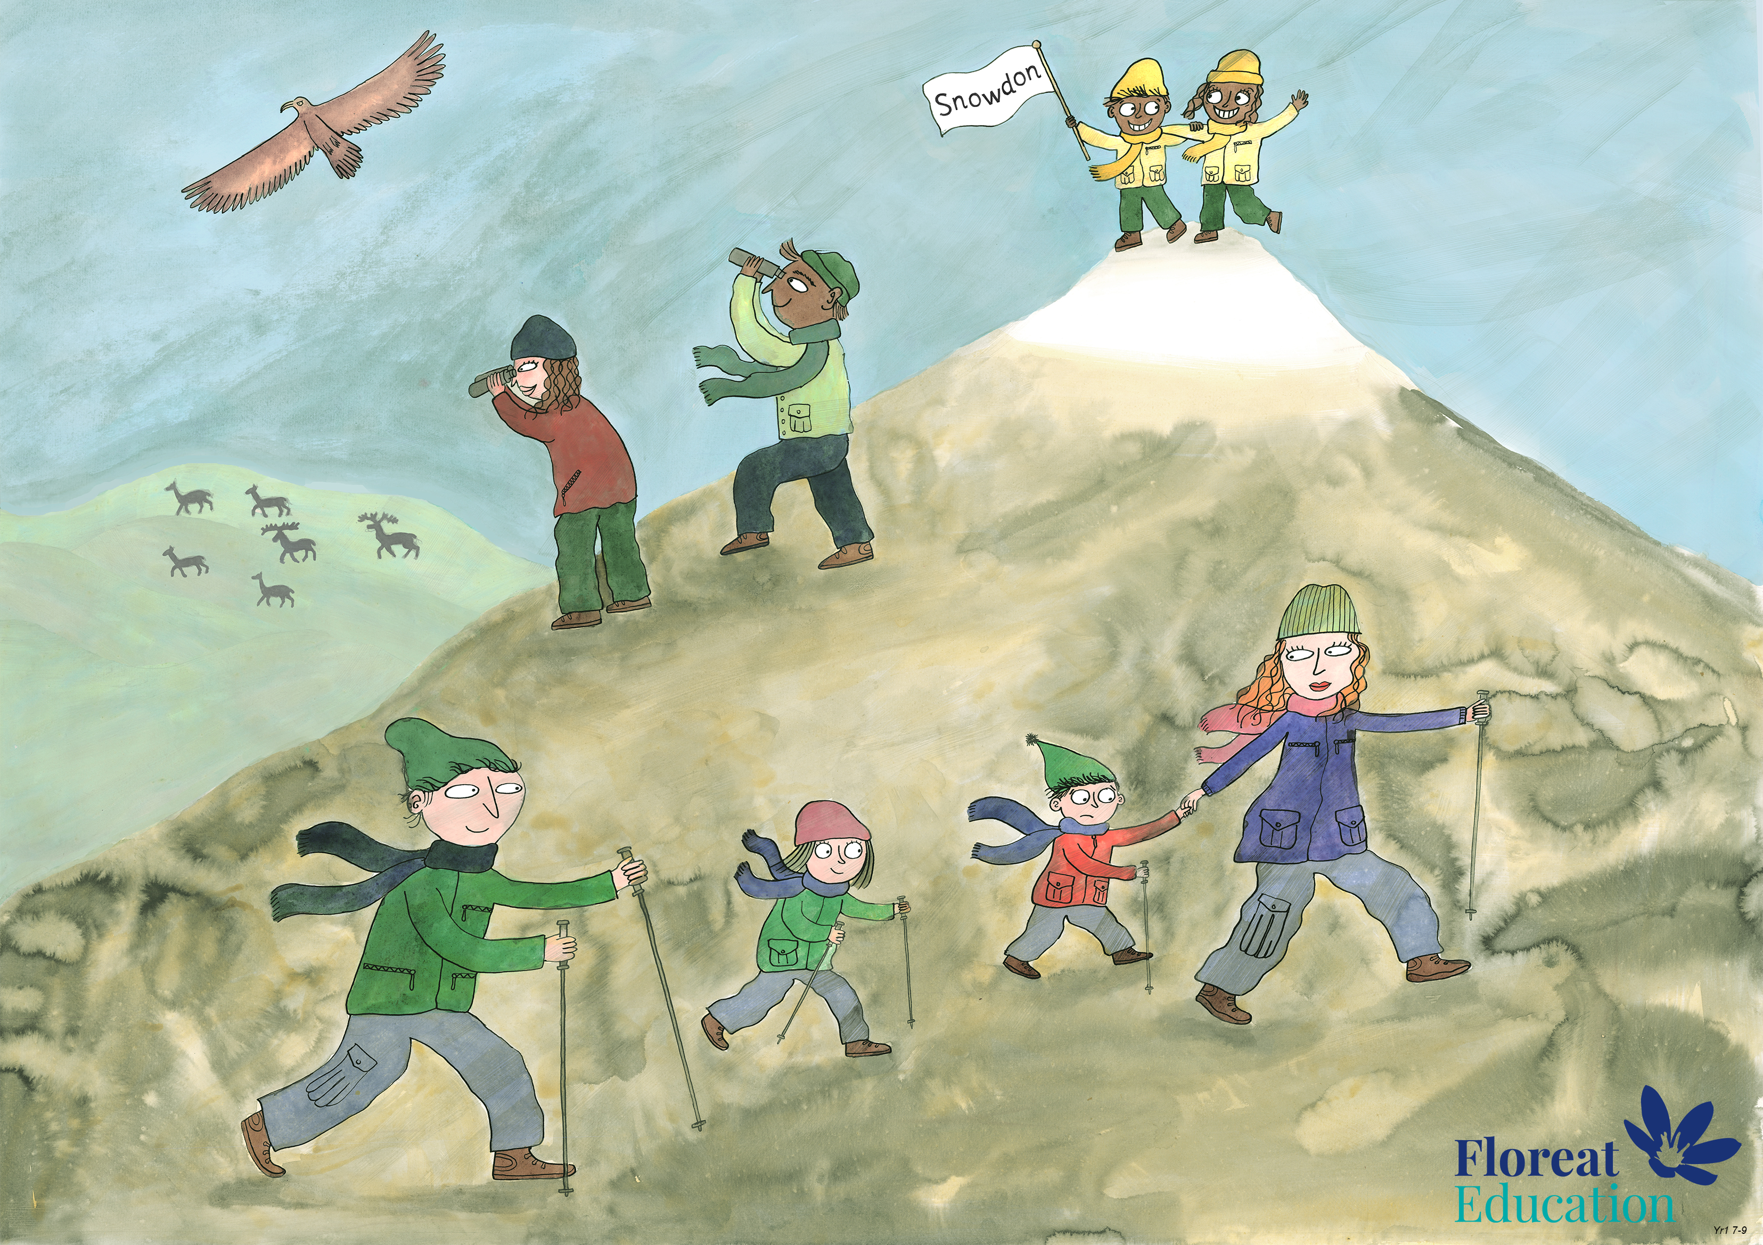
Year 2 Spring 1
Perseverance, Optimism and Joy, Curiosity

