Slide 1
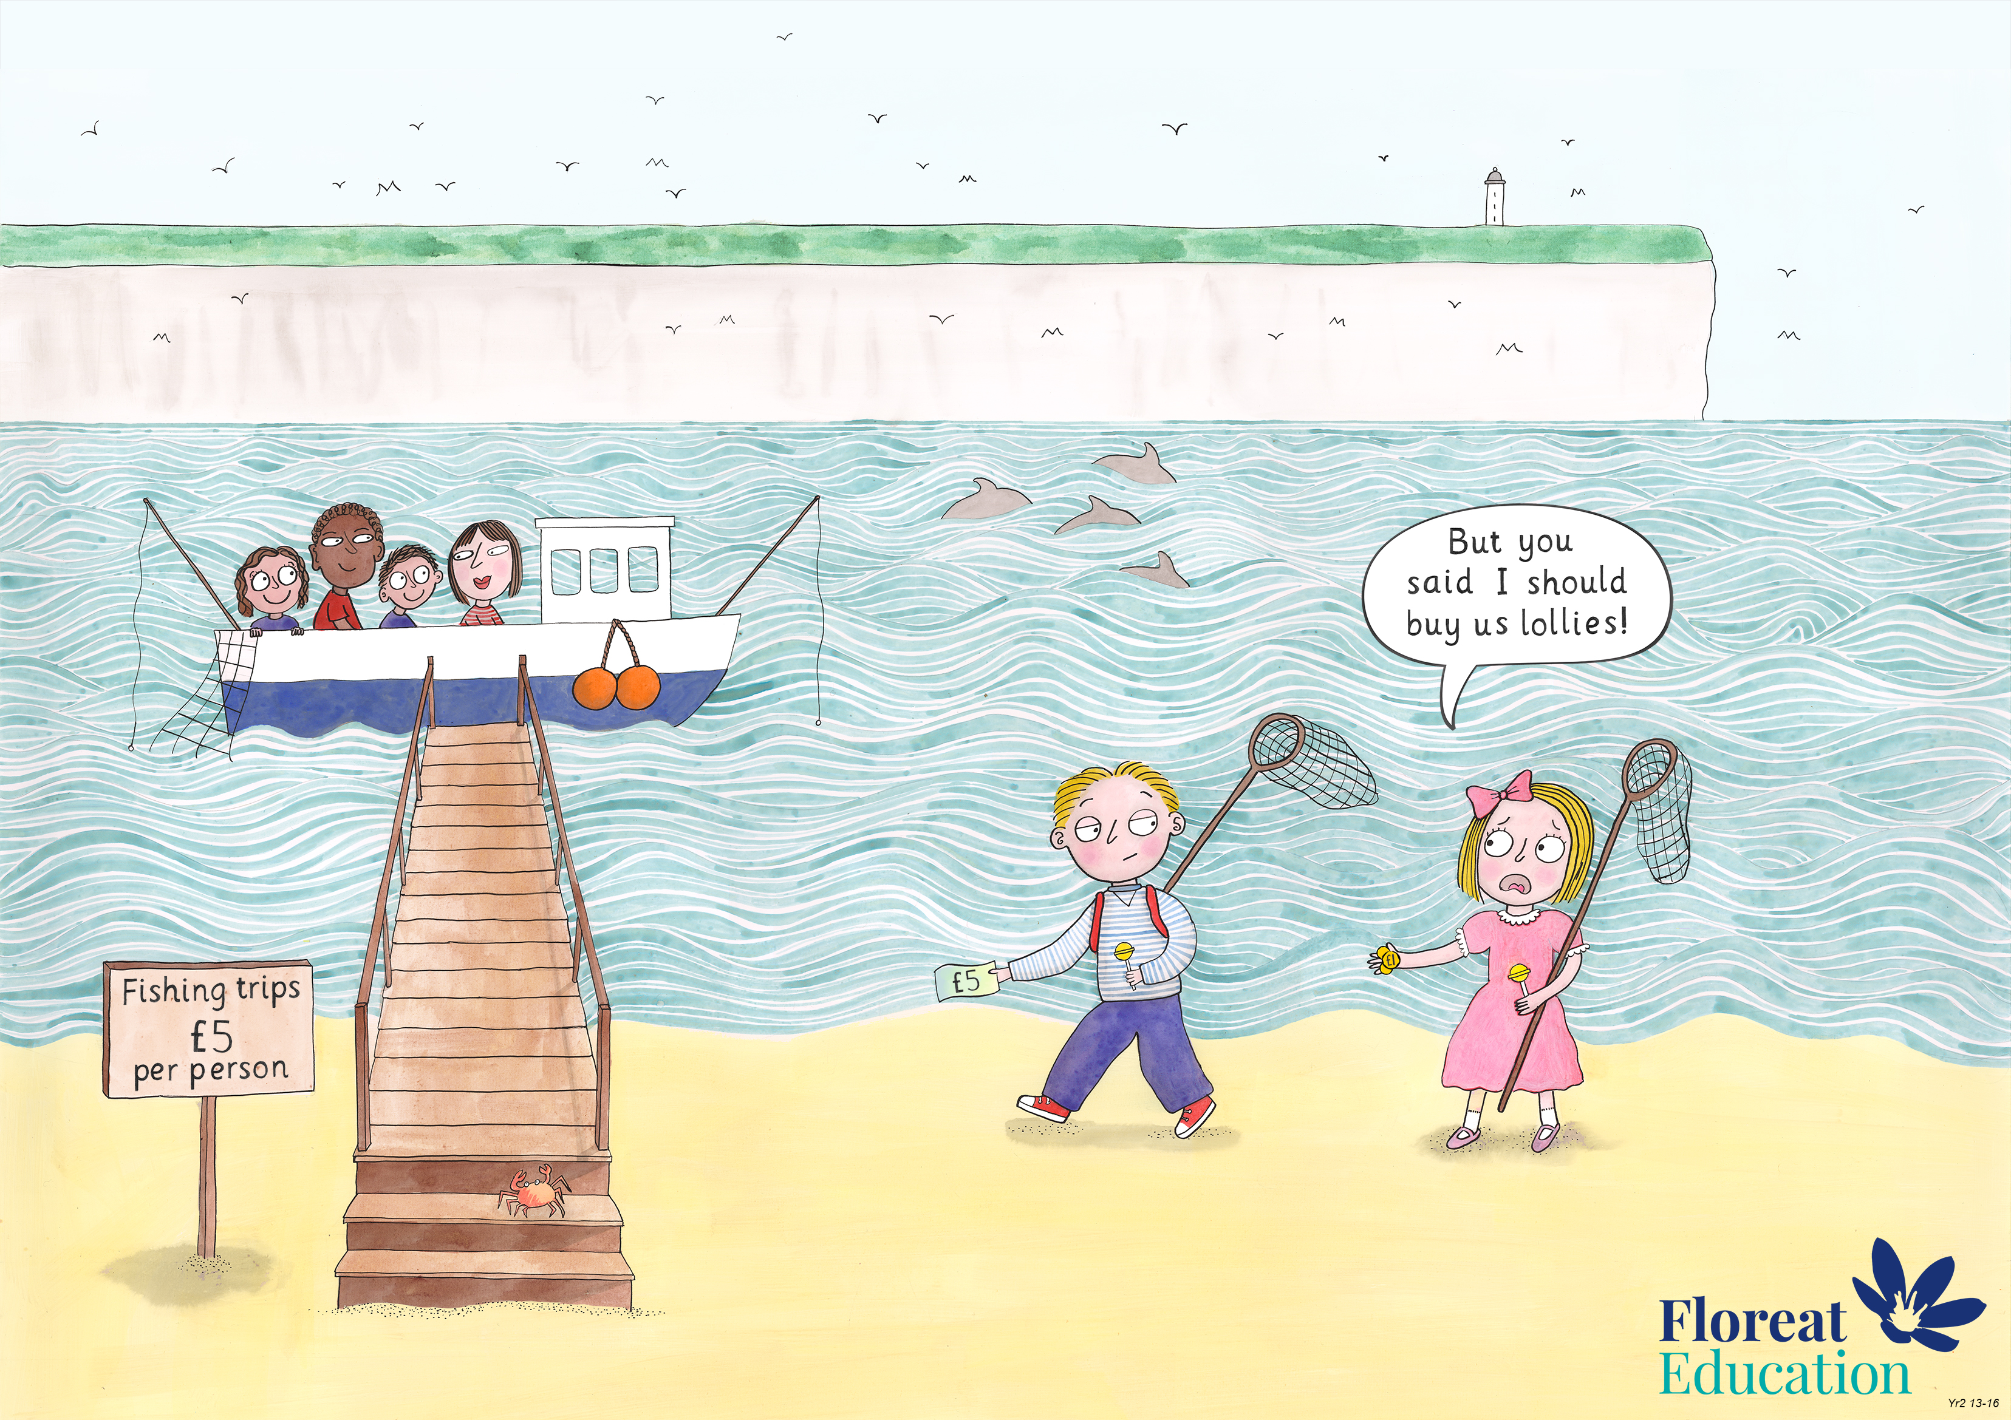
Year 2: Summer 1
Judgement and Prudence, Forgiveness, Appreciation and Awe

